Slide 1
Family and Community Sustainability Action Plan for Climate Change
Notes:
Developed November 8, 2023

Slide 2
Goal
Update the content of this slide for your local area
To make Nashville-Davidson County a more healthy , sustainable and resilient city by reducing family/household greenhouse gas emissions

Slide 3

Objectives
After this course, you will better be able to:
Describe basic facts about climate change
Describe the health effects of climate change
Determine your carbon footprint
Develop a plan to become more sustainable

Slide 4
What are Greenhouse Gases?
Gases in the earth’s atmosphere trap the Sun’s heat
These gases are called greenhouse gases (GHG)
High levels exist because of human activities such as burning fossil fuels

Slide 5
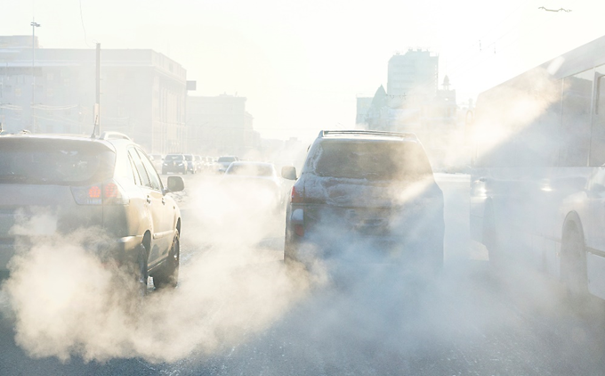
Greenhouse Gases of Concern
Carbon dioxide
Methane
Nitrous oxide
Chlorofluorocarbons
Water vapor
Notes:
NASA: https://climate.nasa.gov/causes/

Slide 6
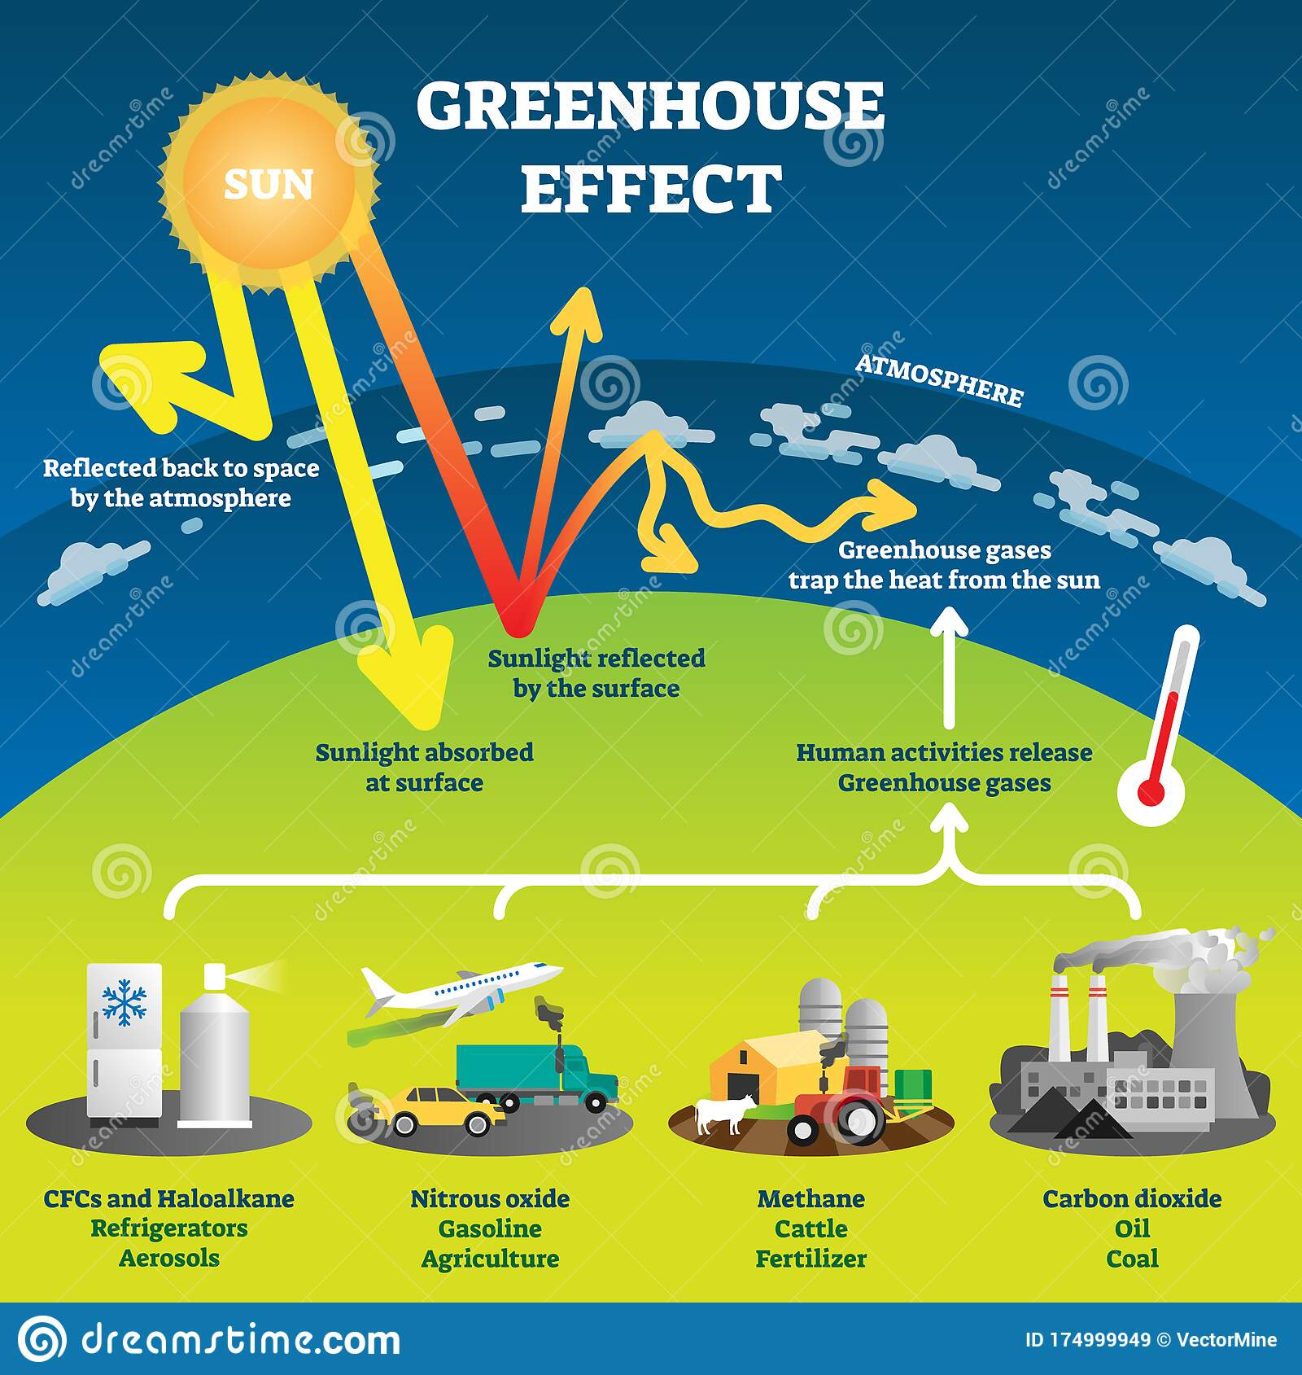
The Greenhouse Effect

Slide 7
The Greenhouse Effect Video: USEPA
https://www.youtube.com/watch?v=VYMjSule0Bw

Slide 8
Impact of excessive amounts of Greenhouse Gases in the atmosphere:
Climate change and global warming

Slide 9

Images of Climate Change
Notes:
Image credit: National Oceanic and Atmospheric Administration (NOAA)
https://www.noaa.gov/education/resource-collections/climate/climate-change-impacts

Slide 10
Climate vs Weather
Climate describes conditions over the long term and over an entire region
Weather is local and temporary

Slide 11
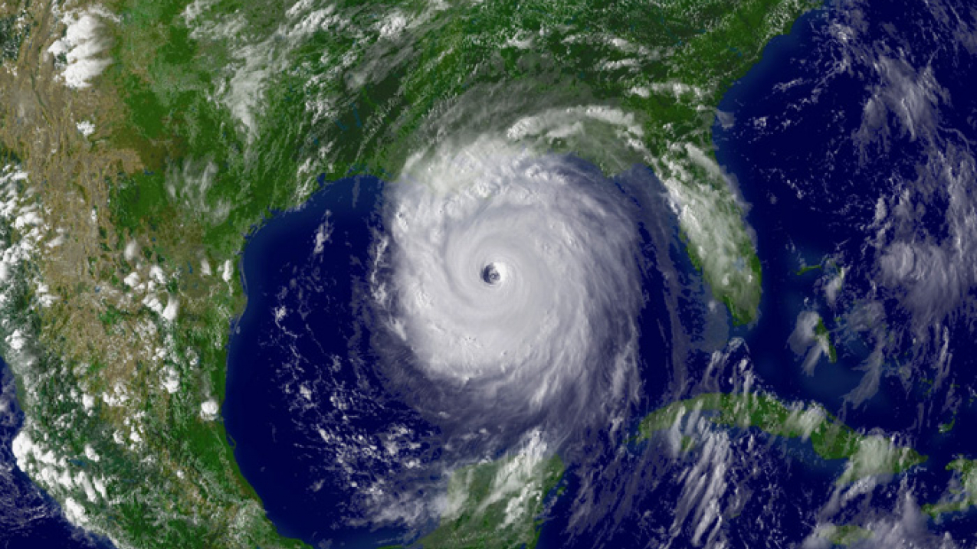
Global Climate Change
Climate change is a long-term change in the Earth’s average weather patterns.

Slide 12
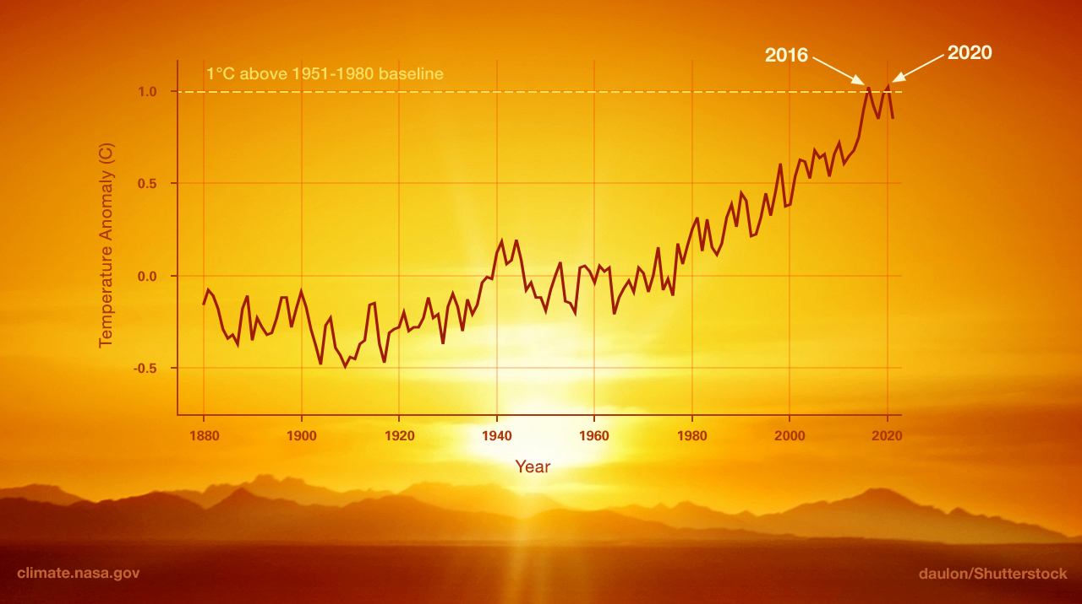
Global Warming
This graph illustrates the change in global surface temperature relative to 1951-1980 average temperatures, with the year 2020 tying with 2016 for hottest on record
Notes:
Source: NASA's Goddard Institute for Space Studies)
https://climate.nasa.gov/global-warming-vs-climate-change/

Slide 13
Climate Change 101 with Bill Nye: National Geographic
https://www.youtube.com/watch?v=EtW2rrLHs08

Slide 14
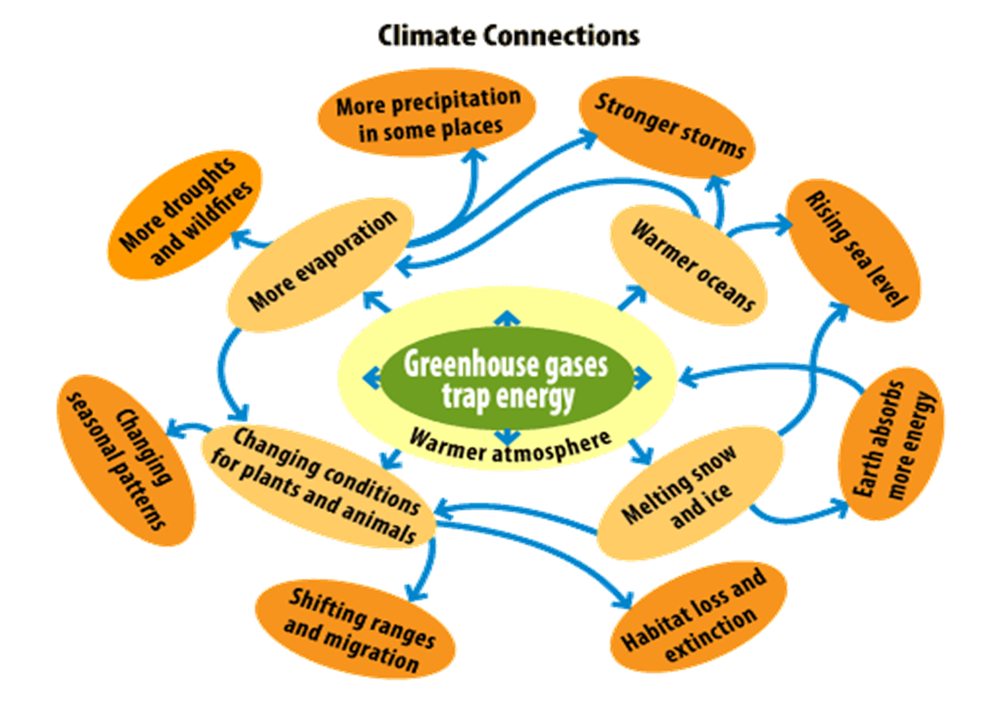
Impacts of Climate Change
Notes:
Source: EPA; https://archive.epa.gov/climatechange/kids/basics/concepts.html

Slide 15
Why is Climate Change a Public Health Issue?
Video: https://www.youtube.com/watch?v=WPMtt5MZnJU

Slide 16
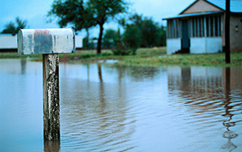
Climate Change Impacts on Health
Extreme weather
Extreme heat
Vector-borne diseases
Poor air quality
Food insecurity
Notes:
https://www.apha.org/-/media/Files/PDF/topics/climate/Childrens_Health.ashx

Slide 17

The Health Risk Of Extreme Heat
Direct impacts on human health
  Heat stroke and other heat illness
  Reduced labor productivity
Indirect impacts
  Promoting air pollution
  Increasing asthma attacks
  Overloading power grids requiring rolling blackouts
Notes:
NOAA: National Integrated Heat Health Information System
https://nihhis.cpo.noaa.gov/

Slide 18

Vulnerable Populations - Children
Children:
  Breathe more air and drink more water per body weight than adults
  Developing organs and low immunity
  Dependent on adults
  More time spent outdoors
Notes:
https://www.apha.org/topics-and-issues/climate-change/vulnerable-populations

Slide 19

Vulnerable Populations – Older Adults
Older adults:
  Low immunity
  Pre-existing conditions
  Limited mobility

Slide 20

Vulnerable Populations – Low Income Communities
Low-income communities:
  Less resources and means to evacuate
  Inadequate infrastructure

Slide 21
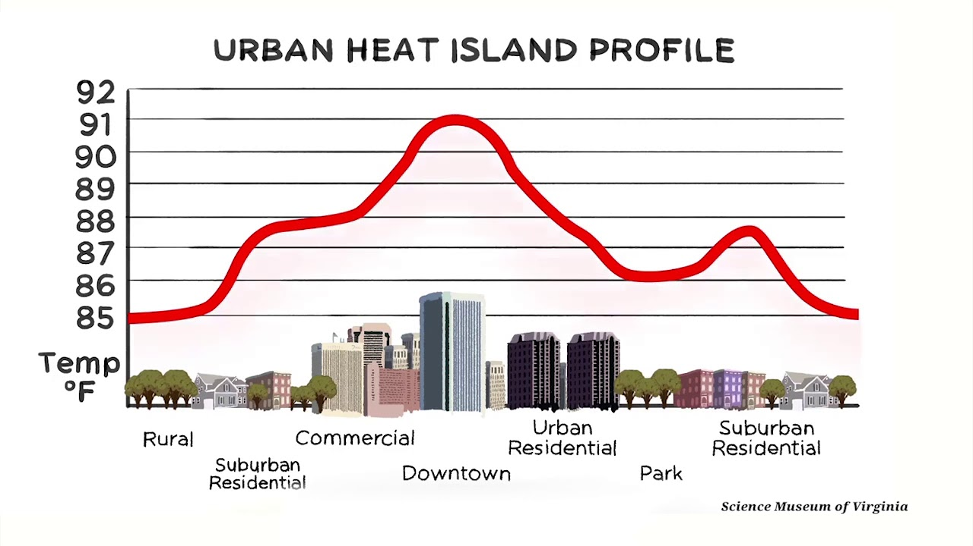
Urban Heat Islands

Slide 22

Climate Change Mitigation: Cut Emissions
To avoid the worst consequences of climate change, we’ll need to reach “net zero” carbon emissions by 2050 or sooner. Net zero means that, on balance, no more carbon is dumped into the atmosphere than is taken out.
Union of Concerned Scientists: Climate Solutions
https://www.ucsusa.org/climate/solutions

Slide 23
Metro Nashville GHG Emission Reduction Goal:
80% reduction in GHG Emissions (based on 2014 inventory) by 2050
Update the title and content of this slide for your local area

Slide 24
Metro Nashville 2019 Community GHG Emissions
Total = 11,256,544 metric tons of CO₂ equivalent
Transportation and mobile sources: 51%
Commercial energy: 20%
Residential: 16%, or 1,830,724 metric tons of CO₂ equivalent
Update the title and content of this slide for your local area

Slide 25
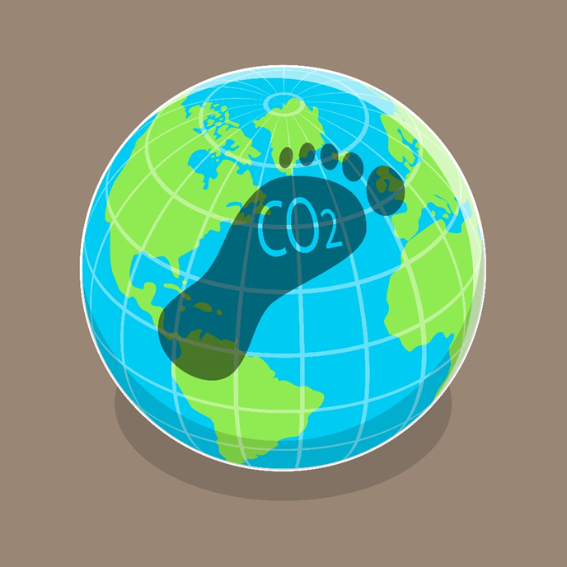
Carbon Footprint
Our carbon footprint is the total amount of greenhouse gases generated by our everyday actions.

Slide 26

Educating Children
Carbon footprint reduction ….
Make it a family activity

Slide 27
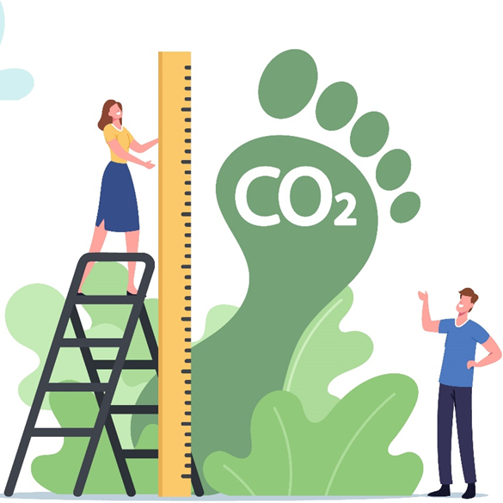
Activity One: Find Your Carbon Footprint
Use Nature Conservancy Carbon Footprint Calculator and/or EPA Carbon Footprint Calculator
You might need to make a “best guess” on some questions
Review any suggested actions steps

Slide 28
Reduction in Household GHG Emission: Actions to Consider
Together we can make a BIG difference by making improvements in the following areas:
IN YOUR HOME: Is your home an energy hog costing you money? Simple changes can save money, increase comfort and reduce your home’s GHG impact.
GETTING AROUND: Mix use of bike, walking and transit to save money on gas, reduce your GHG footprint, and live a healthier life!

Slide 29

Reduction in Household GHG Emission: More Actions to Consider
Together we can make a BIG difference by making improvements in the additional following areas:
EATING: Eating a healthy diet rich in fruits and vegetables will improve your family’s health and reduce your impact on the planet.
BUYING STUFF: When buying new things, consider how long they will last. The things we buy and throw away carry a big GHG”
Notes:
Seattle Climate Action Plan:
https://www.seattle.gov/environment/climate-change/climate-planning

Slide 30
Activity Two: Choose Your Priorities
Decide which areas that you and your family would like to become more sustainable
Review examples on the Choose Your Priorities Worksheet and also consider ideas from Activity One. Consider your routines related to food, shopping, home, and transportation – make it a family conversation!.
Choose your priorities and add them to the Worksheet!

Slide 31
Choose Your Priorities Worksheet
Area | Opportunities | Status |  | Location
 |  | On-going | Plan to do | Work/ School | Home/ Leisure
Daily driving | Walk or bike to school and work! Carpool! Plan ahead, reduce trips, avoid drive-thrus and idling
Reduce energy use | Change to LED lightbulbs, turn off lights when not in room, put a blanket on your water heater, limit hot water use for bathing and washing dishes and clothes, adjust thermostat (no lower than 78 in summer, no higher than 68 in winter)
Conserve water | Limit showers to 10 minutes, avoid using bottled water
Reduce waste | Reduce food waste, recycle plastic, cardboard, paper and metal cans, avoid eating out, use reusable water bottles

Slide 32

Activity Three: Develop Your Plan
Fill in the Action Steps Worksheet
What are the steps you need to work toward your goal(s)?
What barriers do you expect? How can these be overcome?
Measure the success of your actions!

Slide 33
Action Steps Worksheet
Action Step | ‘owner’ | Approach and anticipated barriers | Anticipated benefits | Target Date | Progress Notes | Completion Date
Home energy audit | Mom | Schedule phone appointment by calling 1-855-237-2673 or sign up online at https://energyright.com/residential/
Walk to school |  | Practice route on the weekend. Look for low traffic, flat roads.
Reduce trips in car |  | Plan weekly menu and grocery list. Having necessary groceries limits need to make another trip to store or eat out.

Slide 34
References:
Update the content of this slide for your local area
Nashville Recycling Game
Nashville SOCKET tips
Nashville Trash & Recycling
TDEC: Sustainability and Resilience at Home
Energy Star: Energy Savings at Home
Energy Star: Home Energy Yardstick
Turnip Green Creative Reuse - East Nashville
Sage Refill Market – 12 South

Slide 35
References II
Update the content of this slide for your local area
Energy Assistance | NES (nespower.com) – HUP info and application
Analyze My Bill | NES (nespower.com) – PowerWise Bill Analyzer tool: users put in as much info about their home as they want and get a customized report of where their energy dollars are going and where they can make improvements
Manage My Energy | NES (nespower.com) – TVA EnergyRight link and energy usage calculators
Energy Management at Home - TVA EnergyRight – All the stuff: DIY or in-home / virtual evaluation, energy saver workshops
Explore top rated energy efficient appliances and electronics on EnergyRight Marketplace (efficientchoice.com)

Slide 36

Acknowledgements
Nashville Mayor Cooper’s Sustainability Advisory Committee
Fisk University and The Midwest Consortium developed this course under cooperative agreement number U45 ES 06184 from the National Institute of Environmental Health Sciences

