Slide 1
FAMILY AND COMMUNITY EMERGENCY PREPAREDNESS
Fisk University’s Community Environmental Awareness Program
in partnership with
Metro Public Health Department’s Emergency Preparedness Program

Slide 2
Overview
Introduction
Know the Risks
Family Preparedness
Community Preparedness
During an Emergency
After an Emergency

Slide 3
INTRODUCTION

Slide 4
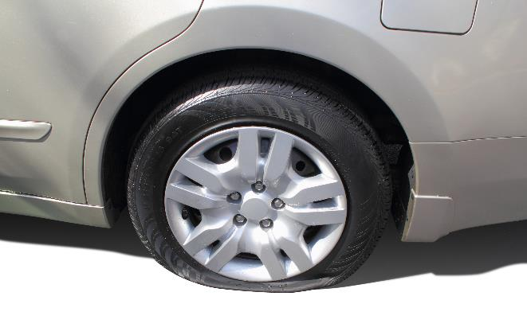
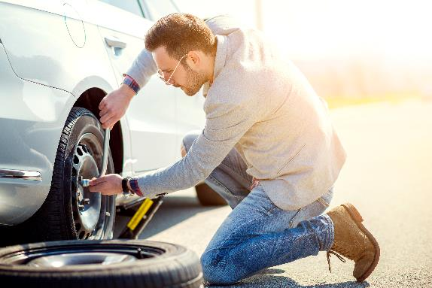
Introduction: Why Family Preparedness?
Stressed, stranded, waiting for help
OR
Scenario: Flat tire
EMPOWERED with ability to self-assist

Slide 5
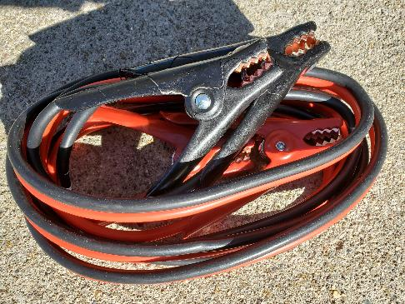
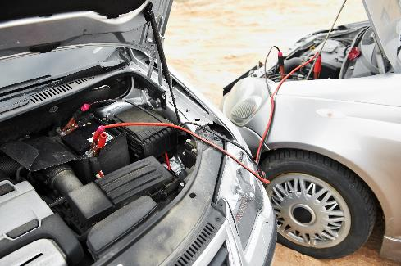
Introduction: Why Community Preparedness?
Equipped but in need of a helping hand
OR
Scenario: Dead car battery
UNITY…Neighbor helping Neighbor

Slide 6
KNOW THE RISKS

Slide 7
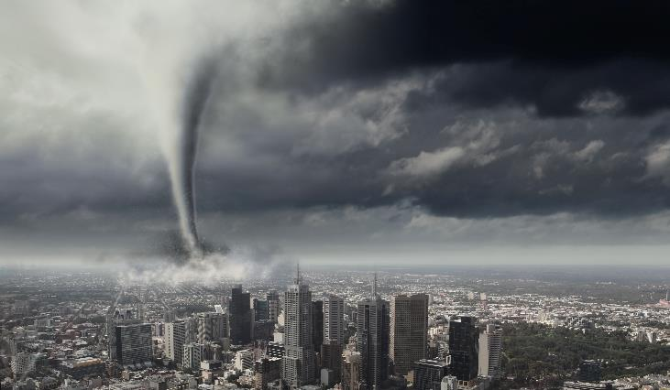
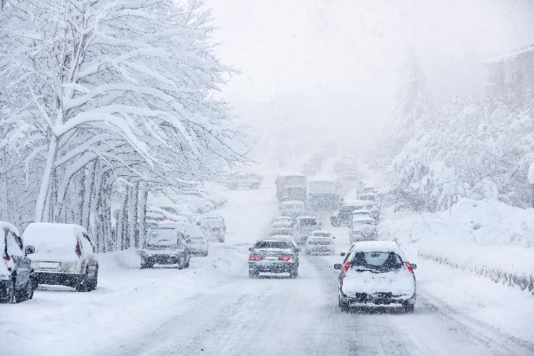
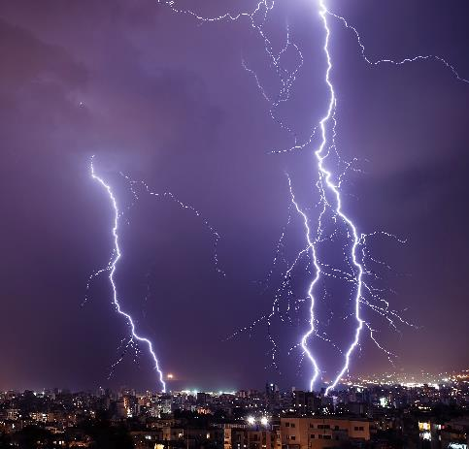
Know the Risks: Natural Hazard
Natural hazard risks include floods, hurricanes, tornadoes, thunderstorms, winter storms, extreme heat or cold, wildfires, earthquakes, volcanoes, landslides, and tsunamis.

Slide 8
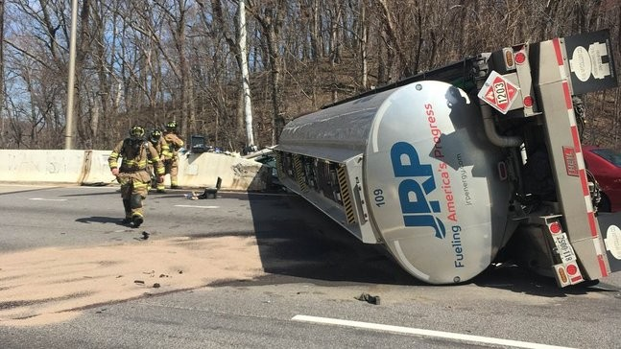
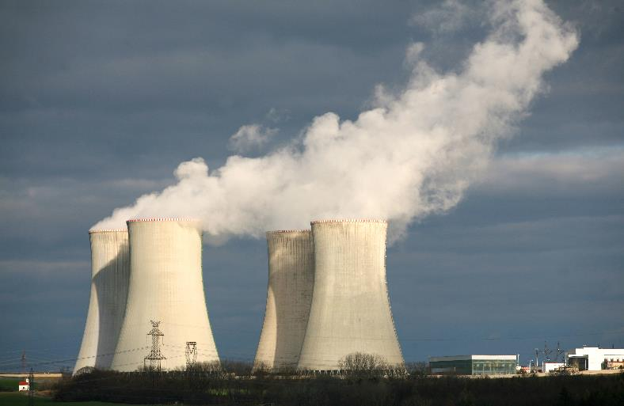
Know the Risks: Hazardous Materials
Courtesy Fairfax Fire and Rescue
Hazardous materials risks include accidental releases from transportation accidents, manufacturing facilities, nuclear power plants, and improper use of household chemical products.

Slide 9
Know the Risks: Terrorism
Terrorism risks include intentional chemical/biological/radiological threats such as bombings, chemical releases, and weaponized biological agents, as well as, computer based cyber-attacks.

Slide 10
Know the Risks
What do you think are the greatest risks for Middle TN?

Slide 11
Hazard Vulnerability Assessment (HVA) for Middle TN
PROLONGED ELECTRICAL OUTAGE
IT FAILURE/CYBER THREAT
SEVERE THUNDERSTORM
FLOOD
TORNADO
ICE STORM
PANDEMIC ILLNESS

Slide 12
Know the Risks
Stay informed about the hazards that may strike your community and the risks you face from these hazards. You can obtain this information from Metropolitan Nashville’s Office of Emergency Management.
https://www.nashville.gov/Office-of-Emergency-Management.aspx

Slide 13
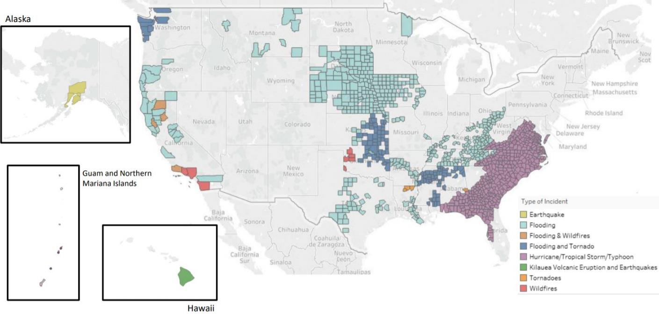
Know the Risks
Stay informed about your community’s risk from hazards. You can obtain this information from your local Office of Emergency Management. Another source of information is FEMA. You can search for past Declared Disaster here https://www.fema.gov/disasters/disaster-declarations.
Disaster Map 2018-2019
https://www.niehs.nih.gov/careers/hazmat/funding/assets/wtp_2019_foa_declared_disaster_map_508.pdf

Slide 14
FAMILY PREPAREDNESS

Slide 15
Family Preparedness
1) Develop a Family Communication Plan
2) Develop a Family Disaster Plan
3) Get an Emergency Kit

Slide 16
1) Family Communication Plan
FEMA has developed a tool to help your family prepare a communication plan.
Collect information
Share information
Practice
The tool can be found here: https://www.fema.gov/media-library-data/1440449346150-1ff18127345615d8b7e1effb4752b668/Family_Comm_Plan_508_20150820.pdf

Slide 17
2) Family Disaster Plan
Think about your homes. What may be some safe spots within them in case of a disaster?
Safe Spots in Home for Each Type of Risk Hazard
Multiple Meeting Places (Outside of Home)
Best Escape Routes
Don’t Forget Pets and People With Special Needs
More information can be found here:
https://www.ready.gov/make-a-plan

Slide 18
Table of Special Considerations
Disability/Special Need | Additional Steps
Hearing impaired | May need to make special arrangements to receive warnings.
Mobility impaired | May need special assistance to get to a shelter.
Single working parent | May need help to plan for disasters and emergencies.
Non-English speaking persons | May need assistance planning for and responding to emergencies. Community and cultural groups may be able to help keep people informed.
People without vehicles | May need to make arrangements for transportation.
People with special dietary needs | Should take special precautions to have an adequate emergency food supply/

Slide 19
Prepare your pets for disasters
See https://www.ready.gov/pets for more details on the outline below
1. Make a Plan
Many shelters/hotels won’t allow pets. Know where you can go.
Have your pet microchipped
Large animals such as horses and pigs will require extra planning
2. Build a Kit
Food, medicine, leash, carrier, toy/blanket, grooming & sanitation items
3. Stay informed
Bring pets indoors at first sign of storm or disaster warning

Slide 20
Family planning for an outbreak like COVID-19
Plan ways to care for those who might be at greater risk such as those with disabilities, special medical needs or the elderly.
Gather essential items your household needs to be ready. Be sure to have access to 2 weeks of medications and supplies.
Create an emergency contact list of family, friends, neighbors, health care providers, and other community resources.
Get to know your neighbors.
Create a list of local organizations that you can contact if you need access to information, healthcare services, support, and resources.
From: https://www.cdc.gov/coronavirus/2019-ncov/faq.html#Preparing-for-an-Outbreak

Slide 21
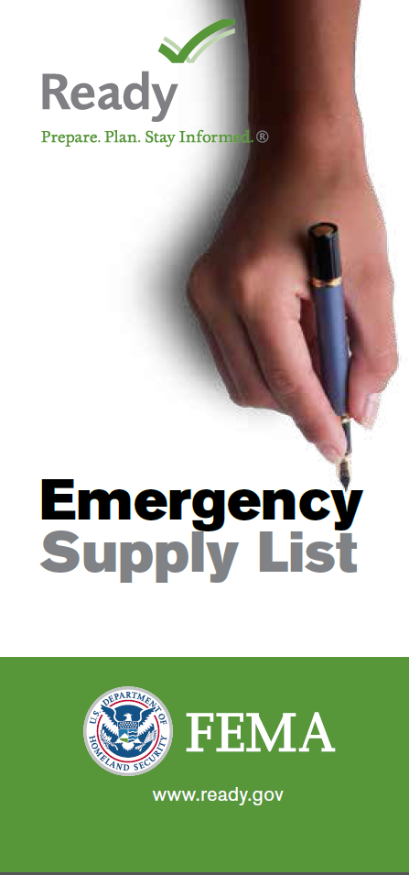
3) Get a Kit
Water (one gallon per person per day for at least three days, for drinking and sanitation)
Food (at least a three-day supply of non-perishable food)
Prescription medicine
Cash
Battery-powered or hand crank radio and a NOAA Weather Radio with tone alert
Flashlight
Extra batteries
First aid kit
Whistle to signal for help
Dust mask, plastic sheeting, and duct tape to shelter-in-place
Moist towelettes, garbage bags, and plastic ties for personal sanitation
Manual can opener
Local maps
Cell phone with charger and a backup battery

Slide 22
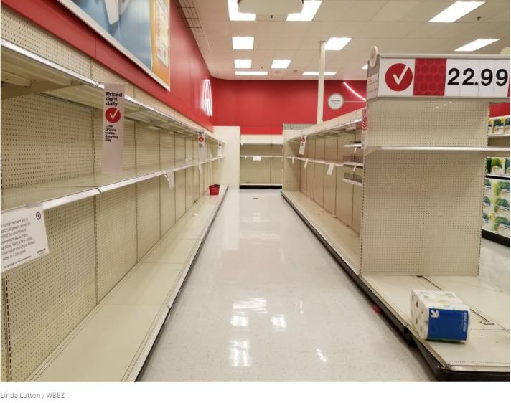
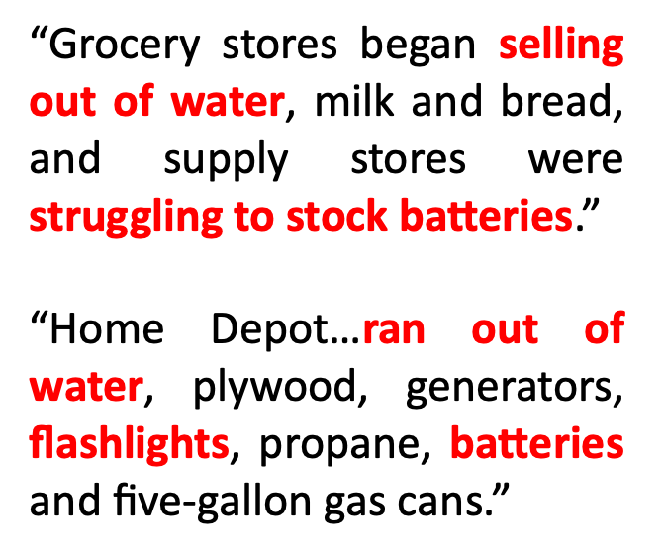
3) Get a Kit
Empty shelves at store during a crisis

Slide 23
3) Get a Kit
Photo: Ready.gov/kit
There are a number of emergency preparedness kits available for sale in stores and online. Alternatively, you can put together a kit over time.

Slide 24
3) Get a Kit
In order to be prepared for an outbreak like COVID-19, add the following items to your kit:
Face masks
Hand sanitizer
Disinfectant wipes
Thermometer
Tissues
Paper towels
Soap
Bleach
Gloves
List of medical conditions, medicines, allergies

Slide 25
Hazard Vulnerability Assessment (HVA) for Middle TN
PROLONGED ELECTRICAL OUTAGE
IT FAILURE/CYBER THREAT
SEVERE THUNDERSTORM
FLOOD
TORNADO
ICE STORM
PANDEMIC ILLNESS

Slide 26
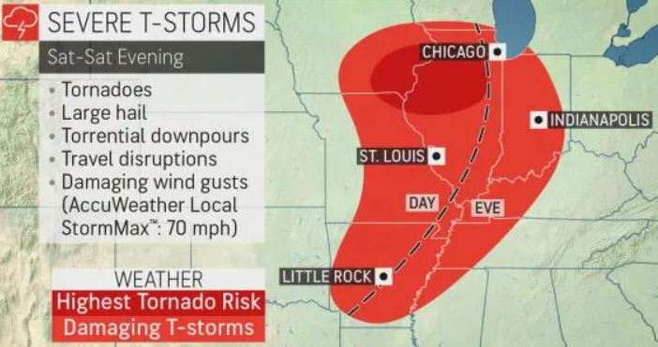
WORKSHOP ACTIVITY Family Disaster Plan Development
Take 10 minutes to jot down some ideas that may work best for YOU and YOUR FAMILY during a TORNADO.

Slide 27
Tornado Safety
Stay away from windows, outside walls, and doors
Go to the basement or take shelter in a small interior ground floor room such as a bathroom, closet, or hallway
You can also protect yourself by taking shelter under a heavy table or desk
Protect head and neck
If caught outside, get in a ditch or drainage area and be very aware of flying debris

Slide 28
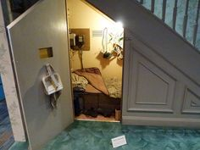
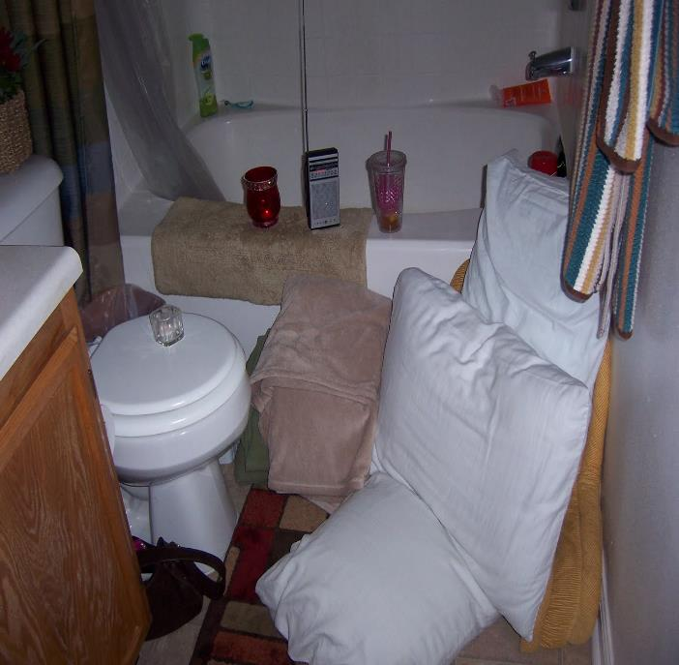
No Shelter, No Basement, No Problem!!
Use pillows, blankets, sleeping bags, coats, and helmets to shield your head and body and to protect yourself from flying debris.

Slide 29
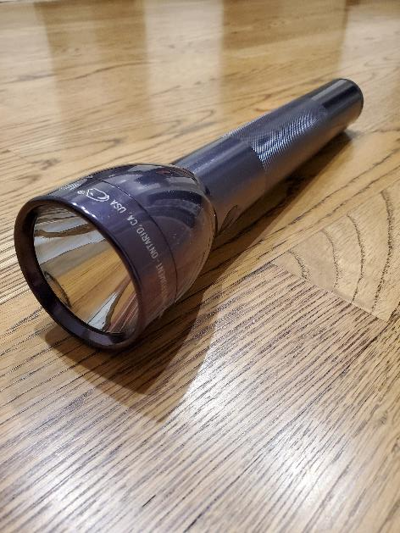
Light Sources During a Power Outage
Flashlights
Battery powered lights
Solar powered lamps
Candlelight*
Glow Sticks
Glow in the Dark Tape
*Exercise caution when using an open flame, especially around children and pets

Slide 30
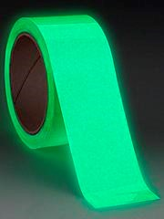
Light Sources During a Power Outage
Non-toxic Glow Sticks
Glow in the dark tape

Slide 31
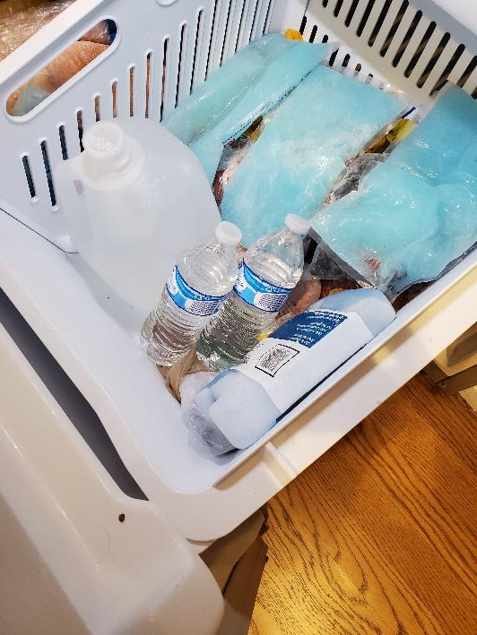
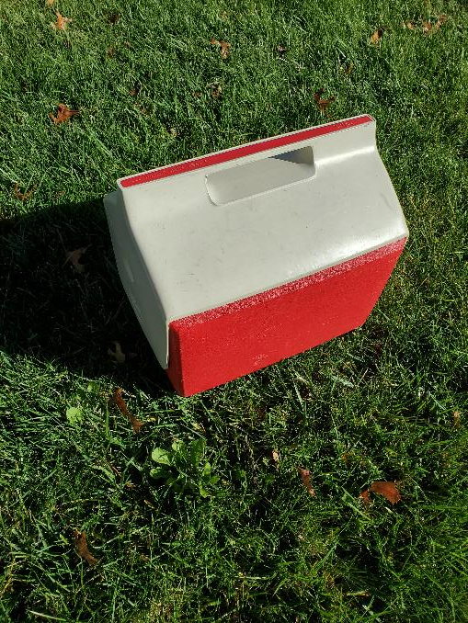
Ways to Keep Food/Medicine Cool
Pre-Freeze Large Chunks of Ice
Transfer to Coolers During Emergency

Slide 32
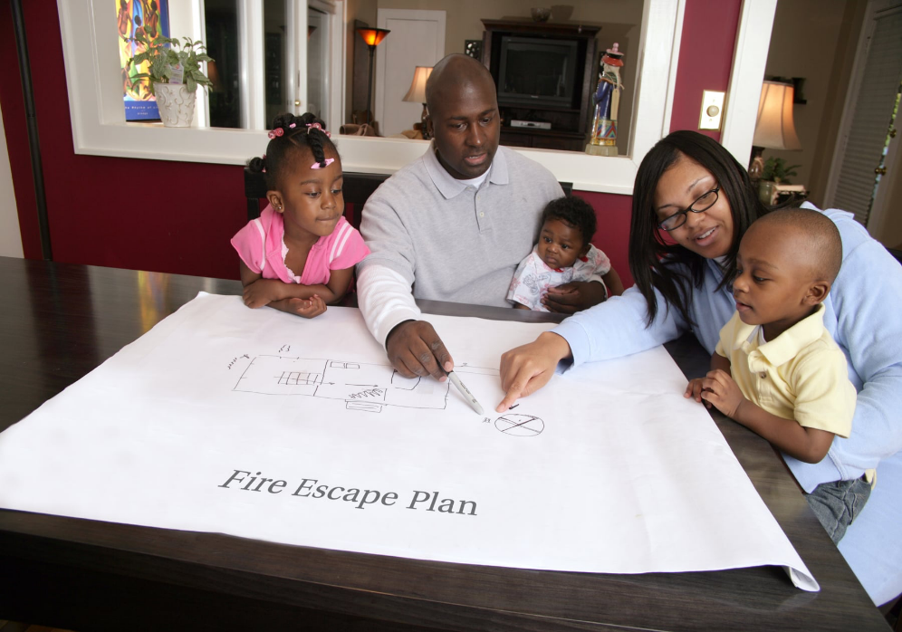
AT HOME ACTIVITY: Educating Children
Quiz Kids on Plans: Make it a Game!
Include activities such as How and When to Call 9-1-1

Slide 33
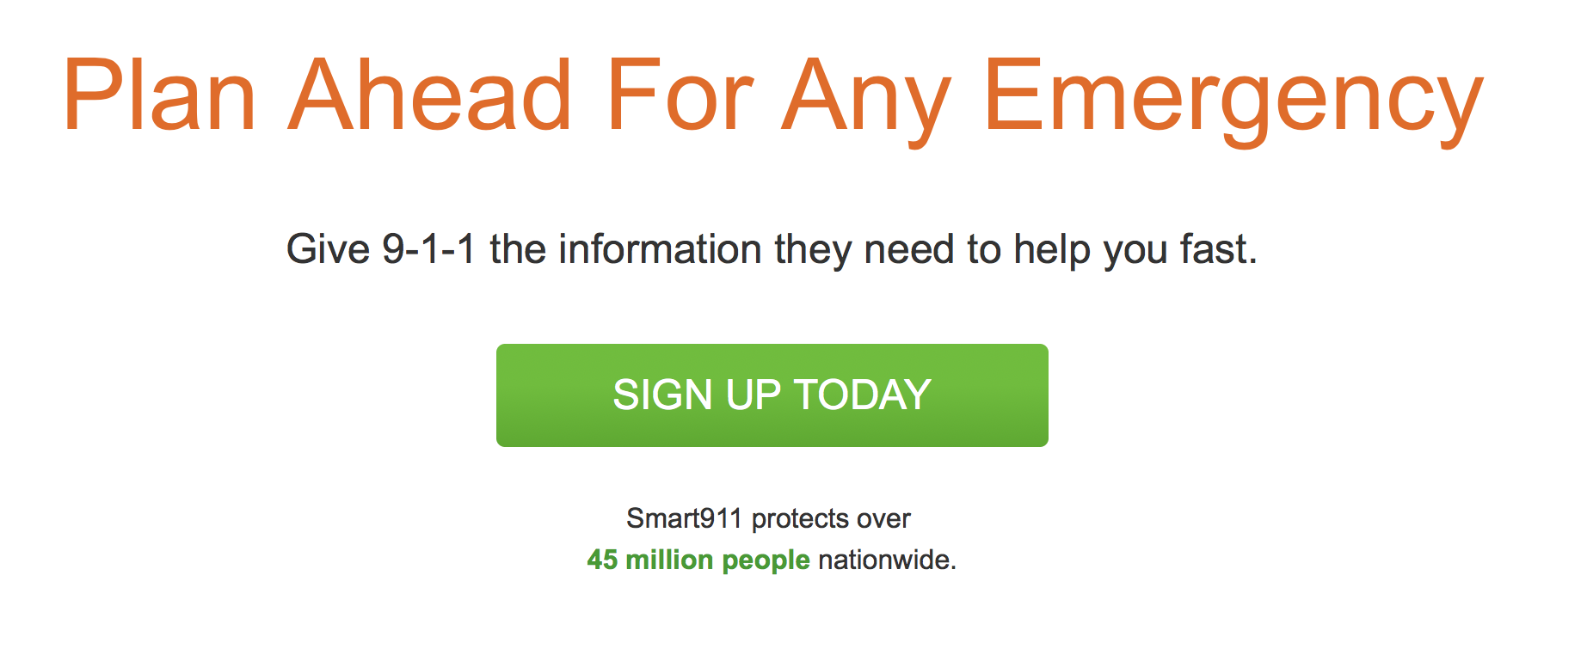
Smart911
https://www.smart911.com

Slide 34
COMMUNITY PREPAREDNESS

Slide 35
Community Preparedness
Neighbors helping neighbors is a great strategy for surviving emergencies.
Learn what your neighborhood’s limitations and needs are now and prepare to respond to those needs when necessary.
Community members are encouraged to develop plans (notifications, meeting location, food/water stockpiling, etc.) prior to emergencies and are encouraged to communicate these plans will all residents.

Slide 36
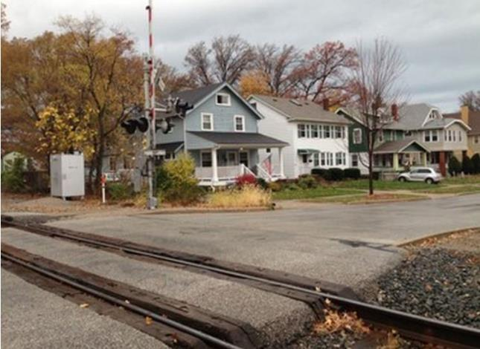
Community Preparedness
Identify specific hazards that are unique to your neighborhood and make emergency preparedness plans as a community.
Photo:https://www.cleveland.com/lakewood/2014/11/train_traffic_triples_though_l.html

Slide 37
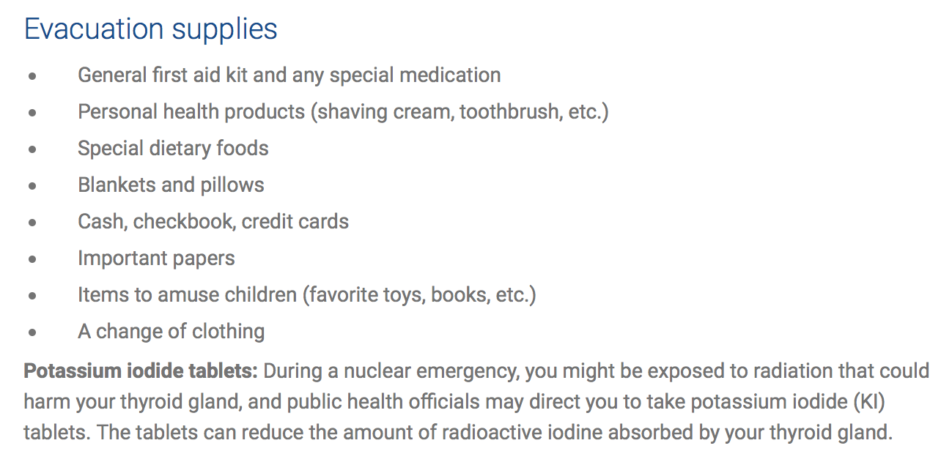
Community Preparedness
Identify specific hazards that are unique to your neighborhood and make emergency preparedness plans as a community.

Slide 38
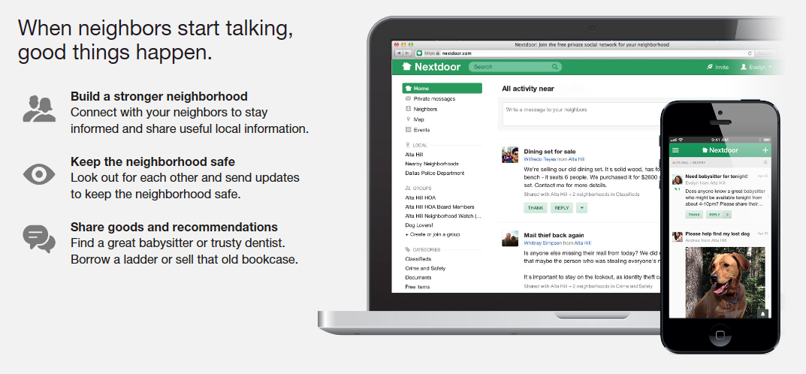
Community Preparedness
https://nextdoor.com

Slide 39
Hazard Vulnerability Assessment (HVA) for Middle TN
PROLONGED ELECTRICAL OUTAGE
IT FAILURE/CYBER THREAT
SEVERE THUNDERSTORM
FLOOD
TORNADO
ICE STORM
PANDEMIC ILLNESS

Slide 40
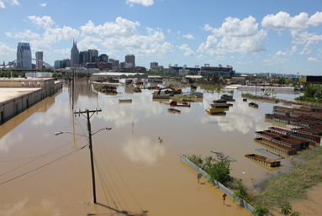
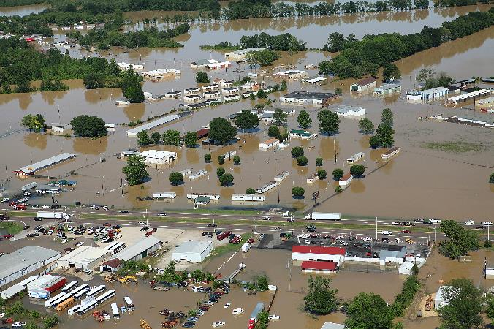
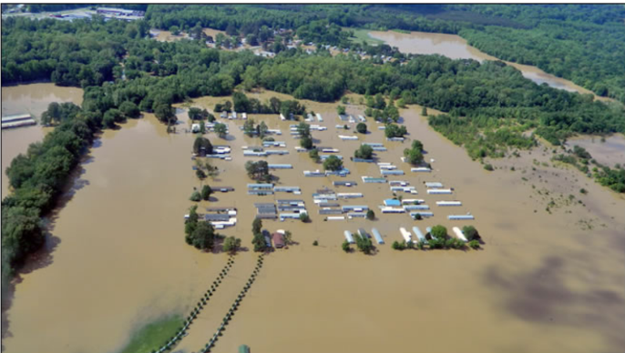
2010 Nashville Flood
Update the title and content of this slide for your local area
Photo: Kaldari, public domain
Photo: FEMA/David Fine, Public domain
The Cumberland River, which winds through downtown Nashville, crested at 51.9 feet spilling into the city and surrounding neighborhoods.
Photo: https://www.weather.gov/safety/flood-states-tn

Slide 41
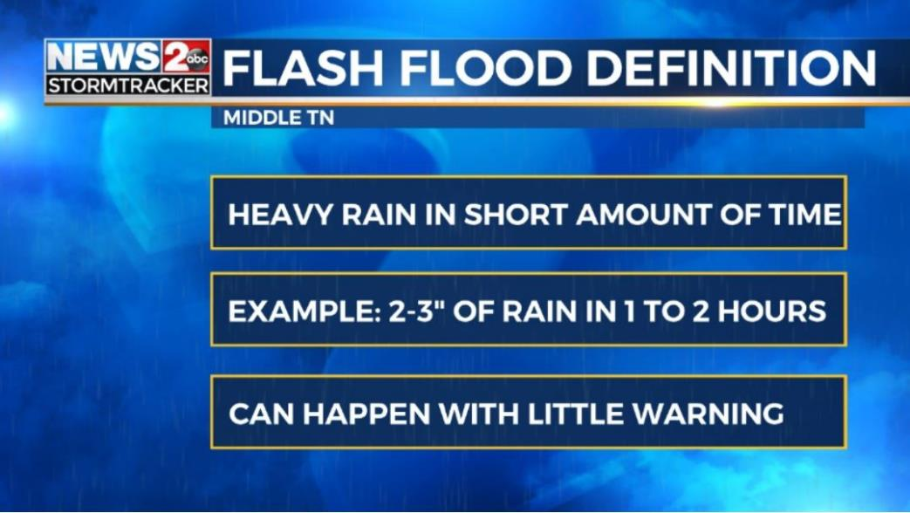
Nashville Flash Flooding After Heavy Rainfall
Update the title and content of this slide for your local area
https://www.wkrn.com/special-reports/flash-flooding-what-you-need-to-know/
Flash floods can be just as dangerous as major floods.
“Turn Around Don’t Drown”
https://www.weather.gov/safety/flood-turn-around-dont-drown

Slide 42
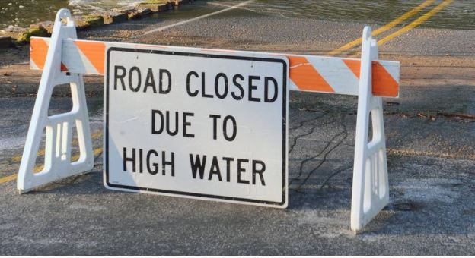
WORKSHOP ACTIVITY Community Plan Development
Take 10 minutes to discuss some ideas that may work best for YOUR COMMUNITY before or during a FLOOD.

Slide 43
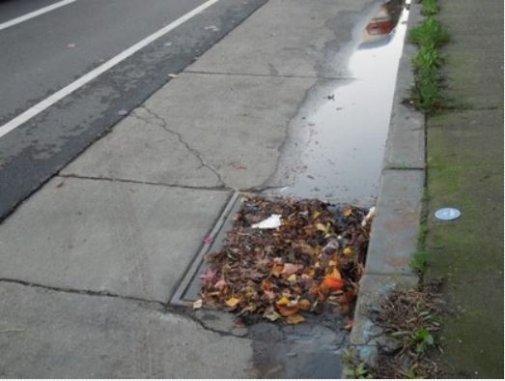
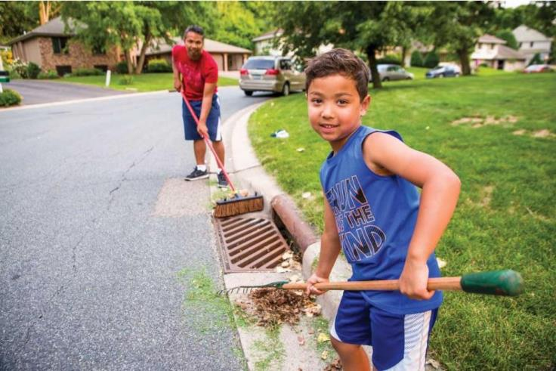
Examples: Community Action Plan Pre-Flooding
Adopt-a-Storm Drain
Photo: http://healthylakewinona.weebly.com/adopt-a-storm-drain.html
Photo: https://www.bloomingtonmn.gov/cob/news/adopt-storm-drain-2020-03-23

Slide 44
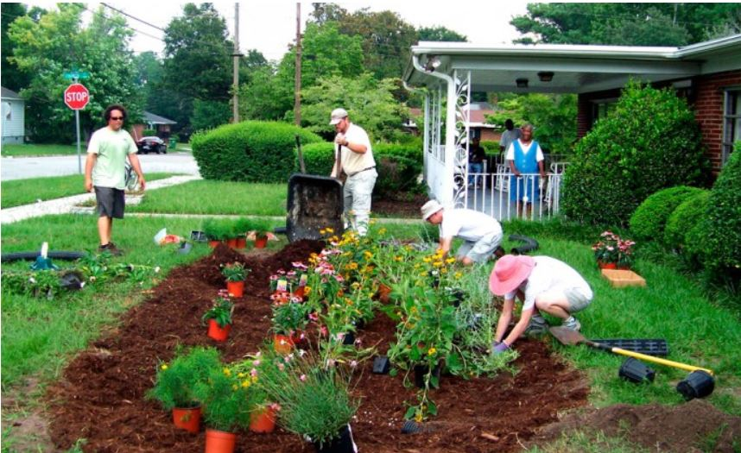
Examples: Community Action Plan Pre-Flooding
Plant Trees and Rain Gardens
Photo: http://www.stormwater.allianceforthebay.org/take-action/installations/rain-gardens

Slide 45
Examples: Community Plan Pre-Flooding
We are a group of volunteers that created a small website to help organize rescues in our Houston neighborhood during Harvey. It wound up helping rescue over 37,000+ people in Harvey, Irma, Maria by connecting them to 12,000+ volunteers via GPS tracking, integrated communication, and skills matching.
If you’re able to help in any potential disaster, whether you’re a civilian rescuing in a boat, a licensed firefighter, distributing relief supplies, or helping your elderly neighbors evacuate, we’d love for you to sign-up!
https://crowdsourcerescue.com

Slide 46
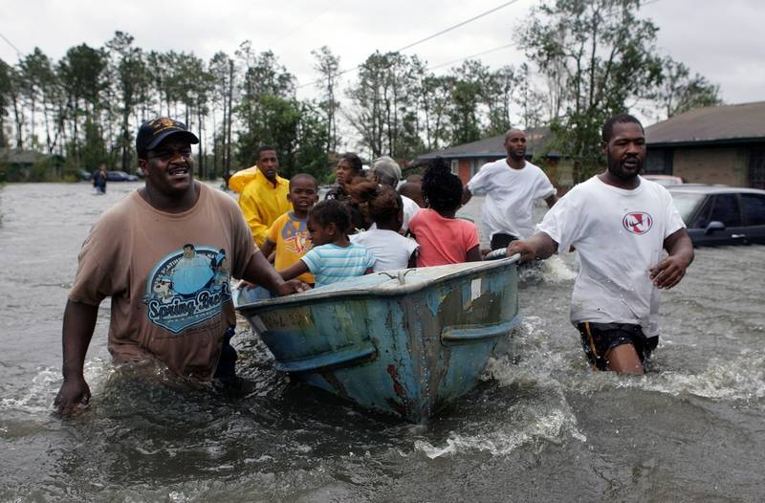
Examples: Community Plan During Flooding
Photo: Associated Press
Community residents use a boat to evacuate children and an elderly woman from their flooded homes.

Slide 47
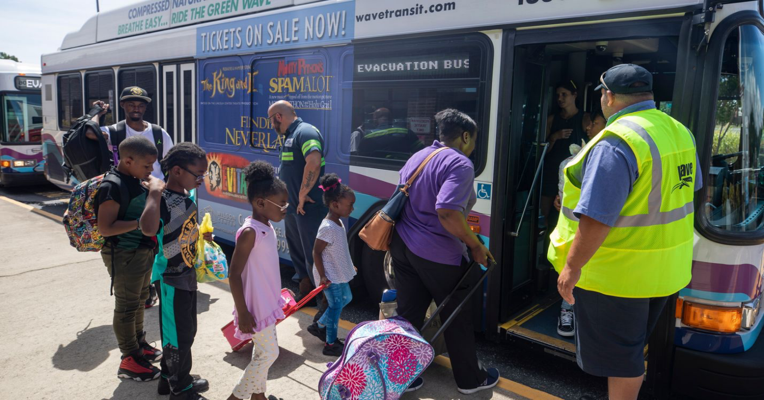
Examples: Community Plan During Flooding
Photo: Jim Lo Scalzo, EPA-EFE
Families board evacuation buses for a shelter.

Slide 48
DURING AN EMERGENCY

Slide 49
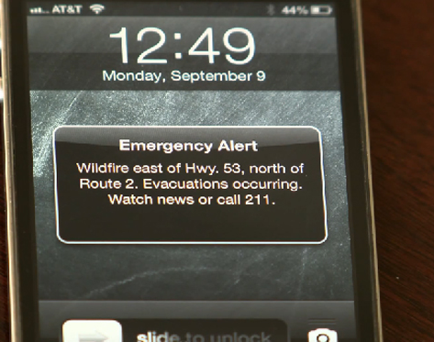
Stay Informed: Emergency Alerts and Warnings
Communication is imperative to surviving emergencies. Weather radios, radios with batteries, cell phones, and any communication device that doesn’t require electricity are great preparedness kit purchases.
Watch vs. Warning
Watch:
Conditions are favorable or expected but not occurring or imminent
Warning:
Conditions are occurring or imminent

Slide 50
Stay Informed: Smart Phone Apps, Facebook, Twitter
Local
News Affiliates
Mayor’s Office of Emergency Management (OEM)
State
Emergency Management Agency
National
Federal Emergency Management Agency (FEMA)
National Weather Service

Slide 51
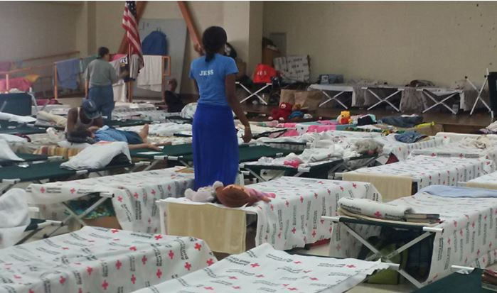
Stay Informed: Evacuation vs. Shelter in Place
Photo: https://emergency.cdc.gov/shelterassessment/
Specific shelter locations are not known until the emergency happens. Red Cross has many volunteer locations, but depending on specific needs and logistics of individual emergencies, locations are chosen in real time.

Slide 52
Stay Informed: Evacuation Guidelines
Emergency Kit
Communications and Disaster Plans
Essential Medications and Copies of Prescriptions
Cell Phone
Pets*
*Pets are not always allowed in some emergency shelters, so plan in advance for a pet-friendly location. Some shelters will allow pets if they are crated.

Slide 53
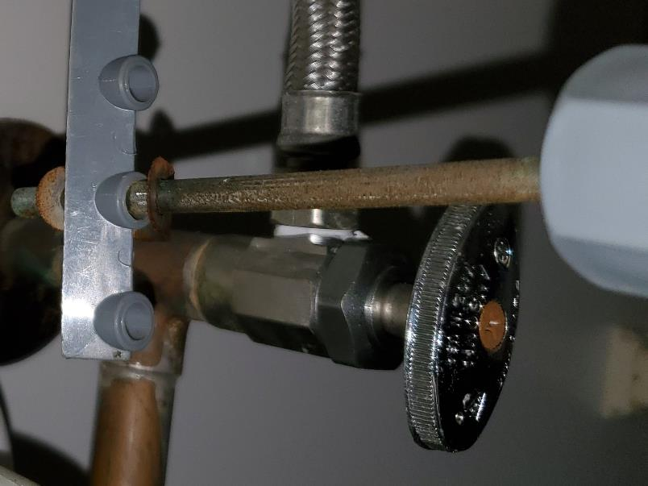
Stay Informed: Evacuation Guidelines
Shut off water, electricity, and natural gas if officials tell you
Lock your home

Slide 54
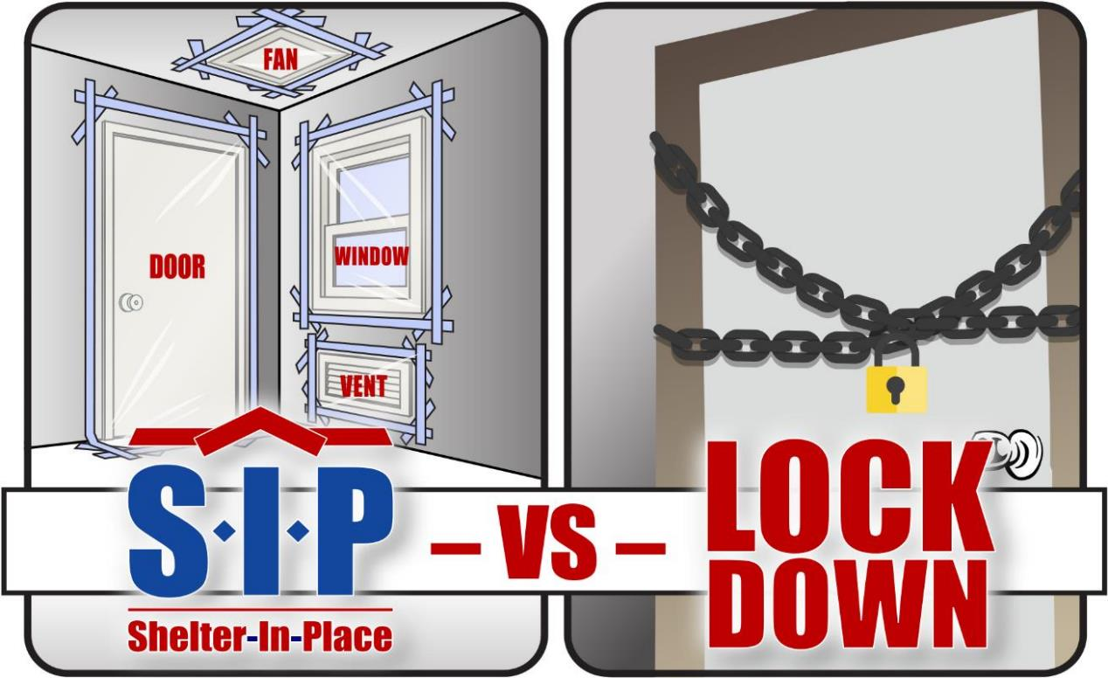
Stay Informed: Shelter in Place vs. Lockdown
U.S. Air Force graphic by David Perry

Slide 55
AFTER AN EMERGENCY

Slide 56
General Instructions
Try to stay calm and tuned in for information/instructions
Use telephone only to report life-threatening emergencies
Pick up your children from pre-determined meeting point
Check on neighbors, especially elderly and special needs
Stay away from damaged areas and dangling power lines
Get the right safety gear for cleanup https://www.cdc.gov/disasters/cleanup/facts.html
Check for spoiled food and water quality
Mark yourself safe on Facebook or the Safe and Well website
Seek support agencies if necessary!!!!

Slide 57
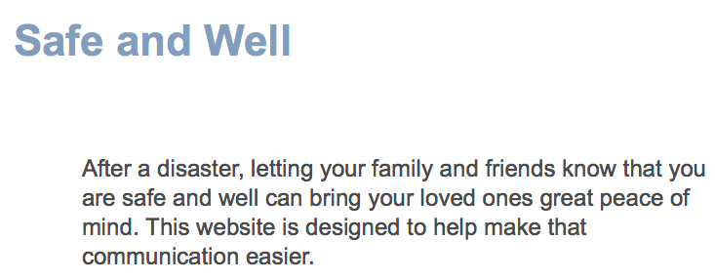
American Red Cross: Safe and Well
https://safeandwell.communityos.org/cms/index.php

Slide 58
Support Agencies
FEMA
Red Cross
Second Harvest Food Bank
Salvation Army
Churches/Faith-Based Agencies
Volunteer Community Agencies

Slide 59
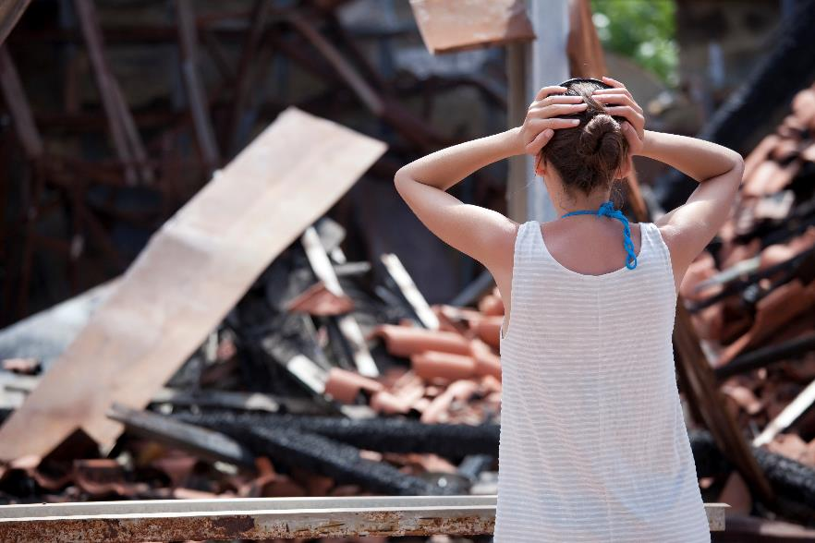
Mental Health: The Storm After the Storm
What is “normal” after a disaster? Reconstruction may last for several months and even years
Mental health symptoms after disasters include general anxiety and fear of the unknown
Post-Traumatic Stress Disorder (PTSD) is also a concern and can include nightmares, flashbacks, anxiety attacks, anger, avoidance, and substance abuse

Slide 60
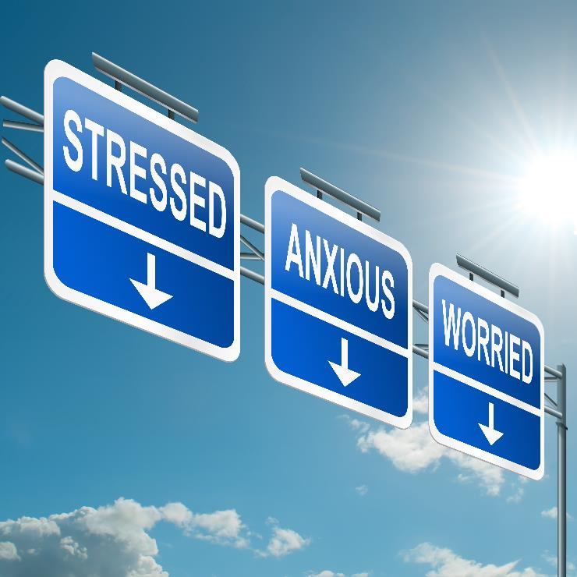
Mental Health: The Storm After the Storm
Most At-risk Populations:
Children and youth
Adults with young children
Elderly and disabled
Low-income groups
People with prior trauma history
First responders and safety workers

Slide 61
Acknowledgements
This curriculum has been developed by the Midwest Consortium for Hazardous Waste Worker Training under grant number D42 ES07200 and cooperative agreement U45 ES 06184 from the National Institute of Environmental Health Sciences.

Slide 62
QUESTIONS:
Robert Wingfield, PhD
Associate Professor
Director, Community Environmental Awareness Program
Fisk University
rwingfld@fisk.edu
615-329-8626
ADDITIONAL QUESTIONS:
Rachel Franklin
Director of Emergency Preparedness
Metro Public Health Department
Rachel.Franklin@Nashville.gov
615-340-5691

