Slide 1
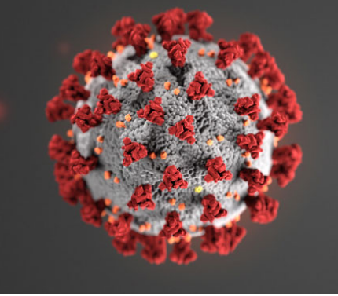
COVID-19 Awareness for Communities

Slide 2
Acknowledgements
The Midwest Consortium developed this course under cooperative agreement number U45 ES 06184 from the National Institute of Environmental Health Sciences for community members who may be impacted by COVID-19.
Source: Except as noted, content and images for this PowerPoint presentation have been adapted from NIEHS COVID-19 Training Tools: https://tools.niehs.nih.gov/wetp/covid19worker/index.cfm

Slide 3
Overall Objectives
After attending, you will be able to:
Explain basic facts about COVID-19
Assess the risk of exposure to COVID-19
Define key steps in protection and infection control
Identify health inequities related to COVID-19
Describe other detailed aspects of COVID-19 such as mental health, testing, and vaccinations

Slide 4
COVID-19 Basics
Notes:
Instructor notes:

Slide 5
What is SARS-CoV-2?
SARS-CoV-2 is the virus that causes coronavirus disease 2019 (COVID-19)
SARS = severe acute respiratory distress syndrome
Spreads easily person-to-person particularly when someone sneezes
Little if any immunity in humans
Detailed information: https://www.cdc.gov/coronavirus/2019-ncov/index.html
Notes:
Instructor notes:

Slide 6
Worldwide distribution map
Click the link to see the latest global numbers and numbers by country visit.
Notes:
Instructor notes:
Click on the link to access the latest map from WHO: https://experience.arcgis.com/experience/685d0ace521648f8a5beeeee1b9125cd

Slide 7
US distribution map
Click the link to see the current cases in the U.S.
Notes:
Instructor notes:
For updates go to CDC website: https://www.cdc.gov/coronavirus/2019-ncov/cases-in-us.html#2019coronavirus-summary

Slide 8
Transmission
COVID-19 is spread from person to person mainly through coughing, sneezing, and possibly talking and breathing.
Droplet - respiratory secretions from coughing or sneezing landing on mucosal surfaces (nose, mouth, and eyes).
Aerosol - a solid particle or liquid droplet suspended in air.
Contact -Touching something with SARS CoV-2 virus on it and then touching mouth, nose or eyes.
Other possible routes: Through fecal matter.
Notes:
Instructor notes:

Slide 9
How long does SARS-CoV-2 survive outside of the body?
It can live on surfaces for a few hours or up to several days, depending on conditions and the type of surface.
It can be killed with disinfectant found using the EPA List N: https://cfpub.epa.gov/giwiz/disinfectants/index.cfm
Notes:
Instructor notes:

Slide 10
Incubation period
The incubation period is the time between exposure to a virus and the onset of symptoms.
With COVID-19, symptoms may show 2-14 days after exposure.
CDC indicates that people are most contagious when they are the most symptomatic.
People can be contagious before developing symptoms.
Notes:
Instructor notes:

Slide 11
COVID-19 can cause mild to severe symptoms
Most common symptoms include:
Fever
Cough
Shortness of breath
Other symptoms may include:
Sore throat
Runny or stuffy nose
Body aches
Headache
Chills
Fatigue
Gastrointestinal: diarrhea, nausea
Loss of smell and taste
Notes:
Instructor notes:

Slide 12
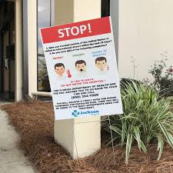
Severe symptoms – emergency warning signs for COVID-19
Most people will have mild symptoms and should recover at home and NOT go to the hospital or emergency room.
Get medical attention immediately if you have:
Difficulty breathing or shortness of breath.
Persistent pain or pressure in the chest.
New confusion or inability to arouse.
Bluish lips or face.
Notes:
Instructor notes

Slide 13
Increased risk of severe illness
COVID-19 poses a greater risk for severe illness for people with underlying health conditions such as:
Heart conditions
Lung disease such as asthma
Diabetes
Suppressed immune systems
Others found here https://www.cdc.gov/coronavirus/2019-ncov/need-extra-precautions/people-with-medical-conditions.html
The elderly have higher rates of severe illness from COVID-19. Children and younger adults have less severe illness and death.
Notes:
Instructor notes:

Slide 14
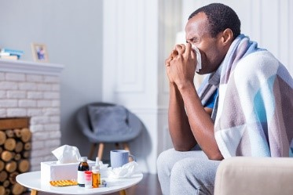
Treatment
The Food and Drug Administration (FDA) has approved one drug, Remdesivir (Veklury), to treat COVID-19.
The FDA has issued authorizations for three monoclonal antibodies that can attach to parts of the virus to help the immune system recognize and respond more effectively to the virus.
Other treatment is primarily supportive, whether in the hospital or at home.
People who are ill with COVID-19 should isolate at home during their illness.
Notes:
Instructor notes:

Slide 15
Mental health
Health, financial, and work-related issues from COVID-19 have increased anxiety and depression worldwide
It is important to care for yourself and others well-being during this time
Many resources are available to support mental health and stress management

Slide 16
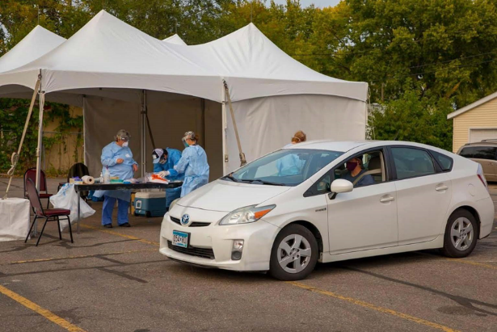
Testing
Photo courtesy of Amira Adawe
Testing is important in our fight against the virus
Testing identifies those who are infected, so they can avoid infecting others
Anyone who is sick or has been exposed should be tested
There are many convenient testing locations and it is typically free

Slide 17
Vaccines
The safety of COVID-19 vaccines is a top priority. You cannot get COVID-19 from the vaccines and side effects should be mild.
The vaccines greatly help slow the spread of the virus.
The current COVID-19 vaccines are for those age 5 and up.
Notes:
Instructor notes:

Slide 18
Information on COVID-19 is rapidly changing, sometimes daily. Refer to reliable sources such as the CDC, OSHA, NIOSH, State Health Departments, and peer-reviewed science publications.
Notes:
Instructor notes:

Slide 19
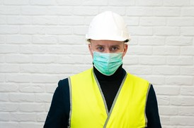
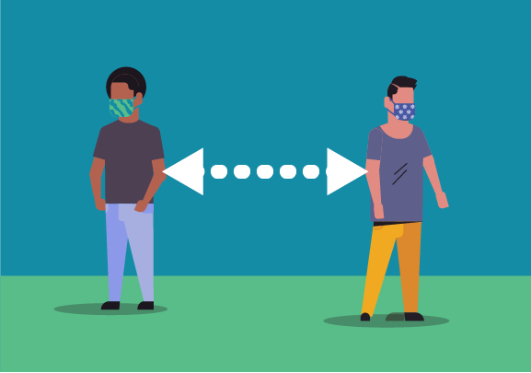
Exposure Prevention
Notes:
Instructor notes:

Slide 20
Where are people exposed?
Any location where people gather has a high potential for exposure
Examples of work settings
Meat packing plants
Retail/grocery stores
Schools
Sports arenas and arts centers
Offices
Correctional facilities
Public transportation services
Manufacturing facilities
Examples of community settings
Sporting events
School events
Weddings and funerals
Parties
Gatherings in homes
Places of worship
Notes:
Instructor notes:

Slide 21
Questions to determine key exposure factors in the workplace
Do specific job duties require close, repeated or extended contact with people with known or suspected to have COVID-19?
Do job tasks require close contact (less than 6 feet) with the public or with co-workers?
Notes:
Instructor notes:

Slide 22
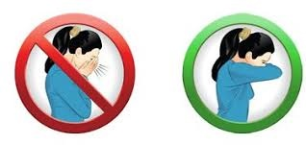
What can we all do to protect ourselves?
Be informed and prepared
Wear masks
Practice social distancing (at least 6 feet)
Wash your hands frequently
Use alcohol-based hand sanitizer
Avoid touching your eyes, nose, and mouth
Stay home when you are sick or exposed (isolation/quarantine)
Cough or sneeze into a tissue or your elbow
Clean and disinfect frequently touched objects and surfaces
Notes:
Instructor notes:

Slide 23
Do not shake hands!
Image courtesy of NUS University of Singapore, Yong Loo Lin School of Medicine
Notes:
Instructor notes:

Slide 24
Five steps to proper handwashing
Wet your hands with clean, running water (warm or cold), turn off the tap, and apply soap.
Lather your hands by rubbing them together with the soap. Lather the backs of your hands, between your fingers, and under your nails.
Scrub your hands for at least 20 seconds. Need a timer? Hum the “Happy Birthday” song from beginning to end twice.
Rinse your hands well under clean, running water.
Dry your hands using a clean towel or air dry them.
Notes:
Instructor notes:

Slide 25
Which is better: soap and water or hand sanitizer?
Soap and water are more effective!
Make sure sanitizer has at least 60% alcohol.
Photo by FDA
Notes:
Instructor notes:

Slide 26
Protecting people
Start with the most effective method
Physically remove the hazard
Replace the hazard
Isolate people from the hazard
Change the way things are done
Protect people with Personal Protective Equipment
Source: https://www.cdc.gov/niosh/topics/hierarchy/default.html
Notes:
Instructor notes:

Slide 27
PPE for jobs with high potential exposure
Face/eye protection
Gloves
Gowns
Respirators
At least N95
Full or half face elastomeric or PAPR for greater protection
Notes:
Instructor notes:

Slide 28
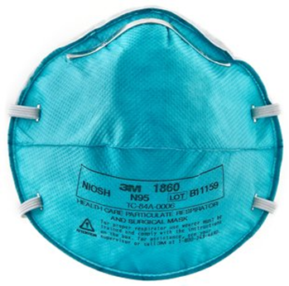
Respirators
Respirators are needed when there is a potential for aerosol transmission.
An N95 respirator is the minimum level of protection to prevent inhaling coronavirus.
Notes:
Instructor notes:

Slide 29
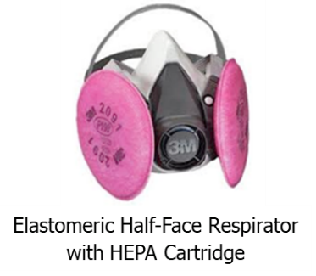
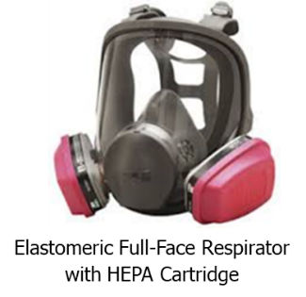
Respirators (continued)
Advantages of reusable respirators:
Durability
Stand up to repeated cleaning and disinfection
Maintain fit over time
Cost savings
Half or full-face elastomeric respirators
Powered air-purifying respirator (PAPR)
Notes:
Instructor notes:

Slide 30
Respirators (continued)
Surgical masks are not respirators!
Surgical masks do not:
Fit tightly against the skin to form a seal
Filter tiny particles, such as viruses or bacteria that are in the air
Notes:
Instructor notes:

Slide 31
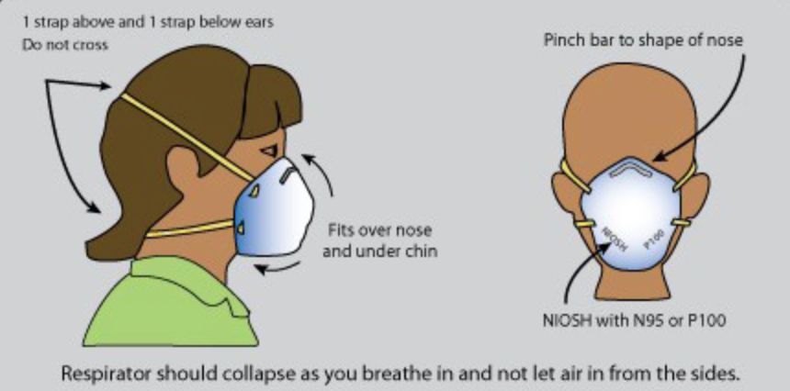
Donning the disposable respirator
Graphic courtesy of LIUNA
Notes:
Instructor notes:

Slide 32
What about cloth masks?
They are not PPE.
Many small particles go around or through cloth. There is not a tight seal to the face.
They are better at protecting others from the wearer than the wearer from others.
Concerns are that people will touch their face more often to adjust mask, or that they will have a false sense of security with one on.
Notes:
Instructor notes:

Slide 33
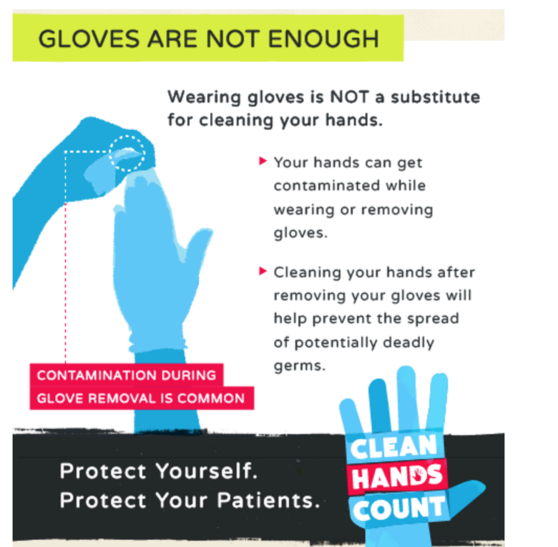
Gloves
Can be a reminder to avoid touching your face!
Assume they are contaminated; dispose of properly.
Wash hands right after removing
Non-latex is better because latex can trigger asthma and allergies
Notes:
Instructor notes:

Slide 34
Are these safeguards adequate?
Notes:
Instructor notes:
Ask participants to name the hazards and safeguards in the photos. Then ask if the safeguards are adequate. If not, ask what would they suggest?
What is the hazard: coming within 6 feet of a contagious customer or coworker or touching a contaminated surface or item.
The signs in the photo let customers know that they are limited to two of each for certain high demand items. Previous features that allowed for high touch self-service have been suspended and use of customers own bags is no longer permitted. Additional signage and markings require 6 feet, social distancing.
Other possibilities: 1) Limit the number of customers allowed in the store. 2) Allow only one-way traffic in the store aisles. 3) Only permit pick up service so that no one enters the store. 4) Provide a minimum N95 fit tested respirator to cashiers and other employees that cannot maintain 6 feet of social distancing.
The floor markings in the photo on the left are used to maintain separation between customers. Will customers comply? If there is no limit on the number of customers, how effective will this approach be? How will the store maintain social distancing when workers are stocking shelves?

Slide 35
Are these safeguards adequate?
Notes:
Instructor notes:
Ask participants to name the hazards and safeguards in the photos. Then ask if the safeguards are adequate. If not, ask what would they suggest?
What is the hazard: coming within 6 feet of a contagious customer or coworker or touching a contaminated surface or item.
Left photo by Larry Stoffer shows the number of customers allowed in the store is limited and they are spaced 6 feet apart to maintain social distancing.
How will the management ensure that customers comply with this system? Some stores have changed hours to allow for seniors or other vulnerable populations to have sole access to stores. Other ideas?
The photo on the right by Karen Berman shows a cashier protected by a sneeze guard, gloves, and a respirator. There is also extensive signage on temporary safety procedures.
Will the plexiglass sneeze guard stop short range aerosols from entering a cashier’s breathing zone? There is no scientific evidence that sneeze guards are effective in preventing spread of infectious aerosols.
Do you notice a problem with the respiratory protection on the cashier?
Answer: you cannot get a proper fit if you have a beard. In most retail stores, workers are not being provided respirators and if they are they are not fit tested.

Slide 36
Are these safeguards adequate?
Notes:
Instructor notes:
Ask participants to name the hazards and safeguards in the photos. Then ask if the safeguards are adequate. If not, ask what would they suggest.
The photo on the right by Karen Berman shows a building superintendent using a respirator and protective gloves.
What is the hazard: coming within 6 feet of a contagious customer or coworker or touching a contaminated surface or item. On the right, handling contaminated garbage or trash.
The photo on the left by Karen Berman shows a bodega worker wearing a surgical masks and gloves. Will the surgical mask protect from a contagious customer who is within 6 feet of her? Do you think the building superintendent has been properly trained to don and doff PPE?

Slide 37
Are these safeguards adequate?
Notes:
Instructor notes:
Ask participants to name the hazards and safeguards in the photos. Then ask if the safeguards are adequate. If not, ask what would they suggest?
What is the hazard: The healthcare worker would be potentially exposed to a contagious patient while providing patient care.
For the bus driver the hazard is coming within 6 feet of a contagious passenger or a contaminated surface.
The photo on the left shows a healthcare workers in protective gear.
The photo on the right shows a city bus with a chain barrier for social distancing from the driver.
Is the chain adequate to prevent exposure to the driver? How can sick passengers be kept off the bus? How can passengers be kept six feet apart?

Slide 38
Are these safeguards adequate?
Notes:
Instructor notes:
Ask participants to name the hazards and safeguards in the photos. Then ask if the safeguards are adequate. If not, ask what would they suggest?
What is the hazard: For the police officer it would include investigating, interviewing, or arresting a contagious individual. For the postal worker it would include coming within 6 feet of a contagious customer or coworker or touching a contaminated surface or item.
The photo on the left by Karen Berman shows a police officer wearing a surgical mask on the streets of NYC. The photo on the right by Jonathan Rosen shows a postal worker wearing gloves and the use of poly strips as a barrier at the customer station.
Did you notice the police officer is not wearing gloves? He also is bearded and wearing a surgical mask, which will protect people from him, but won’t protect him from people he encounters.
The barrier protecting the postal worker will not prevent the intrusion of viral particles.

Slide 39
Are these safeguards adequate?
Notes:
Instructor notes:
Ask participants to name the hazards and safeguards in the photos. Then ask if the safeguards are adequate. If not, ask what would they suggest?
What is the hazard: For the cab driver it would include coming within 6 feet of a contagious passenger or touching a contaminated surface or item.
On the right, the hazard is coming within 6 feet of a contagious customer or touching a contaminated surface or item.
The photo on the left by Karen Berman shows a city cab driver wearing a surgical mask and gloves. The photo on the right shows a postal worker making a delivery, donning gloves and a surgical mask.

Slide 40
Are these safeguards adequate?
Notes:
Instructor notes:
Ask participants to name the hazards and safeguards in the photos. Then ask if the safeguards are adequate. If not, ask what would they suggest?
What is the hazard: for the nurse the hazard includes diagnosing or treating a contagious patient. For the store manager the hazard includes coming within 6 feet of a contagious customer or coworker or touching a contaminated surface or item.
The photo on the left shows a nurse working at an outpatient clinic that has a high volume of patients with respiratory complaints. The photo on the right shows a Goodyear Tire store manager wearing a cloth mask.
The RN in the photo on the left is wearing a procedure mask, not an N95 respirator. The store manager is not protected by potentially contagious customers by wearing a cloth mask. ​

Slide 41
Is this safeguard adequate?
Notes:
Instructor notes:
Ask participants to name the hazards and safeguards in the photos. Then ask if the safeguards are adequate. If not, ask what would they suggest?
The hazard includes coming within 6 feet of a contagious customer or touching a contaminated surface or item.
Photo by Richard Corey. The signs say, “Please respect social distancing and avoid touching the counter.”
Would it make more sense to remove the chairs and place a physical barrier against the customer bar?

Slide 42
Resources
CDC - https://www.cdc.gov/coronavirus/2019-ncov/index.html
NIEHS - https://tools.niehs.nih.gov/wetp/covid19worker/index.cfm

