Slide 1
Cleaning and Disinfecting for COVID-19
Photo credit: https://www.cdc.gov/coronavirus/2019-ncov/prevent-getting-sick/disinfecting-your-home.html#disinfect

Slide 2
Objectives
You will be better able to:
Identify frequently contaminated surfaces
Identify the proper disinfectant for use
Identify safest disinfectants for use
Describe how to safely and effectively disinfect surfaces
Credit: https://www.cdc.gov/coronavirus/2019-ncov/community/disinfecting-building-facility-H.pdf

Slide 3
Clean vs disinfect
The COVID-19 virus can live for hours or days on surfaces. Cleaning and disinfecting surfaces are ways to protect yourself from exposure to COVID-19.
Cleaning removes dust and dirt from a surface
Disinfecting destroys the virus
Cleaning first allows disinfection to be more effective
Credit: https://www.cdc.gov/coronavirus/2019-ncov/community/disinfecting-building-facility-H.pdf

Slide 4
What surfaces?
Clean high touch surfaces including:
Doorknobs
Sinks
Light switches
Dining tables and chairs
Kitchen and bathroom counters
Toilets
Toys
Electronics – phones, keyboards, remote controls, game controllers
Photo credit: https://www.cdc.gov/coronavirus/2019-ncov/prevent-getting-sick/disinfecting-your-home.html#disinfect

Slide 5
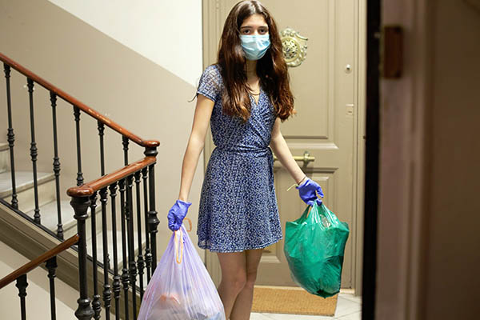
Health concerns with disinfectants
Unsafe use of disinfectants can result in:
Eye irritation
Skin irritation
Headaches
Difficulty breathing, especially for asthmatics
Potential long term health effects
Photo credit: https://www.cdc.gov/coronavirus/2019-ncov/prevent-getting-sick/disinfecting-your-home.html#disinfect

Slide 6
Nine steps for using disinfectants safely
Before using the product:
1. Consider using wipes instead of sprays to reduce irritating fumes (but don’t use disinfectant wipes on skin).
2. Never mix household bleach with ammonia or any other cleanser.
While using the product:
3. Follow the label’s safety instructions on how to use the product.
4. Ventilate by opening windows and using fans that blow air outdoors.
5. Do not allow children to apply the products. Keep children and pets away while you’re using the product and then until it is dry and there is no odor.
After using the product:
6. Wash your hands.
7. Throw away disposable gloves and masks after use because they cannot be cleaned.
8. For reusable gloves, use a designated pair for routine disinfecting.
9. Store product out of reach of children and pets.

Slide 7
5 steps for using disinfectants effectively
Make sure that the product will work against COVID-19 by checking that the product is listed on EPA’s “List N:” https://cfpub.epa.gov/giwiz/disinfectants/index.cfm
2. Make sure the disinfectant is not expired.
3. Use the product only where the label says it can be used. Check the ‘use sites’ and ‘surface types’ on the label for where to use the product.
4. Clean the surface first before you disinfect.
5. Make sure the surface is wet for the entire time listed on the label. This will be called the “contact time” or “dwell time.”

Slide 8
How to use List N
All the disinfectants on List N will kill COVID-19 when used according to the label.
Some work faster, some work on certain surfaces, some are not meant for home usage.
List N allows you to search for disinfectants by various methods including Name, Ingredients, and Contact Time
Food Contact Surfaces
List N can be used to identify disinfectants that can be used on food contact surfaces.
Food contact surfaces, post rinse required means you must rinse the surface after disinfecting with the product.
Food contact surfaces, no rinse means that you do not need to rinse the surface after disinfecting it with the product.
Check the label to confirm whether the product can be used on food contact surfaces.

Slide 9
Activity – Check your disinfectant
Using List N at https://cfpub.epa.gov/giwiz/disinfectants/index.cfm, check to see if your disinfectant kills COVID-19 and how long it must stay on a surface to be effective.
Is your disinfectant on List N? How long does it need to remain on a surface to work?
Are there products that are safer? Disinfectants that have citric acid, hydrogen peroxide, L-lactic acid, ethanol, isopropanol, peracetic acid, and sodium bisulfate as active ingredients are safer for human health and the environment.
Are there products that are safe and work faster than what you have been using?

Slide 10
Acknowledgement
The Midwest Consortium developed this course under cooperative agreement number U45 ES 06184 from the National Institute of Environmental Health Sciences for community members who may be impacted by COVID-19.

Slide 11
Resources
University of Washington. “Safer Cleaning, Sanitizing, and Disinfecting Strategies to Reduce and Prevent Covid-19 Transmission.” https://osha.washington.edu/sites/default/files/documents/FactSheet_Cleaning_Final_UWDEOHS_0.pdf
Western States Pediatric Environmental Health Specialty Unit. “Safer Disinfectant Use During the Covid-19 Pandemic.” http://wspehsu.ucsf.edu/wp-content/uploads/2020/04/safer_disinfect_fxsht_0405.pdf
National Pesticide Information Center. “Using Disinfectants to Control the COVID-19 Virus.” http://npic.orst.edu/ingred/ptype/amicrob/covid19.html
EPA. “Six steps for safe and effective disinfectant use.” https://www.epa.gov/sites/production/files/2020-04/documents/disinfectants-onepager.pdf
CDC. “Cleaning and disinfecting your home.”
https://www.cdc.gov/coronavirus/2019-ncov/prevent-getting-sick/disinfecting-your-home.html
U.S. Environmental Protection Agency List N Tool: https://cfpub.epa.gov/giwiz/disinfectants/index.cfm
NIEHS Cleaning Disinfecting COVID-19 training tool, Module 3 https://tools.niehs.nih.gov/wetp/public/hasl_get_blob.cfm?ID=11922

