Slide 1
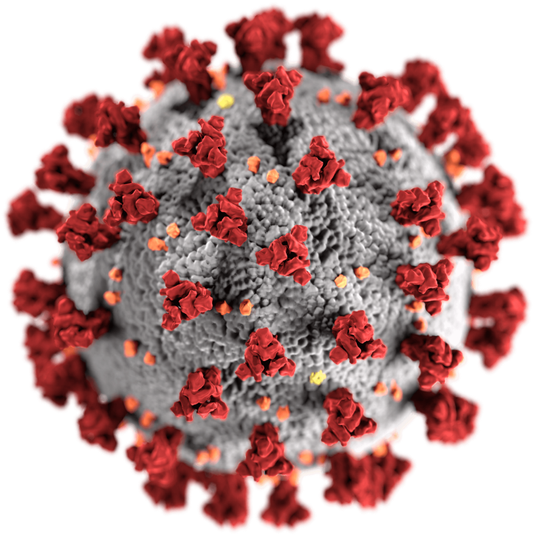
COVID-19 and Health Inequities Among Vulnerable Populations in the United States
Photo by Unknown Author is licensed under CC BY-SA

Slide 2
Objectives
Identify groups that may be disproportionately affected by COVID-19
Describe COVID-19 health inequities
Identify potential paths for reducing health inequities

Slide 3
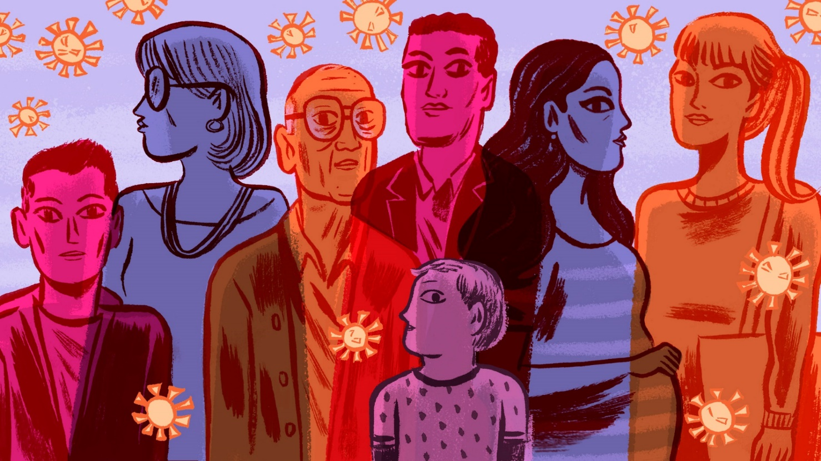
Health Disparities
What groups have been disproportionately affected by COVID-19?

Slide 4
U.S. Data – Race and Ethnicity
As of Sept 9, 2021. https://www.cdc.gov/coronavirus/2019-ncov/covid-data/investigations-discovery/hospitalization-death-by-race-ethnicity.html.

Slide 5
TN Data: COVID-19 by Race and Ethnicity
Update the title and content of this slide for your state. Resources are available in the Facilitator Guide.
Blacks represent 17.1% of the population yet 22.7% of hospitalizations
Hispanics or Latinxs make up 5.2% of the Tennessee population and 5.1% of the hospitalizations.
As of Sept 30, 2021. https://www.tn.gov/health/cedep/ncov/data.html

Slide 6
U.S. Data - Age
As of Sept 9, 2021. https://www.cdc.gov/coronavirus/2019-ncov/covid-data/investigations-discovery/hospitalization-death-by-age.html.

Slide 7
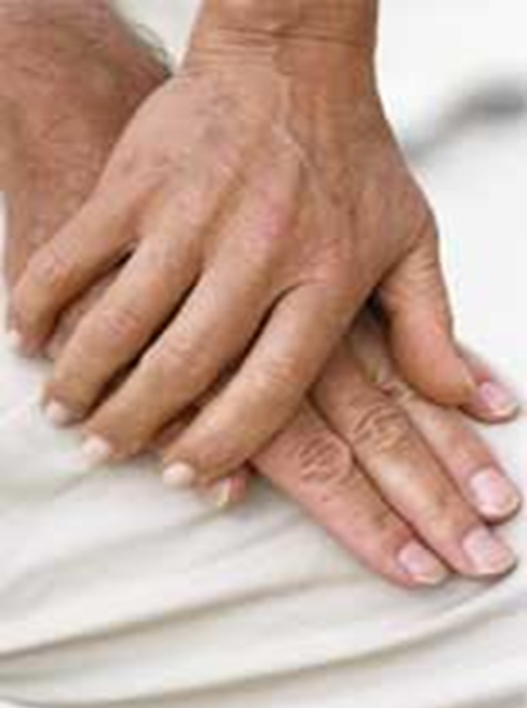
TN Data: COVID-19 by Age
Update the title and content of this slide for your state. Resources are available in the Facilitator Guide.
Those age 61 and older make up 22% of the Tennessee population and 17% of the positive cases, yet account for 81% of the deaths
As of Oct 27, 2021. https://www.tn.gov/health/cedep/ncov/data.html

Slide 8
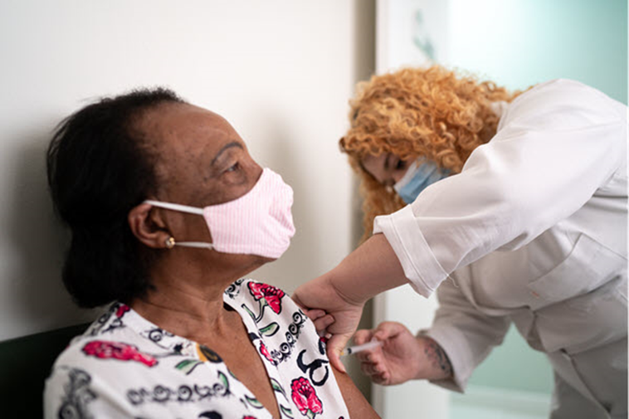
U.S. Data - Vaccinations
Blacks make up 12.4% of U.S. population and 10.6% of vaccinations
Hispanics make up 17.3% of U.S. population and 17.2% of vaccinations
As of Oct 28, 2021. Source: https://covid.cdc.gov/covid-data-tracker/#vaccination-demographic;
Photo credit: https://www.cdc.gov/vaccines/covid-19/index.html

Slide 9
Health Inequities
Are there inequities that could lead to these COVID-19 health disparities?
Access to health care
Access to resources
Mental health
Political, economic and social drivers
Education and career opportunities
Neighborhood environment

Slide 10
What is equity?
Equality – equal solutions for all
Equity – custom solutions for each
Source: Interaction Institute for Social Change; Artist: Angus Maguire. interactioninstitute.org; madewithangus.com

Slide 11
What does health equity look like?
Beneficial cultural, economic and political policies
Safe living environment
Access to resources
Mental health
Transportation
FOR ALL

Slide 12
Paths to COVID-19 health equity
Quality healthcare access for all
Infrastructure that enables physical and mental health for all
Economic support to displaced workers and minority-owned small businesses during the pandemic
Providing housing and utility assistance to unemployed and ill Americans until they regain their employment or health

Slide 13
Activity
1. What are barriers to health equity that you have observed? (Can be something you experienced personally or have seen people in your community experience)
2. Do you feel adequate mental health resources are available to all segments of the population? What are examples?
3. Could education be considered a basic need, how might access to education improve health equity?
4. What are existing assets in your community that promote health equity? (policies, organizations, infrastructure etc.)

Slide 14
Acknowledgement
The Midwest Consortium developed this course under cooperative agreement number U45 ES 06184 from the National Institute of Environmental Health Sciences for community members who may be impacted by COVID-19.
Except as noted, images for this PowerPoint presentation have been adapted from NIEHS COVID-19 Training Tools: https://tools.niehs.nih.gov/wetp/covid19worker/index.cfm

Slide 15
Resources
CDC
https://www.cdc.gov/coronavirus/2019-ncov/community/health-equity/race-ethnicity.html

