Slide 1
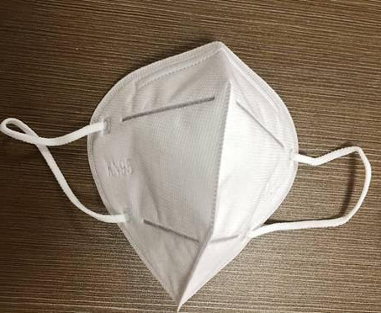
More than just face masks
What is the Hierarchy of Controls?

Slide 2
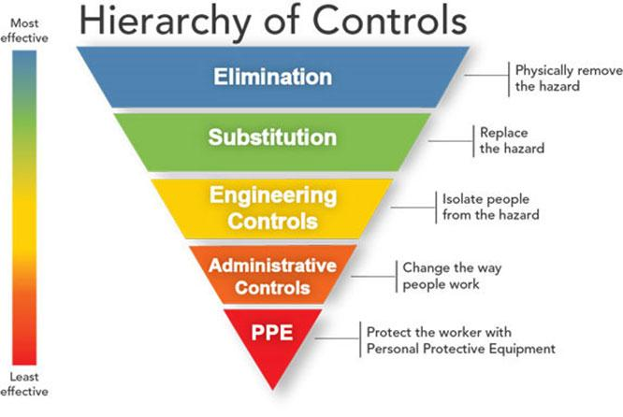
Steps to Reduce Exposure to COVID-19 in the workplace and home
Source: https://www.cdc.gov/niosh/topics/hierarchy/default.html
Notes:
Instructor notes:
As with most any hazard, there are a variety of steps that can reduce or in some cases even eliminate workers’ exposure. A basic principle of workplace safety is to use a combination of strategies to protect workers, starting with the most effective. This approach of moving from most effective to least effective protective measures is called the ‘hierarchy of controls.’
The order of controls, from most effective to least effective is:
Elimination
Substitution
Engineering controls
Administrative Controls & Work practices
Personal protective equipment
Source: NIOSH/CDC https://www.cdc.gov/niosh/topics/hierarchy/default.html
This webpage also provides a more thorough definition of each type of control measure.
Transition: We will now review the overall process for selection and implementation of safeguards and review a few measures that should be used in all workplaces.

Slide 3
Elimination of hazard in workplace and home
Hand sanitizer with at least 60% alcohol is available to all.
Disinfectant and cleaning supplies are available to all.
Clean and disinfect all high-contact surfaces as needed.
For businesses, clean and disinfect all payment portals, pens, and styluses regularly.
Bathrooms, break rooms, kitchens, and other common areas are cleaned and disinfected on a schedule.
Check temperature and symptoms.
Notes:
Instructor notes:
Examples of eliminating the hazard include disinfection and barring people with symptoms from entering the workplace. These methods are applicable to all essential workplaces.
The photo shows a temperature and symptom check being conducted. People with symptoms are sent home and not allowed into the workplace.
High contact surfaces that are touched by many different people, such as:
Desks and chairs;
Counters, tables and chairs;
Door handles and push plates;
Handrails;
Kitchen and bathroom faucets;
Appliance surfaces;
Light switches;
Handles on equipment (e.g., carts);
Remote controls;
Shared telephones;
Shared computers, keyboards and mice
Shared electronics and phones
Shared computer keyboards and mice.
Source: NYS Department of Health, Interim Guidance for Cleaning and Disinfection of Public and Private Facilities for COVID-19 https://newfieldny.org/wp-content/uploads/cleaning_guidance_general_building.pdf

Slide 4
What are examples of engineering controls for COVID-19?
Desks or workstations are set at least 6 feet apart.
Barriers are in place to achieve physical distancing.
Increased general ventilation.
Electronic pre-payment of goods and services.
Notes:
Instructor notes:
Ask participants to list examples of engineering controls and then review the list.
Engineering controls should be selected based on the features of each specific workplace. They need to be tailored to workplace conditions.
Photo by Karen Berman. Online ordering with curbside service keeps customers out of the store.

Slide 5
Administrative controls to reduce exposure
Work
Written plan to reduce exposures
The number of customers is limited
Change hours of operation
Switch to take out/delivery only
Discontinue non-essential travel
Limiting the number of staff present for high potential exposure tasks
Training
Home
Limit visitors to home
Stay home except for essential trips
Isolate those who have COVID or have been exposed to COVID
Notes:
Instructor notes:
Administrative controls include work practices and procedures to reduce the length, frequency or intensity of exposure to a hazard.
Ask participants to list administrative controls and work practices that can reduce exposures, then show the list to affirm their responses.
Employers should:
Provide resources and a work environment that promotes personal hygiene. For example, supply tissues, no-touch trash cans, hand soap, hand sanitizer, disinfectants and disposable towels for workers to clean their work surfaces.
Develop procedures to minimize contacts between workers and between workers and patients, clients or customers.
Limit the number of staff present for high exposure tasks such as aerosol generating procedures or entering patient room.
Provide workers with up-to-date education and training on coronavirus risk factors, and methods to prevent exposure.
Photo by Jonathan Rosen shows Home Depot sign limiting the number of customers to 50 people. This was enforced by having a single entrance and exit to the store with an employee facilitating entrance of people waiting in line, with markings to maintain 6 feet of social distancing.

Slide 6
Administrative controls - Adjust employer policies to reduce exposures
Use temperature/symptom checks before coming to work
Use email, phone, teleconferences instead of face-to-face contact
Enable employees to work from home when possible
Notes:
Instructor notes:
Adjustments in workplace policies can also reduce exposures.
Enabling ill workers to stay at home without fear of any reprisals.
Discontinuing nonessential travel to locations having high prevalence of illness.
Using e-mail, websites and teleconferences to minimizing face-to-face contact between workers. Where possible, encourage flexible work arrangements such as telecommuting or flexible work hours to reduce the number of workers who must be at the work site at one time or in one specific location.
Relying on home delivery of goods and services to reduce the number of clients or customers who must visit your workplace.
Developing emergency communications plans. Maintain a forum for answering workers' concerns and develop Internet-based communications, if feasible.
Provide education and training materials in an easy to understand format and in the appropriate language and literacy level for all employees.

Slide 7
PPE (Personal Protective Equipment)
Face/eye protection
Gloves
Gowns
Respirators
N95 filtering facepiece respirators
Full or half face elastomeric respirators or powered air purifying respirators (PAPRs) for greater protection
Notes:
Instructor notes:
NOTE: This slide shows a high level of worker protection applicable to healthcare, laboratory, EMS and other high risk occupations. Instructors may choose to omit or hide this slide for trainees from other industries.
Personal protective equipment protects against exposures to COVID-19 that cannot be eliminated or reduced by other measures. Workers need to use appropriate PPE.
Respirators approved by the National Institute for Occupational Safety and Health (NIOSH) are needed to prevent inhaling aerosolized SARS CoV-2 particles. At a minimum, workers need to wear an N95 respirator. A higher level of respiratory protection, such as a powered air-purifying respirator or PAPR, should be worn during high hazard procedures that generate aerosols.
Respirators normally should not be used after the expiration date. Maintaining equipment that is current should be part of the practices and procedures in the workplace. NOTE: some of the respirators in the national stockpile that are being released for use in this pandemic are expired. NIOSH has tested batches and found most of them to be still useable. Also Cal/OSHA has issued guidance as has NIOSH on prioritizing use of respirators during the shortage. See the link on slides 56.
NOTE: OSHA has issued Temporary Enforcement Guidance - Healthcare Respiratory Protection Annual Fit-Testing for N95 Filtering Facepieces During the COVID-19 Outbreak in recognition of the shortage of N95s: https://www.osha.gov/memos/2020-03-14/temporary-enforcement-guidance-healthcare-respiratory-protection-annual-fit and https://www.osha.gov/memos/2020-04-03/enforcement-guidance-respiratory-protection-and-n95-shortage-due-coronavirus
Due to PPE shortage, people using PPE in training should be careful to conserve the equipment for use after training. NIOSH and OSHA have published guidance that says In order to conserve the supply of N95 respirators, healthcare facilities should understand which of their healthcare personnel do and do not need to be in a respiratory protection program and thus medically evaluated, trained, and fit tested. If training and fit testing are conducted during two separate steps, it is possible to allow limited re-use of N95 respirators used by individual workers during both steps. https://www.cdc.gov/coronavirus/2019-ncov/hcp/respirators-strategy/conventional-capacity-strategies.html

Slide 8
Activity - Discussion
What steps has your workplace taken to keep workers safe from COVID-19? What else can be done? (see Hierarchy of Controls)
What steps can you use in your home to keep your family safe using the Hierarchy of Controls?
Source: https://www.cdc.gov/niosh/topics/hierarchy/default.html

Slide 9
Acknowledgement
The Midwest Consortium developed this course under cooperative agreement number U45 ES 06184 from the National Institute of Environmental Health Sciences for community members who may be impacted by COVID-19.
Source: Except as noted, content and images for this PowerPoint presentation have been adapted from NIEHS COVID-19 Training Tools: https://tools.niehs.nih.gov/wetp/covid19worker/index.cfm

Slide 10
Resources
NIEHS Essential and Returning Workers Training Tool: https://tools.niehs.nih.gov/wetp/covid19worker/index.cfm
Cornell University: https://ehs.cornell.edu/campus-health-safety/occupational-health/covid-19/covid-19-hierarchy-controls

