Slide 1
Quarantine and Isolation
Are you ready if you need to?

Slide 2
Objectives
When completed, you will be better able to:
Identify the importance of isolation and quarantine
Explain how to isolate and quarantine
Describe how to prepare for isolation or quarantine

Slide 3
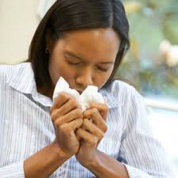
What do Quarantine and Isolation mean?
Quarantine – Unvaccinated people who have had close contact with someone who has COVID-19 need to stay home
Isolation – People who are infected with COVID-19 need to stay home

Slide 4
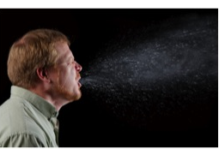
Why are these important?
Quarantine and Isolation prevent the spread of COVID-19
COVID-19 spreads very easily
People can spread COVID-19 before they know they are sick

Slide 5
Who needs to quarantine?
You should quarantine if you are unvaccinated and have had close contact with someone who has COVID-19.
What is close contact?
You were within 6 feet of someone who has COVID-19 for a total of 15 minutes or more
You provided care at home to someone who is sick with COVID-19
You had direct physical contact with the person (hugged or kissed them)
You shared eating or drinking utensils
They sneezed, coughed, or somehow got respiratory droplets on you
Notes:
Source: CDC. https://www.cdc.gov/coronavirus/2019-ncov/your-health/quarantine-isolation.html?CDC_AA_refVal=https%3A%2F%2Fwww.cdc.gov%2Fcoronavirus%2F2019-ncov%2Fif-you-are-sick%2Fquarantine.html

Slide 6
How do you quarantine?
Stay home and monitor your health
Stay home for 14 days after your last contact with a person who has COVID-19
Watch for fever (100.4 °F), cough, shortness of breath, or other symptoms of COVID-19
If possible, stay away from others, especially people who are at higher risk for getting very sick from COVID-19
Wash your hands often
Every day, clean surfaces that get touched a lot

Slide 7
How do you isolate?
Stay home except to get medical care
Monitor your symptoms: if you have an emergency warning sign (such as trouble breathing), seek emergency medical care immediately
Stay in a separate room from other household members, if possible
Use a separate bathroom, if possible
Avoid contact with other members of the household and pets
Don’t share personal household items, like cups, towels, and utensils
Wear a mask when around other people, if you are able to
Wash your hands often
Every day, clean surfaces that get touched a lot

Slide 8
How can I be ready?
Household checklist
Food (canned, rice, cereal, baby food, pet food)
Water
Supplies (toilet paper, paper towels, etc.)
Cleaning supplies
Face masks
Medicine
Identify help outside the home/resources
Source: https://www.ready.gov/kit

Slide 9
Know your situation
Your home may need extra planning if it has:
Elderly people
People with disabilities or medical needs
Children
People at high risk for COVID-19 in your household
No help nearby

Slide 10
Plan ahead
How would you handle it if someone in your home needed to isolate or quarantine? How would they stay apart from the rest of the family? How would you clean? What is important about your specific situation?
How would you handle it if your entire household needed to isolate or quarantine? Do you have enough food and supplies etc.? Who outside your home could help?

Slide 11
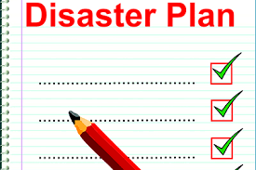
Activity - Make a plan
Make a list of essential items your household needs to be ready for isolation or quarantine
Plan how to keep people apart from one another in your home
If someone in your home needs extra care, plan how to provide what is needed
Decide who outside your home could help

Slide 12
Acknowledgements
The Midwest Consortium developed this course under cooperative agreement number U45 ES 06184 from the National Institute of Environmental Health Sciences for community members who may be impacted by COVID-19.
Except as noted, images for this PowerPoint presentation have been adapted from NIEHS COVID-19 Training Tools: https://tools.niehs.nih.gov/wetp/covid19worker/index.cfm

Slide 13
Resources
CDC
https://www.cdc.gov/coronavirus/2019-nCoV/index.html
Isolation https://www.cdc.gov/coronavirus/2019-ncov/if-you-are-sick/isolation.html
Quarantine https://www.cdc.gov/coronavirus/2019-ncov/if-you-are-sick/quarantine.html
NIEHS
https://tools.niehs.nih.gov/wetp/public/hasl_get_blob.cfm?ID=11923

