Slide 1
State by State COVID-19 Data:
Race and ethnicity data from https://covidtracking.com/race
Population data from various sources listed on slides
Data taken Nov-Dec 2020

Slide 2
Kentucky: Race
Data Accessed Dec 2020

Slide 3
Kentucky: Ethnicity
Accessed Dec 2020

Slide 4
Kentucky: Age
Data Accessed: 12/16/2020
https://chfs.ky.gov/agencies/dph/covid19/COVID19DailyReport.pdf
https://www.infoplease.com/us/census/kentucky/demographic-statistics
Sources:

Slide 5
Kentucky: Sex
Data Accessed: 12/16/2020
https://chfs.ky.gov/agencies/dph/covid19/COVID19DailyReport.pdf
https://www.infoplease.com/us/census/kentucky/demographic-statistics
Sources:

Slide 6
Indiana: Race
*Other includes: Indigenous/Native American, Pacific Islander, Multiracial because Indiana puts these groups together under “Other” in data reports
Accessed 2020

Slide 7
Indiana: Ethnicity
https://covidtracking.com/race/dashboard
Data Accessed: 12/12/2020

Slide 8
Indiana: Age
Data Accessed: 12/16/2020
Sources
https://www.infoplease.com/us/census/indiana/demographic-statistics
https://www.coronavirus.in.gov/2393.htm
Notes:
Double check grey category

Slide 9
Indiana: Sex
Data Accessed: 12/16/2020
Sources: https://www.coronavirus.in.gov/2393.htm
https://worldpopulationreview.com/states/indiana-population

Slide 10
Illinois: Race
https://covidtracking.com/race/dashboard
*.5 taken off groups that were recorded as <1% because decimals were not given, may underrepresent Asian, Indigenous, Pacific Islander, and Multiracial

Slide 11
Illinois:Ethnicity
Mixed with Race

Slide 12
Illinois: Age
Data Accessed: 12/16/2020
https://www.dph.illinois.gov/covid19/covid19-statistics
https://censusreporter.org/profiles/04000US17-illinois/

Slide 13
Illinois: Sex
Data Accessed: 12/16/2020
https://www.dph.illinois.gov/covid19/covid19-statistics
https://censusreporter.org/profiles/04000US17-illinois/

Slide 14
Ohio: Race
https://covidtracking.com/race/dashboard
*.5 taken off groups that were recorded as <1% because decimals were not given, may underrepresent Asian, Indigenous, Pacific Islander, and Multiracial

Slide 15
Ohio: Ethnicity

Slide 16
Ohio: Age
Data Accessed: 12/16/2020
Sources:
https://coronavirus.ohio.gov/wps/portal/gov/covid-19/dashboards/key-metrics/mortality
https://www.statista.com/statistics/912099/ohio-population-share-age-group/
*Data not available for cases by age

Slide 17
Ohio: Sex
Data Accessed: 12/16/2020
Sources:
https://coronavirus.ohio.gov/wps/portal/gov/covid-19/dashboards/key-metrics/mortality
https://worldpopulationreview.com/states/ohio-population
https://www.statista.com/statistics/912099/ohio-population-share-age-group/

Slide 18
Michigan: Race

Slide 19
Michigan: Ethnicity
https://covidtracking.com/race/dashboard

Slide 20
Michigan: Age
Accessed 12/16/2020
Source:
https://www.michigan.gov/coronavirus/0,9753,7-406-98163_98173---,00.html
https://censusreporter.org/profiles/04000US26-michigan/

Slide 21
Michigan: Sex
Accessed 12/16/2020
Source:
https://www.michigan.gov/coronavirus/0,9753,7-406-98163_98173---,00.html
https://censusreporter.org/profiles/04000US26-michigan/

Slide 22
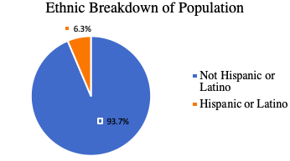
Tennessee: Ethnicity

Slide 23
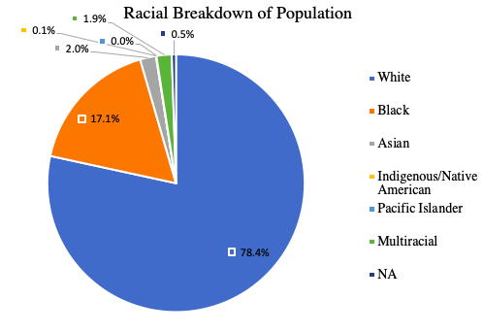
Tennessee: Race

Slide 24
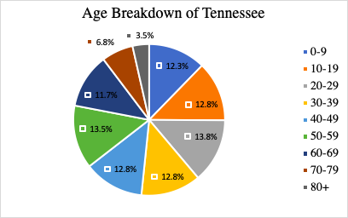
Tennessee: Age

Slide 25
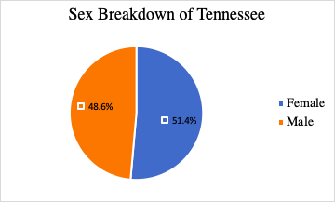
Tennessee: Sex

Slide 26
Wisconsin: Race

Slide 27
Wisconsin: Ethnicity

Slide 28
Wisconsin: Age
Accessed 12/16/2020
Sources:
https://www.dhs.wisconsin.gov/covid-19/deaths.htm
https://www.infoplease.com/us/census/wisconsin/demographic-statistics

Slide 29
Wisconsin: Sex

Slide 30
Minnesota: Race
Accessed: 12/16/2020
Source: https://covidtracking.com/race/dashboard

Slide 31
Minnesota: Ethnicity
Accessed: 12/16/2020
Source: https://covidtracking.com/race/dashboard

Slide 32
Minnesota: Age
Accessed 12/16/2020
https://www.infoplease.com/us/census/minnesota/demographic-statistics
https://www.health.state.mn.us/diseases/coronavirus/situation.html#gendm1

Slide 33
Minnesota: Sex
Death by Sex NA
Accessed 12/16/2020
https://www.health.state.mn.us/diseases/coronavirus/situation.html#gendm1
https://www.census.gov/quickfacts/MN

Slide 34
North Dakota: Race
Accessed 12/16/2020
Source: https://covidtracking.com/race/dashboard

Slide 35
North Dakota: Ethnicity
NA

Slide 36
North Dakota: Age
NA

Slide 37
North Dakota: Sex
NA

