Slide 1
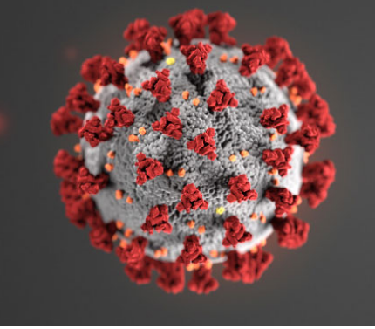
COVID-19 Emergency Response Drill
Course Goal
This program is designed to highlight adjustments in procedures for those responding to emergencies during the COVID-19 pandemic.

Slide 2
Objectives
After completing this program, you will be better prepared to:
Explain COVID-19 characteristics and transmission routes
Describe the Initial Actions required for a response that may involve COVID-19
Identify steps required to complete the Incident Action Plan when responding to a potential COVID-19 incident
Apply viral contact precautions and procedures during emergency response

Slide 3
This program was developed in part by the Midwest Consortium for Hazardous Waste Worker Training under grant D42 ES07200 and cooperative agreement U45 ES06184 from the National Institute of Environmental Health Sciences.

Slide 4
Course Modules
1. COVID-19
2. Initial Actions
3. Completing the Action Plan
4. COVID-19 Drill

Slide 5
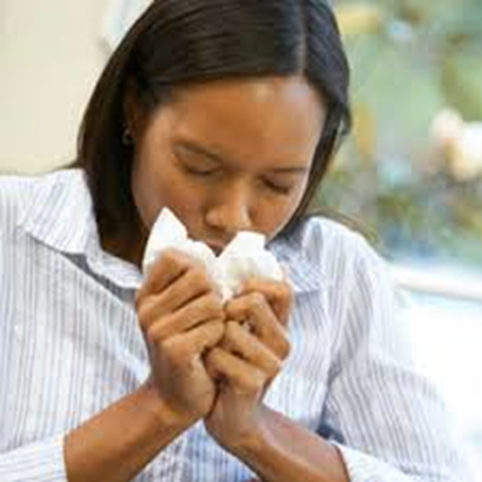
Module 1: COVID-19
Module Goal
Explain COVID-19 characteristics and transmission routes

Slide 6
Module 1: COVID-19
Module Content
Definition
Impact
Incubation
Transmission
Symptoms
Survival Outside the Body
Prevention

Slide 7
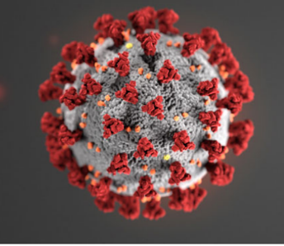
Module 1 - COVID-19 A. Definition of the Virus
SARS-CoV-2 is the virus that causes coronavirus disease 2019 (COVID-19)
SARS = severe acute respiratory syndrome
CoV = coronavirus
Spreads easily from person-to-person particularly when someone sneezes or coughs

Slide 8
Module 1: COVID-19 B. Impact
COVID-19 is HIGHLY DANGEROUS.
It causes severe illness and death.
Person-to-person spread has occurred worldwide.
It poses a high risk for emergency responders, older adults, and people who have severe underlying medical conditions.
As of April 21, 2021
32 million US cases
565,000 US deaths
https://covid.cdc.gov/covid-data-tracker/#datatracker-home

Slide 9
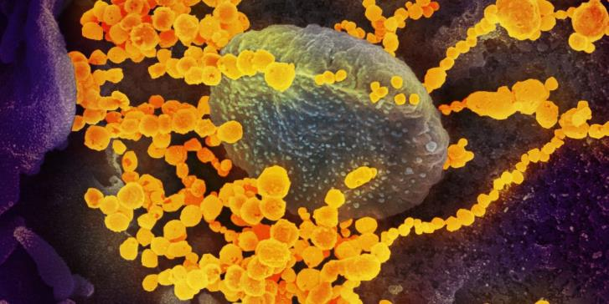
Module 1: COVID-19 C. Incubation
The incubation period is the time between exposure and the onset of symptoms.
Symptoms may show 2-14 days after exposure.
People can spread the virus while asymptomatic.

Slide 10
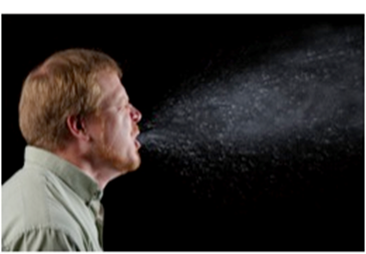
Module 1: COVID-19 D. Transmission
COVID-19 is spread from person to person mainly through coughing, sneezing, and possibly talking and breathing.
Additionally, transmission may occur from touching surfaces and then touching your eyes, nose and mouth.
Watch this video to see just how easily a virus can spread!
https://www.youtube.com/watch?v=UEM5gE-AcXM

Slide 11
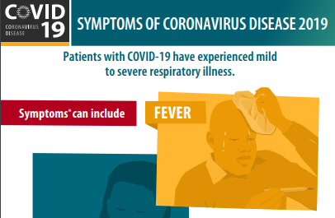
Module 1: COVID-19 E. Symptoms
Most common symptoms include:
Fever or chills
Cough
Shortness of breath
Other symptoms may include:
Sore throat
Runny or stuffy nose
Body aches
Headache
Chills
Fatigue
Loss of taste or smell
Nausea or vomiting

Slide 12
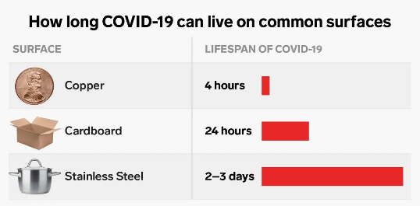
Module 1: COVID-19 F. Survival Outside the Body
COVID-19 may persist on surfaces for a few hours or up to several days, depending on conditions and the type of surface.
The EPA list found below contains disinfectants effective against the virus when used according to directions.
https://www.epa.gov/pesticide-registration/list-n-disinfectants-use-against-sars-cov-2

Slide 13
Module 1: COVID-19 G. Prevention
PPE
Vaccination
Physical distancing
Hand washing
Cleaning and disinfecting

Slide 14
Module 1: COVID-19 – Summary
In Module 1, you learned specific information about COVID-19 by reviewing the following topics.
Definition
Impact
Incubation Period
Transmission
Symptoms
Survival Outside the Body
Prevention

Slide 15
Module 2: Initial Actions
Module Goal
After completing this module, participants will be able to describe the Initial Actions required for a response that may involve COVID-19.
Module Content
Notification
Isolation
Protection
Identification

Slide 16
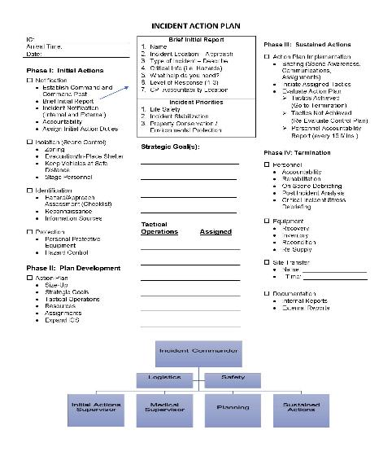
Module 2: Initial Actions
We will be using this Incident Action Plan Worksheet for emergency response

Slide 17
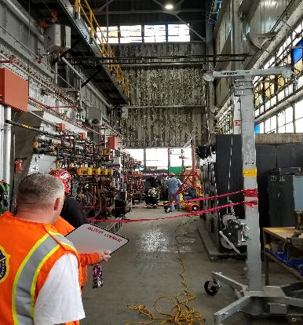
Module 2: Initial Actions Introduction – Mind Set
Regardless of whether you are responding to a machine entrapment, confined space rescue or a patient with chest pains, you must approach the scene with an acute mindset that identifies the possible presence of COVID-19.

Slide 18
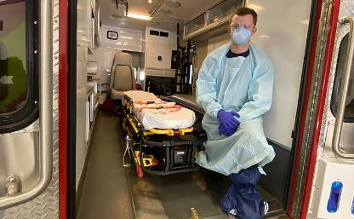
Module 2: Initial Actions Introduction - Mind Set
During a pandemic, we must assume the patient, bystanders and all surfaces are possibly contaminated and take the necessary precautions to protect ourselves and others.
Think….
Do I have my PPE available?
Hand Sanitizer
Medical Gloves
Mask (N95 preferred)
Safety Glasses/Shield
Tyvek suit or medical gown
Stay 6 feet back upon approach

Slide 19
Module 2: Initial Actions A. Notification
If you are the First Responder on the scene, you should give the Brief Initial Report and assume command as soon as possible from a safe distance.
A safe distance would be a minimum of 6 feet from a patient. This distance may increase due to the type of incident (i.e. Confined Space).
Brief Initial Report
Your Name
Incident Location/Approach
Type of Incident
Critical Info (Hazards, Injuries, Symptoms)
What help do you need?
Command Post Location

Slide 20
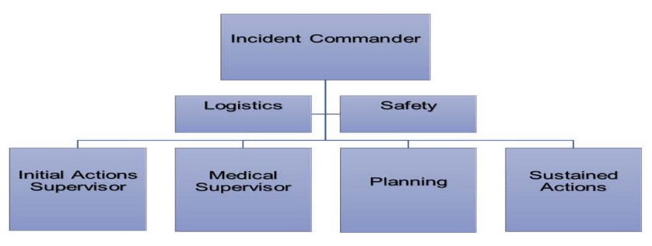
Module 2: Initial Actions A. Notification (Continued)
Assign an Initial Actions Supervisor and Medical Supervisor as early as personnel resources allow. This allows for the safest and most effective control at the scene. You will learn more about these assignments during the hands-on portion of this program.

Slide 21
Module 2: Initial Actions B. Isolation
The Incident Commander or Initial Actions Supervisor should confirm the following with regards to isolating the incident scene:
Create and maintain a minimum Hot Zone around the patient(s) of 6 feet with visible markers
Isolate/evacuate bystanders away from the patient
Report any information gathered to the Incident Commander including the patient’s condition

Slide 22
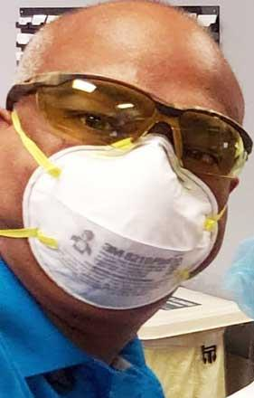
Module 2: Initial Actions C. Protection
PPE is mandatory within 6 feet of a patient(s) during this pandemic crisis. Masks are one of those mandatory protection devices.
N-95 offer the most protection.
Donning/doffing guidance found here:
https://ehs.msu.edu/_assets/docs/don-doff-n95.pdf
https://www.youtube.com/watch?v=zoxpvDVo_NI

Slide 23
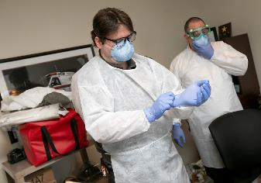
Module 2: Initial Actions C. Protection (Continued)
Protecting your eyes with safety glasses or a shield is necessary, as well as donning medical gloves.
Glove donning/doffing video found here:
https://www.youtube.com/watch?v=xueBYfElFEg
Important:
Avoid touching hands to your face. The mouth, nose and eyes are the most likely areas for the virus to enter your system!

Slide 24
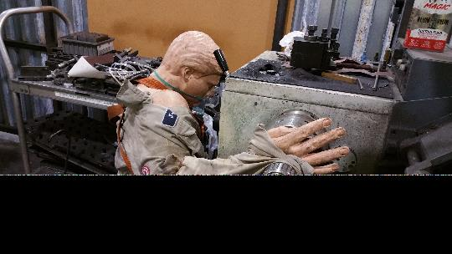
Module 2: Initial Actions C. Protection (Continued)
One of the most effective ways to prevent the spread of the virus is to supply the patient with a mask. This may include:
N-95
Procedural / Surgical
Oxygen
Important:
Have the patient don the mask as soon as is possible, if they are capable.

Slide 25
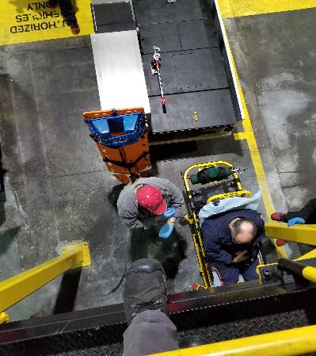
Module 2: Initial Actions D. Identification
Another change in response procedure includes questions for the patient.
These questions are needed to identify possibly exposed people, equipment and surfaces to limit additional exposures.
Important: Limit the number of responders entering the patient area to only those absolutely needed. This reduces the potential for contamination.

Slide 26
Module 2: Initial Actions D. Identification
Have you experienced any COVID-19 symptoms including shortness of breath, dry cough or fever?
Have you been in contact with anyone who has been exposed to COVID-19?
If yes to either question, ask:
Have you received a COVID-19 vaccination?
Who at work have you been in contact with recently?
Where at work have you been recently?
These last 2 questions can be used to identify others in the workplace who may need to be sent home.

Slide 27
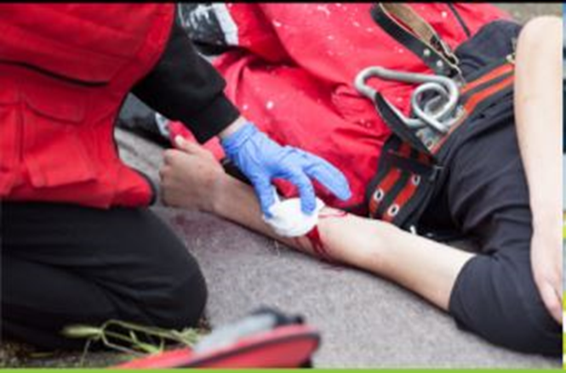
Module 2: Initial Actions D. Identification (Continued)
Document the patient’s answers and discuss this information with medical or the outside responder if this is a suspected or confirmed COVID-19 incident
Important:
A patient’s personal information is protected and should never be shared with the general public.

Slide 28
Module 2: Initial Actions D. Identification (Continued)
Regardless of the answers to the questions, the patient and responders must continue to wear the PPE throughout the event.
Remember, this event is most likely related to some other emergency that will still need to be mitigated.

Slide 29
Module 2: Initial Actions – Summary
In Module 2, you learned about the goals you must accomplish during the Initial Actions of a potential COVID-19 incident including:
Notification
Isolation
Protection
Identification
In

Slide 30
Module 3: Completing the Action Plan
Module Goal
The participant will be able to identify steps required to complete the Incident Action Plan, when responding to a potential COVID-19 incident.
Module Content
Planning
Sustained Actions
Termination

Slide 31
Module 3: Completing the Action Plan A. Planning
Incident Action Plan Worksheet
Phase II: Plan Development
Action Plan
Size-Up
Strategic Goals
Tactical Operations
Resources
Assignments
Expand ICS
Following the IAP Worksheet, we begin at Size-Up. Changes for Size-Up in reference to COVID-19 include:
Is COVID-19 suspected to be on the scene?
How many people have been exposed?
Who will transport patient(s)
Where will patient(s) be transported?

Slide 32
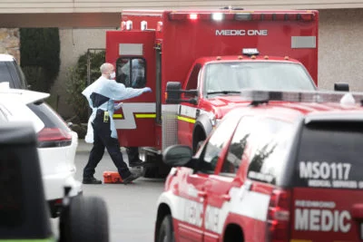
Module 3: Completing the Action Plan A. Planning (Continued)
Strategic Goals
There can be many goals for a given emergency. Some of these goals include removal from a space or a machine. Specific to COVID-19 we are limited:
Reduce possible exposures
Transport / direct to higher level of medical treatment
Make the patient(s) comfortable

Slide 33
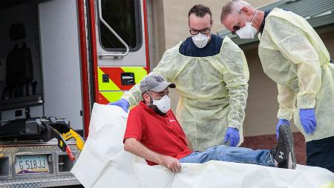
Module 3: Completing the Action Plan A. Planning (Continued)
Tactical Operations
The following tactics can be used by first responders to achieve the 3 previously mentioned goals.
Protect Transport Vehicle
Transport Patient
Contain Isolation Area
Administer Oxygen (if available)
Deciding the tactics you assign will depend on the type of incident you have and how many people you have.

Slide 34
Match the tactic to achieve the goal.
Tactics
Administer Oxygen
Place a plastic covering on transport vehicle
Assign a Pathfinder for outside responders
Goals
Reduce Exposure
Direct patient to higher level of medical treatment
Make patient more comfortable

Slide 35
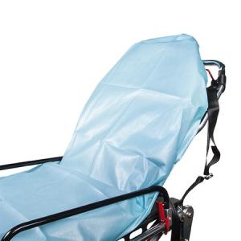
Module 3: Completing the Action Plan B. Sustained Actions
IAP Worksheet
Phase III: Sustained Actions
Action Plan Implementation
Briefing (Scene Awareness, Communications, Assignments)
Initiate Assigned Tactics
Evaluate Action Plan
Tactics Achieved
(Go to Termination)
Tactics Not Achieved
(Re-Evaluate Control Plan)
Personnel Accountability Report
(every 15 Mins.)
The Sustained Actions Phase of an incident is where the work or mitigation to resolve the emergency is done. Review the content on the right from the IAP Worksheet to answer questions on the next page.

Slide 36
Module 3: Completing the Action Plan B. Sustained Actions (continued)
In reference to COVID-19, the single most important goal in Sustained Actions is closely monitoring all activities and ensuring protection from exposures to personnel and equipment.
If available, administering oxygen may offer some comfort and provide some shielding from the patient sneezing, coughing or otherwise releasing droplets into the atmosphere.

Slide 37
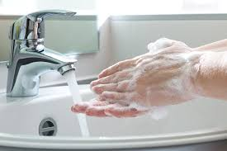
Module 3: Completing the Action Plan C. Termination
Next, we will discuss how COVID-19 affects the termination goals of:
Personnel
Equipment
Transfer of Site
Documentation

Slide 38
Module 3: Completing the Action Plan C. Termination (continued)
Personnel
After an incident, it is important that response personnel, who may have been exposed to contaminated equipment or patients, properly wash and disinfect.
Handwashing video found here: https://youtu.be/nEzJ_QKjT14

Slide 39
Module 3: Completing the Action Plan C. Termination (continued)
Personnel
Be sure to debrief all response personnel at the end of the incident.
Response personnel will be concerned and emotionally affected.
Your employer may have reps who can help.
Here is a link for additional information about COVID-19 and mental health.
https://mhanational.org/covid19

Slide 40
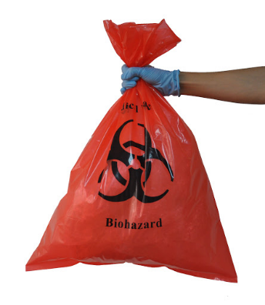
Module 3: Completing the Action Plan C. Termination (continued)
Equipment
Equipment should be washed, disinfected and returned to service, including the response vehicle and personal effects, such as cell phone and glasses.
Perishable equipment must be disposed of according to the infectious equipment procedures at your location.
Here is a link of EPA approved disinfectants for COVID-19
https://www.epa.gov/pesticide-registration/list-n-disinfectants-use-against-sars-cov-2

Slide 41
Module 3: Completing the Action Plan C. Termination (continued)
Site Transfer
At some point, the Incident Commander will release control of the emergency scene.
It is important that this is a formal transfer of site with a briefing that includes pertinent information regarding the incident and possible COVID-19 contamination.

Slide 42
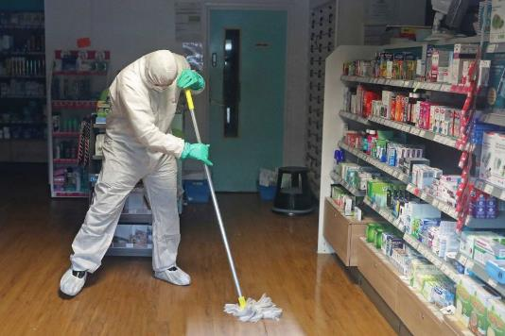
Module 3: Completing the Action Plan C. Termination (continued)
Documentation
Documentation of the incident is vital. Information received during the incident and debrief can:
Help isolate and prevent the spread of COVID-19.
Allow clean-up teams to focus on exposed locations.
Identify who may have been exposed.

Slide 43
Module 3: Completing the Action Plan Summary
In Module 3, you learned how the current COVID-19 crisis impacts Planning, Sustained Actions and Termination when using an Incident Action Plan.
Module 4 includes a drill you can use to practice responding to a potential COVID-19 incident.

Slide 44
Module 4: COVID-19 Response Drill
To complete this course, you will practice a simulated response to a potential COVID-19 incident.

