Slide 1
Opioid Overdose Emergency Response
Course Goal
This program is designed to train emergency responders and others who may respond to an opioid overdose, including use of Naloxone (Narcan).
Notes:
Finalized October 21, 2021

Slide 2
Course Objectives
After completing this course, you will better be able to:
Describe opioid characteristics and the opioid epidemic
Perform initial actions, including donning of PPE, required for a response to a potential opioid overdose
Identify how to use Naloxone (Narcan)
Administer Naloxone (Narcan) during an overdose response

Slide 3
Acknowledgement
The Midwest Consortium for Hazardous Waste Worker Training adapted this program from work created by ERS International for private industry under cooperative agreement number U45 ES 06184 from the National Institute of Environmental Health Sciences (NIEHS), as well as programming created by NIEHS.

Slide 4
CAUTION
CAUTION!
Personnel must be trained to their employer’s site-specific policies and procedures.

Slide 5
Course Modules
1. Opioids
2. Initial Actions
3. Treatment (Narcan)

Slide 6
Module 1: Opioids What Is an Opioid?
A class of drugs used to reduce pain.
Prescription opioids are prescribed to treat moderate to severe pain, but have serious risks and side effects. Examples: oxycodone, hydrocodone, morphine, methadone, and fentanyl.
Illegal opioid: heroin, illegally produced fentanyl and other synthetic opioids.
Notes:
Instructor notes:
Photo: U.S. Department of Veteran Affairs
Source: https://www.cdc.gov/drugoverdose/opioids/prescribed.html
Accessed 10/23/17

Slide 7
What Is Fentanyl?
A powerful synthetic opioid, similar to morphine and heroin.
50 to 100 times more potent than morphine.
A rapid-acting synthetic opioid that alleviates pain.
Acts quickly to depress central nervous system and respiratory function.
Exposure may be fatal.
Notes:
Instructor notes:
The photo shows seized illicit powered fentanyl.
Photo: U.S. Drug Enforcement Administration.
Source: https://www.cdc.gov/drugoverdose/opioids/fentanyl.html

Slide 8
What Color Is Fentanyl?
Fentanyl powder may be:
White
Pink
Purple
Blue
Green
The color and texture do not provide any indication about its strength

Slide 9
How Much Fentanyl Is Fatal?
2‐3 milligrams of fentanyl can induce respiratory depression, arrest, and death.
Comparable to 5-7 grains of salt!
Notes:
Instructor notes:
Photo: U.S. Drug Enforcement Administration, “Carfentanil: A Dangerous New Factor in the U.S. Opioid Crisis

Slide 10
Legal Forms of Fentanyl and Synthetic Opioids
What do they look like?
Lozenges called “lollipops”
Tablets
Sprays
Patches
Injectables
Notes:
Instructor notes:
Photos: CDC and Dailymed.NLM.NIH.GOV

Slide 11
Photos of Illegal Fentanyl
Notes:
Instructor notes:
Photos: U.S. Drug Enforcement Administration

Slide 12
Background on the Epidemic
Drug overdoses killed 70,630 in the U.S. in 2019.
Leading cause of death for Americans under 50.
Opioids were involved in 49,860 overdose deaths in 2019.
Other synthetic opioids (primarily fentanyl) overdose deaths increased nearly 14-fold from 2012 to 2019.
Lethal doses of heroin, fentanyl, and carfentanil. (U.S. DEA photo)

Slide 13
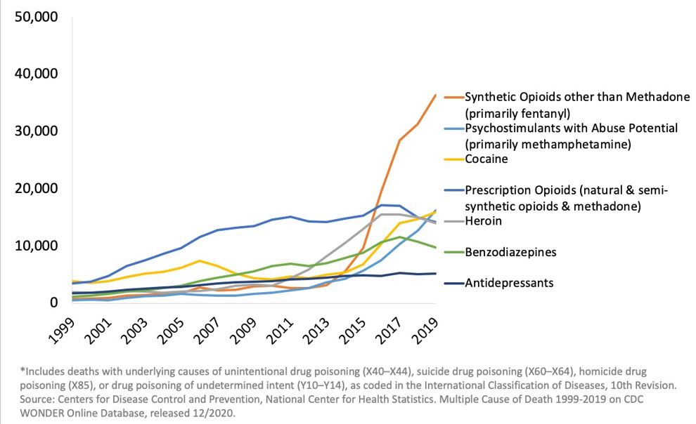
National Drug-Involved Overdose Deaths* Number Among All Ages, 1999-2019

Slide 14
Recovery is Possible
Support
Family
Community
Peers
Recovery Coach
Mutual aid groups
Assistance Programs
Medication-Assisted Treatment (MAT)
Notes:
Source:
https://www.cdc.gov/rxawareness/treatment/index.html

Slide 15
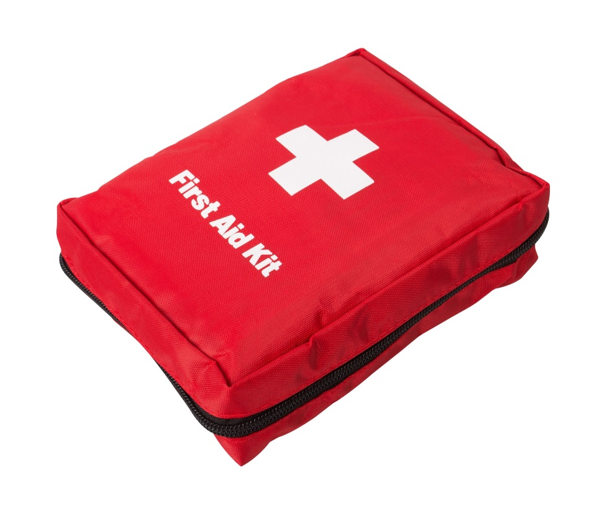
Module 2: Initial Actions
Module Content
Notification
Isolation
Protection
Identification

Slide 16
Module 2: Initial Actions A. Notification
Brief Initial Report
Your Name
Incident Location/Approach
Type of Incident
Critical Info (Hazards, Injuries, Symptoms)
What help do you need?
Command Post Location
If you are the First Responder on the scene, you should give the Brief Initial Report and assume command as soon as possible from a safe distance.

Slide 17
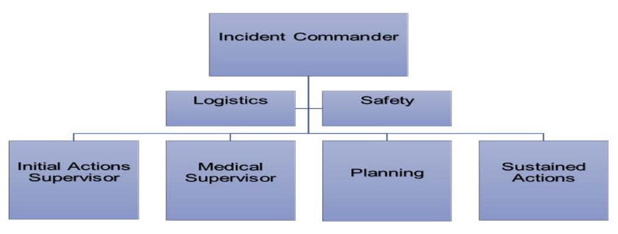
Incident Commander
Assign an Initial Actions Supervisor and Medical Supervisor as early as personnel resources allow. This allows for the safest and most effective control at the scene.

Slide 18
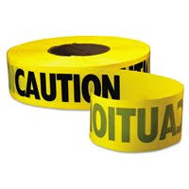
Module 2: Initial Actions B. Isolation
The Incident Commander or Initial Actions Supervisor should confirm the following with regards to isolating the incident scene:
Create and maintain a minimum Hot Zone around the patient(s) of 6 feet with visible markers
Isolate/evacuate bystanders away from the patient
Report any information gathered to the Incident Commander including the patient’s condition

Slide 19
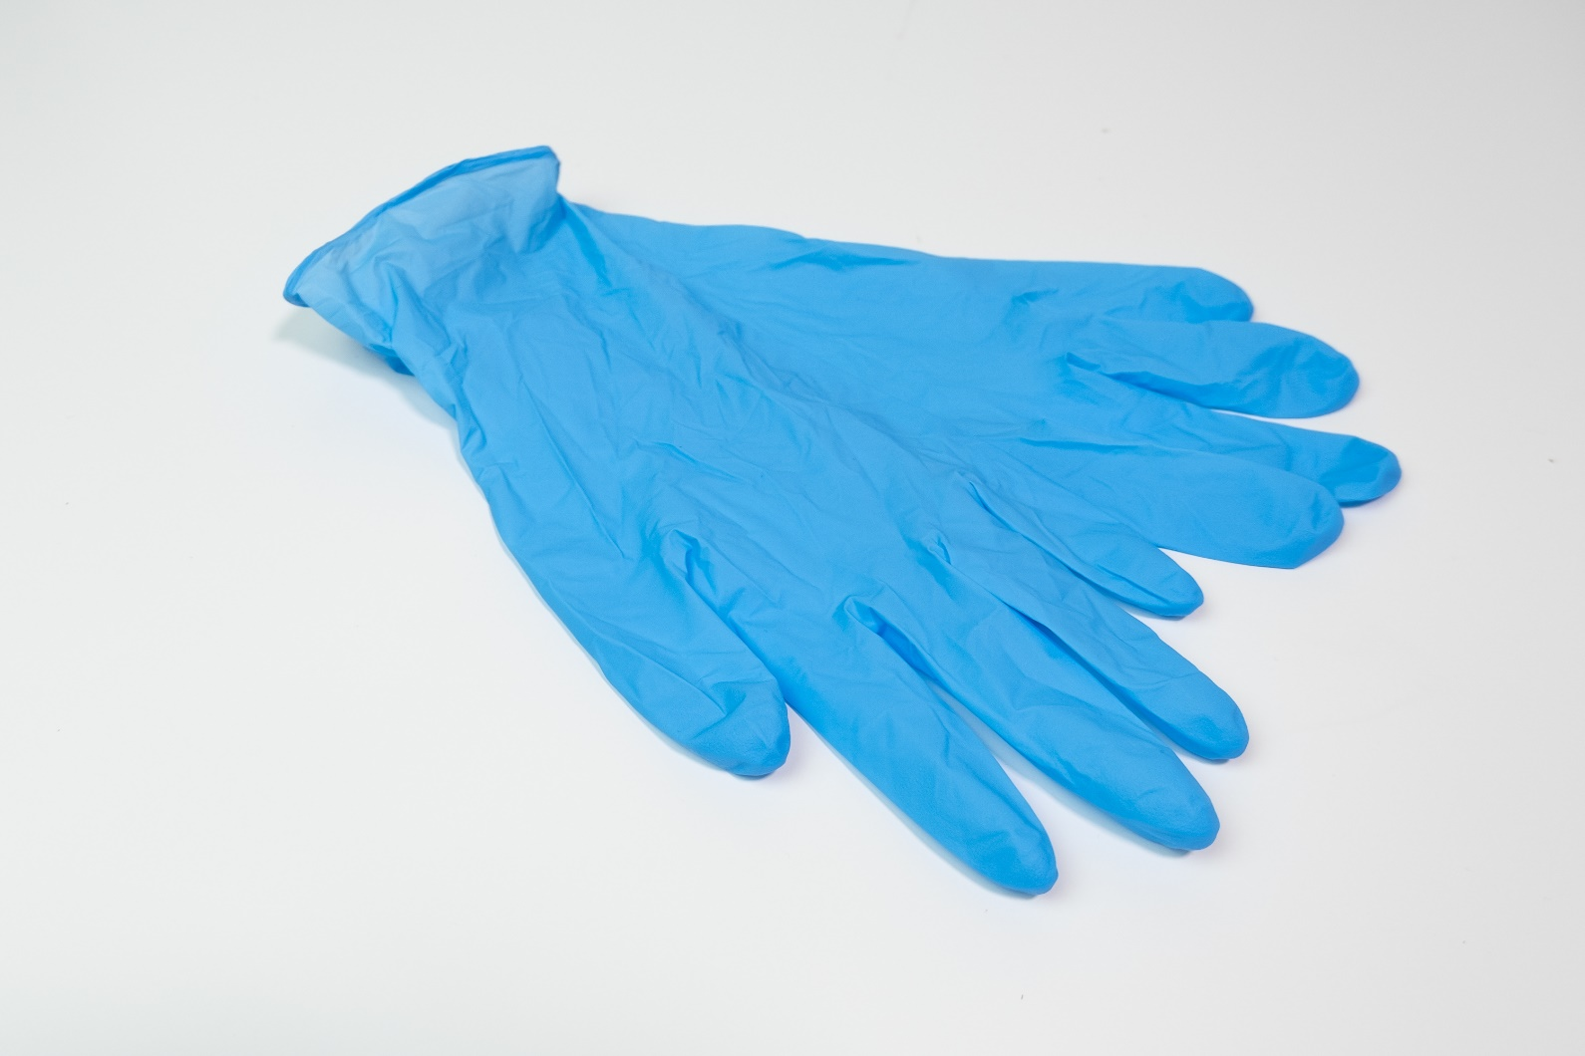
Module 2: Initial Actions C. Protection

Slide 20
What Are the Routes of Exposure?
Inhalation of powders and aerosols
Skin, eye, and mucous membrane absorption
Incidental ingestion (hand to mouth)
Accidental inoculation with sharps or needles
Leading science organizations advise that incidental skin contact with dry products is not likely to cause overdoses.
Skin contact with liquid or gel can be highly toxic.

Slide 21
Skin Exposure
Skin exposure to powdered or dry forms of fentanyl is not likely to cause overdose in small amounts if promptly removed.
Liquid or highly concentrated fentanyl can be absorbed rapidly via skin and can be extremely toxic.
It is prudent to provide full skin protection because the fatal dose is so low.

Slide 22
IAB Recommended Best Practices for Minimal Risk
Exposure Risk | Operational Functions | Minimum Recommended PPE
Minimal (no visible product or product contained within syringe or other package) | Response to a person with suspected overdose | Standard duty uniform and nitrile gloves (NFPA 1999)

Slide 23
IAB Recommended Best Practices for Moderate Risk
Exposure Risk | Operational Functions | Minimum Recommended PPE
Moderate (small volume [grams] of material visible and not contained within a package) | Response to one or more persons with suspected overdose; response to a localized seizure | Standard duty uniform; nitrile gloves (NFPA 1999); P100 filtering facepiece respirator; safety glasses
Note: While the IAB recommends a P100 filtering facepiece respirator, N100 and R100 filtering facepiece respirators should work acceptably too.

Slide 24
NIOSH Standard Operating Procedures to protect responders
Hazard assessment
No drinking, eating, smoking at the scene
Do not touch eyes, nose, mouth
Always wear nitrile gloves when illicit drugs may be present
Field testing of possible drug residue is NOT recommended
Avoid tasks that aerosolize suspected fentanyl
Wash hands with soap and water
Notes:
Instructor notes:
Source: Fentanyl: Preventing Occupational Exposure to Emergency Responders
https://www.cdc.gov/niosh/topics/fentanyl/default.html

Slide 25
Decon
Direct skin contact with suspected fentanyl should be immediately washed with soap and water.
Do NOT Use alcohol-based hand disinfectants or hypochlorite bleach solutions as they may enhance skin absorption of fentanyl.
Notes:
Instructor notes:
Photo: personal.psu.edu

Slide 26
Decon
Avoid contamination while removing PPE.
Isolate used PPE for decon or disposal.
Decon surfaces with absorbent wipes, and a peracetic acid (5%) or hydrogen peroxide-based (10%) solution.

Slide 27
Module 2: Initial Actions D. Identification
The presence of these 3 symptoms is strongly suggestive of opioid poisoning:
Coma
Pinpoint pupils
Respiratory depression
Overdose may result in:
Stupor
Pinpoint pupils that later may become dilated
Cold and clammy skin
Cyanosis: blue or purplish discoloration due to low oxygen
Coma
Respiratory failure leading to death

Slide 28
Identification
Opioid-associated resuscitative emergencies are defined by the presence of cardiac arrest; respiratory arrest; or severe life-threatening instability.
The American Heart Association recognizes the difficulty in accurately differentiating opioid-associated resuscitative emergencies from other causes of cardiac and respiratory arrest.
Other factors to consider include patient history, evidence on scene, and bystander reports.

Slide 29
Module 3: Treatment

Slide 30
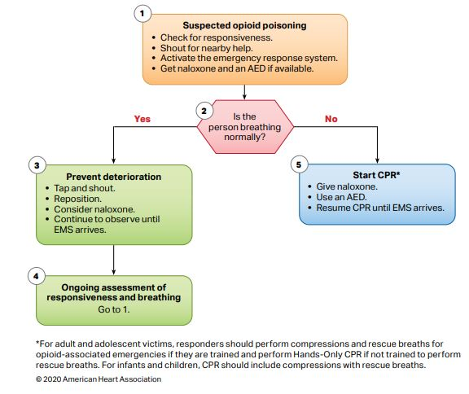
AHA flow chart for non-Healthcare Providers

Slide 31
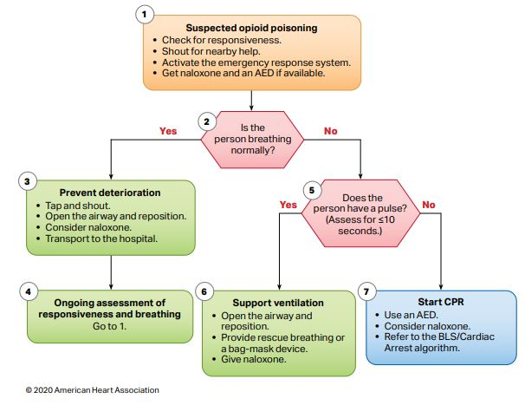
AHA flow chart for Healthcare Providers

Slide 32
Key Actions to Remember
1. Identify and assess the victim for responsiveness.
2. If victim is not responsive and not breathing, initiate CPR and AED per protocol:
Check for pinpoint pupils.
If suspected opioid overdose call for Narcan.
3. Check for medical alert tags (around wrists, ankles, or neck) indicating a pre-existing medical condition.
4. If respirations are present and the victim is unconscious, assess breathing status, pupils, and pulse.
If breathing is adequate (> 8 per minute, no cyanosis) and no signs of trauma, place in the recovery position.
Check for pinpoint pupils.
If breathing is < than 8 per minute or signs of low oxygen and overdose is suspected (based on history, evidence on scene, bystander reports, patient assessment) proceed with Naloxone administration and high O₂ therapy.

Slide 33
Naloxone (Narcan)
Naloxone (Narcan) displaces the opioid from the receptors in the brain.
Can rapidly reverse respiratory depression in a patient with an opioid-associated emergency.
Naloxone doesn’t work with drugs other than opioids.
Naloxone is safe and effective. It is not a controlled substance and has no abuse potential.
Notes:
Instructor notes:
Photo: Donna S. Heidel, CIH, FAIHA

Slide 34
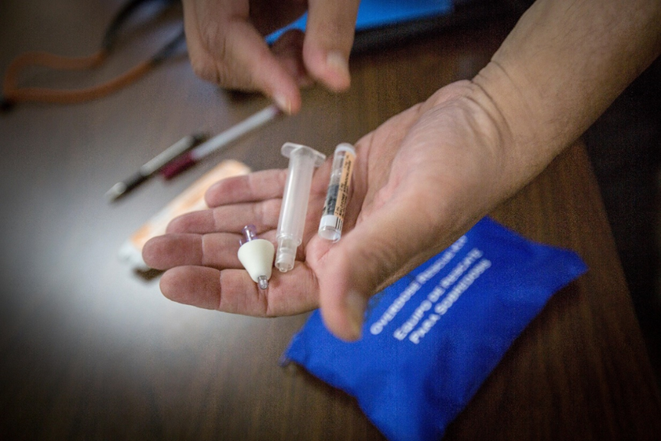
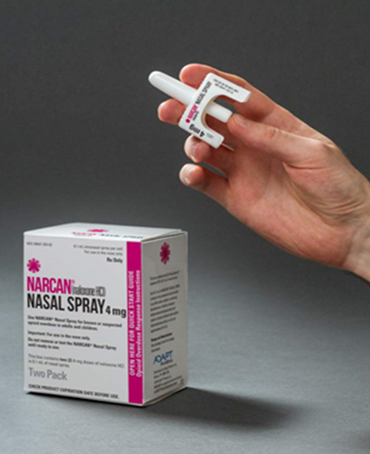
Naloxone (Narcan)
Multiple doses are sometimes required. If the person does not wake up in five minutes, a second dose should be administered
It is available as an injectable and nasal spray
Automatic injectors are similar to an EpiPen
Multi-step or single-step sprays are packaged containing two doses to allow for repeat dosing if needed
Notes:
Instructor notes:
Photos: Donna S. Heidel, CIH, FAIHA

Slide 35
State Laws Vary on Naloxone
Naloxone is accessible in all states without a prescription.
All states have Naloxone Access laws, which protect individuals who administer Naloxone
Only Kansas, Texas and Wyoming DO NOT have Good Samaritan laws, which protect individuals who call for medical assistance for an overdose victim
These laws are all different. Check your state’s law for more info: https://www.gao.gov/products/gao-21-248.
Notes:
Source: https://www.gao.gov/products/gao-21-248

Slide 36
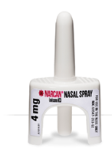
Treatment of Opioid Overdose Emergency with Single Step Nasal Spray
1. Retrieve Naloxone Kit.
2. PRIOR to administration of Naloxone, ensure safety of the victim and remove any sharp or heavy objects within victims reach. The sudden onset of opioid withdrawal may cause physical symptoms, such as agitation, rapid heart rate, nausea, projectile vomiting, violent behavior, seizures, difficulty breathing.
3. Administer 4 mg of Naloxone in one nostril. (do not prime nasal spray)
4. If no response after 3-5 minutes and there is an available second dose of Naloxone, repeat the administration.
• Continue CPR including rescue breathing, (if initiated prior to Narcan) until respirations return
• Continue to monitor respirations and pulse if patient was placed in recovery position with high flow oxygen
• Transport to local Emergency Department via EMS.

Slide 37
Opioid Overdose Response Exercise
1. Review the purpose of the Exercise.
2. Read the directions on the checklist.
3. Review the signs and symptoms of an opioid overdose.
4. Each participant will follow the skills checklist to assess and treat an overdose incident.
5. Each participant will practice the skill until they have mastered all the steps on the skills checklist.

Slide 38
Summary
Opioids/Fentanyl and the related epidemic
Recommended PPE during an opioid response
Assessment of suspected opioid overdose
Use of Naloxone (Narcan) during an opioid response

Slide 39
Resources
​NIEHS Worker Training Program - https://tools.niehs.nih.gov/wetp/index.cfm?id=2587
Centers for Disease Control and Prevention (CDC) - https://www.cdc.gov/niosh/topics/fentanyl/risk.html
InterAgency Board for Emergency Preparedness & Response (IAB) - https://www.interagencyboard.org/sites/default/files/publications/IAB%20First%20Responder%20PPE%20and%20Decontamination%20Recommendations%20for%20Fentanyl.pdf
U.S. Drug Enforcement Administration (DEA) - https://www.dea.gov/documents/2017/2017-11/2017-11-28/fentanyl-safety-recommendations-first-responders

