Slide 1
Opioid Awareness for Communities Practical Tools for Community Members to Help with the Opioid Epidemic
Copyright © 2022 - Midwest Consortium for Hazardous Waste Worker Training

Slide 2
Opioid Awareness Module
This program was developed from content by:
U.S. Department of Health and Human Services https://www.hhs.gov/about/agencies/iea/partnerships/opioid-toolkit/index.html
National Institute of Environmental Health Sciences - https://tools.niehs.nih.gov/wetp/index.cfm?id=2587
This program was developed by the Midwest Consortium for Hazardous Waste Worker Training under cooperative agreement U45 ES06184 from the National Institute of Environmental Health Sciences.

Slide 3
Objectives
After completion of the program, you will better be able to:
Discuss opioids, opioid use disorder, and the opioid epidemic
Describe ways to educate your community about opioid addiction
Identify partners to help your community fight the epidemic
Describe ways to assist those in need in your community
Identify local and federal resources

Slide 4
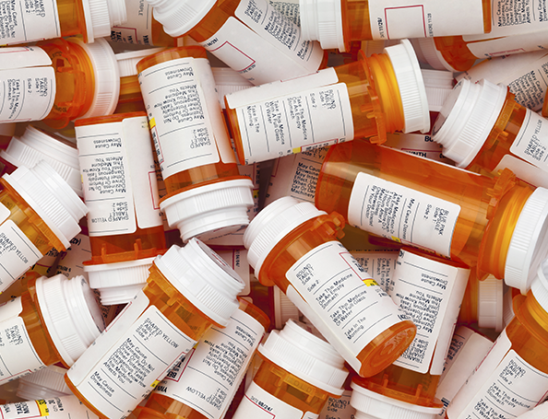
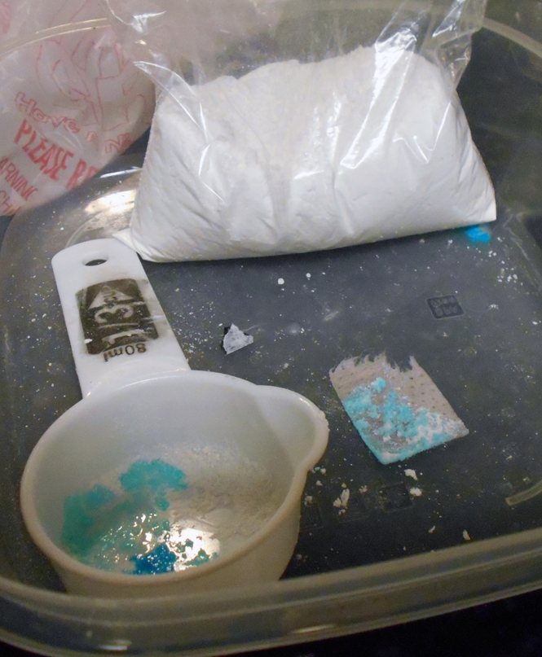
Opioid Basics
Notes:
Photos: CDC, U.S. DEA

Slide 5
What Is an Opioid?
A class of drugs used to reduce pain.
Prescription opioids are used to treat moderate to severe pain but have serious risks and side effects.
Examples: oxycodone, hydrocodone, morphine, methadone, tramadol, and fentanyl.
Illegal opioids: heroin, illegally produced fentanyl, and other synthetic opioids.
Notes:
Instructor notes:
Source: CDC (Centers for Disease Control and Prevention). Opioid Overdose: Prescription Opioids. Available: https://www.cdc.gov/drugoverdose/opioids/prescribed.html.
Photo: U.S. Department of Veterans Affairs

Slide 6
What Is Fentanyl?
A powerful synthetic opioid, similar to morphine and heroin.
50 to 100 times more potent than morphine.
A rapid-acting synthetic opioid that alleviates pain.
Acts quickly to depress central nervous system and respiratory function.
Exposure may be fatal.
Notes:
Instructor notes:
Source: CDC (Centers for Disease Control and Prevention). Opioid Overdose: Fentanyl. Available: https://www.cdc.gov/drugoverdose/opioids/fentanyl.html.
Photo: U.S. Drug Enforcement Administration. The photo shows seized illicit powered fentanyl.

Slide 7
How Much Fentanyl Is Fatal?
2-3 milligrams of fentanyl can induce respiratory depression, arrest, and death.
Comparable to 5-7 grains of salt!
Notes:
Instructor notes:
Source and photo: DEA (U.S. Drug Enforcement Administration). 2016. Carfentanil: A Dangerous New Factor in the U.S. Opioid Crisis. Available: https://www.dea.gov/sites/default/files/divisions/hq/2016/hq092216_attach.pdf.

Slide 8
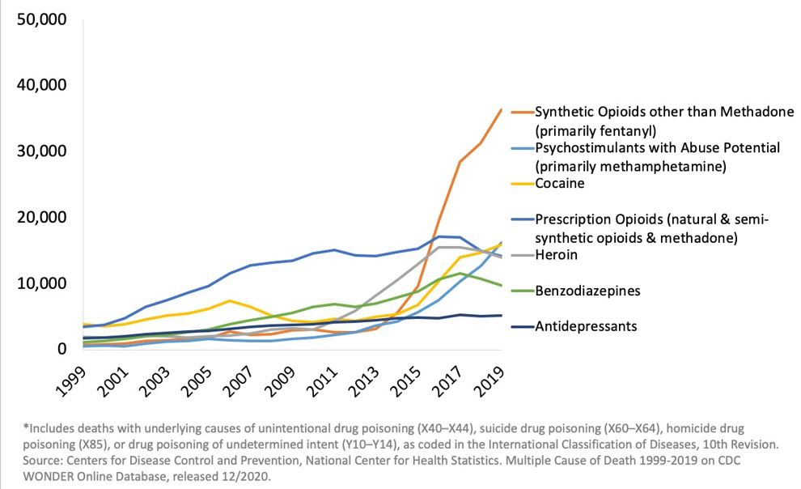
Waves of the Rise in Opioid Overdose Death
National Drug-Involved Overdose Deaths* Number Among All Ages, 1999-2019
Notes:
Instructor notes:

Slide 9
NSC’s video: Opioids & the Brain
Notes:
Instructor notes:
The video was developed by the National Safety Council (NSC) and is entitled, Opioids & the Brain. It is 2 minutes and 36 seconds long, and features Dr. Natalie Kirilichin of the NSC Physician Speakers Bureau.
The video is embedded in slide. Note: you will need an internet connection and sound source to show the video. The Youtube URL for the video is: https://youtu.be/baCPgy6YLs4. If you know that you will not have internet access you can make your PPT presentation self-contained uploading the video and then save the PPT as a packaged PowerPoint presentation and not a full PowerPoint file by clicking File > Save As > PowerPoint Show. Be sure to test the file to make sure it works properly.

Slide 10
The American Medical Association, the American Society of Addiction Medicine, as well as most medical associations and the CDC define substance use disorder as a disease, like diabetes, cancer, and heart disease.
Notes:
Instructor notes:
Sources:
National Institute on Drug Abuse. Drugs, Brains, and Behavior: The Science of Addiction. Preface. Available: https://www.drugabuse.gov/publications/drugs-brains-behavior-science-addiction/preface.
The National Center on Addiction and Substance Abuse. 2012. Addiction Medicine: Closing the Gap between Science and Practice. Available: https://www.centeronaddiction.org/addiction-research/reports/addiction-medicine-closing-gap-between-science-and-practice.

Slide 11
Substance Use Disorder Is a Disease
Opioid misuse is not a moral failing or caused by lack of willpower.
It causes changes in the brain that lead to drug-seeking behavior and avoidance of withdrawal.
The drug changes the brain in ways that make quitting hard, even for those who want to.
Quitting takes more than good intentions or good will.
Notes:
Instructor notes:

Slide 12
Who is Affected?
70% of those with substance use disorder are working
Men are more likely to misuse opioids
The peak for opioid use disorder treatment is age 20-35
The peak for opioid overdose deaths is age 40-50
Notes:
Instructor notes:
Sources:
Substance Abuse and Mental Health Services Administration. 2014. Results from the 2013 National Survey on Drug Use and Health: Summary of National Findings, NSDUH Series H-48, HHS Publication No. (SMA) 14-4863. Rockville, MD: Substance Abuse and Mental Health Services Administration.
Dydyk AM, Jain NK, Gupta M. Opioid Use Disorder. In: StatPearls. Treasure Island (FL): StatPearls Publishing; 2021.
Photo: Earl Dotter

Slide 13
What Is the Impact of Substance Use Disorder?
Mental and physical stress
Financial ruin
Divorce
Loss of child custody
Job loss
Prison
Death
Notes:
Instructor notes:
Photo: U.S. Department of Veterans Affairs

Slide 14
Physical Warning Signs of Addiction
Change in physical appearance
Small pupils
Decreased respiratory rate
Nonresponsiveness
Drowsy
Loss or increase in appetite
Weight loss or weight gain
Intense flu-like symptoms (nausea; vomiting; sweating; shaky hands, feet, or head; large pupils)
Wearing long sleeves or hiding arms
Notes:
Instructor notes:
Source: New York State Office of Alcoholism and Substance Abuse Services. Recognizing the Signs of Addiction. Available: https://combataddiction.ny.gov/warning-signs.

Slide 15
Behavioral Warning Signs
Change in attitude and/or personality
Tendency to avoid contact with family and/or friends
Change in friends, hobbies, activities and/or sports
Drops in grades or performance at work
Isolation and secretive behavior
Moodiness, irritability, nervousness, giddiness
Tendency to steal
Notes:
Instructor notes:
Source: New York State Office of Alcoholism and Substance Abuse Services. Recognizing the Signs of Addiction. Available: https://combataddiction.ny.gov/warning-signs.
Photo: U.S. Department of Veterans Affairs

Slide 16
Overdose - Signs and Symptoms
The presence of a triad of symptoms is strongly suggestive of opioid poisoning:
Coma
Pinpoint pupils
Respiratory depression
Overdose may result in:
Stupor
Pinpoint pupils that later may become dilated
Cold and clammy skin
Cyanosis: blue or purplish discoloration due to low oxygen
Coma
Respiratory failure leading to death
Notes:
Instructor notes:
Source: National Institute on Drug Abuse. Fentanyl. Available: https://www.drugabuse.gov/publications/drugfacts/fentanyl.

Slide 17
Post-exposure Treatment
Naloxone (Narcan) displaces the opioid from the receptors in the brain.
Can rapidly reverse respiratory depression in a patient with an opioid-associated emergency.
Naloxone does not work with drugs other than opioids.
Naloxone is safe and effective. It is not a controlled substance and has no abuse potential.
Notes:
Instructor notes:
Photo: Donna S. Heidel, CIH, FAIHA

Slide 18
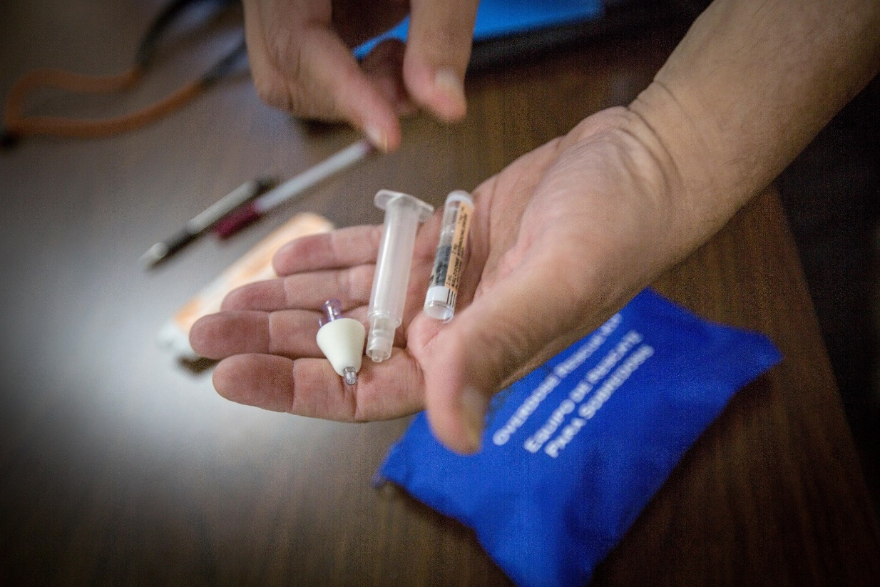
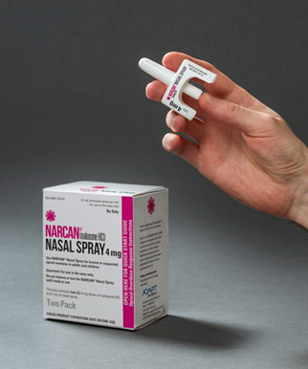
Naloxone (Narcan)
Multiple doses are sometimes required. If the person does not wake up in five minutes, a second dose should be administered.
It is available as a nasal spray or an injectable.
The spray is packaged containing two doses to allow for repeat dosing if needed.
Notes:
Instructor notes:
Photos: Donna S. Heidel, CIH, FAIHA

Slide 19
Opioid misuse prevention
Improve Opioid Prescribing
Prevent Opioid Use Disorder
Treat Opioid Use Disorder
Notes:
Source:
https://www.cdc.gov/opioids/overdoseprevention/index.html

Slide 20
Opioid Prescribing - Scope of the Problem
Notes:
Instructor notes:
Sources:
CDC (Centers for Disease Control and Prevention). Opioid Overdose: Understanding the Epidemic. Available: https://www.cdc.gov/drugoverdose/epidemic/index.html.
CDC (Centers for Disease Control and Prevention). Opioid Overdose: Prescription Opioids. Available: https://www.cdc.gov/drugoverdose/opioids/prescribed.html.

Slide 21
Opioid Prescribing - Talk to Doctors about…
Opioid avoidance. Discuss alternative pain treatment methods such as acetaminophen, ibuprofen, ice, physical therapy, chiropractic care, etc.
Dosage and duration.
Discuss limiting opioid prescriptions for short-term use (3-7 days).
Don’t start with long-acting opiates and use the lowest possible dose.
Expectations. 100% pain-free may not be realistic.
Risks. If a prescription is given, make sure you know the risks
Notes:
Instructor notes:

Slide 22
Prevent Opioid Use Disorder
Those who misused pain relievers got their prescriptions from:
53.1% - Given by, bought from, or took from a friend or relative
36.1% - Prescription from doctor
5.7% - Bought from drug dealer, or stranger
Store Medications in a Safe Place
Dispose of Unused Amounts
Do Not Share Prescriptions!
Notes:
Instructor notes:
Source: Substance Abuse and Mental Health Services Administration. 2018. Key Substance Use and Mental Health Indicators in the United States: Results from the 2017 National Survey on Drug Use and Health (HHS Publication No. SMA 18-5068, NSDUH Series H-53). Rockville, MD: Center for Behavioral Health Statistics and Quality, Substance Abuse and Mental Health Services Administration. Available: https://www.samhsa.gov/data/nsduh/reports-detailed-tables-2017-NSDUH.

Slide 23
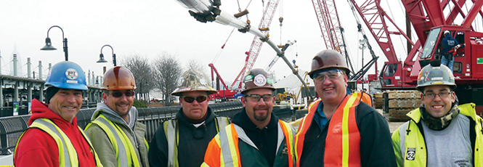
Prevent Opioid Use Disorder (continued)
Employee and Peer Assistance Programs
Notes:
Photo: IUOE International

Slide 24
Treatment – Recovery is Possible
Support
Family
Community
Peers
Recovery Coach
Mutual aid groups
Medication-Assisted Treatment (MAT)
Notes:
Source:
https://www.cdc.gov/rxawareness/treatment/index.html

Slide 25
Treatment - Access
Only 10% of people with opioid use disorder get into treatment.
Key barriers include stigma, lack of availability, and cost.
Notes:
Instructor notes:
Sources:
Bondurant S, Lindo JM, Swensen ID. 2018. Access to substance abuse treatment, drug overdose deaths, and crime. Econofact, 16 March. Available: https://econofact.org/access-to-substance-abuse-treatment-drug-overdose-deaths-and-crime.
The President’s Commission On Combating Drug Addiction And The Opioid Crisis Final Report. 2017. Available: https://www.whitehouse.gov/sites/whitehouse.gov/files/images/Final_Report_Draft_11-15-2017.pdf.

Slide 26
Treatment - What Is Stigma and How Does It Affect People?
Stigma is the shame or disgrace attached to something regarded as socially unacceptable.
Language matters, such as calling people “junkies” or “addicts.”
Stigma interferes with people coming forward for help.
The key to recovery is support and compassion. People who are in pain and have a substance use disorder need comprehensive treatment, not judgment.
Notes:
Instructor notes:

Slide 27
Tools for Community Members
Increase Awareness
Open Your Doors
Build Community Capacity
Rebuild and Restore
Get Ahead of the Problem
Connect and Collaborate
Notes:
Source: U.S. Department of Health and Human Services https://www.hhs.gov/about/agencies/iea/partnerships/opioid-toolkit/index.html

Slide 28
Activity – Discussion #1
Note: For a one-hour program, this will be the only Activity. Place it after the Local Resources slide, right before the Closing. For a two- or three-hour program place Discussion #1 about 45 minutes into the program. REMOVE THIS RED TEXT PRIOR TO CLASS.
Discussion Questions
In what way(s) can you make a difference in your community?
Who can you partner with in helping your community?

Slide 29
Activity – Discussion #2
Note: Remove this slide for one- and two-hour programs. For a three-hour program place Discussion #2 about 90 minutes into the program. REMOVE THIS RED TEXT PRIOR TO CLASS.
Discussion Questions
1. What did you learn today that you would like to share with others?
2. What barriers exist to making a difference in your community?

Slide 30
Activity – Make a Plan (Slide 1)
Note: Remove the 2 Make a Plan slides for a one-hour program. For a two- or three-hour program place them after the Local Resources slide, right before Closing. REMOVE THIS RED TEXT BEFORE CLASS.
Work individually or in a small group to complete items with an asterisk (*) to begin a plan to help your community. A template is available to record key elements of your plan.
I. Form a team
(a) Identify leaders
(b) Identify team members
(c) Identify key stakeholders - Who will be most impacted? Who has a vested interest in the welfare of the community? Who knows the community well? Who has resources?
2. Understanding your community’s situation
(a) *Who is already helping in the community?
(b) How extensive is the problem?
(c) What existing relationships should be considered?
(d) What are key factors of the community to consider?
3. Plan Development
*Establish goals
*Identify community resources
*List and evaluate potential options
(d) Develop strategy - Who will do what and when? What resources are needed? What is timeline?
(e) Obtain feedback
(f) Finalize plan
4. Plan implementation and Maintenance
(a) Begin
(b) Evaluate and modify strategy as needed

Slide 31
Activity – Make a Plan (Slide 2) - Template
Plan element |  |  | Anticipated barriers and approach to each | Date to be completed | Reason for Delay | Date done
1.Call a meeting | Who calls it? | Who participates?
2.Get support | Volunteers to help = Money = Supervisor =
3.Finalize plan and set deadlines for each action | Actions and Deadlines | Who “owns” each action
4.Present final plan to teammates
5.Begin plan

Slide 32
Increase Awareness
Provide Educational Opportunities that Create Understanding & Encourage Compassion
A supportive community is essential to recovery. However, misunderstandings about addiction and the recovery process often stand in the way of our communities providing the critical support and connections people need.
When addiction is understood as a treatable, chronic, medical condition — and not a personal or moral failing — then prejudice and shame can be replaced by a spirit of compassion and hope that opens doors, hearts, and resources to those suffering with a substance-use disorder.
Notes:
Source: U.S. Department of Health and Human Services https://www.hhs.gov/about/agencies/iea/partnerships/opioid-toolkit/index.html

Slide 33
Increase Awareness – Get Started
Addiction as a Treatable Disease and Long-Term Chronic Condition: Help community members understand the need for long-term support of people in recovery.
Pain Management: Increase awareness of pain treatment and management. Learn to ask the doctor:
“Is this an opioid?”
“Is an opioid necessary?”
“Are there alternatives to using opioids for pain relief?”
Safe Drug Disposal: More than half of those who abuse prescription painkillers actually obtained them from friends or family. To address this trend, participate and promote “Take Back Drug Days” in your community and help reduce the supply of prescription opioids getting into the wrong hands.
Notes:
Source: U.S. Department of Health and Human Services https://www.hhs.gov/about/agencies/iea/partnerships/opioid-toolkit/index.html

Slide 34
Increase Awareness - Additional Ideas
Adverse Childhood Experiences (ACEs)/ Trauma Informed Approaches: Help others learn how childhood adversities can actually increase a person’s risk for substance misuse and challenge their recovery efforts.
Medication-Assisted Treatment (MAT): Educate your community on MAT and how to offer the best support people need when they are in treatment.
Good Samaritan Laws: Invite local law enforcement officials to talk to your group about the laws in your state that may protect those who are Providing and/or calling for help when someone has overdosed.
Notes:
Source: U.S. Department of Health and Human Services https://www.hhs.gov/about/agencies/iea/partnerships/opioid-toolkit/index.html

Slide 35
Open Your Doors – Get Started
Offer your space for weekly recovery programs and/or self-help support groups for people with substance-use disorders, as well as their families who may also need support.
Connect people to existing support in your community.
Offer free transportation to treatment services and/or recovery support programs.
Notes:
Source: U.S. Department of Health and Human Services https://www.hhs.gov/about/agencies/iea/partnerships/opioid-toolkit/index.html

Slide 36
Open Your Doors (continued)
Advertise local meetings in your newsletters, community calendars, websites, and social media channels. Consider including:
Local AA.org, NA.org and/or CelebrateRecovery.com mutual aid support groups.
SAMHSA’s Behavioral Health Treatment Services Locator.
SAMHSA’s National Helpline (Free, confidential help in English/Spanish, 24/7): (800) 662-HELP (4357).
Your community’s programs on United Way 2.1.1., your Facebook page, or community’s event schedule.
Notes:
Source: U.S. Department of Health and Human Services https://www.hhs.gov/about/agencies/iea/partnerships/opioid-toolkit/index.html

Slide 37
Build Community Capacity
Your community can partner with local expertise to help deliver capacity-building trainings.
Public Health offices
Treatment facilities
Hospitals
Community health centers
Nonprofit service providers
Notes:
Source: U.S. Department of Health and Human Services https://www.hhs.gov/about/agencies/iea/partnerships/opioid-toolkit/index.html

Slide 38
Build Community Capacity – Get Started
Screening, Brief Intervention and Referral to Treatment (SBIRT): A public health approach to encourage early intervention and refer people to the appropriate treatment and support.
Peer-Recovery Models: Sharing experiences brings hope to people in recovery and promotes a sense of belonging within the community.
Mental Health First Aid: Gain the skills to help someone experiencing a mental health crisis.
Notes:
Source: U.S. Department of Health and Human Services https://www.hhs.gov/about/agencies/iea/partnerships/opioid-toolkit/index.html

Slide 39
Build Community Capacity - Additional Ideas
Trauma-Informed Approaches and Trauma-Specific Interventions: Learn about the critical connections between recovery and resilience for people impacted by trauma.
Motivational Interviewing: Learn a counseling approach that seeks to facilitate and strengthen an individual’s motivation to change misuse of substances and other risky behaviors.
Emergency Response: Learn how to recognize overdose symptoms and administer naloxone (opioid overdose-reversing drug).
Notes:
Source: U.S. Department of Health and Human Services https://www.hhs.gov/about/agencies/iea/partnerships/opioid-toolkit/index.html

Slide 40
Rebuild and Restore Support Individuals and Families in Rebuilding Their Lives
Addiction can leave the lives of individuals and their families dramatically altered by the loss of jobs, homes, or damaged relationships.
Faith and community organizations can provide service that can help to restore and rebuild lives and livelihoods. The opportunity is to connect those programs to what SAMHSA has identified as the four dimensions that support a life in recovery:
Health: Overcoming or managing one’s disease or symptoms.
Home: Having a stable and safe place to live.
Purpose: Conducting meaningful daily activities (e.g., job, family care-taking, and resources to participate in society, etc.).
Community: Having relationships and social networks that provide support, friendship, love, and hope.
Notes:
Source: U.S. Department of Health and Human Services https://www.hhs.gov/about/agencies/iea/partnerships/opioid-toolkit/index.html

Slide 41
Rebuild and Restore – Get Started
Provide help with employment readiness, housing, transportation, food, clothing, or assist with child care.
Coach people on how to manage their finances.
Support local foster care families by gathering resources, donating clothing items and/or other much-needed necessities exit disclaimer icon, including cribs and car seats.
Notes:
Source: U.S. Department of Health and Human Services https://www.hhs.gov/about/agencies/iea/partnerships/opioid-toolkit/index.html

Slide 42
Rebuild and Restore – Additional Ideas
Designate a community leader to connect people to essential services by creating a database or using United Way 2.1.1
Offer life readiness and coaching programs for formerly incarcerated citizens reentering society.
Notes:
Source: U.S. Department of Health and Human Services https://www.hhs.gov/about/agencies/iea/partnerships/opioid-toolkit/index.html

Slide 43
Get Ahead of the Problem Focus Efforts on Youth and Prevention
Children exposed to abuse, neglect, mental illness, substance-use disorders in the household may experience poorer health outcomes, learning problems, and are at higher risk for substance-use disorders.
To nurture the healthy development of future generations, we need to reduce known risk factors, elevate protective factors — such as early intervention and the support of stable and caring relationships — and implement programs that support families and empower youth.
Notes:
Source: U.S. Department of Health and Human Services https://www.hhs.gov/about/agencies/iea/partnerships/opioid-toolkit/index.html

Slide 44
Get Ahead of the Problem – Get Started
Educate your community leaders and family members about Adverse Childhood Experiences (ACEs) and their impact on future behavior and learning. Offer programs on positive parenting and mentor youth and young adults.
Help ensure all children and youth have access to safe, stable, nurturing relationships and environments, so people can reach their life potential.
Notes:
Source: U.S. Department of Health and Human Services https://www.hhs.gov/about/agencies/iea/partnerships/opioid-toolkit/index.html

Slide 45
Get Ahead of the Problem - Additional Ideas
Host faith-based recovery support programs, such as The Landing or Teen Challenge USA
Include the subject of substance-use disorder in your programs.
Create a place on your website, in your newsletters or on your social media pages that links to helpful resources, such as:
NIDA’s “Teen Talk” website.
Partnership for Drug-Free Kids’ “Above the Influence ” website.
Sign up to receive the latest Drugs & Health NIDA Blogs for Teens and share the latest blogs and videos with your community
Notes:
Source: U.S. Department of Health and Human Services https://www.hhs.gov/about/agencies/iea/partnerships/opioid-toolkit/index.html

Slide 46
Connect and Collaborate – Get Started Join Local Substance-Use Prevention Coalitions to Inform, Connect, and Strengthen Your Efforts
After assessing your community’s needs, explore available coalition partners in your community:
Contact your regional public health department, HHS Regional Offices, or SAMHSA Regional Offices.
Connect with diverse partners to establish collaborative, cross-cultural, and comprehensive substance-abuse prevention efforts.
Review SAMHSA’s toolkit, One Voice, One Community: Building Strong and Effective Partnerships Among Community and Faith Organizations.
Notes:
Source: U.S. Department of Health and Human Services https://www.hhs.gov/about/agencies/iea/partnerships/opioid-toolkit/index.html

Slide 47
Connect and Collaborate – Additional Ideas
Visit the Community Anti-Drug Coalitions of America (CADCA)
Lend Your Organization’s Health “Assets”: Whether you have space for a support group to meet, can hold or host educational forums, coordinate volunteers to help transport people to treatment and recovery support services, or help with job interviews, your community’s contribution is an essential element to the recovery journey of any individual or their family.
Recognize National Observances:
National Prevention Week
National Recovery Month
Notes:
Source: U.S. Department of Health and Human Services https://www.hhs.gov/about/agencies/iea/partnerships/opioid-toolkit/index.html

Slide 48
Federal Resources
Department of Health and Human Services (HHS), Opioid Epidemic Practical Toolkit: Helping Faith and Community Leaders Bring Hope and Healing to Our Communities - https://www.hhs.gov/about/agencies/iea/partnerships/opioid-toolkit/index.html
Substance Abuse and Mental Health Services Administration (SAMHSA), Opioid Overdose Prevention Toolkit - https://store.samhsa.gov/product/Opioid-Overdose-Prevention-Toolkit/SMA18-4742
Centers for Disease Control and Prevention (CDC), Opioids - https://www.cdc.gov/opioids/index.html
National Institute of Environmental Health Sciences (NIEHS), Opioids & Substance Use: Workplace Prevention & Response - https://tools.niehs.nih.gov/wetp/index.cfm?id=2587
National Institute on Drug Abuse (NIDA) - https://www.drugabuse.gov/

Slide 49
Local Resources
Populate this slide with local resources such as…
Public Health offices
Treatment facilities
Hospitals
Community health centers
Nonprofit service providers

Slide 50
Summary
Thank you for participating in this program. You should now be better able to:
Discuss opioids, opioid use disorder, and the opioid epidemic
Describe ways to educate your community about opioid addiction
Identify partners to help your community fight the epidemic
Describe ways to assist those in need in your community
Identify local and federal resources

Slide 51
Closing and Evaluation
This is an opportunity to ask any questions you may have, or to discuss how the knowledge and skills learned can be used at work.
Finally, we ask that you take 10 minutes to complete the evaluation forms. These are important for improving the program. We take your comments seriously and make changes in content based on participant feedback. Your comments are anonymous. You can also comment by clicking on the Contact page of the Midwest Consortium website: https://mwc.umn.edu/contact/

Slide 52
Warning
The Midwest Consortium has copyrighted this material. A recipient of the material, other than the Federal Government, may not reproduce it without permission of the copyright owner. The material was prepared for use by instructors experienced in the training of community members to become better prepared to help with the opioid epidemic. Authors of this material have prepared it for the training as of the date specified on the title page. Users are cautioned that the subject is constantly evolving. Therefore, the material may require additions, deletions, or modifications to incorporate the effects of that evolution occurring after the date of this material preparation.

Slide 53
Disclaimer
This training is intended to assist community members to become better prepared to help with the opioid epidemic. It does not provide the necessary skills required to treat those with opioid use disorder, which would require additional training.
Content was finalized March 1, 2022 and all web links are active as of that date; if you find an error, please inform the facilitator so that it can be updated.

