Slide 1
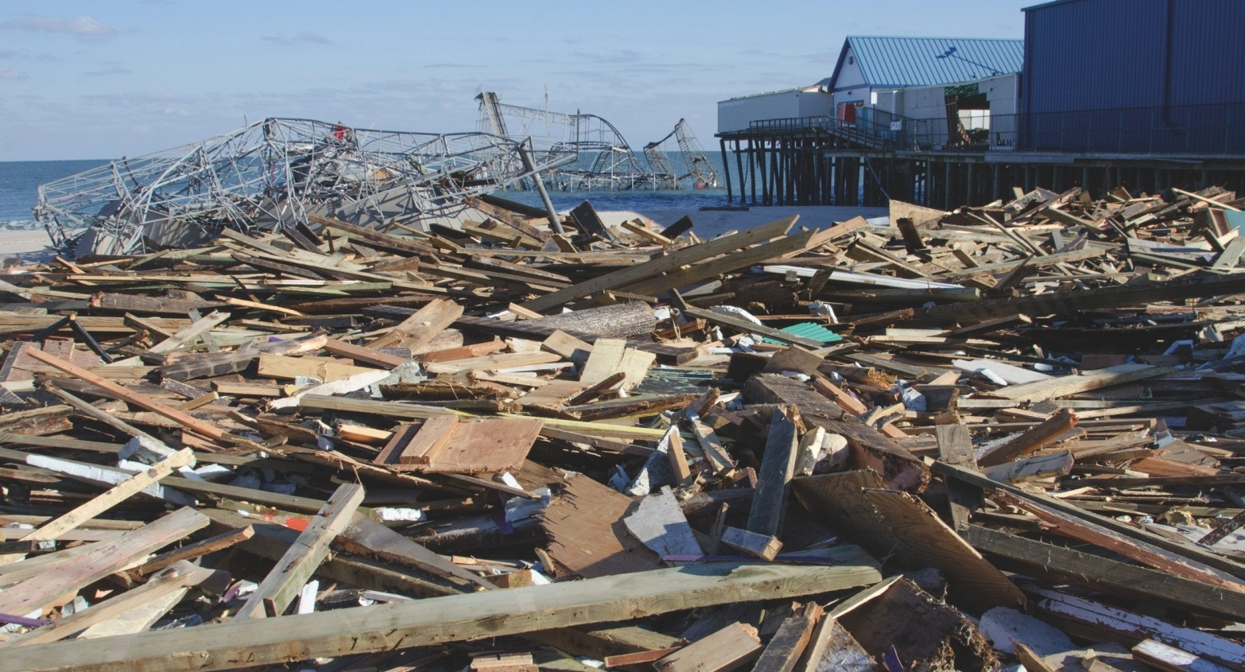
Safety Awareness for Responders to Hurricanes: Protecting Yourself While Helping Others
Notes:
NOTE:
This presentation is not a substitute for any of the provisions of the Occupational Safety and Health Act of 1970 or for any standards issued by the U.S. Department of Labor. Mention of trade names, commercial products, or organizations does not imply endorsement by the U.S. Department of Labor.
General Construction Safety & Health Provisions Subpart C 29 CFR 1926.20 – 35. Subpart C is one of the most important subparts because it covers an overview of many of the major safety requirements for construction work.

Slide 2
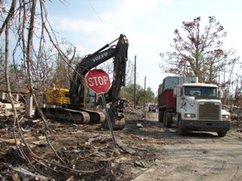
Overview
Introduction
Hazards
Other Protective Measures
Summary
Notes:
TRAINER NOTES:
Introduction/Overview
Background
Workers’ Rights
Additional Training Required
Incident Command
Physical Hazards
- Traffic/Driving - Work Zones
Heavy Equipment - Falls
Debris
Electrical
-Confined Space
Health Hazards
Heat Stress
Cold Stress
-Traumatic Stress
- Sunburn - Chemicals
Water-borne - Food-borne
Animals/Insects
Summary
Additional Information

Slide 3
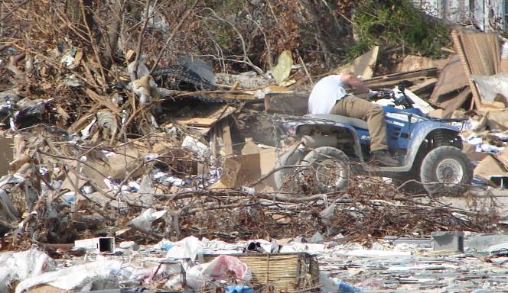
Training Objectives
Identify the hazards in the field
Explain how to protect yourself from these hazards
Increase safety and health awareness
Notes:
TRAINER NOTES:
Environmental and occupational health hazards are a potential threat to deployed personnel
Additional training is required for specific operations involving, but not limited to:
Confined spaces
Excavations
Heavy equipment operators
Fall protection
Work zone safety

Slide 4
Introduction
Notes:
TRAINER NOTES:
An effective disaster site worker safety program includes provisions for the systematic identification, evaluation, and prevention or control of general workplace hazards, specific job hazards, and potential hazards that may arise from foreseeable conditions.

Slide 5
Workers’ Rights
What are employers' responsibilities?
The Occupational Safety and Health Act requires employers to provide a safe and healthful workplace free of recognized hazards and to follow OSHA standards. Employers' responsibilities also include providing training, medical examinations and recordkeeping.
For more information about OSHA, go to http://www.osha.gov or call 1-800-321-OSHA (6742)
Notes:
TRAINER NOTES:

Slide 6
Workers’ Rights (continued)
What are workers' responsibilities?
Follow the employer's safety and health rules and wear or use all required gear and equipment
Follow safe work practices for your job, as directed by your employer
Report hazardous conditions to a supervisor.
Report hazardous conditions to OSHA, if employers do not fix them
Notes:
TRAINER NOTES:

Slide 7
Advanced/Additional Training Required
This training tool, and/or its companion booklet, does not replace the additional duty specific training or PPE specific training requirements.
Regardless of work scope, many topics covered in this awareness booklet/ training tool have corresponding OSHA standards – such standards must be met in order to safely and legally perform associated job duties.
Cleanup workers should always keep in mind that when in doubt about the safety of an activity, stop what you are doing and ask questions. Be sure you are safe before continuing.
Contact the National Clearinghouse for Worker Safety and Health Training (202-331-7733) and review the website https://tools.niehs.nih.gov/wetp/index.cfm for additional information on hurricane and flood response and cleanup. You may also contact us regarding training for hurricane response and cleanup activities.

Slide 8
Incident Command
Incident Command provides a structure to promote effective coordination among responders.
Allows for an integrated organizational structure not hindered by jurisdictional boundaries.
Has 5 organizational functions to allow for a manageable span of control:
Command
Operations
Planning
Logistics
Finance and Administration
Safety is part of the Command function.

Slide 9
Incident Command System Structure
Command Staff
Incident Commander
Safety
Operations
Planning
Logistics
Information
Liaison
Finance and Administration

Slide 10
Emergency in the Field
Notify your supervisor or the incident commander about all injuries sustained at your site.
For minor injuries:
Apply buddycare/first aid
Seek a first aid station or clinic
For serious injuries:
Go to local hospital
Call 911 (Know your exact location)
Notes:
TRAINER NOTES:
OSHA Subpart D 1926.23 contains specific requirements for the provision of first aid, medical attention, and emergency facilities.

Slide 11
Protect Yourself
Be careful walking over and handling debris that is covered with water due to increased risk of slips, trips and falls.
Remain current with tetanus vaccination.
If you will be performing direct patient care or otherwise expected to have contact with bodily fluids, get the Hepatitis B vaccine series.
Avoid contact with stagnant water.
Wash and sanitize immediately if exposed
Consider steel toe/shank footwear if available.
Use durable gloves when handling debris.
Use hearing protection for noisy environments.
Know your medicines, allergies, and blood type.
If in doubt, contact your supervisor!
Notes:
TRAINER NOTES:
Physical injury was a leading diagnosis following Hurricanes Katrina and Andrew.
Key items to have
Insect repellant with Deet or Picaridin
Water life vest
Earplugs
Bottled water
Sun screen
Rain Gear

Slide 12
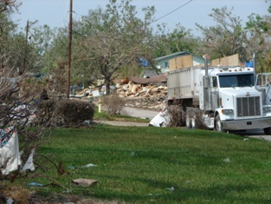
Injuries May Result From
Vehicle accidents
Struck by
Falls
Contusions
Lacerations
Notes:
TRAINER NOTES:
Hazard Recognition, Control and Education are Tools for Injury Prevention
Engineering Controls. Any physical safety device that is designed to passively protect the worker by preventing exposure to worksite hazards.
Administrative Controls. Any procedure which significantly limits daily exposure by control or manipulation of the work schedule or manner in which work is performed. Using Personal Protective Equipment (PPE) is not administrative control.
Work Practice Controls. A type of administrative control where the employer modifies the manner in which the employee performs assigned work. The modification may result in a reduction of exposure through such methods as changing work habits, improving sanitation and hygiene practices, or making other changes in the way the employee performs the job.

Slide 13
Physical Environment
The land:
Flat, coastal, some areas at or below sea level at some areas
Urban areas
The Climate (October-March):
Low Temperatures (below freezing)
Potential for additional storms (rain or snow)

Slide 14
Hazard: Falls
Notes:
TRAINER NOTES:

Slide 15
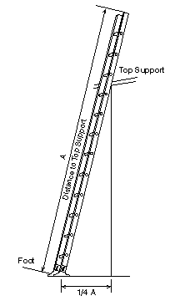
Hazard: Ladders
Ladders can create a falling hazard. Make sure your ladder is secure:
Position portable ladders so the side rails extend at least 3 feet above the landing.
Secure side rails at the top to a rigid support and use a grab device when 3 foot extension is not possible.
Do not apply more weight on the ladder than it is designed to support and make sure that the weight on the ladder will not cause it to slip off its support.
Before each use, inspect ladders for cracked, broken, or defective parts.
Use only ladders that comply with OSHA standards.
Notes:
TRAINER NOTES:

Slide 16
The Blue Tarps
Notes:
TRAINER NOTES:
The Blue tarps are designed to temporarily protect a building until a permanent roof is constructed

Slide 17
Aerial Lifts
Notes:
TRAINER NOTES:
Aerial lifts – Vehicle-mounted devices used to get a worker to an elevated position, — referred to as “cherry pickers” or “boom trucks”

Slide 18
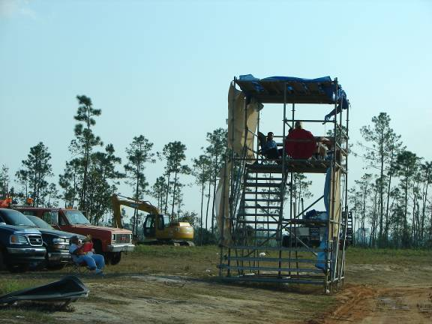
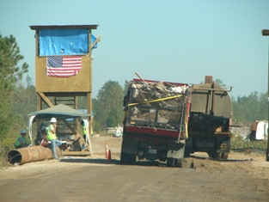
QA Towers
No Cone or Barrier between traffic and QA Tower
A proper zone buffer between traffic and QA Tower
Notes:
TRAINER NOTES:
This QA tower is set up to inspect debris trucks going into dumpsites. The inspector is at risk from vehicle traffic traveling near the tower. Notice in this photo, the lack of buffer zone around the tower. There should be visual markings such as cones, signs or tape to identify the tower to the drivers.

Slide 19
Hazard: Driving
Notes:
TRAINER NOTES:

Slide 20
Traffic Issues
Notes:
TRAINER NOTES:

Slide 21
Work Zone Safety
Notes:
TRAINER NOTES:

Slide 22
Component Parts of a Temporary Traffic Control Zone
Traffic Space
Work Space
Buffer Space
Termination Area
Activity Area
Advance Warning Area
Notes:
TRAINER NOTES:
§1926.201 Signaling
Flagmen

Slide 23
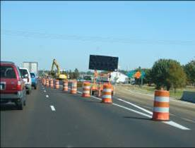
Minimum Signs Recommended in the Manual on Uniform Traffic Control Devices (MUTCD)
Notes:
TRAINER NOTES:
§ 1926.202 Barricades

Slide 24
Debris Truck Hazards
Notes:
TRAINER NOTES:

Slide 25
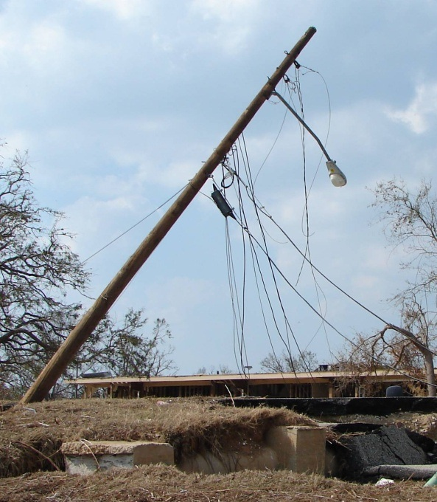
Hazard: Electrical, Overhead Power Lines, Downed Electrical Wires, Cables
Jobs Affected
Debris removal
Tree pruning
Hazard Control
Use appropriately grounded low-voltage equipment
Stay clear of downed electrical lines
Do not work within 10 feet of energized power lines if you are not a qualified worker
Only qualified employees may guard or insulate the lines
Use ground fault circuit interrupters (GFCI).
Notes:
TRAINER NOTES:

Slide 26
Exposed Underground Power Lines
Notes:
TRAINER NOTES:

Slide 27
Hazard: Operating a Chain Saw
Notes:
TRAINER NOTES:
OSHA 1926 Subpart I - Tools – Hand and Power

Slide 28
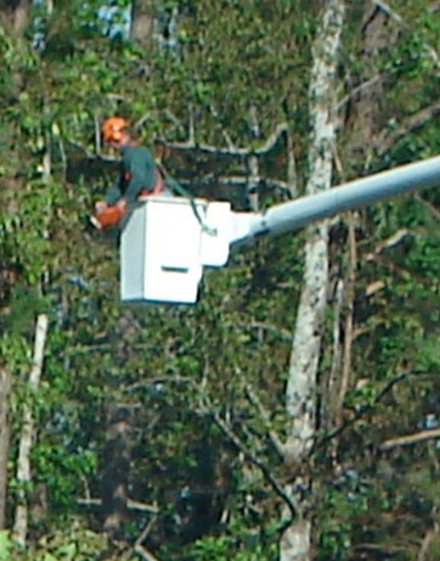
Operating a Chain Saw
Wear the appropriate protective equipment
Always cut at waist level or below
Avoid contact with power lines
Bystanders or coworkers should remain at least:
2 tree lengths (at least 150 feet) away from anyone felling a tree.
30 feet from anyone operating a chain saw to remove limbs or cut a fallen tree.
Notes:
TRAINER NOTES:

Slide 29
Hazard: Eye Injuries
Use safety glasses with side shields as a minimum
An eye wear retainer strap is suggested
Consider safety goggles for protection from fine dust particles or for use over regular prescription eye glasses
Any worker using a welding torch for cutting must have special eye wear to protect against welding flash
Welding flash causes severe burns to the eyes and surrounding tissue
Use only protective eyewear that has an ANSI Z87 mark on the lenses or frames
Notes:
TRAINER NOTES:

Slide 30
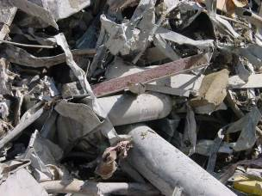
Hazard: Flying Debris/ Material Handling
Wear personal protective equipment, including hard hats, safety shoes, eye glasses, and work gloves
Do not walk under or through areas where cranes and other heavy equipment are being used to lift objects
Make sure that you have an up-to-date tetanus immunization
Notes:
TRAINER NOTES:

Slide 31
Hazard: Debris Piles/ Unstable Work Surfaces
Don’t walk on surfaces you aren’t sure are stable
Use other ways to get to work surfaces, such as bucket trucks
Erect scaffolding on stable surfaces and anchor it to stable structures
Wear protective equipment provided, including safety shoes with slip resistant soles
Use fall protection with lifelines tied off to suitable anchorage points, including bucket trucks, whenever possible
Notes:
TRAINER NOTES:

Slide 32
Hazard: Handling a Variety of Sharp, Jagged Materials
Wear personal protective equipment, including hard hats, safety shoes, eye glasses, and work gloves.
Immediately clean out all open wounds and cuts with soap and clean water.
Apply an antibiotic ointment to discourage infection. Contact a doctor to find out whether more treatment is needed (such as a tetanus shot). If a wound gets red, swells, or oozes, seek immediate medical attention.
Make sure that you have an up-to-date tetanus shot (within the past 10 years).

Slide 33
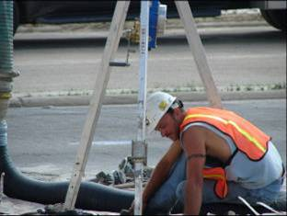
Hazard: Confined Space
What is a Confined Space?
Limited access
Not designed for normal occupancy
Large enough for bodily entry
Example: sewers/storm drains
Your Safety Officer Must Approve Confined Space Entry!!!!
HAZARDS
Oxygen deficiency
Entrapment
Engulfment
Hazardous atmosphere
Notes:
TRAINER NOTES:

Slide 34
Structural Integrity
Notes:
TRAINER NOTES:
This is an example of unstable structures that workers will be tempted to enter.

Slide 35
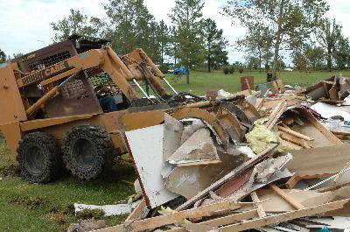
Hazard: Heavy Equipment
Operate equipment correctly and safely.
Be alert to the activities around you
Do not exceed the load capacity of cranes and other lifting equipment
Do not walk under or through areas where cranes and other heavy equipment are lifting objects
Do not climb onto or ride loads being lifted or moved
Use outriggers when operating equipment on unstable ground
Do not ride in or on buckets, forks or blades of heavy equipment
Notes:
TRAINER NOTES:

Slide 36
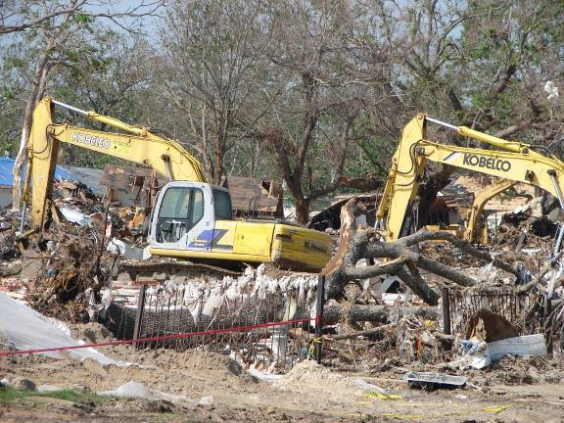
Heavy Equipment
Forklifts
Bobcats
Loaders
Backhoes
ATVs
Notes:
TRAINER NOTES:

Slide 37
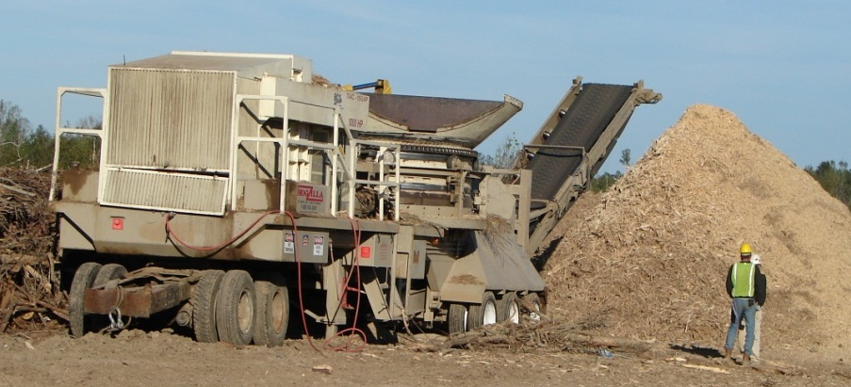
Chippers-Grinders
Loud noise
Use hearing protection
Flying debris
Stay back 300 feet
Moving parts
Do not reach into a machine
Do not use machine unless trained and authorized
Notes:
TRAINER NOTES:

Slide 38
Health Hazards
Notes:
TRAINER NOTES:

Slide 39
Hazard: Heat Related Illness
Heat Stress | Heat Exhaustion | Heat Stroke
Headache Thirst Profuse sweating Muscle aches | Headache Dizziness Confusion Nausea Sweating-pale, clammy skin Cramps, legs & abdomen Rapid, weakening pulse & breathing | Headache Dizziness Restlessness Confusion Hot, flushed dry skin Body temp above 104°F Unresponsive/disoriented
Notes:
TRAINER NOTES:

Slide 40
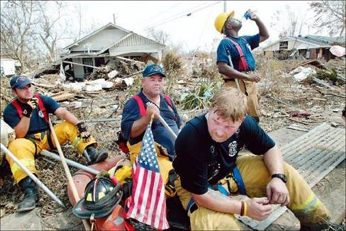
Hydration is Critical!!
Drink plenty of fluids
Drink when you’re thirsty. Drink sports drinks, instead of water, if possible.
Notes:
TRAINER NOTES:
Picture from the Sun Herald.com http://www.sunherald.com/mld/sunherald/

Slide 41
Hazard: Cold Stress
When the body is unable to warm itself, serious cold related illnesses and injuries may occur, and permanent tissue damage and death may result.
Hypothermia can occur when land temperatures are above freezing or water temperatures are below 98.6°F/ 37°C.
Cold related illnesses can slowly overcome a person who has been chilled by low temperatures, brisk winds, or wet clothing.

Slide 42
Hazard: Cold Stress (continued)
Workers Are at Increased Risk When...
They have predisposing health conditions such as cardiovascular disease, diabetes, and hypertension.
They take certain medication (check with your doctor, nurse, or pharmacy and ask if any medicines you are taking affect you while working in cold environments).
They are in poor physical condition, have a poor diet, or are older.
Notes:
Trainer Notes:

Slide 43
Hazard: Cold Stress (continued)
Frost Bite
What Happens to the Body: Freezing in deep layers of skin and tissue; pale, waxy-white skin color; skin becomes hard and numb; usually affects the fingers, hands, toes, feet, ears, and nose.
What Should Be Done: (land temperatures) Move the person to a warm dry area. Don’t leave the person alone.
Remove any wet or tight clothing that may cut off blood flow to the affected area.
DO NOT rub the affected area, because rubbing causes damage to the skin and tissue.
After the affected area has been warmed, it may become puffy and blister. The affected area may have a burning feeling or numbness. When normal feeling, movement, and skin color have returned, the affected area should be dried and wrapped to keep it warm.
Seek medical attention as soon as possible.
Notes:
Trainer Notes:

Slide 44
Hazard: Cold Stress (continued)
Hypothermia
What Happens to the Body: Normal body temperature (98.6° f/37°c ) drops to or below 95°f (35°c); fatigue or drowsiness; uncontrolled shivering; cool bluish skin; slurred speech; clumsy movements; irritable, irrational or confused behavior.
What Should Be Done: (land temperatures)
Call for emergency help (i.e., Ambulance or Call 911).
Move the person to a warm, dry area. Don’t leave the person alone. Remove any wet clothing and replace with warm, dry clothing or wrap the person in blankets.
Have the person drink warm, sweet drinks (sugar water or sports-type drinks) if they are alert. Avoid drinks with caffeine or alcohol.
Have the person move their arms and legs to create muscle heat. If they are unable to do this, place warm bottles or hot packs in the arm pits, groin, neck, and head areas. DO NOT rub the person’s body or place them in warm water bath. This may stop their heart.
Notes:
Trainer Notes:

Slide 45
Hazard: Cold Stress (continued)
Recognize the environmental and workplace conditions that lead to potential cold-induced illnesses and injuries.
Learn the signs and symptoms of cold-induced illnesses/injuries and what to do to help the worker.
Train the workforce about cold-induced illnesses and injuries.
Select proper clothing for cold, wet, and windy conditions. Layer clothing to adjust to changing environmental temperatures. Wear a hat and gloves, in addition to underwear that will keep water away from the skin (polypropylene).
Take frequent short breaks in warm dry shelters to allow the body to warm up.
Perform work during the warmest part of the day.
Avoid exhaustion or fatigue because energy is needed to keep muscles warm.
Use the buddy system (work in pairs).
Drink warm, sweet beverages (sugar water, sports-type drinks). Avoid drinks with caffeine (coffee, tea, or hot chocolate) or alcohol.
Eat warm, high-calorie foods like hot pasta dishes.

Slide 46
Hazard: Sunburn
Prevent overexposing skin
Sunglasses, if used, must be ANSI approved for use as safety glasses
Use sunscreen and lip balm
Use protective eyewear
Limit exposure
Sunburn reduces responder readiness and increases the likelihood of skin cancer.
Notes:
TRAINER NOTES:

Slide 47
Hazard: Noise
Wear appropriate hearing protection in noisy work environments
Examples: saws, earth-moving equipment, pneumatic tools
Notes:
TRAINER NOTES:

Slide 48
Hazard: Inhalation of Dust Containing Asbestos, Silica and Other Toxins
Jobs affected
Debris removal & dumping
Loading trucks
Demolition
Protection
Appropriate respiratory protection
If in doubt about respirators, see your supervisor.
Notes:
TRAINER NOTES:

Slide 49
Hazard: Carbon Monoxide Inhalation
Symptoms: Headache, dizziness, drowsiness, or nausea; progressing to vomiting, loss of consciousness, and collapse, coma or death under prolonged or high exposures.
Carbon Monoxide has no warning properties; it is a colorless, odorless gas!
Areas affected from gasoline- or propane-powered generators or heavy machinery:
Near operating equipment
Near generators
Fire pits
Debris reduction sites
Burning and compacting
Notes:
TRAINER NOTES:

Slide 50
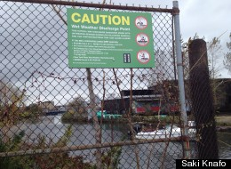
Hazard: Chemicals
Of NY’s and NJ’s 198 Superfund toxic-waste sites, 45 are within a half-mile of coastal areas vulnerable to storm surge, including Gowanus Canal in NY.
Raw sewage, industrial chemicals and floating debris filled flooded waterways around New York City.
Stormwater mixed with sewage spilled from the Gowanus Canal in the wake of Hurricane Sandy.
Notes:
TRAINER NOTES:
Image from Huffington Post (October 30, 2012) http://i.huffpost.com/gen/840327/thumbs/s-HURRICANE-SANDY-SEWAGE-large.jpg?7
Wall Street Journal (November 11, 2012)
http://online.wsj.com/article/SB10001424127887324073504578109550624063018.html
Hurricane Sandy's environmental impact is still being assessed, but the worries for residents of New York and New Jersey are crystallized by one fact: Of the two states' 198 Superfund toxic-waste sites, 45 are within a half-mile of coastal areas vulnerable to storm surge.
The Environmental Protection Agency, which oversees cleanup of those sites, was unable to say how many of them flooded on the night of Oct. 29. But the agency said its initial appraisals show that several "were impacted by the storm," including a site contaminated by lead near Sayreville, N.J., and the Gowanus Canal and Newtown Creek sites in New York City.
Huffington Post (October 30, 2012)
Raw sewage, industrial chemicals and floating debris filled flooded waterways around New York City on Tuesday.
Left in the wake of Hurricane Sandy, the toxic stew may threaten the health of residents already dealing with more direct damages from the disaster.
"Normally, sewer overflows are just discharged into waterways and humans that generate the sewage can avoid the consequences by avoiding the water," said John Lipscomb of the clean water advocacy group Riverkeeper. "But in this case, that waste has come back into our communities."
One particular concern is the Gowanus neighborhood in Brooklyn, which abuts a 1.8 mile canal that was recently designated a Superfund cleanup site by the U.S. Environmental Protection Agency due to a legacy of industrial pollution and sewage discharges.
ABC News http://abcnews.go.com/blogs/health/2012/10/31/sewage-bacteria-gasoline-found-in-nyc-floodwater/
Water is everywhere in the aftermath of Hurricane Sandy – in basements, on the streets and in transit systems – but the one place that flood water is most dangerous is in your body.
ABC News chief health and medical editor Dr. Richard Besser collected floodwater and drinking water in some of the areas hit hardest by Sandy and had them tested at The Ambient Group lab. The floodwater collected in Lower Manhattan tested positive for gasoline and two types of bacteria found in sewage: E. coli and coliform.
“Very dangerous,” Besser said. “Make sure you wear protective gear if you are coming into contact with flood water.”
NY Times
http://www.nytimes.com/2012/11/06/nyregion/gowanus-canal-flooding-brings-contamination-concerns.html?pagewanted=all&_r=2&

Slide 51
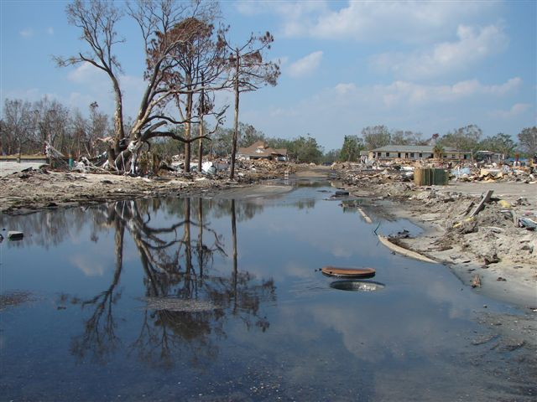
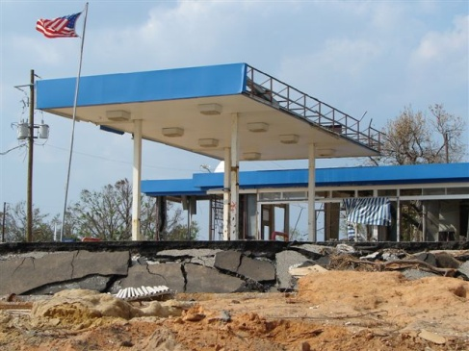
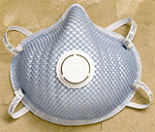
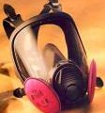
Potential Chemical Exposures
Symptoms: Eye, nose, throat, upper respiratory tract, and skin irritation; flu like symptoms; central nervous system depression, fatigue, loss of coordination, memory difficulties, sleeplessness, mental confusion. Chronic effects depend on the extent and the duration of exposure.
Jobs affected
Debris removal
Site clean-up
Protection
Hazard specific as identified by supervisor or safety officer
Notes:
TRAINER NOTES:
Fire Fighting: Use Self Contained Breathing Apparatus (SCBA) with full face piece in pressure demand or other positive pressure mode.
Entry into unknown concentration: Use SCBA gear.
Rescue operations with vapors present: Use gas mask with front mounted organic vapor canister (OVC) or any chemical cartridge respirator with an organic vapor cartridge
Dusty environments: Use combination HEPA/Organic Vapor Cartridge.
Hazardous materials spills, leaks, and releases (including oil)
The release, spill, or leak of any hazardous material (including oil) shall be reported to U.S. EPA and/or USCG for appropriate handling. The cleanup of hazardous materials releases will be handled by properly trained and protected individuals in accordance with the requirements of 29 CFR 1910.120.
In case of unanticipated discoveries, such as tanks, drums, or cylinders of hazardous materials, or unexploded ammunitions, all work shall cease in the vicinity, the area shall be cordoned off, and appropriate public safety agencies shall be summoned.

Slide 52
Hazard Communication
Notes:
TRAINER NOTES:
Workers must be made aware of the potential hazards, personal hygiene, and personal protective measures required.

Slide 53
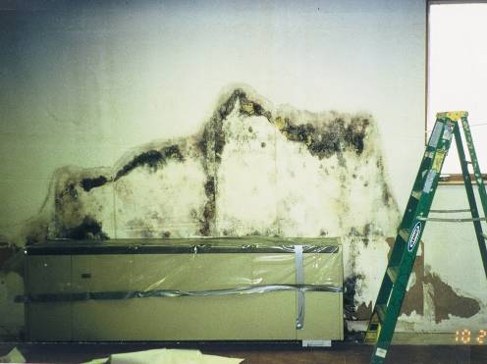
Hazard: Mold
After hurricanes and floods, the water creates the perfect environment for mold to grow in homes and other buildings. Exposure to mold can cause wheezing and severe nasal, eye and skin irritation.
Notes:
TRAINER NOTES:

Slide 54
Hazard: Trench Foot (Immersion Foot)
Trench foot, also known as immersion foot, occurs when the feet are wet for long periods of time. It can be quite painful.
Symptoms include a tingling and/or itching sensation, pain, swelling, cold and blotchy skin, numbness, and a prickly or heavy feeling in the foot. The foot may be red, dry, and painful after it becomes warm. Blisters may form, followed by skin and tissue dying and falling off. Obtain medical assistance as soon as possible.
To prevent trench foot, when possible, air-dry and elevate your feet, and exchange wet shoes and socks for dry ones.

Slide 55
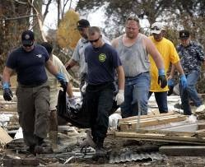
Hazard: Blood-borne Disease
Use impervious gloves when handling human remains
Replace gloves if punctured or torn
Protect yourself from injured persons’ blood and bodily fluids
Do not handle human remains if you have skin cuts or punctures
Notes:
TRAINER NOTES:
Picture from the Sun Herald.com http://www.sunherald.com/mld/sunherald/

Slide 56
Hazard: Handling Bodies of Victims
There is no direct risk of infectious disease from being near human remains for people who are not directly handling dead bodies.
Human remains may contain blood-borne viruses such as hepatitis viruses and HIV, and bacteria that cause diarrheal diseases, such as shigella and salmonella.
For personnel exposed to blood and body fluids:
–Use gloves when handling bodies or body fluids
–Use eye protection, gowns, and masks when large quantities or splashes of blood are anticipated
–Wash hands frequently
–Use body bags to reduce the risk of contamination

Slide 57
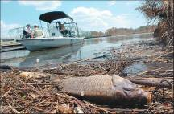
Hazard: Food-borne Disease
Identify and throw away food that may not be safe to eat:
Food that may have come in contact with flood or storm water
Food that has an unusual odor, color, or texture
Meat, poultry, fish, eggs and leftovers that have been above 40 degrees Fahrenheit (F) for 2 hours or more
Food containers with screw-caps, snap-lids, crimped caps (soda pop bottles), twist caps, flip tops, snap-open, and home canned items
These cannot be disinfected if they have been in contact with floodwater
Store food safely
While the power is out, keep the refrigerator and freezer doors closed as much as possible
Add block ice or dry ice to your refrigerator if the electricity is expected to be off longer than 4 hours. Wear heavy gloves when handling ice
Notes:
TRAINER NOTES:
Picture from the Sun Herald.com http://www.sunherald.com/mld/sunherald/

Slide 58
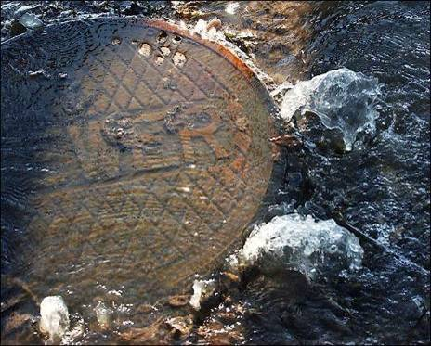
Hazard: Water-borne Disease
Communicable disease outbreaks of diarrhea and respiratory illness can occur when water and sewage systems are not working and personal hygiene is hard to maintain as a result of a disaster.
Wash Your Hands Often With Soap and Use Water-Free Sanitizers!!
Notes:
TRAINER NOTES:

Slide 59
Hazard: Animals and Insects
Protect yourself from mosquitoes:
Use screens on dwellings
Wear long pants, socks, and long-sleeved shirts
Use insect repellents that contain DEET or Picaridin
Beware of wild or stray animals:
Avoid wild or stray animals. Call local authorities to handle animals
Get rid of dead animals according to local guidelines
Wear and clean proper protective clothing when handling carcasses
Notes:
TRAINER NOTES:
Picture from the Sun Herald.com http://www.sunherald.com/mld/sunherald/

Slide 60
Spiders: Black Widow
The most widely recognized of the dangerously poisonous spiders
They frequently nest in electrical, water, and telephone equipment boxes
May also be found in crawlspaces, beneath appliances, and usually in areas that are dark and damp.

Slide 61
Black Widow
Black widow spider venom affects the nervous system
Because the bite itself is relatively mild, some people may not even realize immediately that they were bitten.
The venom causes pain in the lymph nodes.
Other symptoms of a severe bite include nausea, elevated blood pressure, sweating, tremors, and increased white blood cell counts.
The wound may appear as a bluish red spot, surrounded by a whitish area.
An antivenom serum is available, but it must be administered soon as possible after the bite occurs.

Slide 62
Spiders: Brown Recluse
Brown recluse spiders are nocturnal in their feeding habits.
Outdoors, they are most common under rocks, debris, wood piles, etc.
Indoors, common hiding places are bathrooms, attics, cellars, and storage areas

Slide 63
Brown Recluse
A brown recluse bite may go unnoticed for 3-8 hours, before the bite area reddens, swells and becomes tender.
Blistering of the wound will start to appear.
In some instances, a bite victim may become feverish and feel nauseous.
A necrotic lesion (i.e., an area of dead skin tissue) may develop and require surgery
Although an antidote has been developed, it is not widely available and it appears to be most effective before the lesion develops.
Prompt medical attention is critical to successful chemical or surgical treatment of the bite.

Slide 64
Fire Ants
Beware of floating colonies of ants
Ants will attempt to attach to any stable vertical or horizontal surface
Will exhibit swarming aggressive behaviors if you come in contact with them

Slide 65
Fire Ants
Avoid any contact if at all possible
Wear PPE to make it more difficult for ants to reach skin surfaces
Dishwashing soap/water mix may be used to remove ants
Spraying colonies with mix can kill up to 90% of ants within 10 minutes

Slide 66
American Dog Tick
Adults prefer humans and dogs as hosts
Most common vector of Rocky Mountain spotted fever.
This species does not transmit Lyme disease.

Slide 67
Lone Star Tick
All stages of the lone star tick readily feed on man and large wild or domestic animals
The mite-like larvae of this species, commonly called seed ticks, are abundant in the fall
Bites can result in an illness called STARI (Southern Tick Associated Rash Infection) which exhibits a rash similar in appearance to that seen with Lyme Disease

Slide 68
Tick-Borne Disease
Rocky Mountain Spotted Fever
Lyme Disease
Ehrlichiosis

Slide 69
Self Protection From Ticks
Stay on wide clear paths and roads when possible. Avoid overgrown weedy areas where ticks are often found.
When practical, layer your clothing. Tuck your pant legs into your socks and your shirt tail into your pants. Wearing light-colored clothing makes ticks easier to see.
Most commercial insect repellents are effective against ticks
Liberally apply one of these to exposed areas of your body and to your clothing.
Try to avoid areas that are heavily infested with ticks.
You can check for ticks by dragging a piece of white flannel cloth or clothing over the grass and shrubs and then examining it for ticks.

Slide 70
Self Protection
When you have been in a tick-infested area, examine your clothing and body at least twice each day. Frequent self-inspection lessens the chance of a tick having enough time to attach.
A tick must be attached at least six hours in order to transmit disease organisms causing Rocky Mountain spotted fever and more than 24 hours to transmit Lyme disease.
The longer that a tick is attached, the greater the chances are that the disease-causing germs will be transmitted.
Blood test for tick-borne diseases rely on detecting antibodies which take several weeks to reach detectable levels. Symptoms are more likely to develop before you can get an accurate test done.

Slide 71
Tick Removal
The risk of infection with tick-transmitted disease organisms can be greatly reduced by inspecting yourself frequently for ticks and promptly removing any that have attached.
Applying petroleum jelly or cleaning fluid or holding a burning cigarette near an attached tick will not cause it to dislodge. Such “home remedies” irritate the skin and kill the tick, making it difficult to remove intact.
Protect your fingers with a piece of folded tissue paper or use tweezers.

Slide 72
Tick Removal
Disease organisms carried by an engorged tick may penetrate even microscopic breaks in the skin.
Grasp the body of the attached tick firmly and, without twisting or jerking, pull directly away from the point of attachment, increasing the force gradually until the tick is pulled free.
If the tick’s mouth parts break off in the skin, use a sterilized needle to remove them as you would a splinter.

Slide 73
Tick Removal
Wash the bite area with soap and water and apply an antiseptic such as alcohol.
Wash your hands thoroughly with soap and water after removing the tick.
Mark the date of the tick bite on a calendar. If you develop any symptoms of Rocky Mountain spotted fever or Lyme disease, you will be able to tell your physician when you were bitten.

Slide 74
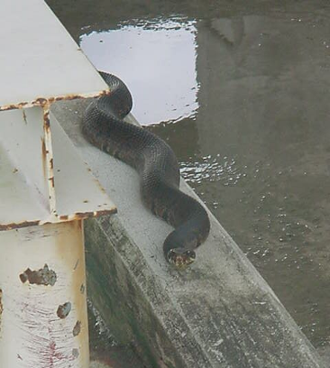
Hazard: Snakes and other reptiles
Be on the alert for snakes that may be hiding in unusual places after flooding
Wear snake chaps
If you are bitten, seek immediate medical attention
Notes:
TRAINER NOTES:

Slide 75
Cottonmouth
Cottonmouth snakes are often found in or near swamps, ditches, rivers, streams, and lakes
An identifying stripe along the side of the head; even in dark-colored individuals, this stripe is usually visible
Avoid this snake! It may prefer to flee rather than strike, but its bite is more toxic than a copperhead snake’s bite and can be fatal

Slide 76
Copperhead
Favorite hiding places include stone walls, sawdust, mulch or compost piles, and under decaying stumps, in wood piles, under abandoned building debris, and under large flat stones
Although venomous, these snakes are generally not aggressive and bites are rarely fatal.

Slide 77
Rattlesnakes
The Eastern Diamondback Rattlesnake is considered by some people the most dangerous snake found in the southeastern U.S Fortunately these snakes are unlikely to strike at a person unless provoked.

Slide 78
Alligators
Strongly associated with wetlands
Primarily freshwater but may be found in brackish water as well
• Do not intentionally feed an alligator no matter what its size.

Slide 79
Alligators
• Do not throw food into waters where alligators may be found.
• Don’t allow canine assets to swim, exercise or drink in or near waters that may contain alligators.
• Be particularly mindful between dusk and dawn when alligators are most active.
• Do not harass or provoke any alligator.

Slide 80
Hazard: Poisonous Plants
Train workers on hazardous plant recognition
Use gloves and wear long pants and long-sleeved shirts when possibility of contacting poisonous plants
Clothes, shoes, and tools may become contaminated by coming in contact with poisonous plants.
summer
spring
where it grows
it’s a bush
it creeps
it climbs
at the beach
fall
Notes:
TRAINER NOTES:

Slide 81
Hazard: Traumatic Stress
Pace yourself and take frequent rest breaks.
Watch out for each other. Co-workers may not notice a hazard nearby or behind.
Be conscious of those around you. Responders who are exhausted, feeling stressed, or even temporarily distracted may place themselves and others at risk.
Maintain as normal a schedule as possible: regular eating and sleeping are crucial.
Make sure that you drink plenty of fluids such as water and juices.
Try to eat a variety of foods and increase your intake of complex carbohydrates (for example, breads and muffins made with whole grains, granola bars).
Whenever possible, take breaks away from the work area. Eat and drink in the cleanest area available.

Slide 82
Traumatic Stress (continued)
Recognize and accept what you cannot change—the chain of command, organizational structure, waiting, equipment failures, etc.
Talk to people when YOU feel like it. You decide when you want to discuss your experience. Talking about an event may be reliving it. Choose your own comfort level.
If your employer provides you with formal mental health support, use it!
Give yourself permission to feel rotten: You are in a difficult situation.
Recurring thoughts, dreams, or flashbacks are normal—do not try to fight them. They will decrease over time.
Communicate with your loved ones at home as frequently as possible.

Slide 83
Traumatic Stress (continued)
What you can do at home
Reach out—people really do care
Reconnect with family, spiritual, and community supports
Consider keeping a journal
Do not make any big life decisions
Make as many daily decisions as possible to give yourself a feeling of control over your life
Spend time with others or alone doing the things you enjoy to refresh and recharge yourself
Be aware that you may feel particularly fearful for your family. This is normal and will pass in time
Remember that "getting back to normal" takes time. Gradually work back into your routine. Let others carry more weight for a while at home and at work.

Slide 84
Traumatic Stress (continued)
What you can do at home
Be aware that recovery is not a straight path but a matter of two steps forward and one back. You will make progress.
Appreciate a sense of humor in yourself and others. It is OK to laugh again.
Your family will experience the disaster along with you. You need to support each other. This is a time for patience, understanding, and communication.
Avoid overuse of drugs or alcohol. You do not need to complicate your situation with a substance abuse problem.
Get plenty of rest and normal exercise. Eat well balanced, regular meals.

Slide 85
Other Protective Measures
Key items to have:
Insect repellent with Deet or Picaridin
PPE – For information on what equipment you need for protection, contact your local OSHA office or NIOSH
Personal floatation device
Earplugs
Bottled water
Sun screen
Rain Gear
Pocket Knife (put in your checked luggage)
Notes:
TRAINER NOTES:

Slide 86
Additional Information
This training program is based on recommendations from FEMA, NIEHS, NIOSH, OSHA, CDC and the USACE
You can find a link to their fact sheets and other important information at the National Clearinghouse for Worker Safety and Health Training website, http://tools.niehs.nih.gov/wetp/.
Notes:
TRAINER NOTES:

Slide 87
Summary
The hazards and issues are dynamic and require vigilance and flexibility
The key to a safe response is attention to the safety issues of your work environment
The physical hazards are similar to any construction or demolition site
The health hazards include the hazards associated with the environment
Notes:
TRAINER NOTES:

