Slide 1
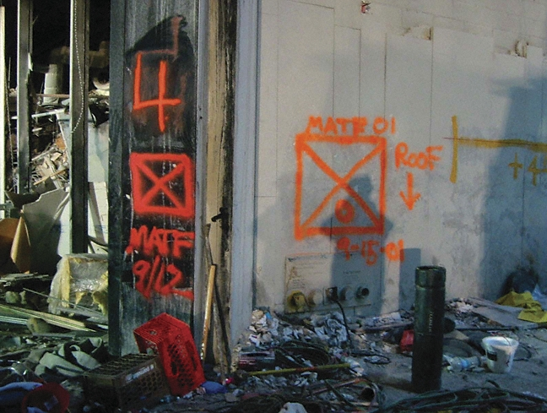
FEMA Marking Systems
Notes:
FEMA uses a uniform marking system , originally developed by its Urban Search and Rescue Program

Slide 2
General Background
Historically, inconsistent markings made it difficult to tell if affected structures had been assessed and /or searched for victims
Multiple searches were conducted due to lacking or inaccurate search information
Search operations became redundant, creating a strain on limited response resources

Slide 3
Background
The FEMA marking system facilitates a uniform assessment , search and marking process, which ultimately leads to more efficient use of response resources
Having the ability to utilize this system improves responder hazard recognition, and therefore improves responder safety

Slide 4
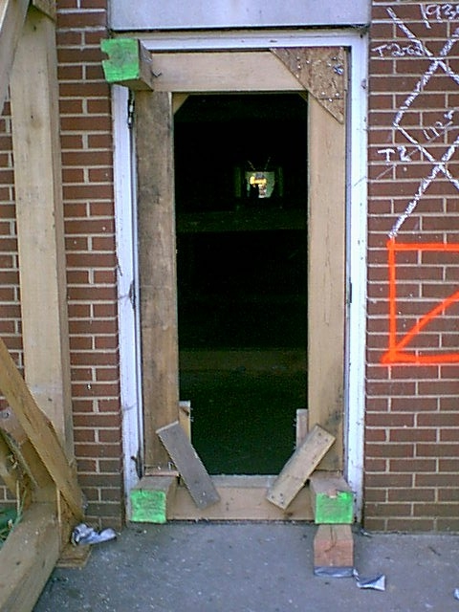
Marking Types
Boundary Marks
Building Marks
Search Markings
Victim Markings
Notes:
The FEMA system utilizes distinct categories of structural markings to provide specific categories of information
On the right side of the doorway, both structural assessment and search markings are visible

Slide 5
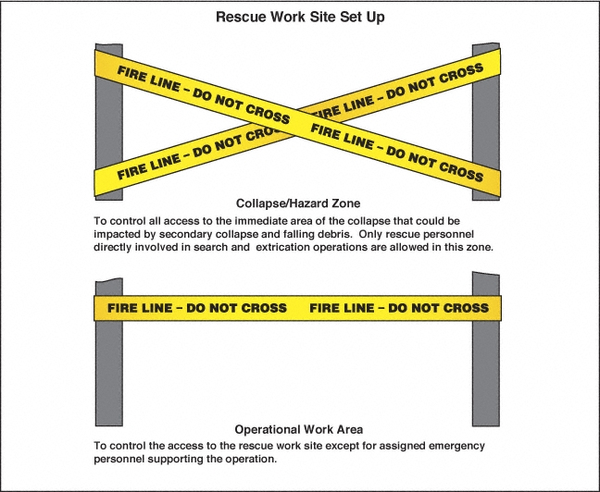
Boundary Markers
Collapse/Hazard Zones
Notes:
Boundary markers are just that. They define operational areas and hazard zones
Boundary marks can also be used to delineate access and egress routes
The markings should be placed in a manner that creates a physical and visual cue as to personnel are to be channeled into or restricted from operational areas

Slide 6
Boundary Markers:
Work Areas

Slide 7
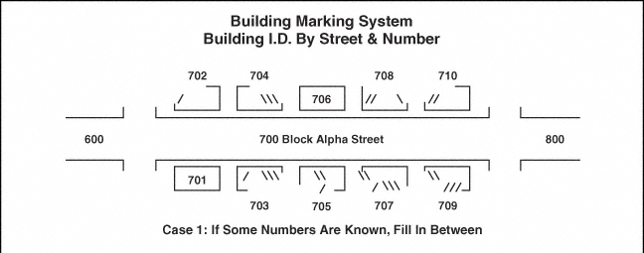
Address Marking Systems
Notes:
The FEMA USAR System, and most federal response entities use the US National Grid System to establish location reference points

Slide 8
Address Marking Systems
Notes:
Use low numbers to aid in simplicity whenever possible

Slide 9
Building Marking System
Orientation
Notes:
The marking system also addresses the sides and floor positions of structures
As you face on the street facing the building, that becomes Side A
To the left is Side B
The rear of the building is Side C
To the right is Side D
If more than four sides are present, simply add more numbers

Slide 10
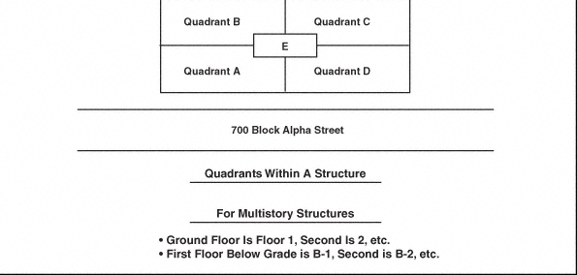
Building Marking System
Interior Orientation
Notes:
Ground level is Floor 1
Second Story is Floor 2 and so upwards
Basements and floors below ground level are designated with a “B”

Slide 11
Structural Assessment Markings

Slide 12
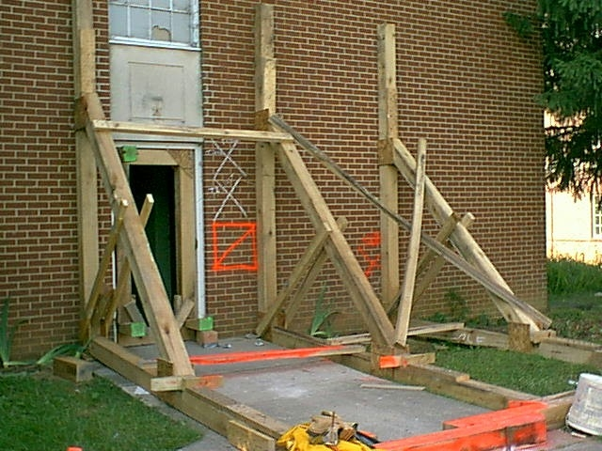
Structural Assessment Markings
Typically performed by engineers or designees
Easily seen from front or most accessible side of structure
NOT necessarily at front doors(s)
Arrows used for direction to entrance or safe havens

Slide 13

Structural Assessment Markings
Structure safe for entry
Debris without structural damage
Utilities likely not an issue
Additional collapse unlikely
High potential for survivors

Slide 14

Structural Assessment Markings
Has problems, may become structurally unsound
Some areas may require bracing/shoring
May fail in aftershocks
Complete required work and exit
Notes:
The structure is significantly damaged
Some areas may be safe but others may require structural shoring and bracing
Ongoing hazard monitoring required
This can include “pancaked” structures

Slide 15

Structural Assessment Markings
Structurally Unsound
Has structural failures and may collapse
Shoring will be required
Safe havens will have to be designated by engineers
Notes:
Structure unsafe without extensive shoring and bracing
Remote search operations may proceed but at significant risk

Slide 16

Structural Assessment
Additional Information
When checked
Who checked it
What was found
Arrows to entrance/safe havens
Notes:
An HM marking generally indicates the presence of hazardous condition within the structure
Operations in the building will generally not be allowed until the condition is better defined or eliminated

Slide 17
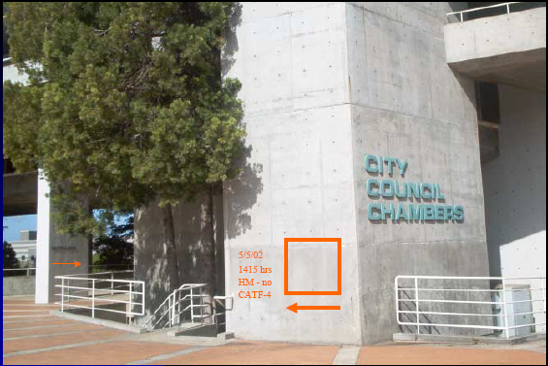
What Do You See ???
Notes:
The structure is safe for entry
Checked on May 5 of 2002
No hazardous materials
Checked by California Task Force 4

Slide 18
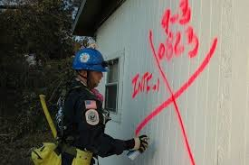
Search Markings

Slide 19

Straightforward, But Noncompliant Marking

Slide 20
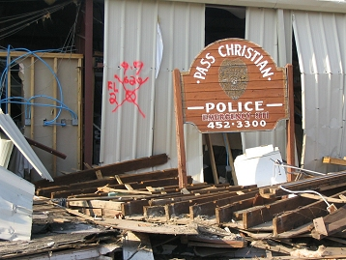
Search Markings
Often confused with structural assessment marks
Lets others know that structure has been searched and safely exited
Documents information and finds
Notes:
As with structures markings often made with spray paint or lumber crayon, although the use of preprinted tags and stickers are quickly gaining acceptance
The placard /decal approach is sometimes less confusing than successive paint markings as operations cross multiple operational periods

Slide 21
Search Marking Placard/Decal

Slide 22
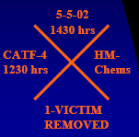
Main Entrance Markings
Reports on whole building
Start with single slash, ID, entry time and date
Balance of information recorded as team LEAVES the structure
Total of victims indicates victims left in the building…change number as they are removed
DO NOT place on doors or areas where doors swing to cover
Notes:
A large “slash” mark is made to indicate a search has been initiated
After the entire building is searched, an additional slash mark is added to form an “X”
Additional information is added to the other quadrants summarizing the search activity in the structure:
Left Quadrant: Search team identifier, date and time team entered structure
Top Quadrant: Date and time search team left the structure
Right Quadrant: Any significant hazards found during the search
Bottom Quadrant: Number of survivors or victims still inside the structure
“L”: Live
“D” Dead
Small “x” : no survivors or victims

Slide 23
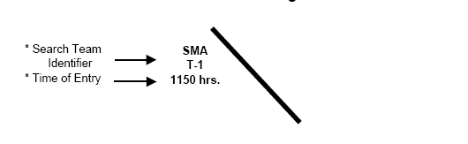
Main Entrance Markings:
Entry Marks

Slide 24
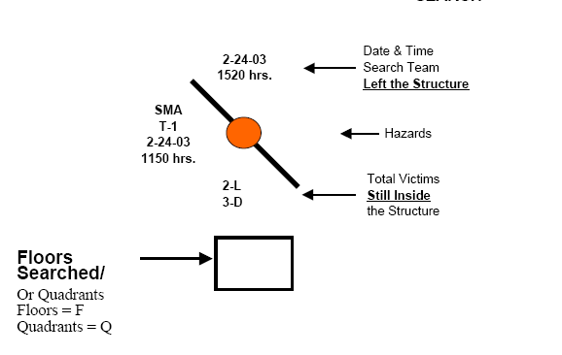
“Incomplete” Search Marking
Notes:
On multi-floor structures, an additional box is provided to indicate which floors/quadrants have been searched
The “dot” indicates an incomplete search

Slide 25
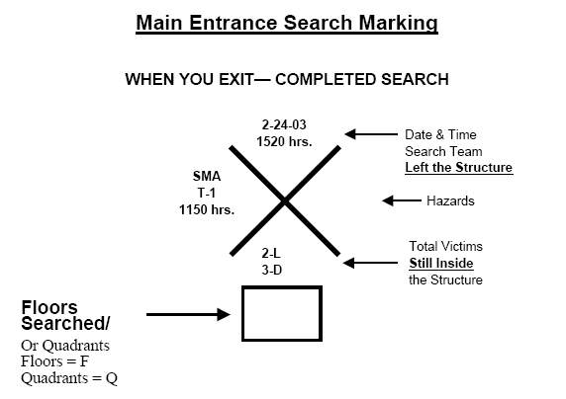
“Completed” Search Marking
Notes:
Note the mark has been “Xed” to indicate that search operations are completed

Slide 26
Interior Search Markings

Slide 27
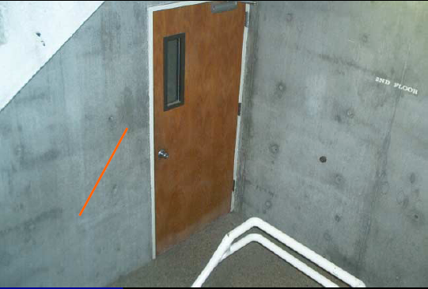
Interior Markings
Divides structure on floor by floor basis
Starts from where responders initially exit stairwells
Single slash at start
“X” out with second slash on completion
Notes:
As with exterior markings, placards or decals can be used to clarify activities and reduce additional damage to the structure

Slide 28
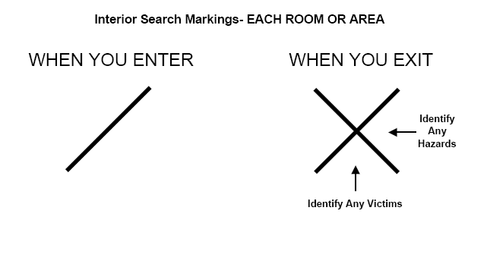
Interior Search Markings:
Each Room or Area

Slide 29
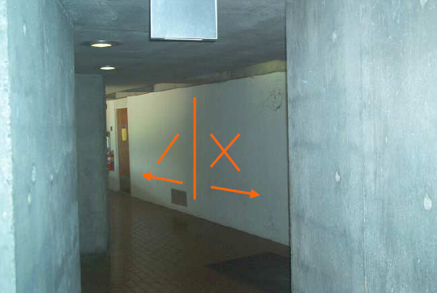
Floor Searches
Usually begin at center stairs
Use arrow marks to indicate direction of search
Mark each room as it is entered and exited
Notes:
It is very important that the search process used is consistent throughout the structure, especially is multiple teams are conducting search operations within the same building

Slide 30
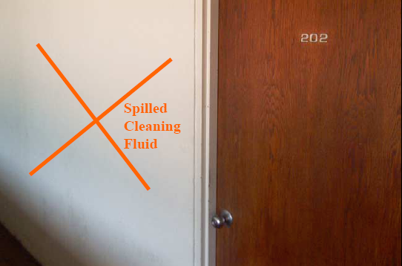
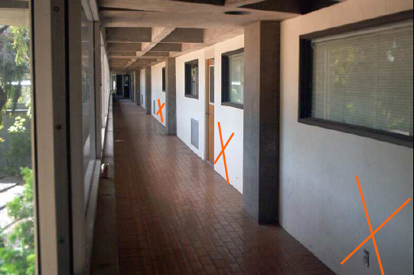
Floor Markings

Slide 31
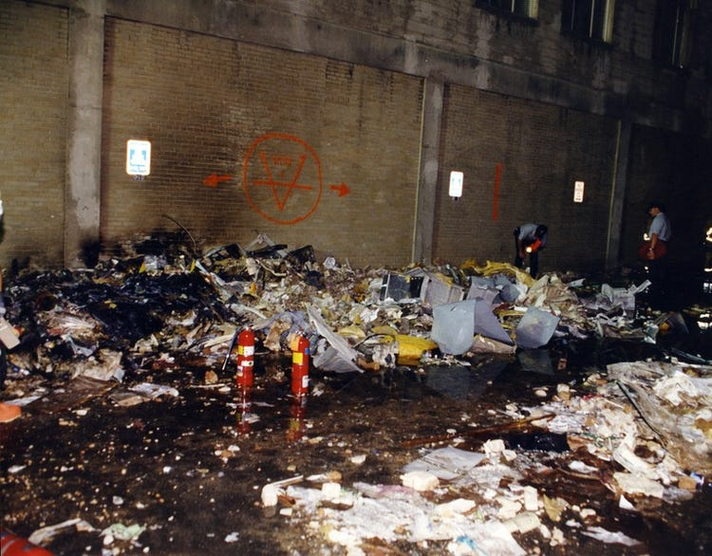
Victim Marking System

Slide 32
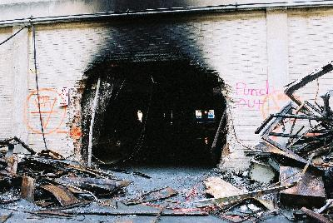
Victim Markings
Used to identify location of known or potential victims
Victims may be visible or covered with debris
Victim location marks are made whenever a known or possible victim is located and not immediately removed
Marks are made with either orange paint or orange crayon
Notes:
Mark a large “V” near the location of a potential survivor or victim
If needed, paint a directional arrow when the actual location is not immediately near where the “V” is placed

Slide 33

Potential Victim
Make large “V” near location of potential victim
Mark crew identifier in top part of the “V”

Slide 34

Confirmed Survivors
Paint a circle around the “V” when a victim is confirmed to be alive
Use visual, vocal, or acoustic methods
If more than one confirmed live victims, indicate the total number under the “V”

Slide 35

Deceased Victims
Paint a horizontal line through the “V” if the victim is confirmed to be deceased
If more than one fatality is present, mark the number of decedents under the “V”
Use both “live” and Dead” symbols to represent victims discovered in a given area

Slide 36

Victims Removed
Paint an “X” through the confirmed victim symbol after ALL victims have been removed from the marked location

Slide 37

Offset Arrow
Paint an arrow next to the “V” if needed to mark a victim location not immediately near the “V”
Show the distance above the arrow

Slide 38
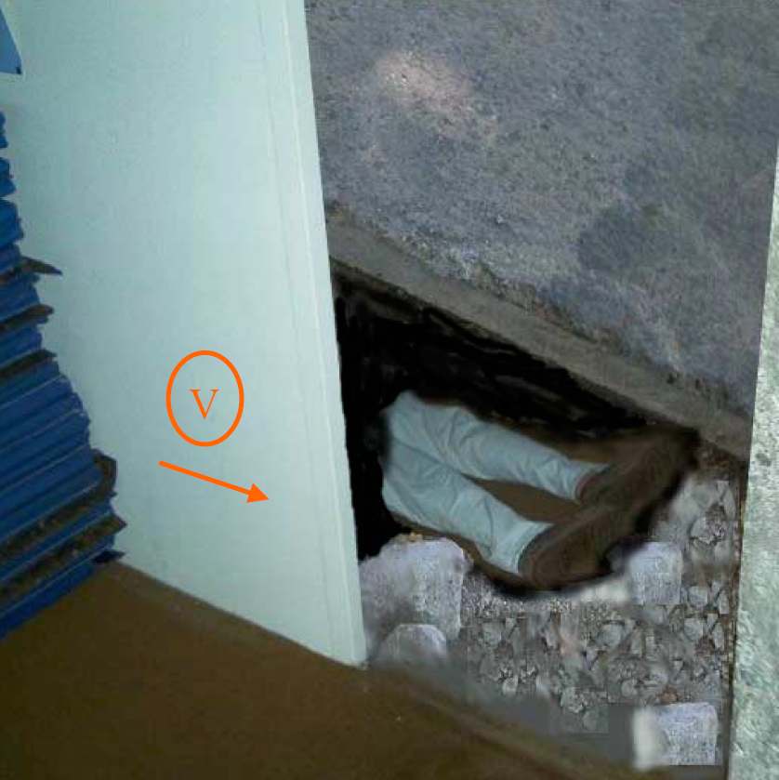
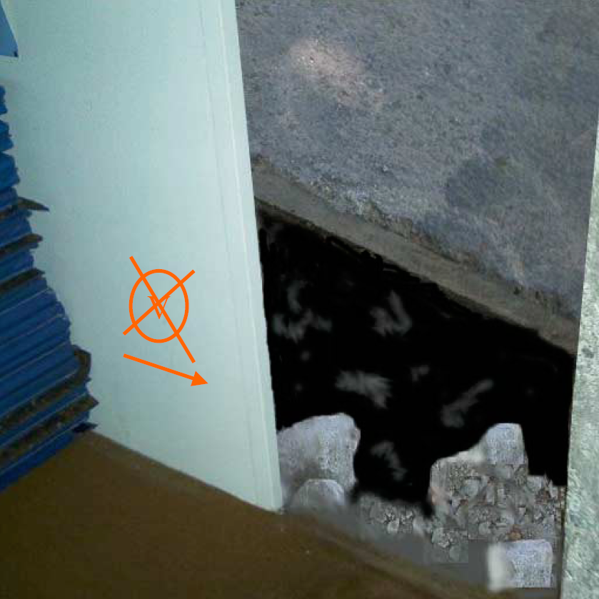
Examples

Slide 39
Group Exercises
Develop appropriate markings for scenarios presented to your group
Demonstrate/explain your markings in the materials provided

Slide 40
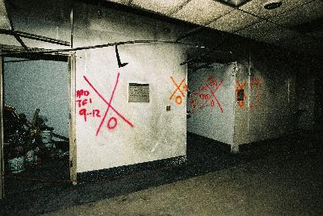
Questions ????

