Slide 1
Working Around Water: Dressing for the Dance

Slide 2
Water Incidents Are Going to Occur
Floods most destructive of natural catastrophes
•Kill more people than any other form of disaster
Expose public employees to hazards they are often not prepared for

Slide 3
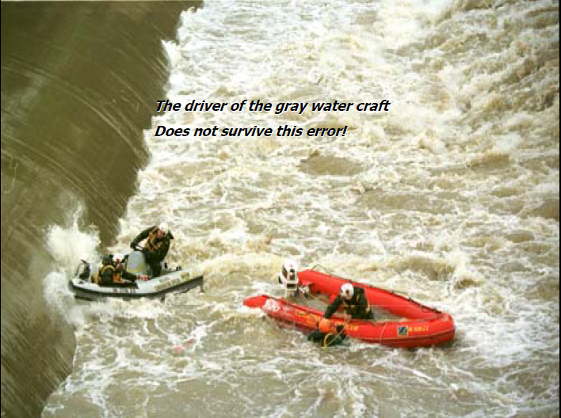
Common Characteristics Of Failed Operations (We Got Someone Hurt or Killed)
Good people
Good Intentions
Poor or no training
Wrong equipment
Failure to recognize hazards
Failure to evaluate risk versus benefit

Slide 4
The Desire to Help Can Get You Killed
“If you do not have the skills, If you do not have the equipment, If you do not have the knowledge, then you should not even be here”

Slide 5
Working Safely: Critical Elements
Awareness: To understand the dangers
Capability: Having the right mental and physical tools to do the job
Knowledge: Having a plan, knowing what to do and how to do it

Slide 6
The Basics: Head
Swift water type helmet (best option)
Low brim rescue helmet
Low Brim hard hat with chin strap
NO FIRE HELMETS

Slide 7
Flotation
Flotation Devices Are Rated by USCG:
Three Main Types:
Inherently buoyant—a foam vest that floats on its own. Offers buoyancy without the need for inflation
Inflatable—features chamber that is inflated by CO2 mechanism when buoyancy is needed
Manual and automatic options available.
Hybrid—features an inflatable chamber and buoyant foam material.

Slide 8
Type 1 PFD
Best for all waters, open ocean, rough seas, or remote water, where rescue may be slow coming. Abandon-ship lifejacket for commercial vessels and all vessels carrying passengers for hire:

Slide 9
Type II PFD
For general boating activities. Good for calm, inland waters, or where there is a good chance for fast rescue.
Inherently Buoyant Type II PFDs
Inflatable Type II PFDs
Hybrid Type II PFDs

Slide 10
Type III PFD
For general boating or the specialized activity that is marked on the device Good for calm, inland waters, or where there is a good chance for fast rescue.
Inherently Buoyant Type III PFDs
Inflatable Type III PFDs
Hybrid Type III PFDs

Slide 11
Type IV PFD
These are designed to be thrown to a person in the water.
Throw able devices include boat cushions, ring buoys, and horseshoe buoys. ]
They are not designed to be worn and must be supplemented by wearable PFD

Slide 12
Type V PFD
Only for special uses or conditions. See label for limits of use:
Hybrid Inflatable PFDs
Canoe/Kayak Vest
Deck Suits
Work Vests for Commercial Vessels
Commercial Whitewater Vests
Man-Overboard Rescue Devices
Law Enforcement Flotation Devices

Slide 13
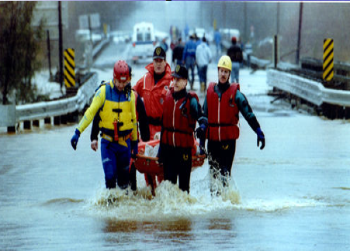
What Should We Use?
Type III as a minimum
Type V if high risk or rescue operation

Slide 14
Clothing
“Bank” work: Layered synthetics materials work best in cooler conditions
“Entry” work: wet/dry suits as appropriate.
Dry suits are better choice for contaminated/polluted environments
Dry suits require specific safety training

Slide 15
NO FIREFIGHTER TURNOUTS IN AREAS WITH MOVING WATER!!!

Slide 16
Footwear
NO RUBBER TURNOUT BOOTS !!!
Lace up hard sole boots are adequate
Special water operations boots are available (for a price!)

Slide 17
Gloves
Neoprene or work-specific gloves superior to cloth or leather
If chemical contamination is present, “Silvershield” or other over-glove may be used

Slide 18
Knife
If you are working around moving water, you should carry a good knife
Single edge
Heavy blade
Blunt tip if possible
“Folders” ok

Slide 19
Visibility Enhancement
Reflective striping on vests, helmets
Waterproof strobes for persons entering water at night

Slide 20
Closing Comments
We must have the right PPE for the tasks at hand
“Improvisation” in this environment can lead to disasters

Slide 21
Questions?

