Slide 1


Opioids and Work
Notes:
Content and websites up-to-date as of: 10/27/2023

Slide 2

Acknowledgement
Developed by the Midwest Consortium for Hazardous Waste Worker Training under cooperative agreement U45 ES06184 from the National Institute of Environmental Health Sciences, this program uses content from the ʹNational Institute of Environmental Health Sciences – Opioids and the Workplace Training Toolʹ.
Notes:
https://tools.niehs.nih.gov/wetp/index.cfm?id=2587

Slide 3
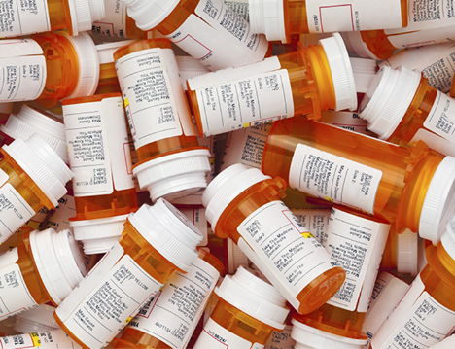
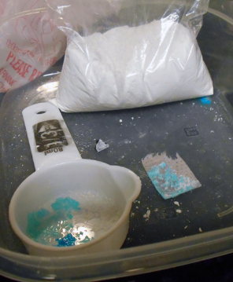
Opioid Basics

Slide 4

Objectives
When complete, you should better be able to:
Describe opioid characteristics, opioid use disorder, and the opioid epidemic
Identify opioid misuse prevention and recovery strategies

Slide 5
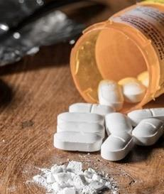
What Is an Opioid?
  A class of drugs used to reduce pain.
  Prescription opioids are used to treat moderate to severe pain but have serious risks and side effects.
  Examples: oxycodone, hydrocodone, morphine, methadone, tramadol, and fentanyl.
  Illegal opioids: heroin, illegally produced fentanyl, and other synthetic opioids.
Notes:
Instructor notes:
Source: CDC (Centers for Disease Control and Prevention). Opioid Overdose: Prescription Opioids. Available: https://www.cdc.gov/drugoverdose/opioids/prescribed.html.
Photo: U.S. Department of Veterans Affairs

Slide 6
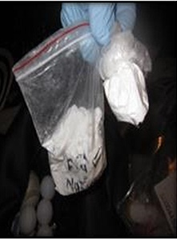
What Is Fentanyl?
  A powerful synthetic opioid, similar to morphine and heroin.
  50 to 100 times more potent than morphine.
  A rapid-acting synthetic opioid that alleviates pain.
  Acts quickly to depress central nervous system and respiratory function.
  Exposure may be fatal.
Notes:
Instructor notes:
Source: CDC (Centers for Disease Control and Prevention). Opioid Overdose: Fentanyl. Available: https://www.cdc.gov/drugoverdose/opioids/fentanyl.html.
Photo: U.S. Drug Enforcement Administration
The photo shows seized illicit powered fentanyl.

Slide 7
How Much Fentanyl Is Fatal?
2-3 milligrams of fentanyl can induce respiratory depression, arrest, and death.
Comparable to 5-7 grains of salt!
Notes:
Instructor notes:
Source and photo: DEA (U.S. Drug Enforcement Administration). 2016. Carfentanil: A Dangerous New Factor in the U.S. Opioid Crisis. Available: https://www.dea.gov/sites/default/files/divisions/hq/2016/hq092216_attach.pdf.

Slide 8
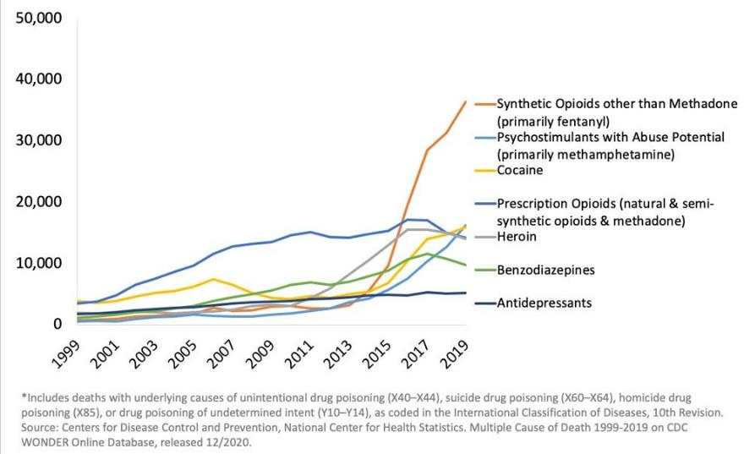
Waves of the Rise in Opioid Overdose Death
National Drug-Involved Overdose Deaths* Number Among All Ages, 1999-2019
Notes:
Instructor notes:

Slide 9

NSC’s video: Opioids & the Brain
Notes:
Instructor notes:
The video was developed by the National Safety Council (NSC) and is entitled, Opioids & the Brain. It is 2 minutes and 36 seconds long, and features Dr. Natalie Kirilichin of the NSC Physician Speakers Bureau.
The video is embedded in slide. Note: you will need an internet connection and sound source to show the video. The Youtube URL for the video is: https://youtu.be/baCPgy6YLs4. If you know that you will not have internet access you can make your PPT presentation self-contained uploading the video and then save the PPT as a packaged PowerPoint presentation and not a full PowerPoint file by clicking File > Save As > PowerPoint Show. Be sure to test the file to make sure it works properly.

Slide 10



The American Medical Association, the American Society of Addiction Medicine, as well as most medical associations and the CDC define substance use disorder as a disease, like diabetes, cancer, and heart disease.
Notes:
Instructor notes:
Sources:
National Institute on Drug Abuse. Drugs, Brains, and Behavior: The Science of Addiction. Preface. Available: https://www.drugabuse.gov/publications/drugs-brains-behavior-science-addiction/preface.
The National Center on Addiction and Substance Abuse. 2012. Addiction Medicine: Closing the Gap between Science and Practice. Available: https://www.centeronaddiction.org/addiction-research/reports/addiction-medicine-closing-gap-between-science-and-practice.

Slide 11
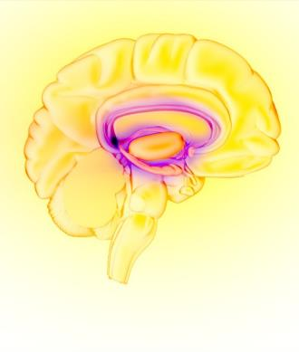
Substance Use Disorder Is a Disease
Opioid misuse is not a moral failing or caused by lack of willpower.
It causes changes in the brain that lead to drug-seeking behavior and avoidance of withdrawal.
The drug changes the brain in ways that make quitting hard, even for those who want to.
Quitting takes more than good intentions or good will.
Notes:
Instructor notes:

Slide 12
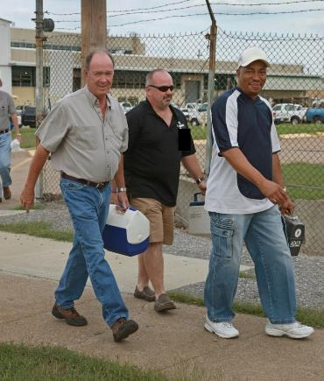
Who is Affected?
70% of those with substance use disorder are working
Men are more likely to misuse opioids
The peak for opioid use disorder treatment is age 20-35
The peak for opioid overdose deaths is age 40-50
Notes:
Instructor notes:
Sources:
Substance Abuse and Mental Health Services Administration. 2014. Results from the 2013 National Survey on Drug Use and Health: Summary of National Findings, NSDUH Series H-48, HHS Publication No. (SMA) 14-4863. Rockville, MD: Substance Abuse and Mental Health Services Administration.
Dydyk AM, Jain NK, Gupta M. Opioid Use Disorder. In: StatPearls. Treasure Island (FL): StatPearls Publishing; 2021.
Photo: Earl Dotter

Slide 13

What Is the Impact of Substance Use Disorder?
  Mental and physical stress
  Financial ruin
  Divorce
  Loss of child custody
  Job loss
  Prison
  Death
Notes:
Instructor notes:
Photo: U.S. Department of Veterans Affairs

Slide 14

Physical Warning Signs of Addiction
Change in physical appearance
Small pupils
Decreased respiratory rate
Nonresponsiveness
Drowsy
Loss or increase in appetite
Weight loss or weight gain
Intense flu-like symptoms (nausea; vomiting; sweating; shaky hands, feet, or head; large pupils)
Wearing long sleeves or hiding arms
Notes:
Instructor notes:
Source: New York State Office of Alcoholism and Substance Abuse Services. Recognizing the Signs of Addiction. Available: https://combataddiction.ny.gov/warning-signs.

Slide 15
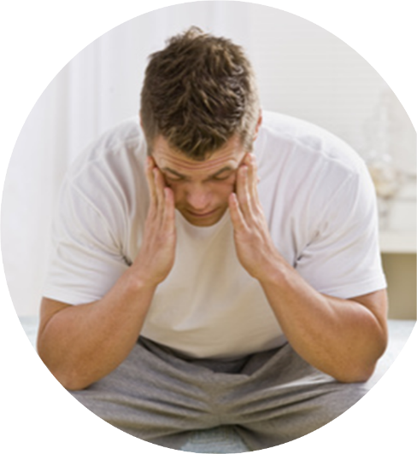
Behavioral Warning Signs
Change in attitude and/or personality
Tendency to avoid contact
with family and/or friends
Change in friends, hobbies,
activities and/or sports
Drops in grades or performance at work
Isolation and secretive behavior
Moodiness, irritability, nervousness, giddiness
Tendency to steal
Notes:
Instructor notes:
Source: New York State Office of Alcoholism and Substance Abuse Services. Recognizing the Signs of Addiction. Available: https://combataddiction.ny.gov/warning-signs.
Photo: U.S. Department of Veterans Affairs

Slide 16
Overdose - Signs and Symptoms
The presence of a triad of symptoms is strongly suggestive of opioid poisoning:
Coma
Pinpoint pupils
Respiratory depression
Overdose may result in:
  Stupor
  Pinpoint pupils that later may become dilated
  Cold and clammy skin
  Cyanosis: blue or purplish discoloration due to low oxygen
  Coma
  Respiratory failure leading to death
Notes:
Instructor notes:
Source: National Institute on Drug Abuse. Fentanyl. Available: https://www.drugabuse.gov/publications/drugfacts/fentanyl.

Slide 17
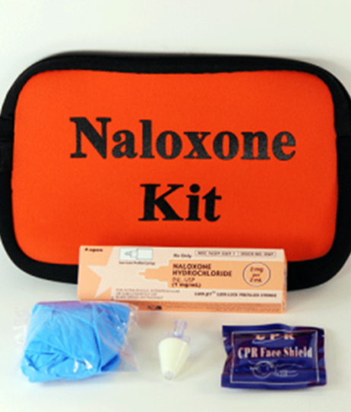
Post-exposure Treatment
  Naloxone (Narcan) displaces the opioid from the receptors in the brain.
  Can rapidly reverse respiratory depression in a patient with an opioid-associated emergency.
  Naloxone doesn’t work with drugs other than opioids.
  Naloxone is safe and effective. It is not a controlled substance and has no abuse potential.
Notes:
Instructor notes:
Photo: Donna S. Heidel, CIH, FAIHA

Slide 18
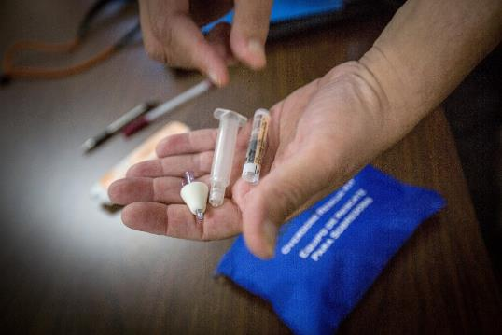
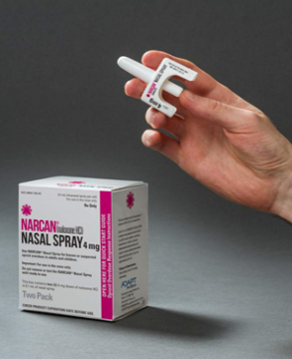
Naloxone (Narcan)
Multiple doses are sometimes required. If the person does not wake up in five minutes, a second dose should be administered.
It is available as a nasal spray and as an injectable.
The spray is packaged containing two doses to allow for repeat dosing if needed.
Notes:
Instructor notes:
Photos: Donna S. Heidel, CIH, FAIHA

Slide 19
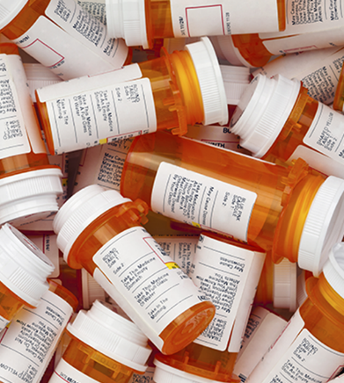
Opioid misuse prevention
Improve Opioid Prescribing
Prevent Opioid Use Disorder
Treat Opioid Use Disorder
Notes:
Source:
https://www.cdc.gov/opioids/overdoseprevention/index.html

Slide 20
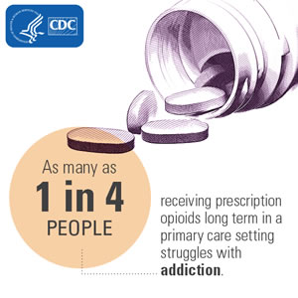
Opioid Prescribing - Scope of the Problem
Notes:
Instructor notes:
Sources:
CDC (Centers for Disease Control and Prevention). Opioid Overdose: Understanding the Epidemic. Available: https://www.cdc.gov/drugoverdose/epidemic/index.html.
CDC (Centers for Disease Control and Prevention). Opioid Overdose: Prescription Opioids. Available: https://www.cdc.gov/drugoverdose/opioids/prescribed.html.

Slide 21
Opioid Prescribing - Talk to Doctors about…
  Opioid avoidance - Discuss alternative pain treatment methods such as acetaminophen, ibuprofen, ice, physical therapy, chiropractic care, etc.
  Dosage and duration
    Discuss limiting opioid prescriptions for short-term use (3-7 days).
    Don’t start with long-acting opiates and use the lowest possible dose.
  Expectations - 100% pain-free may not be realistic.
  Risks - If a prescription is given, make sure you know the risks
Notes:
Instructor notes:

Slide 22
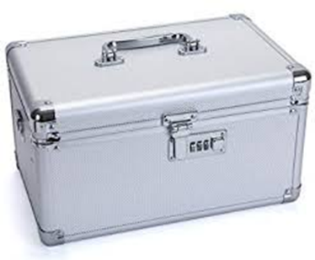
Prevent Opioid Use Disorder
Those who misuse pain relievers get their prescriptions from:
  53.1% - Given by, bought from, or took from a friend or relative
  36.1% - Prescription from doctor
  5.7% - Bought from drug dealer, or stranger
Store Medications in a Safe Place
Dispose of Unused Amounts
Do Not Share Prescriptions!
Notes:
Instructor notes:
Source: Substance Abuse and Mental Health Services Administration. 2018. Key Substance Use and Mental Health Indicators in the United States: Results from the 2017 National Survey on Drug Use and Health (HHS Publication No. SMA 18-5068, NSDUH Series H-53). Rockville, MD: Center for Behavioral Health Statistics and Quality, Substance Abuse and Mental Health Services Administration. Available: https://www.samhsa.gov/data/nsduh/reports-detailed-tables-2017-NSDUH.

Slide 23
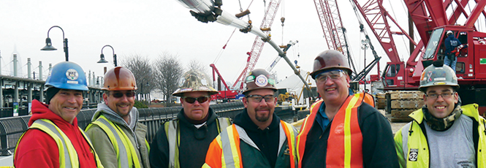
Prevent Opioid Use Disorder
Employee and Peer Assistance Programs
  EAPs offer counseling, education, referrals
  Peer counselors are trained to support co-workers
Notes:
Photo: IUOE International

Slide 24

Treatment – Recovery is Possible
Support
  Family
  Community
  Peers
  Recovery Coach
  Mutual aid groups
Medication-Assisted Treatment (MAT)
Notes:
Source:
https://www.cdc.gov/rxawareness/treatment/index.html

Slide 25

Treatment - Access
  Only 10% of people with opioid use disorder get into treatment
  Key barriers include stigma, lack of availability, and cost
Notes:
Instructor notes:
Sources:
Bondurant S, Lindo JM, Swensen ID. 2018. Access to substance abuse treatment, drug overdose deaths, and crime. Econofact, 16 March. Available: https://econofact.org/access-to-substance-abuse-treatment-drug-overdose-deaths-and-crime.
The President’s Commission On Combating Drug Addiction And The Opioid Crisis Final Report. 2017. Available: https://trumpwhitehouse.archives.gov/sites/whitehouse.gov/files/images/Final_Report_Draft_11-15-2017.pdf.

Slide 26
Treatment - What Is Stigma and How Does It Affect People?
  Stigma is the shame or disgrace attached to something regarded as socially unacceptable.
  Language matters, such as calling people "junkies" or "addicts".
  Stigma interferes with people coming forward for help.
  The key to recovery is support and compassion. People who are in pain and have a substance use disorder need comprehensive treatment, not judgment.
Notes:
Instructor notes:

Slide 27
Summary
Opioid misuse and overdose deaths continue to rise
Opioid use disorder is a disease
Opioid use disorder has serious consequences
Opioid use disorder can be prevented
Opioid use disorder can be treated

Slide 28
Resources
  Free and confidential drug hotline: https://addictionresource.com/
  Labor Assistance Professionals (LAP): https://www.laborassistanceprofessionals.com/
  NAADAC, the Association of Addiction Professionals: https://www.naadac.org/
  NIEHS Worker Training Program, Prevention of Occupational Exposure to Fentanyl and Other Opioids: https://tools.niehs.nih.gov/wetp/public/hasl_get_blob.cfm?ID=11206
  NIOSH Opioids in the Workplace webpage: https://www.cdc.gov/niosh/topics/opioids/default.html
  Opioids and Worker Health, Interview with CPWR’s Chris Trahan Cain: https://www.niehs.nih.gov/research/supported/translational/peph/podcasts/2019/jan24_opioids/index.cfm
  SAMHSA Behavioral Health Finder: https://findtreatment.samhsa.gov/
  Start Your Recovery: https://startyourrecovery.org/
Notes:
Instructor notes:

Slide 29
Workplace Injuries and Opioids (Topic 1)
Objectives
When complete, you should better be able to:
Describe the relationship between workplace injuries and opioid misuse
Identify workplace opioid prevention strategies

Slide 30
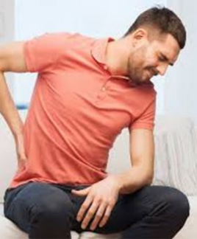
Is Occupational Injury and Pain a Pathway to Opioid Use, Misuse, Addiction?
  2.8 million work injuries and illnesses in 2017
  How many opioid deaths began as treatment for these work injuries?
Notes:
Instructor notes:
Source: U.S. Department of Labor, Bureau of Labor Statistics. 2018. Employer-Reported Workplace Injuries and Illnesses – 2017. News Release. USDOL 18-1788. Available: https://www.bls.gov/news.release/pdf/osh.pdf.

Slide 31
Opioid-related Overdose Deaths by Occupation
A large study by Massachusetts Department of Public Health found:
Opioid overdose deaths were significantly higher in industries with high rates of work-related injuries and illnesses
  (Examples: Construction, Material Moving, Installation, Maintenance, Production)
Opioid overdose deaths were significantly higher in jobs without paid sick leave
Notes:
Instructor notes:
Source: Massachusetts Department of Public Health, Occupational Health Surveillance Program. 2018. Opioid-related Overdose Deaths in Massachusetts by Industry and Occupation, 2011-2015. Boston, MA: Massachusetts Department of Public Health. Available: https://www.mass.gov/doc/opioid-related-overdose-deaths-in-massachusetts-by-industry-and-occupation-2011-2015/download

Slide 32
Massachusetts Study – Summary
Need interventions in high injury rate occupations to prevent opioid-related overdose deaths
  Interventions should address:
  Prevention of workplace injuries for which opioids are prescribed
  Safer alternatives for pain management following injury
  Access to treatment for opioid use disorder
  Overdose prevention programs
Notes:
Instructor notes:
Source: Massachusetts Department of Public Health. 2021. Opioid-related Overdose Deaths in Massachusetts by Industry and Occupation, 2016-2017. Boston, MA: Massachusetts Department of Public Health. Available: https://www.mass.gov/doc/opioid-related-overdose-deaths-by-industry-and-occupation-2016-2017-0/download

Slide 33
Opportunities for prevention
Workplace Prevention
Before pain, injury and opioid use | Post injury | Post substance use disorder
Prevent pain & injuries | Access to injury treatment | Access to SUD treatment & recovery support
Safety & Health Programs | Paid sick leave | EAP/Peer support programs
Increase opioid awareness | Return to work accommodations | Naloxone/training in the workplace
Notes:
Instructor notes:
Source – Adapted from: Letitia Davis, Massachusetts Department of Public Health, PowerPoint presentation presented at the NIEHS Worker Training Program Fall 2018 Technical Workshop, 24 October 2018.

Slide 34
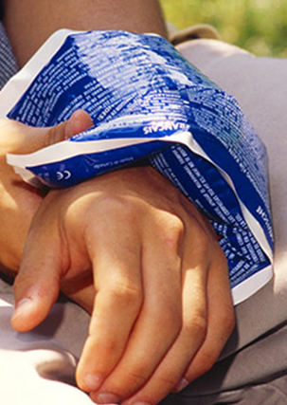
Opioid Prevention - Workplace injuries
BEFORE INJURY - Identify and control job hazards to prevent injuries which may expose workers to opioids during treatment for pain.
AFTER INJURY - Provide access to alternative pain treatment, assistance with workers’ compensation, paid sick leave, and return to work accommodations.

Slide 35

Musculoskeletal Injuries
Musculoskeletal includes your muscles, nerves, ligaments and tendons
Injuries caused by lifting, bending, reaching, pushing, pulling, moving heavy loads, working in awkward body postures, and performing repetitive tasks
Examples: Low back injuries, muscle strains, tendinitis, shoulder rotator cuff, carpal tunnel syndrome, trigger finger
Notes:
Instructor notes
Photos and source: NIOSH (The National Institute for Occupational Safety and Health). Ergonomics and Musculoskeletal Disorders. Available: https://www.cdc.gov/niosh/topics/ergonomics/default.html.

Slide 36
Musculoskeletal Injuries (continued)
Among the most frequent reported causes of lost work time
High risk occupations include Emergency Responders and Manufacturing & Construction jobs
Associated with widespread use of prescription pain medication
Can often be prevented through ergonomics – creating better workplaces. This may involve tools, workstations, and tasks designed to reduce musculoskeletal injuries.
Notes:
Instructor notes
Photos and source: NIOSH (The National Institute for Occupational Safety and Health). Ergonomics and Musculoskeletal Disorders. Available: https://www.cdc.gov/niosh/topics/ergonomics/default.html.

Slide 37
Gaps Leading to Stress, Injury, Illness, and Pain
Outdated or no OSHA standards:
Ergonomics
Outdated chemical standards
Slips, trips, and falls
Minimum staffing
Workplace violence prevention
Indoor air quality
Hazardous drugs in health care
Psychological health at work
Other potential gaps:
Lack of management commitment/worker involvement
Safety culture/safety climate
Inadequate hazardous assessment and control
Occupational stress and bullying
Lack support systems: sick leave, employee assistance programs, family leave
Notes:
Instructor notes:

Slide 38
Safety and Health Programs in Your Workplace
Consider the strengths and weaknesses of existing prevention programs and ideas for improvement.
Are current programs for identifying and controlling hazards effective? What are the gaps?
Are current systems for reporting and investigating incidents effective? What are the gaps?
Are current committees and procedures for managing the safety and health program effective? What are the gaps?
Notes:
Instructor notes:

Slide 39
Small Group Activity (Topic 1)
Prevention of injuries that can lead to pain treatment or substance use
Time for activity: 10-15 minutes
Objective: Document opportunities to identify and control workplace hazards
Task: Choose one or more workplace hazards and brainstorm ideas on how the problems could be evaluated, documented, and prevented
Notes:
Instructor notes:

Slide 40
Workplace Opioid Prevention Policies and Support Programs (Topic 2)
Objective
When complete, you should better be able to:
Describe workplace opioid misuse prevention policies and support programs

Slide 41
Opportunities for prevention
Workplace Prevention
Before pain, injury and opioid use | Post injury | Post substance use disorder
Prevent pain & injuries | Access to injury treatment | Access to SUD treatment & recovery support
Safety & Health Program | Paid sick leave | EAP/Peer support programs
Increase opioid awareness | Return to work accommodations | Naloxone/training in the workplace
Notes:
Instructor notes:
Source – Adapted from: Letitia Davis, Massachusetts Department of Public Health, PowerPoint presentation presented at the NIEHS Worker Training Program Fall 2018 Technical Workshop, 24 October 2018.

Slide 42
National Safety Council Survey of Employers’ Substance Use Programs:
76% do not offer training
81% lack a workplace policy
41% who drug test don’t test for synthetic opioids
Many lack sufficient insurance coverage for substance use and mental health treatment
Notes:
Instructor notes:
Source: Hersman D. 2017. How the Prescription Drug Crisis is Impacting American Employers. National Safety Council.

Slide 43

Drug-Free Workplace and Zero-Tolerance Policies
  1981 aircraft crash aboard USS Nimitz: 14 service members killed, 48 injured, costing $150 million. Half the flight crew were using illicit drugs.
  Military began treating substance use disorder as a discipline problem rather than an addiction problem.
  Developed punitive actions, court martial, and discharge for failed drug tests.
  "War on Drugs": punitive and prosecutorial action against drug users.
  Entire federal government and its contractors subject to Executive Order 12564 – Drug-Free Federal Workplace.
Notes:
Instructor notes:
Source: United States Department of Defense. Military Drug Program Historical Timeline. Available: http://prhome.defense.gov/Portals/52/Documents/RFM/Readiness/DDRP/docs/72208/DoD%20Drug%20Policy%20History.pdf.
Source: Reagan R. 1986. Executive Order 12564. Drug-free federal workplace. Fed Reg 51:32889. Available: https://www.archives.gov/federal-register/codification/executive-order/12564.html.

Slide 44
What’s the Impact of Punitive Policies?
A high-performing employee with 20 years of seniority has a back injury, is prescribed opioids for pain, and subsequently develops an opioid use disorder.
  How might this employee react to a drug-free workplace policy?
  Will he come forward to speak to his supervisor or HR or the union rep?
  How do the terms “zero-tolerance” and “will lead to discipline or termination” impact employees struggling with substance use disorder coming forward for help?
Notes:
Instructor notes:

Slide 45
Supportive Policies
  Proactive rather than reactive
  Understand jobs are a lifeline, providing a paycheck, daily structure, a sense of purpose and identity, stability, and social support
  Create an environment where it is safe to talk about mental health and substance use
  Ensure confidentiality
  Establish return-to-work policies
  Work with workplace stakeholders to revise policies and programs
Old way
New way
Notes:
Instructor notes:
Source: Connecticut Department of Public Health. 2018. The Opioid Crisis and Connecticut’s Workforce: Updating Your Approach to Employees Suffering from Addiction Can Preserve Your Greatest Resource. Available: https://portal.ct.gov/-/media/Departments-and-Agencies/DPH/dph/environmental_health/occupationalhealth/Opioid-conference-writeup_FINAL-FINAL_11_28_18-(2).pdf?la=en.

Slide 46
Supportive Drug-Free Policy
Written policy with union and employee involvement
Training of supervisors, managers, union reps, and employees
Access to treatment for addiction, facilitated by the workplace or union
Leave of absence for detoxification and treatment
Leave for medical appointments and recovery meetings
Alternate duty assignments
Reassignments to nonhazardous work
Source: Connecticut Department of Public Health
Notes:
Instructor notes:
Source: Connecticut Department of Public Health. 2018. The Opioid Crisis and Connecticut’s Workforce: Updating Your Approach to Employees Suffering from Addiction Can Preserve Your Greatest Resource. Available: https://portal.ct.gov/-/media/Departments-and-Agencies/DPH/dph/environmental_health/occupationalhealth/Opioid-conference-writeup_FINAL-FINAL_11_28_18-(2).pdf?la=en.

Slide 47
Treatment/Recovery Support for Workers
Alternative-to-discipline (ATD) programs help workers recover from addiction and return to work without losing their jobs.
The worker enters a substance use treatment program.
An individual sobriety and recovery program is established.
Return-to-work agreements involve drug testing and participation in recovery programs. In health care and law enforcement, no access to narcotics.
Continued treatment and monitoring for periods of 2 to 5 years.
These programs have been successful by providing a nonpunitive pathway for workers to obtain treatment and keep their employment.
Notes:
Instructor notes:
Sources:
Monroe TB, Kenaga H, Dietrich MS, Carter MA, Cowan RL. 2013. The prevalence of employed nurses identified or enrolled in substance use monitoring programs. Nurs Res 62(1):10-15; doi:10.1097/NNR.0b013e31826ba3ca.
NYSNA Statewide Peer Assistance for Nurses. 2017. Substance use among nurses and nursing students. “SPAN”ing New York State 14(2).

Slide 48
Recovery
“Is it finding work through recovery or finding recovery through work?” he asked. “I don’t think recovery would have been so successful if I hadn’t been working.”
Notes:
Instructor notes:

Slide 49

Employee Assistance Programs (EAPs)
  EAPs offer services such as:
  Counseling
  Education
  Assessments
  Referrals to treatment
  Do you have one in your workplace?
  Is it an external, internal, or blended service program?
  Do workers trust it and use it?
  What coverage is there for mental health and substance use services?
Notes:
Instructor notes:

Slide 50
Peer Assistance Programs
  Peer Counselors are trained volunteers who:
    help prevent substance use
    motivate co-workers to accept referral for treatment
    support co-workers when they return to work
  Peers helping each other to stay clean and sober
  Labor Assistance Professionals can help unions and employers mobilize peer counselors https://www.laborassistanceprofessionals.com

Slide 51
Small Group Activity (Topic 2)
Ideas to improve workplace substance use treatment and recovery programs
Time for activity: 10-15 minutes
Objective: Identify ideas to improve workplace substance use program
Task: Write down one or more ideas that will help improve workplace substance use treatment and recovery programs. Describe any relevant details (who, what, when, why, where).
Notes:
Instructor notes:

Slide 52
Substance Use & Mental Health (Topic 3)
Objectives
When complete, you should better be able to:
Describe the importance of positive mental health
Identify actions to improve your mental health

Slide 53
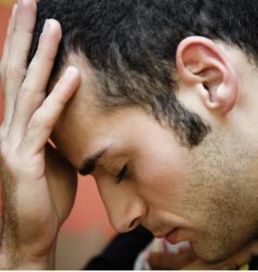
Substance Use Disorders & Mental Health
20.6% of U.S. adults experienced mental illness (such as anxiety or depression) in 2019
3.8% of U.S. adults experienced both mental illness and substance use disorder in 2019 (1 in every 25 people)
Mental health is important because those
with poor mental health are more likely to
develop substance use disorders
Notes:
https://www.drugabuse.gov/publications/research-reports/common-comorbidities-substance-use-disorders/part-1-connection-between-substance-use-disorders-mental-illness
https://www.nami.org/mhstats

Slide 54

What is Health?
Health is more than the absence of disease
It includes:
  Positive emotions and moods (contentment, happiness)
  The absence of negative emotions (depression, anxiety)
  Leading a fruitful, satisfying life
It could be described as feeling good and viewing life positively
Notes:
https://www.cdc.gov/hrqol/wellbeing.htm#three

Slide 55
Your Health
Physical
Intellectual
Emotional These 3 parts of your Health
Psychological make up your Mental Health
Social
Spiritual
Notes:
https://www.cdc.gov/mentalhealth/learn/index.htm

Slide 56

What is Mental Health?
Mental health is our emotional, psychological, and social well-being
It affects how we think, feel, and act
It also helps determine how we handle stress, relate to others, and make choices
Notes:
https://www.mentalhealth.gov/basics/what-is-mental-health
https://www.cdc.gov/mentalhealth/learn/index.htm

Slide 57

Positive mental health allows people to:
  Realize their full potential
  Cope with the stresses of life
  Work productively
  Make meaningful contributions to their communities
Notes:
https://www.mentalhealth.gov/basics/what-is-mental-health

Slide 58

How to maintain positive mental health
  Connect with others
  Stay positive
  Be physically active
  Help others
  Get enough sleep
  Manage stress
  Get help if you need it
Notes:
https://www.mentalhealth.gov/basics/what-is-mental-health

Slide 59
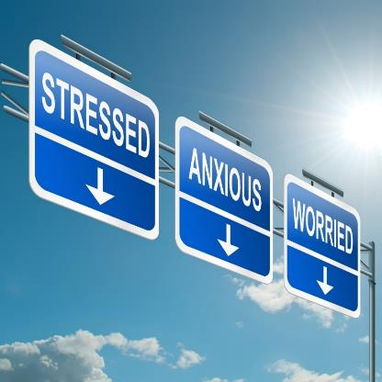
Manage Stress
AVOID stress by planning ahead, saying no, prioritization
ALTER your situation
ACCEPT things you cannot change
ADAPT your standards or expectations
Notes:
https://www.mayoclinic.org/healthy-lifestyle/stress-management/in-depth/stress-relief/art-20044476

Slide 60

Stay positive
Be thankful
Look at big picture
Spend time with positive people
Practice positive self-talk
Focus on the good things
Stop negative thinking
Focus on the present, not the past or future
Live a healthy lifestyle

Slide 61
Early Warning Signs
Experiencing one or more of the following feelings or behaviors can be an early warning sign of a problem:
  Eating or sleeping too much or too little
  Pulling away from people and usual activities
  Having low or no energy
  Feeling numb or like nothing matters
  Having unexplained aches and pains
  Feeling helpless or hopeless
  Smoking, drinking, or using drugs more than usual
Notes:
https://www.mentalhealth.gov/basics/what-is-mental-health

Slide 62
Early Warning Signs (continued)
Experiencing one or more of the following feelings or behaviors can be an early warning sign of a problem:
  Feeling unusually confused, forgetful, on edge, angry, upset, worried, or scared
  Yelling or fighting with family and friends
  Experiencing severe mood swings that cause problems in relationships
  Having persistent thoughts and memories you can't get out of your head
  Hearing voices or believing things that are not true
  Thinking of harming yourself or others
  Inability to perform daily tasks like taking care of your kids or getting to work or school
Notes:
https://www.mentalhealth.gov/basics/what-is-mental-health

Slide 63


Get help if you need it
Build Your Support System
Find a Peer Group
Make Treatment Decisions
Develop a Recovery Plan
Notes:
https://www.mentalhealth.gov/talk/people-mental-health-problems

Slide 64

Mental Health Resources
MentalHealth.gov - https://www.mentalhealth.gov/get-help
SAMHSA – Substance Abuse and Mental Health Services Administration https://www.samhsa.gov/

Slide 65
Small Group Activity (Topic 3)
Identify work-related risk factors affecting mental health
Time for activity: 10-15 minutes
Objective: Identify work-related risk factors that can impact mental health
Task: Discuss if these risk factors are present in your worksite and list any key examples.
Work-Related Risk Factors Affecting Mental Health
Work-life balance | Workplace violence/ harassment/ bullying | Job demands | Presenteeism | Job burnout | Occupational injury/illness
Notes:
Instructor notes:
Adapted from USW, Healthy Minds for a Strong Union, Ashley Fitch, 2019.

Slide 66

Treating an Opioid Overdose (Topic 4)
Objectives
When complete, you should better be able to:
Identify and safely treat an opioid overdose
Administer Naloxone (Narcan) during a simulated overdose

Slide 67
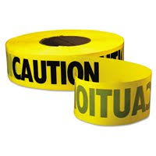
Isolation
Create and maintain a minimum Hot Zone around the patient(s) of 6 feet with visible markers if possible
Isolate/evacuate bystanders away from the patient
Report any information gathered, including the patient’s condition, to the appropriate personnel

Slide 68
What Are the Routes of Exposure?
Inhalation of powders and aerosols
Skin, eye, and mucous membrane absorption
Incidental ingestion (hand to mouth)
Accidental inoculation with sharps or needles
    Leading science organizations advise that incidental skin contact with dry products is not likely to cause overdoses.
    Skin contact with liquid or gel can be highly toxic.

Slide 69
Skin Exposure
Skin exposure to powdered or dry forms of fentanyl is not likely to cause overdose in small amounts if promptly removed.
Liquid or highly concentrated fentanyl can be absorbed rapidly via skin and can be extremely toxic.
It is prudent to provide full skin protection because the fatal dose is so low.

Slide 70
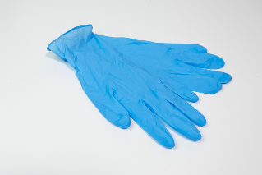
IAB Recommended Best Practices for Minimal Risk
Exposure Risk | Operational Functions | Minimum Recommended PPE
Minimal (no visible product or product contained within syringe or other package) | Response to a person with suspected overdose | Standard duty uniform and nitrile gloves (NFPA 1999)
IAB = InterAgency Board for Emergency Preparedness & Response

Slide 71
IAB Recommended Best Practices for Moderate Risk
Exposure Risk | Operational Functions | Minimum Recommended PPE
Moderate (small volume [grams] of material visible and not contained within a package) | Response to one or more persons with suspected overdose; response to a localized seizure | Standard duty uniform; nitrile gloves (NFPA 1999); P100 filtering facepiece respirator; safety glasses
Note: While the IAB recommends a P100 filtering facepiece respirator, N100 and R100 filtering facepiece respirators should work acceptably too.

Slide 72
NIOSH Standard Operating Procedures for Protection
  Hazard assessment
  No drinking, eating, smoking at the scene
  Do not touch eyes, nose, mouth
  Always wear nitrile gloves when illicit drugs may be present
  Field testing of possible drug residue is NOT recommended
  Avoid tasks that aerosolize suspected fentanyl
  Wash hands with soap and water
Notes:
Instructor notes:
Source: Fentanyl: Preventing Occupational Exposure to Emergency Responders
https://www.cdc.gov/niosh/topics/fentanyl/default.html

Slide 73

Decontamination
  Direct skin contact with suspected fentanyl should be immediately washed with soap and water.
  Do NOT use alcohol-based hand disinfectants or hypochlorite bleach solutions as they may enhance skin absorption of fentanyl.
Notes:
Instructor notes:
Photo: personal.psu.edu

Slide 74
Decontamination
  Avoid contamination while removing PPE.
  Isolate used PPE for decon or disposal.
  Decon surfaces with absorbent wipes, and a peracetic acid (5%) or hydrogen peroxide-based (10%) solution.

Slide 75
Identification of an opioid overdose
The presence of these 3 symptoms is strongly suggestive of opioid poisoning:
Coma
Pinpoint pupils
Respiratory depression
Overdose may result in:
  Stupor
  Pinpoint pupils that later may become dilated
  Cold and clammy skin
  Cyanosis: blue or purplish discoloration due to low oxygen
  Coma
  Respiratory failure leading to death

Slide 76
Identification
Opioid-associated resuscitative emergencies are defined by the presence of cardiac arrest; respiratory arrest; or severe life-threatening instability.
The American Heart Association recognizes the difficulty in accurately differentiating opioid-associated resuscitative emergencies from other causes of cardiac and respiratory arrest.
Other factors to consider include patient history, evidence on scene, and bystander reports.

Slide 77

Treatment

Slide 78
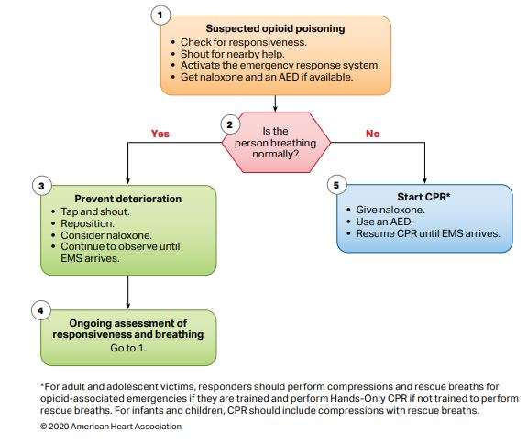
AHA flow chart for non-Healthcare Providers

Slide 79
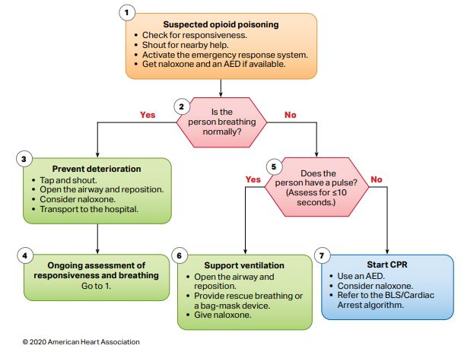
AHA flow chart for Healthcare Providers

Slide 80
Key Actions to Remember
1. Identify and assess the victim for responsiveness.
2. If victim is not responsive and not breathing, initiate CPR and AED per protocol:
    Check for pinpoint pupils.
    If suspected opioid overdose call for Narcan.
3. Check for medical alert tags (around wrists, ankles, or neck) indicating a pre-existing medical condition.
4.If respirations are present and the victim is unconscious, assess breathing status, pupils, and pulse.
    If breathing is adequate (> 8 per minute, no cyanosis) and no signs of trauma, place in the recovery position.
    Check for pinpoint pupils.
    If breathing is < than 8 per minute or signs of low oxygen and overdose is suspected (based on history, evidence on scene, bystander reports, patient assessment) proceed with Naloxone administration and high O₂ therapy.

Slide 81
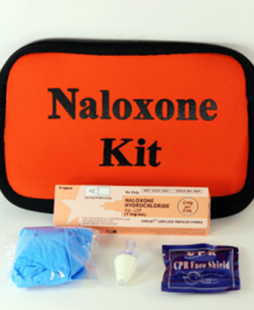
Naloxone (Narcan)
  Naloxone (Narcan) displaces the opioid from the receptors in the brain.
  Can rapidly reverse respiratory depression in a patient with an opioid-associated emergency.
  Naloxone doesn’t work with drugs other than opioids.
  Naloxone is safe and effective. It is not a controlled substance and has no abuse potential.
Notes:
Instructor notes:
Photo: Donna S. Heidel, CIH, FAIHA

Slide 82

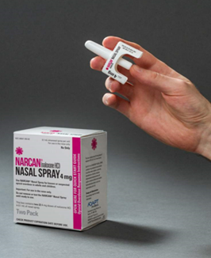
Naloxone (Narcan)
Multiple doses are sometimes required. If the person does not wake up in five minutes, a second dose should be administered
It is available as an injectable and nasal spray
Automatic injectors are similar to an EpiPen
Multi-step or single-step sprays are packaged containing two doses to allow for repeat dosing if needed
Notes:
Instructor notes:
Photos: Donna S. Heidel, CIH, FAIHA

Slide 83
State Laws Vary on Naloxone
  Naloxone is accessible in all states without a prescription.
  All states have Naloxone Access laws, which protect individuals who administer Naloxone
  Only Kansas, Texas and Wyoming DO NOT have Good Samaritan laws, which protect individuals who call for medical assistance for an overdose victim
  These laws are all different. Check your state’s law for more info: https://www.gao.gov/products/gao-21-248.
Notes:
Source: https://www.gao.gov/products/gao-21-248

Slide 84
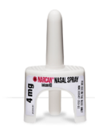



Treatment of Opioid Overdose Emergency with Single Step Nasal Spray
1. Retrieve Naloxone Kit.
2. PRIOR to administration of Naloxone, ensure safety of the victim and remove any sharp or heavy objects within victims reach. The sudden onset of opioid withdrawal may cause physical symptoms, such as agitation, rapid heart rate, nausea, projectile vomiting, violent behavior, seizures, difficulty breathing.
3. Administer 4 mg of Naloxone in one nostril. (do not prime nasal spray)
4. If no response after 3-5 minutes and there is an available second dose of Naloxone, repeat the administration.
  • Continue CPR including rescue breathing, (if initiated prior to Narcan) until respirations return
  • Continue to monitor respirations and pulse if patient was placed in recovery position with high flow oxygen
  • Transport to local Emergency Department via EMS.

Slide 85
Opioid Overdose Response Activity
1. Review the purpose of the Activity.
2. Read the directions on the Skills Checklist.
3. Review the signs and symptoms of an opioid overdose.
4. Each participant will follow the Skills Checklist to assess and treat an overdose incident.
5. Each participant will practice the skill until they have mastered the steps on the Skills Checklist.

