Slide 1

Heat and Cold Safety
Course Goal
This program trains workers how to minimize their risk of experiencing heat and cold stress and how to treat heat- and cold-related illnesses.
Notes:
Course created April 26, 2023
Photo: OSHA

Slide 2
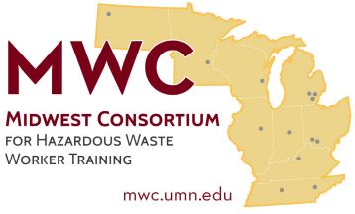
Acknowledgement
The Midwest Consortium for Hazardous Waste Worker Training created this program under cooperative agreement number U45 ES 06184 from the National Institute of Environmental Health Sciences (NIEHS).

Slide 3

Course Objectives
Heat stress occurs when the body cannot get rid of excess heat.
Cold stress occurs when a body’s temperature falls below normal.
After completing this course, you will better be able to:
Recognize risk factors for heat and cold stress
Describe types of heat/cold illness, symptoms, and first aid
Identify worker protection standards
Identify methods to reduce the risk of heat and cold stress

Slide 4
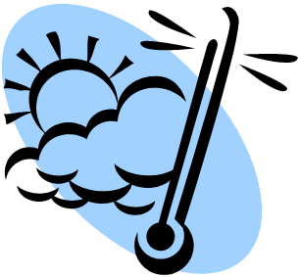
Course Modules
HEAT
Heat Stress Risk Factors
Heat Illness – Symptoms and First Aid
Worker Protection Standards
Heat Stress Prevention
Planning & Supervision
Small Group Exercise
COLD
Cold Stress Risk Factors
Types of Cold Stress and First Aid
Worker Protection Guidelines
Cold Stress Prevention
Winter Hazards
Small Group Exercise

Slide 5
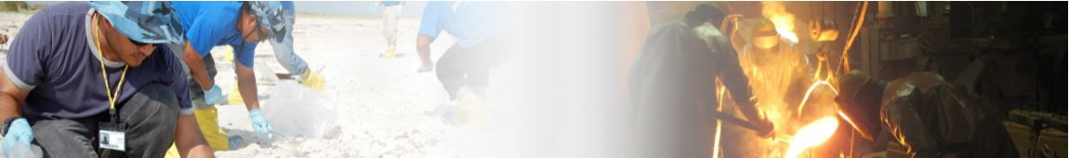
Workplace Hazard: HEAT
Many workers experience heat stress in the workplace. It is becoming a more prevalent workplace hazard due to climate change. However, indoor workers are also at risk of heat illness.
Notes:
Photo: OSHA

Slide 6
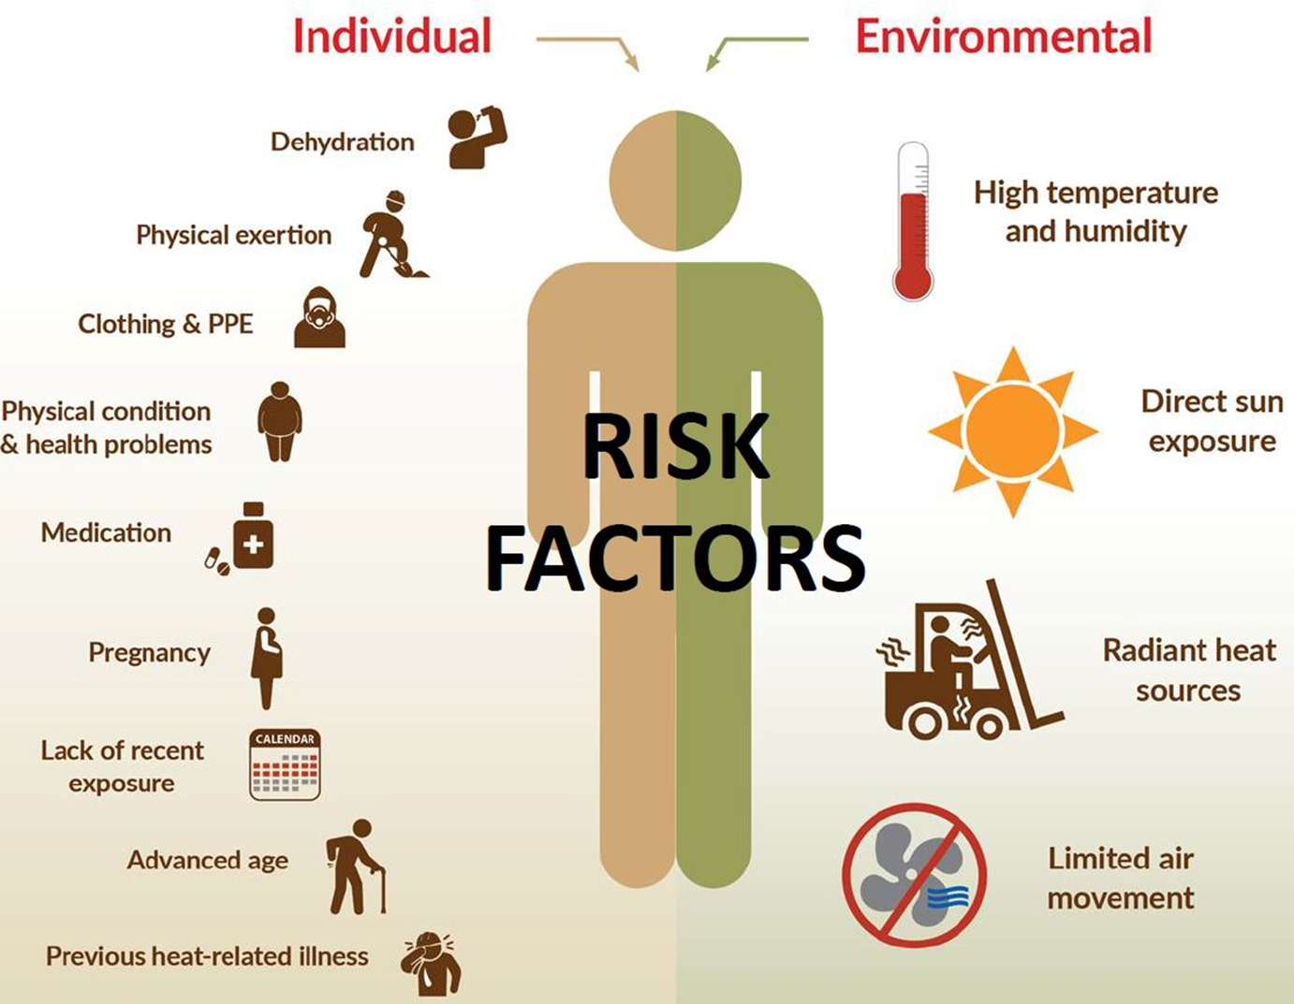
Module 1: Heat Stress Risk Factors
Notes:
Image credit: NIOSH

Slide 7

Module 2: Heat Illness Symptoms and First Aid
Become familiar with heat illness symptoms
Diagnosis is often difficult because symptoms of multiple heat-related illnesses can occur together
Do not try to diagnose which illness is occurring
When any of these symptoms is present, promptly provide first aid
Prompt response is important as conditions can worsen quickly
Notes:
Photo: OSHA
Source: https://www.osha.gov/heat-exposure/illness-first-aid

Slide 8
Types of Heat Illness
Heat Rash Clusters of red bumps on skin
Often appears on neck, chest, and skin folds
Heat Cramps Muscle spasms or pain
Usually in legs, arms, or trunk
Loss of consciousness Fainting
Dizziness
Muscle tissue breakdown Muscle pain Weakness
Dark urine or reduced urine output
Heat Exhaustion Fatigue Heavy sweating Irritability
Thirst Dizziness or lightheadedness Nausea or vomiting Elevated body temperature or fast heart rate
Heat Stroke Confusion Heavy sweating or hot, dry skin Seizures
Unconsciousness Very high body temperature
Slurred speech Rapid heart rate
Notes:
Source: https://www.osha.gov/heat-exposure/illness-first-aid
Facilitator note: The term for loss of consciousness due to heat is Heat Syncope. The term for muscle tissue breakdown due to heat is Rhabdomyolysis.

Slide 9
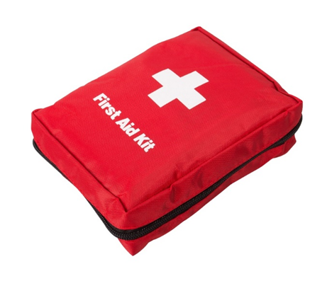
Heat Illness First Aid
Take the affected worker to a cooler area (e.g., shade or air conditioning).
Cool the worker immediately:
  Remove outer layers of clothing, especially heavy protective clothing.
  Place ice or cold wet towels on the head, neck, trunk, armpits, and groin.
  Use fans to circulate air around the worker.
  Immerse the worker in cold water or an ice bath. Create the ice bath by placing all the available ice into a large container with water. This is the best method to cool workers rapidly in an emergency.
Never leave a worker with heat-related illness alone. The illness can rapidly become worse.
When in doubt, call 911!
Notes:
Source: https://www.osha.gov/heat-exposure/illness-first-aid

Slide 10

Heat Illness First Aid (continued)
Confusion, slurred speech, or unconsciousness are signs of heat stroke. When these types of symptoms are present, call 911 immediately and cool the worker with ice or cold water until help arrives.
Workers who are new to working in warm environments are at increased risk of heat-related illness. Especially during a worker's first few days, all symptoms should be taken seriously. Workers who develop symptoms should be allowed to stop working and should receive evaluation for possible heat-related illness.
OSHA Video - A life lost to heat illness at work: OSHA Heat Illness video
Notes:
Source: https://www.osha.gov/heat-exposure/illness-first-aid

Slide 11

Module 3: Worker Protection Standards and Recommendations
  OSHA – Occupational Safety and Health Administration
  NIOSH – National Institute for Occupational Safety and Health
  ACGIH – American Conference of Governmental Industrial Hygienists
  State Standards - Minnesota (indoor)

Slide 12

OSHA Standards
Employers are required to provide their employees with a place of employment that “is free from recognized hazards that are causing or likely to cause death or serious physical harm to employees.”
Court cases show this OSHA section applies to heat-related hazards
Employers must provide safe drinking water and adequate first aid
Employers must conduct hazard assessment to determine needed PPE

Slide 13

NIOSH Recommendations
NIOSH recommendations for employers about how to prevent heat-related illnesses can be found here: NIOSH Criteria for a Recommended Standard
      Highly technical document that could be used to support future OSHA regulation
      Includes Recommended Action Limits and Recommended Exposure Limits that are measurable and account for metabolic rate (tied to the difficulty of work), fraction of total time doing the work, and acclimatization status (how used to heat the worker is)
      Also includes controls, measurement, and monitoring methods
Not enforceable
Notes:
Source: Criteria for a Recommended Standard: Occupational Exposure to Heat and Hot Environments: https://www.cdc.gov/niosh/docs/2016-106/

Slide 14
ACGIH Guidelines
ACGIH has detailed content on heat stress: ACGIH Heat Stress and Strain
It includes Threshold Limit Values (TLVs) which are based on a very accurate way to measure heat conditions - the Wet Bulb Globe Temperature (WBGT).

Slide 15
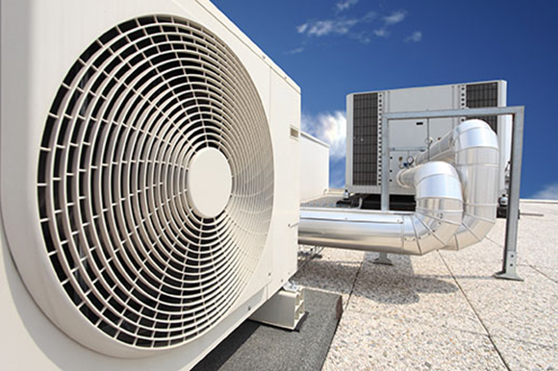
Minnesota Indoor Standard
As ventilation and difficulty of work are related to heat stress, the standard:
Specifies minimum amounts of indoor air flow
Regulates recirculated air
Specifies heat exposure limits by level of work (heavy, moderate, light)
Notes:
Source: 5205.0110 INDOOR VENTILATION AND TEMPERATURE IN PLACES OF EMPLOYMENT: https://www.revisor.mn.gov/rules/5205.0110/

Slide 16
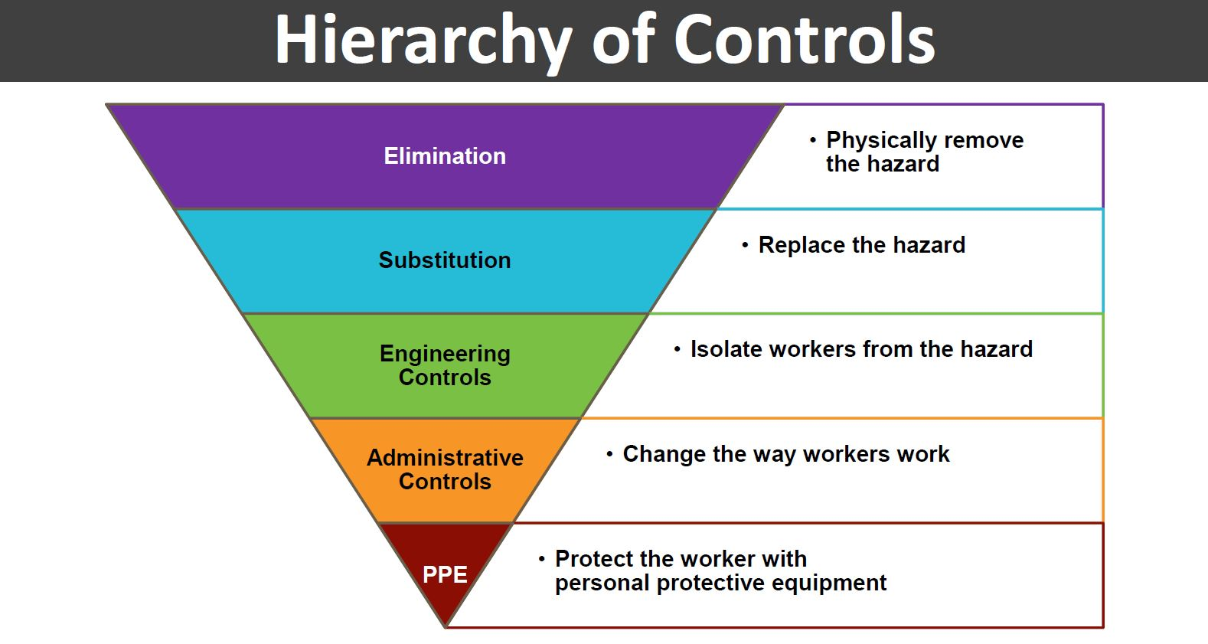
Module 4: Heat Stress Prevention
Notes:
Image credit: NIOSH

Slide 17
Module 4: Heat Stress Prevention
Module Content
Acclimatization
Hazard Assessment
Training
Engineering Controls
Work Practices
PPE

Slide 18

Module 4: Prevention
A. Acclimatization
Almost half of heat-related deaths occur on a worker’s very first day on the job
Over 70 percent of heat-related deaths occur during a worker’s first week
The term “acclimatization” means that the body gradually adapts and tolerates higher levels of heat stress. Workers who are new to working in warm environments may not be acclimatized to heat. Their bodies need time to adapt to working in hot conditions.
Notes:
Source: https://www.osha.gov/heat-exposure/protecting-new-workers
Photo: OSHA

Slide 19
Module 4: Prevention
A. Acclimatization
Who is at Risk?
New, temporary, or existing employees who start new work activities in warm or hot environments
Workers returning to work environments with potential exposure to heat hazards after an absence of one week or more.
Workers who continue working through seasonal changes when temperatures first begin to increase in the spring or early summer.
Workers who work on days when the weather is significantly warmer than on previous days (for example, a heat wave)
Notes:
Source: https://www.osha.gov/heat-exposure/protecting-new-workers

Slide 20
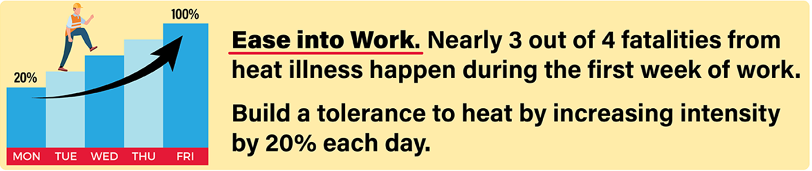
Module 4: Prevention
A: Acclimatization
For the first week or two…
Schedule new workers to work shorter amounts of time working in the heat
Give new workers more frequent rest breaks
Monitor new workers closely for any symptoms of heat-related illness
Use a buddy system and don’t allow new workers to work alone
Train new workers about heat stress
Notes:
Source: https://www.osha.gov/heat-exposure/protecting-new-workers
Graphic: OSHA

Slide 21
Module 4: Prevention
B. Heat Hazard Assessment
Wet bulb globe temperature (WBGT)
Physical workload
Acclimatization status
Clothing
Normal/obese status
Notes:
Photo: OSHA
Sources: https://www.osha.gov/otm/section-3-health-hazards/chapter-4
https://www.osha.gov/heat-exposure/hazards

Slide 22
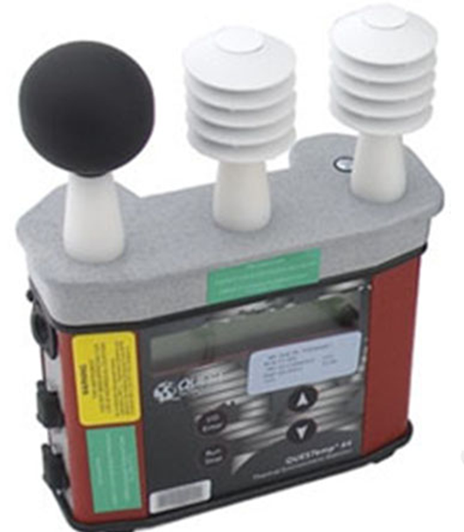
Wet Bulb Globe Temperature (WBGT)
WBGT estimates the effect of temperature, relative humidity, wind speed and solar radiation
It is measured with a monitor like the one shown here
Video from the National Weather Service: What is WBGT?
OSHA has a Heat Stress Calculator which uses WBGT: OSHA Heat Stress Calculator

Slide 23
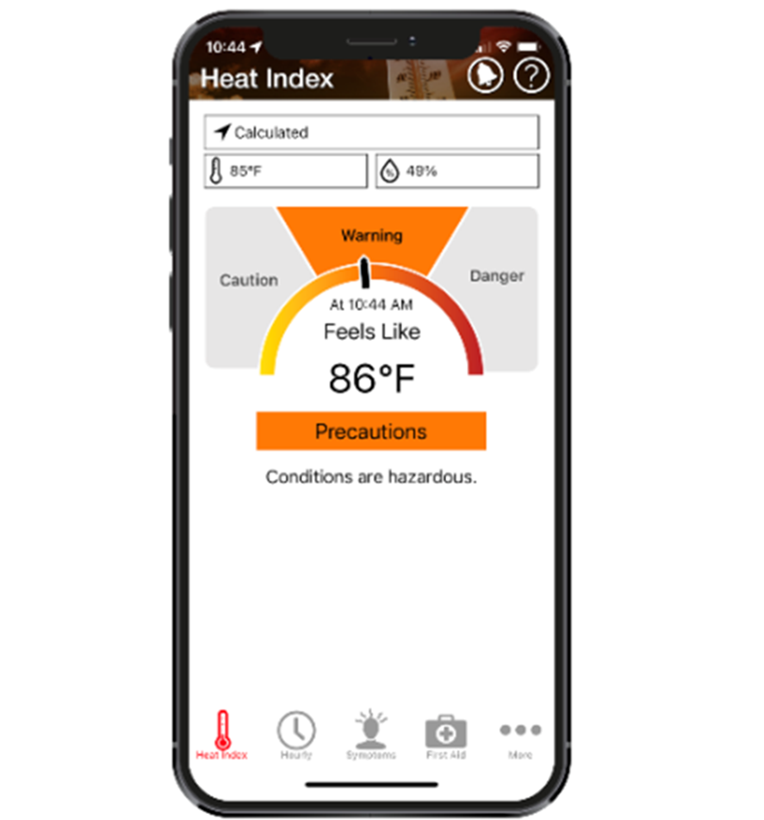
Heat Safety Tool App
The Heat Safety Tool developed by NIOSH and OSHA
Real-time heat index
Precautions based on heat index
Symptoms and First Aid
Risk factors
Training recommendations

Slide 24

Module 4: Prevention
C. Training
  Supervisors and workers should be trained about…
  Types of heat-related illness, including symptoms and first aid
  Procedures for contacting emergency medical services
  Protecting new workers who have not been acclimatized
  Job-related and personal risk factors for heat-related illness
  Importance of drinking enough water and taking rest breaks in areas that are cooler than the worksite
  Proper care and usage of PPE
  Appropriate work/rest cycles when heat stress risk is high
Notes:
Sources: https://www.osha.gov/heat-exposure/training
https://www.cdc.gov/niosh/topics/heatstress/recommendations.html
Photo: OSHA

Slide 25
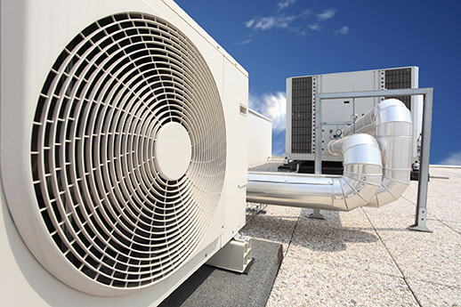
Module 4: Prevention
D. Engineering Controls
Reduce heat stress through engineering controls such as…
Increase general ventilation
Cooling fans
Air conditioning (such as air-conditioned crane or construction equipment cabs, air conditioning in break rooms)
Local exhaust ventilation at points of high heat production or moisture (such as exhaust hoods in laundry rooms)
Reflective or heat-absorbing shielding or barriers
Insulation of hot surfaces (such as furnace walls)
Reduce steam leaks, wet floors, or humidity
Cooled seats or benches for rest breaks
Use of mechanical equipment to reduce manual work (such as conveyors and forklifts)
Misting fans that produce a spray of fine water droplets
Notes:
Source: https://www.osha.gov/heat-exposure/controls
Photo: OSHA

Slide 26

Module 4: Prevention
E. Work Practices
Reduce heat stress through work practice controls such as…
Reduce the physical demands of the job
Increase the number of workers per task
Rotate job functions among workers to help minimize heat exposure
Limit time in the heat and/or increase recovery time spent in a cool environment
Use a buddy system
Have a plan for what to do if a worker has signs of heat illness
Provide adequate amounts of water and encourage workers to drink frequently
Implement a heat alert program whenever the weather service forecasts that a heat wave is likely to occur
Institute a heat acclimatization plan and increase physical fitness
Notes:
Sources: https://www.cdc.gov/niosh/topics/heatstress/recommendations.html
https://www.osha.gov/heat-exposure/controls
Photo: OSHA

Slide 27
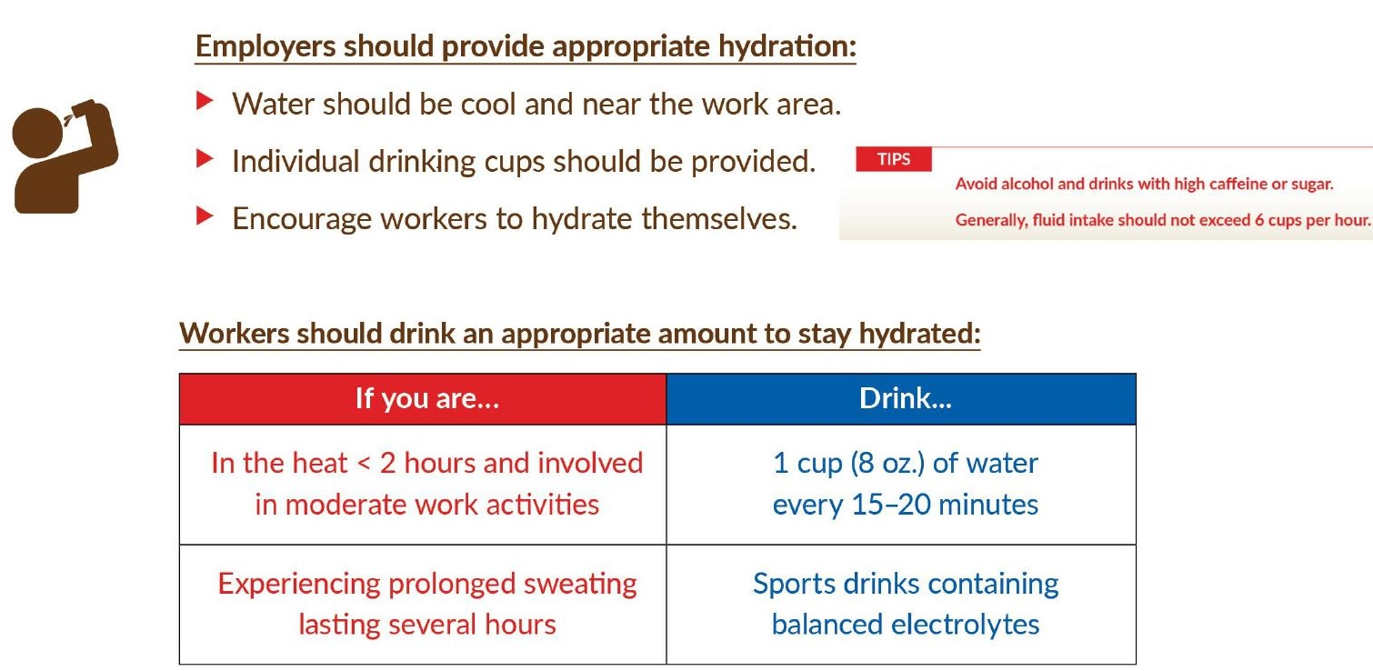
Hydration
Notes:
Image credit: NIOSH

Slide 28
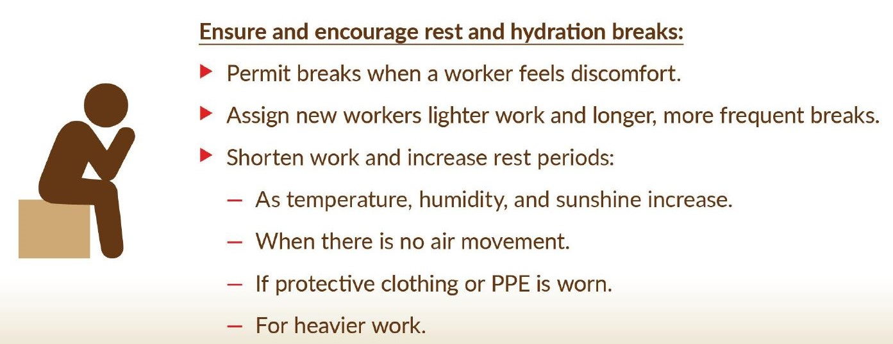
Rest breaks
Notes:
Image credit: NIOSH

Slide 29
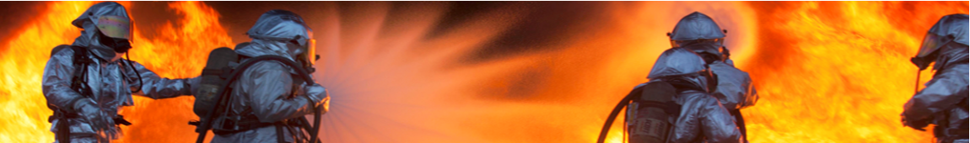
Module 4: Prevention
F. PPE
Notes:
Photo: OSHA

Slide 30
Heat Burden While Wearing PPE
Wearing PPE and certain clothing can increase your risk for heat-related illnesses. PPE…
Is often necessary to reduce exposure to external hazards such as chemicals.
Reduces the body’s normal way of getting rid of heat by sweating and other means.
Holds excess heat and moisture inside, making the worker’s body even hotter.
Increases the physical effort to perform duties while carrying the extra weight of the PPE and can lead to the worker getting hotter faster.
Notes:
Source: https://www.cdc.gov/niosh/topics/heatstress/heat_burden.html

Slide 31
Protect workers wearing PPE from heat-related illness
Adjust work/rest cycles based on:
  Type of PPE
  Length of time an individual can wear the PPE
  Individual worker’s actual work rate, fitness level, hydration level, and acclimatization
  Environmental conditions, such as level of heat and humidity, radiant heat from sun if outdoors, and wind speed if outdoors or using a fan indoors
Note that certain types of PPE can increase core body temperature more quickly than wearing other types of PPE in the same environment.
Wear light-weight, breathable, fast-drying clothing
Notes:
Source: https://www.cdc.gov/niosh/topics/heatstress/heat_burden.html

Slide 32
PPE to protect against heat exposures
WHEN? In most cases, heat stress should be reduced by engineering controls or work practice changes. However, when heat stress levels exceed the NIOSH recommended occupational exposure limit (RAL or REL), heat-protective clothing or equipment can help.
WHAT? PPE that protects against heat exposures range in simplicity, cost, and maintenance. They include:
      Insulated suits
      Reflective clothing
      Infrared reflecting face shields
      Cooling neck or head wraps
For extremely hot environments, consider auxiliary cooling systems or personal cooling systems such as:
      Vest that receives cooled air from a vortex tube connected to an external compressed air source
      Jackets or vests with reusable ice packs or phase change cooling packs in the pockets
Notes:
Sources: https://www.cdc.gov/niosh/topics/heatstress/heat_burden.html
https://www.osha.gov/heat-exposure/controls

Slide 33
PPE to protect against heat exposures (continued)
Limitations
Wearable personal cooling systems have limitations within a work setting, such as:
Ice vests are cheap, but their tem­perature cannot be controlled and they often do not stay cool long enough to be practical.
If the cooling system is too cold, this will result in reduced heat transfer from the body to the environ­ment.
Water-cooled garments require that the worker be tethered to a system that circulates the cool water, which limits the person’s range of operation.
Many of the wearable personal cooling systems are too heavy or too cumbersome to be practical in a work environment.
Notes:
Sources: https://www.cdc.gov/niosh/topics/heatstress/heat_burden.html
https://www.osha.gov/heat-exposure/controls

Slide 34

Module 5: Planning and Supervision
A heat illness prevention program should be part of the overall Safety and Health Program and should include:
Heat Hazard Assessment/Monitoring
Acclimatization
Training
Controls (Engineering, Administrative, PPE)
Medical Monitoring
Day-to-Day Supervision:
An individual at the worksite should be responsible for monitoring conditions and implementing the heat plan throughout the workday.
Notes:
Sources: https://www.osha.gov/otm/section-3-health-hazards/chapter-4
https://www.osha.gov/heat-exposure/planning

Slide 35
Summary - Heat
There are workplace and individual risk factors for heat stress
When heat stress symptoms are observed, promptly give first aid
Worker standards exist to protect against heat illness
Workers must become acclimatized to heat
Heat hazards can be reduced through engineering controls and work practices such as rest, shade, and water

Slide 36
Module 6: Small Group Exercise
Break into small groups and discuss the following scenarios. You may also discuss scenarios from your own workplace.
Scenario 1:
One small room in your workplace is particularly hot due to machinery and steam. The two people who work there are long-term employees (25 years) who must wear heavy coveralls and gloves for protection. They work a lot of overtime for extra money. What potential workplace and individual risk factors can you identify? What engineering controls and work practice changes could be implemented?

Slide 37
Module 6: Small Group Exercise (continued)
Scenario 2: A co-worker complains of feeling dizzy. He appears to be sweating more than usual. What should you do?
Scenario 3: The new employees at your hot workplace seem to have the necessary experience and work hard at first. But half quit the first week saying the job is too hard. What can you do?
Scenario 4: A few tasks at your hot workplace require Level B suits. What can be done to protect these workers from heat stress?

Slide 38
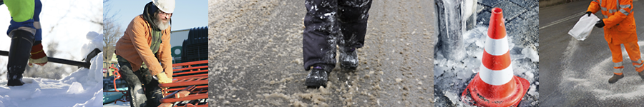
Workplace Hazard: COLD
Winter can present hazards to workers. In addition to the cold and wind, snow and ice as well as rapidly changing temperatures can provide unique challenges.
Notes:
Photo: OSHA

Slide 39
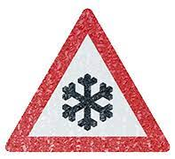
Module 1: Cold Stress Risk Factors
Cold air temperature/wind chill
Wetness/dampness
Dressing improperly
Exhaustion
Dehydration
Health conditions such as hypertension, diabetes, and hypothyroidism (when thyroid doesn’t make enough hormones)
Poor physical conditioning
Notes:
Image: OSHA
Source: https://www.osha.gov/winter-weather/cold-stress

Slide 40
Cold Stress Chart

Slide 41

Module 2: Types of Cold Stress and First Aid
Immersion/Trench Foot
Frostbite
Hypothermia
Notes:
Photo: CDC

Slide 42
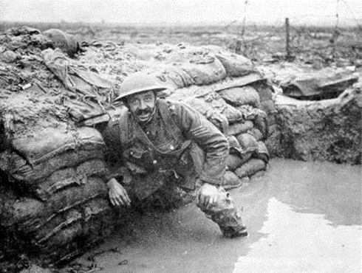
Immersion/Trench Foot
Symptoms
  Feet immersed in cold water for long periods of time
  Tingling, itching or burning sensation
  Blisters may be present
Treatment
  Soak feet in warm water
  Wrap feet with dry cloth bandages
  Drink warm, sugary drinks

Slide 43
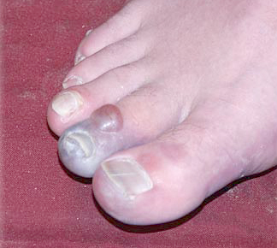
Frostbite
Symptoms
  Freezing of extremities: nose, cheeks, ears, fingers, toes
  Pain and tingling at first
  Numbness later
  Flesh turns red, then purple, and then white or grayish
  Skin cold to touch
Treatment
  Avoid rubbing the area
  Avoid thawing if refreezing is possible
  Wrap in soft cloth
  Immerse in 100 °F water for 20-45 minutes
  No hot water, salves or creams
  Seek professional medical attention

Slide 44
Hypothermia
Symptoms
  Uncontrollable shivering or shivering stops without warning
  Falling body temperature and blood pressure
  Irregular heartbeat
  Slurred speech
  Incoherence and disorientation
  Drowsiness
Treatment
  Seek immediate professional medical attention
  In mild cases, keep person active
  Drink warm, sugary fluid but no caffeine
  Apply hot packs to head, neck and torso if moderate case, but not if severe case

Slide 45


Module 3: Cold Stress Guidelines
OSHA - Does not have a specific standard, but employers are responsible for providing a workplace free from recognized hazards that are likely to cause death or serious physical harm, including cold stress. OSHA has recommendations.
NIOSH – Recommendations
ACGIH – Threshold Limit Values (TLVs) and guidelines
Notes:
Sources: https://www.osha.gov/emergency-preparedness/guides/cold-stress
https://www.cdc.gov/niosh/topics/coldstress/recommendations.html

Slide 46

Module 4: Cold Stress Prevention
Module Content
Training
Engineering Controls
Work Practices
Clothing and PPE
Notes:
Photo: OSHA

Slide 47

Module 4: Prevention
A:Training
Cold stress training should include information about:
Risk Factors
Prevention
Symptoms
The importance of monitoring yourself and coworkers for symptoms
First aid and how to call for additional medical assistance
How to select proper clothing for cold, wet, and windy conditions
Notes:
Sources: https://www.osha.gov/winter-weather/cold-stress
https://www.cdc.gov/niosh/topics/coldstress/recommendations.html
Photo: OSHA

Slide 48
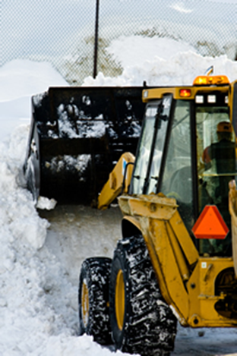
Module 4: Prevention
B: Engineering Controls
Warm air jets
Radiant heaters
Contact warm plates
Metal handles of tools and control bars are covered with thermal insulating material
Shielding from winds
Heated warming shelters
In refrigeration rooms, keep air velocity below 200 fpm (2 mph)
Notes:
Photo: CDC

Slide 49
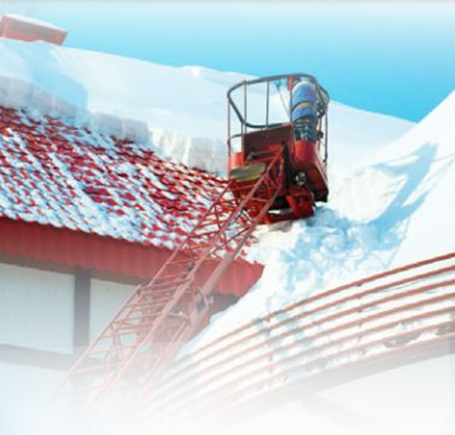
Module 4: Prevention
C: Work Practices
Schedule maintenance and repair jobs for warmer months
Schedule cold jobs in the warmer part of the day
Limit exposure to extremely cold temperatures
Assign extra workers to long, demanding jobs
Use the buddy system
If heavy work, rest frequently and allow changing to dry clothing
Avoid long periods of inactivity
Have warm areas for use during break periods
Drink warm liquids (no alcohol)
Monitor workers who are at risk of cold stress
Monitor the weather conditions, having a reliable means of communicating with workers and being able to stop work or evacuate when necessary
Notes:
Photo: OSHA
Sources: https://www.cdc.gov/niosh/topics/coldstress/recommendations.html
https://www.osha.gov/winter-weather/preparedness

Slide 50

Module 4: Prevention
D: Clothing & PPE
Wear at least 3 layers of loose-fitting clothing
  An inner layer of wool, silk or synthetic (not cotton) to wick moisture away from the body.
  A middle layer of wool or synthetic to provide insulation even when wet.
  An outer wind and rain protection layer that allows some ventilation to prevent overheating.
Insulated/waterproof gloves/mittens
Insulated/waterproof boots
Hat; one that covers ears is even better
Knit mask to cover face and mouth
Goggles to protect eyes from cold and ultraviolet light
Have extra clothing to change into in case you get wet, especially dry socks
Need thermal protection even when wearing Chemical-Protective Clothing (CPC)
Notes:
Photo: NIOSH
Source: https://www.osha.gov/winter-weather/preparedness

Slide 51
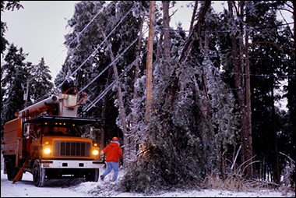
Module 5: Winter Hazards
OSHA has safety precautions for the following Hazards. See https://www.osha.gov/winter-weather/hazards#walking for details
Winter Driving
Work Zone Traffic Safety
Stranded in a Vehicle
Shoveling Snow
Using Powered Equipment like Snow Blowers
Clearing Snow from Roofs and Working at Heights
Preventing Slips on Snow and Ice
Repairing Downed or Damaged Power Lines
Working Near Downed or Damaged Power Lines
Removing Downed Trees
Notes:
Source: https://www.osha.gov/winter-weather/hazards
Photo: OSHA

Slide 52
Module 6: Small Group Exercise
Break into small groups and discuss the following Scenarios. You may also discuss scenarios from your own workplace.
Scenario 1. An older co-worker has a demanding job that requires being outside frequently, even on cold days. What are the cold stress risk factors? What can be done to reduce the cold stress hazard?
Scenario 2: Your job requires working at heights, even during winter weather when it can be icy. What can be done to make your job safer?

Slide 53
Module 6: Small Group Exercise (continued)
Scenario 3: You will be working outside in your Level B suit during a very cold day. Do you need thermal protection? How can you reduce your cold stress risk?
Scenario 4: You and a buddy are working outside on a very cold day. He seems disoriented and is having trouble completing routine tasks. What should you do?
Scenario 5: You are working outside on a very cold day. You have lost feeling in your fingers and toes. What should you do?

Slide 54
Summary - Cold
There are risk factors for cold stress
When cold stress symptoms are observed, promptly treat
Winter weather brings hazards such as cold, snow, ice
Hazards can be reduced through engineering controls, work practices, appropriate clothing and training

Slide 55
Resources
OSHA – Heat - https://www.osha.gov/heat-exposure
Heat Illness Prevention Campaign - https://www.osha.gov/heat
Technical Manual - https://www.osha.gov/otm/section-3-health-hazards/chapter-4
Heat Stress Risk Factors - https://www.cdc.gov/niosh/mining/UserFiles/works/pdfs/2017-125.pdf
Winter Weather - https://www.osha.gov/winter-weather/cold-stress
NIOSH – Heat Stress https://www.cdc.gov/niosh/topics/heatstress/default.html
Criteria for a Recommended Standard: Occupational Exposure to Heat and Hot Environments: https://www.cdc.gov/niosh/docs/2016-106/
Cold Stress - https://www.cdc.gov/niosh/topics/coldstress/default.html
Cold Stress Fast Facts - https://www.cdc.gov/niosh/docs/2010-115/pdfs/2010-115.pdf

Slide 56
Closing and Evaluation
This is an opportunity to ask any questions you may have, or to discuss how to use the knowledge and skills you have learned.
Finally, we ask that you take 10 minutes to complete the evaluation forms. These are important for improving the program. We take your comments seriously and make changes in content based on participant feedback. Your comments are anonymous. You can also comment by clicking on the Contact page of the Midwest Consortium website: https://mwc.umn.edu/contact/

Slide 57
Disclaimer
The Midwest Consortium has copyrighted this material. A recipient of the material, other than the Federal Government, may not reproduce it without permission of the copyright owner.
The material was prepared for use by experienced instructors for the training of those who are or anticipate working in hot or cold environments. Authors of this material have prepared it for the training of this target audience as of the date specified on the title page. Users are cautioned that the subject is constantly evolving. Therefore, the material may require additions, deletions, or modifications to incorporate the effects of that evolution occurring after the date of this material preparation.

