Slide 1
Environmental Releases – Hybrid Course Part 2 Health Effects & Resources
Copyright © 2023 Midwest Consortium for Hazardous Waste Worker Training

Slide 2
Acknowledgements
This program was developed by the Midwest Consortium for Hazardous Waste Worker Training under cooperative agreement U45 ES06184 from the National Institute of Environmental Health Sciences.
Content was updated February 13, 2023 and all web links are active as of that date; if you find an error, please inform the facilitator so that it can be updated.

Slide 3
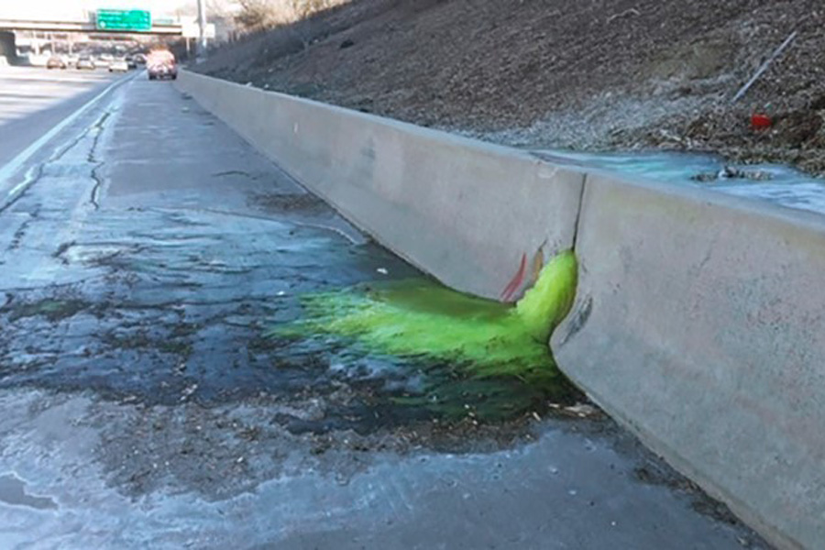
Health Effects
Recognizing the potential for a health effect is the first step in avoiding it.

Slide 4
Objectives
Describe how the body can react to hazardous substances
Identify what to do if you think you have been exposed

Slide 5
How do chemicals enter your body?
Skin/Eye Contact: If you come into physical contact with some chemicals, they may irritate your skin or eyes and/or they may be absorbed into your body.
Ingestion: If you eat or smoke after being exposed, chemicals on your hands may enter your body through ingestion.
Inhalation: Chemicals that are gases or vapors coming from liquid chemicals can enter your body through inhalation. Some chemicals can mix with steam that you might inhale. Dusts and liquid droplets may also be inhaled.
Injection: Chemicals can enter your body through cuts or skin abrasions. If you receive any type of puncture wound, it is possible that whatever caused the puncture wound could be contaminated.

Slide 6
As you observe….
Your body may be able to help you pick up clues that will help describe the scene to the emergency responders.
Although many substances leave no clues that can be detected by your senses, you should report anything that your senses pick up.
Do not move closer to the scene to see if you can “sense” something.

Slide 7
Clues your senses can provide
Eyes can spot hazards, read signs and placards, and display symptoms caused by hazardous materials.
Skin can tingle or burn.
Ears can hear unusual sounds such as hissing.
Nose can smell bad or unusual odors.
WARNING — Your nose will not detect many substances. Even substances that have a smell may be missed if you have a cold or allergy or become “used to” the odor. Many substances have no odor. Never breathe hazardous materials on purpose.
Stay a safe distance away as you observe to avoid possible exposure. If you are outdoors, stay upwind.
Use your eyes; if your eyes or other senses are affected, MOVE AWAY.

Slide 8
When do health effects appear?
A chemical’s effect may be considered acute and/or chronic.
Acute: Develops quickly, usually after exposure to high concentrations of a hazardous substance.
Example: Contact with concentrated nitric acid can cause an acid burn on the skin.
Chronic: Takes a long time to develop or requires long exposures, usually at low concentrations.
Example: Breathing asbestos can result in lung diseases many years after exposure.

Slide 9
Where do health effects appear?
Reactions to chemical exposure may be local or systemic.
Local: The reaction develops where the substance enters the body or comes into direct contact with parts of the body.
Example: Breathing hydrochloric acid can immediately result in a coughing spell and cause bronchitis.
Systemic: The reaction develops at some place other than the point of contact.
Example: Benzene can be absorbed through the skin and cause leukemia and other blood disorders.

Slide 10
Health effects while you are observing
If you have a physical response while observing, move further away and immediately make your report, including your symptoms.
Also, report if your skin or clothing contacted any of the chemical.
Make every effort to not contaminate any other surface, such as getting into your car, unless directed to do so.
Follow all instructions you are given, including seeking medical evaluation

Slide 11
Health effects after your observation
Be aware of any symptoms that you may be having. If you are having any symptoms after making your observations, you should:
Keep a diary of any symptoms you experience. The specific date and time of potential exposure is part of the report record; if you did not make a report, record the date and time in a diary. For any symptoms, write date, time and symptoms in the diary.
Notify the agency (fire department, State EPA, or other agency) in charge of responding to the incident. Others who were at the scene may be experiencing similar symptoms.
Get information about the chemicals involved in the incident.
See a doctor. You may need to see an occupational physician who is trained to recognize signs and symptoms of chemical exposures. Your family doctor may not have the right training or experience.

Slide 12
Health effects summary
Chemicals can enter your body through skin/eye contact, ingestion, inhalation, or injection.
Health effects may show up either immediately or after exposure.
Exposures affect different parts of the body.
Your senses may help you spot clues, but they are not reliable for evaluating whether a hazard exists.
If you have any symptoms or know you have come into contact with a substance, back off and make a call-in; follow advice regarding medical follow up.
If you have any symptoms after the observation, see an occupational physician.
Avoid exposure. Stay at a safe distance. If outdoors, stay upwind.

Slide 13
Resources

Slide 14
Objectives
Describe the responsibilities of some of the federal, state, and local agencies
Describe relevant legislation
List online resources

Slide 15
Environmental Protection Agency (EPA)
Concerned with the quality of the environment, including the air, land, and water (except for navigable waterways).
Published regulations to define hazardous waste. Regulations set by the EPA are published in Section 40 of the Code of Federal Regulations, beginning with Part 200.
Created identification and reporting systems so that the government can track the quantities and types of hazardous waste being generated and confirm that they are being properly handled.

Slide 16
EPA (continued)
The federal EPA has delegated the enforcement of its regulations to state EPA agencies. Some states don’t call their agency EPA.
Some states have regulated other wastes in addition to EPA hazardous wastes, and they are called “special wastes.” Examples of special wastes that come under state-by-state rules are waste oils, asbestos abatement waste, and petroleum-contaminated soil.
In states where federal personnel enforce OSHA, health and safety at hazardous waste sites is overseen by EPA; if a State Plan is in place to cover government workers, the state OSHA personnel can enforce HAZWOPER sites.

Slide 17
Department of Transportation (DOT)
Concerned with the transport of hazardous materials through interstate commerce.
Publishes a manual, the Emergency Response Guidebook (ERG), that is useful in interpreting labels it requires on containers.
Regulations set by the DOT are published in Section 49 of the Code of Federal Regulations, Parts 100–200.
Each state also has its own DOT, which may be involved in the transport of hazardous materials.

Slide 18
United States Coast Guard (USCG)
Responsible for monitoring the transportation of hazardous materials across navigable waterways and preserving our bodies of water.
Involved in clean-up actions following oil spills.

Slide 19
Nuclear Regulatory Commission (NRC)
Responsible for community and worker protection from radiation hazards

Slide 20
State and Local Health Departments
Your health department can be a valuable resource as related to releases in your neighborhood.

Slide 21
Toxic Substance Control Act (TSCA)
Updated in 2016 as the Frank R. Lautenberg Chemical Safety for the 21st Century Act.
Requires evaluation of chemicals before they are sold.
Requires EPA to create a list of reviewed harmful substances that need precautions and safe work practices by the community as well as industry.
Gives the manufacturers, importers, and distributers of these goods the responsibility to report on and keep records related to those substances. Some substances have additional restrictions, while others are excluded from the requirement due to the nature of their use.

Slide 22
Resource Conservation and Recovery Act (RCRA)
Established to regulate the management and disposal of hazardous materials and wastes.
Started the manifest system of tracking a hazardous waste from generation through transportation, storage, and disposal, referred to as the “cradle-to-grave” liability tracking system.
Encourages hazardous waste recycling and minimization. The RCRA gave the EPA the jurisdiction and responsibility to create and enforce the regulations regarding the proper handling, labeling, storing, treating, and disposing of hazardous waste.
RCRA Amendments of 1984 strengthened the program to include underground storage tanks (USTs), to redefine small-quantity generator (SQG) to include more generators, and to restrict liquid and hazardous wastes from landfills.

Slide 23
Hazardous Materials Transportation Uniform Safety Act (HMTUSA)
Covers any person who transports hazardous materials.
Covers any person or company that manufactures, fabricates, marks, maintains, reconditions, repairs, or tests a package.
Purpose is to protect life, property and the environment against the risks associated with the transportation of hazardous materials – interstate, intrastate, and foreign
Prompted in part to reduce illegal dumping of hazardous materials

Slide 24
Comprehensive Environmental Response, Compensation, and Liability Act (CERCLA)
CERCLA, also known as Superfund, authorized government money for clean-up of abandoned hazardous waste sites, clean-up of and emergency response to transportation incidents involving chemical releases, payment to injured or diseased citizens, etc.

Slide 25
Superfund Amendment and Re-Authorization Act (SARA)
Passed to better safeguard the safety and health of workers and the community at large.
Reauthorized money for continued abandoned site clean-up and continued site characterizations to determine which locations belong on the National Priorities List (NPL).
Mandated that OSHA establish worker safety and health standards for hazardous waste operations and emergency response.
Provided for training of management and workers about safety and health concerns at waste sites, TSD facilities, and emergency response situations.
Includes three sections, or “Titles” relevant to hazardous waste issues.

Slide 26
SARA (Continued)
Title I
Training of emergency response personnel and workers at hazardous waste operation sites (HAZWOPER).
Preparation of a written emergency response plan for companies where hazardous materials may be spilled or released.
Proper procedures for handling emergency response operations.
Title II
Continues “Superfund” to pay for hazardous waste clean-up through a tax on industry.

Slide 27
SARA (Continued)
Title III (Emergency Planning and Community Right-to-Know, or EPCRA)
Development of comprehensive community emergency plans by Local Emergency Planning Committees (LEPCs).
Immediate reporting by facilities of accidental releases of Extremely Hazardous Substances (EHSs) in quantities greater than the Reportable Quantity (RQ).
Reporting by facilities of certain chemical inventory and release information to fire departments, LEPCs, and the State Emergency Response Commission (SERC).
Annual completion and submission of a Toxic Chemical Release Inventory Form by facilities utilizing each of over 650 Toxic Release Inventory (TRI) chemicals. This information is available to the public on the internet. The following exercise utilizes the TRI to find information on toxic releases in your area or any area of the US.

Slide 28
Websites
Environmental Protection Agency
Department of Transportation
United States Coast Guard, Department of Homeland Security
United State Nuclear Regulatory Commission
Federal Emergency Management Agency (FEMA)
Department of Homeland Security
Emergency Response Guidebook
Minnesota Dept. of Health Meth Lab Program

Slide 29
Activity
The facilitator will now guide you through an activity.

Slide 30
Closing and Evaluation
This is an opportunity to ask any questions you may have, or to discuss how the knowledge and skills learned can be used.
Finally, we ask that you take 10 minutes to complete the evaluation forms. These are important for improving the program. We take your comments seriously and make changes in content based on participant feedback. Your comments are anonymous. You can also comment by clicking on the Contact page of the Midwest Consortium website: https://mwc.umn.edu/contact/

Slide 31
Warning
The Midwest Consortium has copyrighted this material. A recipient of the material, other than the Federal Government, may not reproduce it without permission of the copyright owner.
The material was prepared for use by experienced instructors for training those who may discover environmental releases or observe possible dumping violations. Authors of this material have prepared it for the training of this target audience as of the date specified on the title page. Users are cautioned that the subject is constantly evolving. Therefore, the material may require additions, deletions, or modifications to incorporate the effects of that evolution occurring after the date of this material preparation.

Slide 32
Disclaimer
The training program covers basic hazard recognition, identification, reporting, and self-protection for individuals who may observe the preliminary stages of an event. It does not provide the necessary hazard recognition and protective skills required to approach a drum or other container which may be hazardous. Emergency responders receive substantial training in order to protect themselves when approaching hazardous material or stopping releases. For further information about this matter, consult the training facilitator and the Local Emergency Planning Committee for your city or county

