Slide 1
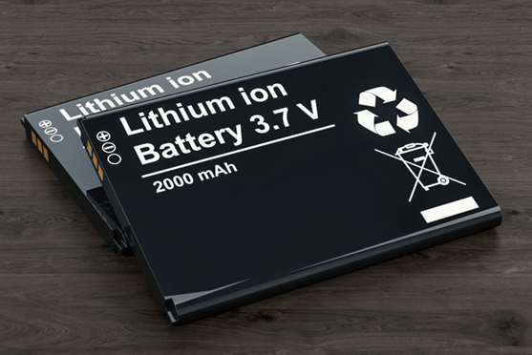
Lithium Battery Safety
Course Goal
This course trains workers and community members regarding the potential hazards of lithium batteries, safe handling practices, and what to do in case of emergency.
Notes:
Developed 8/2/2023

Slide 2
Acknowledgement
The Midwest Consortium for Hazardous Waste Worker Training created this program under cooperative agreement number U45 ES 06184 from the National Institute of Environmental Health Sciences (NIEHS).

Slide 3
Course Objectives
After completing this course, you will better be able to:
Identify devices that use lithium batteries
Describe potential risks of lithium batteries
Identify safe practices for lithium batteries, including use, charging, storage, and disposal
Identify action steps in case of a lithium battery emergency

Slide 4
Agenda
Types and Uses of Lithium Batteries
Potential Hazards
Usage
Charging
Storage
Disposal
Emergency Actions
Exercises

Slide 5
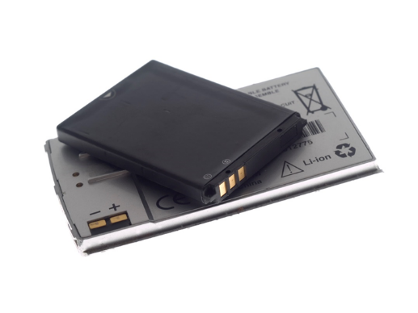
1. Types and Uses
Lithium batteries…
Are commonly used in many workplace and consumer products
Store a large amount of energy in a very small space
Are safe when handled correctly and are free from damage or defect
Notes:
Source: OSHA - https://www.osha.gov/sites/default/files/publications/shib011819.pdf

Slide 6
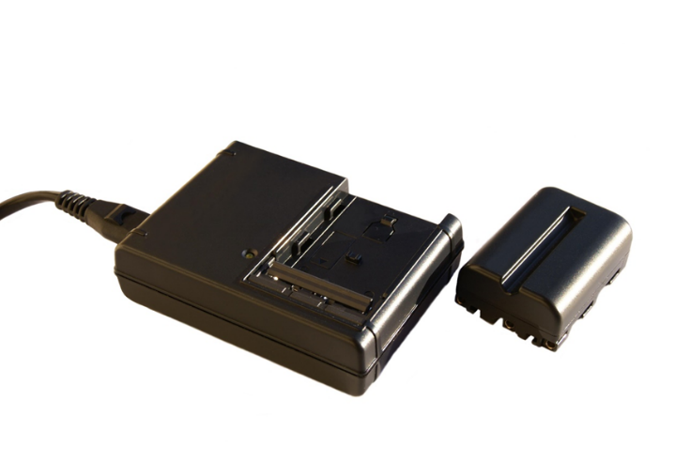
Lithium batteries in the news
Recent fires
E-scooter - Manhattan apartment fire
Electric wheelchair - Detroit apartment fire

Slide 7
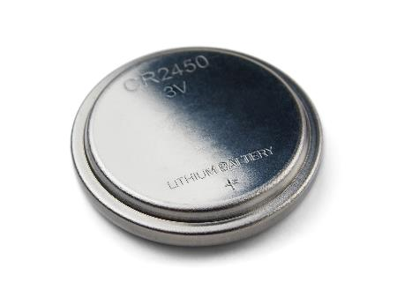
1. Types and Uses
Lithium-metal batteries are usually not rechargeable and are found in watches, car key fobs, and remote controls
They are usually shaped like a button

Slide 8
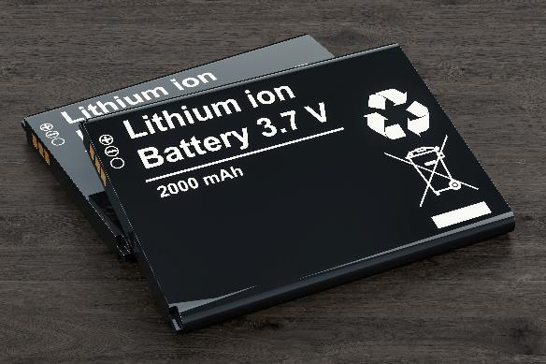
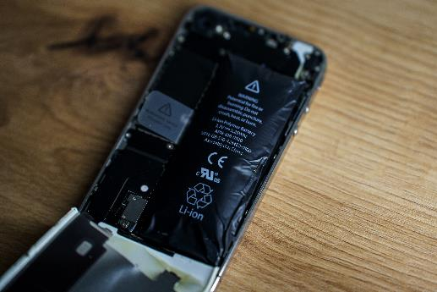
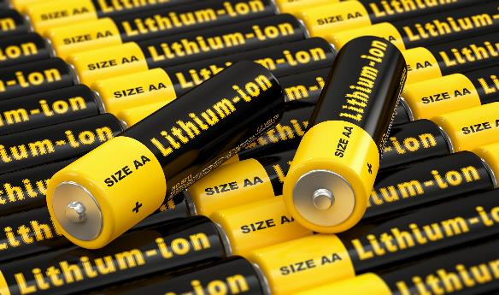
1. Types and Uses: Designs
Lithium-ion batteries are usually rechargeable and are used in devices such as cell phones, laptops, and cordless tools
Their shape can be:
Prismatic
Pouch
Cylindrical

Slide 9
1. Types and Uses
How are lithium-ion batteries used?

Slide 10
1. Types and Uses

Slide 11
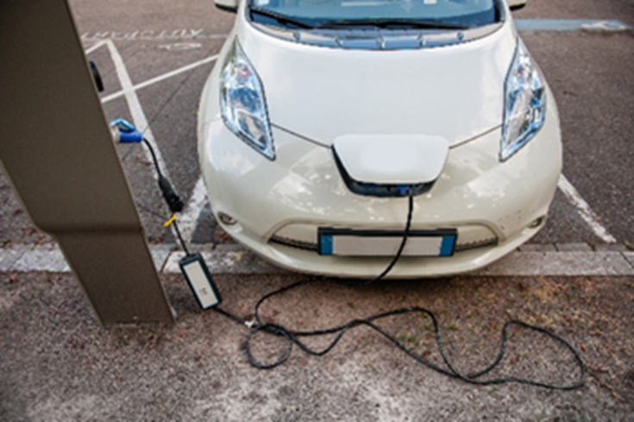
1. Types and Uses: Vehicles

Slide 12
2. Potential Hazards
Lithium-ion batteries are a potential hazard when damaged.
How are batteries damaged?
Physical damage – dropping, crushing, puncturing
Temperature extremes – flames, heaters, freezing
Improper charging
Notes:
Source: OSHA - https://www.osha.gov/sites/default/files/publications/shib011819.pdf

Slide 13
2. Potential Hazards
Lithium-ion batteries are a potential hazard if defective.
Like any other product, a small number of batteries are defective.
Signs of a defective battery are odor, change in color, giving off too much heat, change in shape, leaking, smoking, hissing.
Purchase devices and batteries from a reputable source, ideally with an appropriate test standard (e.g., UL 2054).
Notes:
Source: OSHA - https://www.osha.gov/sites/default/files/publications/shib011819.pdf

Slide 14
2. Potential Hazards
Fire – very hot, sustained, thermal runaway, may produce toxic gas
Explosion
Damaged or defective batteries can catch fire even when not being charged or in a device
Video showing what can happen when a lithium battery is punctured - Lithium battery fire

Slide 15
3. Usage
No federal standards (for example, OSHA) exist for lithium battery usage
Follow manufacturer instructions for using devices and batteries
Put batteries in device correctly
Use correct batteries with devices; do not use a battery in a way for which it is not intended
Keep batteries at room temperature; do not place batteries in direct sunlight, on hot surfaces, or keep them in hot vehicles
Inspect batteries regularly for damage
Notes:
Sources: NFPA - https://www.nfpa.org/-/media/Files/Public-Education/Resources/Safety-tip-sheets/LithiumIonBatterySafety.ashx; University of Washington - https://www.ehs.washington.edu/system/files/resources/lithium-battery-safety.pdf

Slide 16
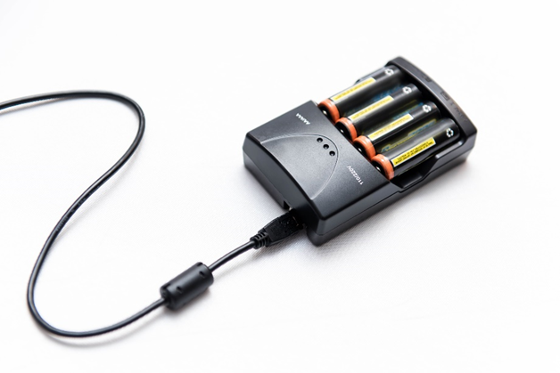
4. Charging
Fire can start during charging – e-bikes and
e-scooters in news recently
Follow manufacturer instructions for charging
Charge batteries with the correct charger
Do not overcharge; remove batteries from charger when fully charged
Do not charge a device under your pillow, on your bed or on a couch
Never charge disposable batteries
Charge and store batteries in a fire-retardant container if possible
Do not parallel charge batteries of varying age and charge status
Allow time for cooling before charging a battery that is still warm from usage and using a battery that is still warm from charging
Notes:
Sources: NFPA - https://www.nfpa.org/-/media/Files/Public-Education/Resources/Safety-tip-sheets/LithiumIonBatterySafety.ashx;University of Washington - https://www.ehs.washington.edu/system/files/resources/lithium-battery-safety.pdf

Slide 17
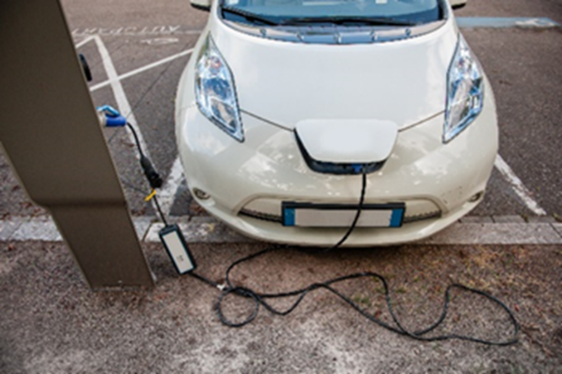
4. Charging – Electric Vehicles
Follow manufacturer guidelines when charging your vehicle.
Use a charging device that is certified by a nationally
recognized testing laboratory.
Plug Level I EV chargers directly into an outlet designed to
handle the amperage of the charging device. Never use a multiplug adapter or extension cord.
Install a ground-fault circuit interrupter (GFCI) with the charging unit. It will turn off the power if a fault is detected and help prevent a fire.
Place all charging device components out of reach of children when not in use.
Maintain the components of your charging station according to the manufacturer’s maintenance guidelines. Signs of excessive wear may indicate a potential shock hazard. Never use an EV charger with obvious signs of damage.
Cover the EV charging station outlet to stop water from entering. Check the manufacturer’s guidelines to make sure it is safe to charge your EV in wet conditions.
Notes:
Source: FEMA - https://www.usfa.fema.gov/downloads/pdf/publications/electric-vehicle-safety-handout.pdf

Slide 18
5. Storage
Store batteries away from anything that can catch fire
Store batteries and devices in dry locations at room temperature
Remove batteries from the device for long-term storage
Keep charged and depleted batteries separate (or keep a log)
If practical, store batteries in a metal storage cabinet
Visually inspect battery storage areas at least weekly
Charge batteries in storage to approximately 50% of capacity at least once every six months to preserve battery life
Notes:
Source: University of Washington - https://www.ehs.washington.edu/system/files/resources/lithium-battery-safety.pdf

Slide 19
5. Storage - Airplanes
Spare lithium batteries and battery chargers must be carried in carry-on baggage only.
Devices with lithium batteries such as laptops should be carried in carry-on baggage when possible. If in checked baggage, they should be powered off and protected from damage.
Notes:
Source: FAA - https://www.faa.gov/hazmat/packsafe/

Slide 20
6. Disposal
Do not put lithium batteries or devices containing lithium batteries in the trash or recycling bins - they could become damaged during processing and start a fire
Take them to a battery recycling location (Find battery recycle center) or follow your workplace protocol
Follow manufacturer information for disposal of damaged batteries
Tape battery terminals and/or place each battery in a separate plastic bag; do not make piles of discarded batteries
Notes:
Sources: NFPA - https://www.nfpa.org/-/media/Files/Public-Education/Resources/Safety-tip-sheets/LithiumIonBatterySafety.ashx;EPA - https://www.epa.gov/recycle/used-lithium-ion-batteries

Slide 21
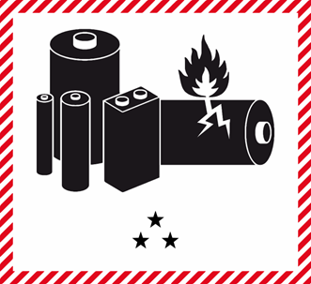
6. Disposal for Businesses
Most used lithium-ion batteries meet the definition of hazardous waste under the Resource Conservation and Recovery Act (RCRA)
Non-household waste generators will likely need to manage disposal under federal “universal waste” regulations in 40 CFR Part 273: 40 CFR Part 273
This may include requirements for employee training, labeling containers, length of time stored prior to disposal, and shipping

Slide 22
7. Emergency Actions
If you notice an odor, change in color, giving off too much heat, change in shape, leaking, hissing….
Stop using the battery
If you can do so safely…
Disconnect the battery and/or remove it from the device
Move battery away from other flammable items
Store battery in sand, dirt or kitty litter
Notes:
Source: NFPA - https://www.nfpa.org/-/media/Files/Public-Education/Resources/Safety-tip-sheets/LithiumIonBatterySafety.ashx

Slide 23
7. Emergency Actions: Fires
Call 911 if you need assistance
Follow manufacturer’s guidance on how to extinguish small battery fires, which could include using:
Class ABC dry chemical extinguisher
Class BC CO2 fire extinguisher
Sand, dirt, or kitty litter
Notes:
Sources: OSHA - https://www.osha.gov/sites/default/files/publications/shib011819.pdf;University of Washington - https://www.ehs.washington.edu/system/files/resources/lithium-battery-safety.pdf

Slide 24
7. Emergency Actions: Emergency Response Guidebook
The US Department of Transportation Emergency Response Guidebook offers guidance on lithium-ion battery emergencies.

Slide 25
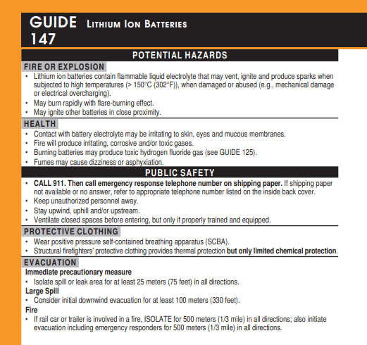
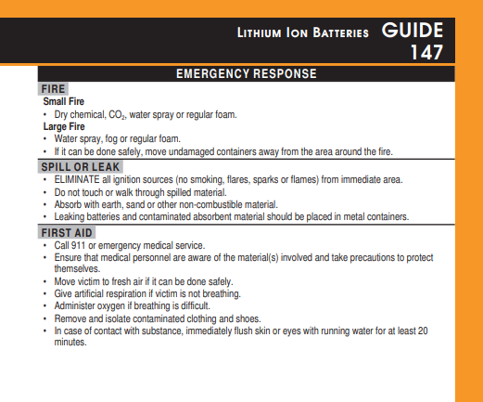
ERG 2020 – Guide 147 – Lithium-Ion Batteries

Slide 26
Resources
OSHA - https://www.osha.gov/sites/default/files/publications/shib011819.pdf
NFPA - https://www.nfpa.org/-/media/Files/Public-Education/Resources/Safety-tip-sheets/LithiumIonBatterySafety.ashx
FAA - https://www.faa.gov/hazmat/packsafe/
EPA - https://www.epa.gov/recycle/used-lithium-ion-batteries
FEMA - https://www.usfa.fema.gov/downloads/pdf/publications/electric-vehicle-safety-handout.pdf
University of Washington - https://www.ehs.washington.edu/system/files/resources/lithium-battery-safety.pdf

Slide 27
Summary
Lithium batteries are widely used at work and home
Damaged or defective lithium batteries are a fire and/or explosion risk
Lithium batteries should be properly used, charged, stored, charged, and disposed of properly
In case of lithium battery malfunction, try to remove the battery and move it away from flammable items

Slide 28
Exercise #1
In your small group discuss:
Where do you use lithium batteries at work? At home?
How can you more safely handle lithium batteries? Discuss usage, storage, charging, and disposal.
Does your workplace have a standard operating procedure (SOP) for lithium batteries? If not, how would you go about developing one?

Slide 29
Exercise #2
In your small group discuss the following scenarios:
Scenario 1: You’ve accidentally punctured the battery on your cordless drill. What should you do?
Scenario 2: You left your laptop on a heater, and you now notice smoke coming out of it. What should you do?
Scenario 3: You are charging several lithium batteries when you notice they are on fire. What should you do?
Scenario 4: You are in an accident involving several cars. One of them, a hybrid, is on fire. What should you do?

Slide 30
Exercise #3
In your small group, use the DOT ERG (Guide 147) for the following scenario.
At your workplace, lithium-ion batteries are stored/re-charged along the wall in a large room. The room contains some machinery and various chemicals. Several people are typically at work in the room. You notice a small fire coming from the batteries.
What should be your immediate action steps? What is the evacuation distance? What PPE should be worn?

