Slide 1
Using the TRI - Toxic Release Inventory
Copyright © 2024 Midwest Consortium for Hazardous Waste Worker Training

Slide 2
Acknowledgements
This program was developed by the Midwest Consortium for Hazardous Waste Worker Training under cooperative agreement U45 ES06184 from the National Institute of Environmental Health Sciences.
Content was updated January 29, 2024 and all web links are active as of that date; if you find an error, please inform the facilitator so that it can be updated.

Slide 3
Objectives
Access Toxic Release Inventory (TRI)
Demonstrate the use of TRI to:
identify local sources of emissions
identify chemicals being released
Identify violations of environmental laws
Discuss why this information is important

Slide 4
What is the TRI?
Go to https://www.epa.gov/toxics-release-inventory-tri-program/what-toxics-release-inventory and spend a few minutes scrolling through the page.
The Toxics Release Inventory (TRI) is maintained by the US Environmental Protection Agency (EPA)
It is a tool to access data about local industrial facility emissions to air, water and land
It provides information on the chemicals, volume and changes in emission over time
The data are self-reported by each facility

Slide 5
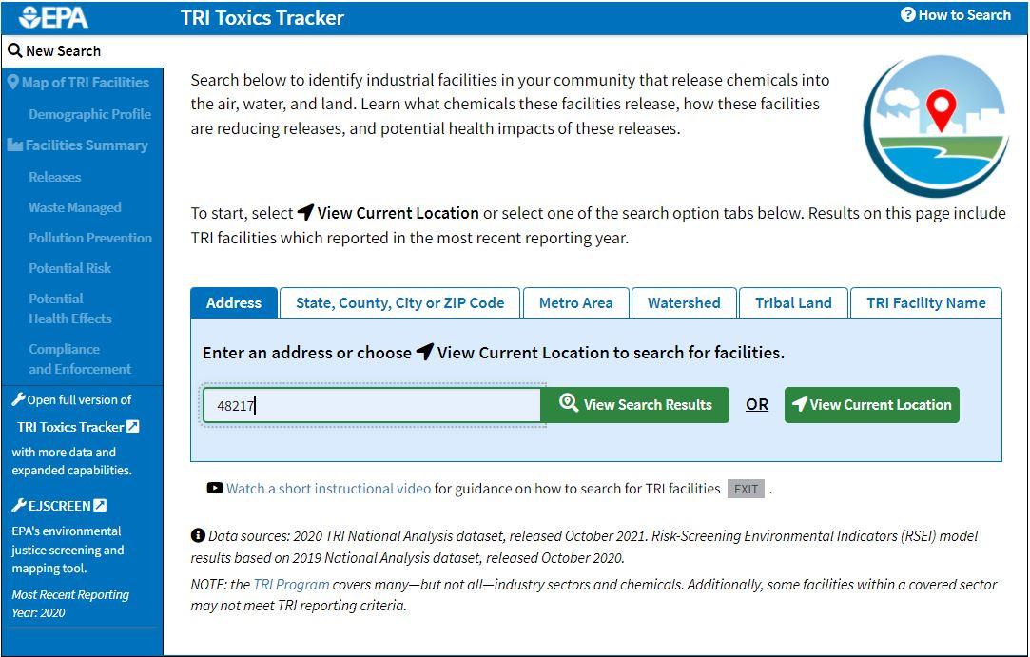
TRI website
Go to https://www.epa.gov/toxics-release-inventory-tri-program and scroll to the bottom to find the TRI Toxics Tracker.
Enter a zip code you are interested in. You’ll be able to compare it to 48217, which we will use as an example.

Slide 6
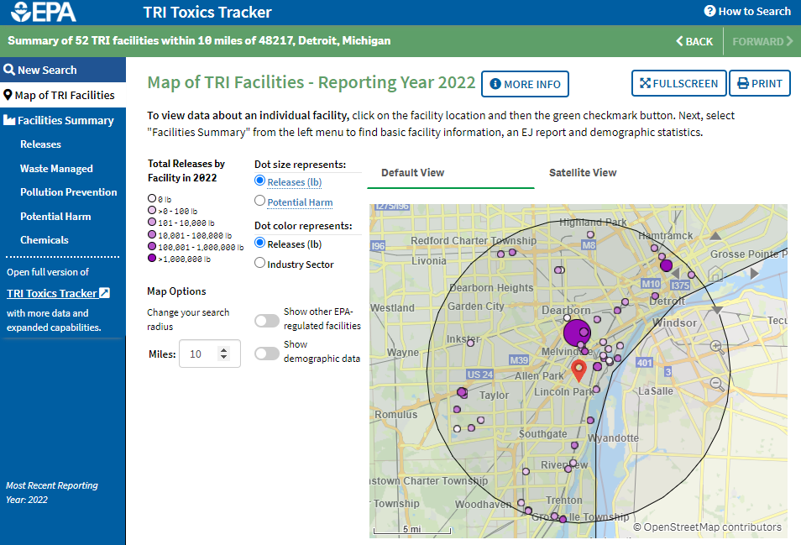
Map
Hover your mouse over the largest circle on the map to see the facility name. What is the industry sector?
How many facilities were found within 10 miles of your zip code?
This section is where you’ll explore for additional information. Select Facilities Summary next. Note if you click on one facility circle in the map, you will see information for only that one facility on future screens.
You can reduce or expand the search area here.

Slide 7
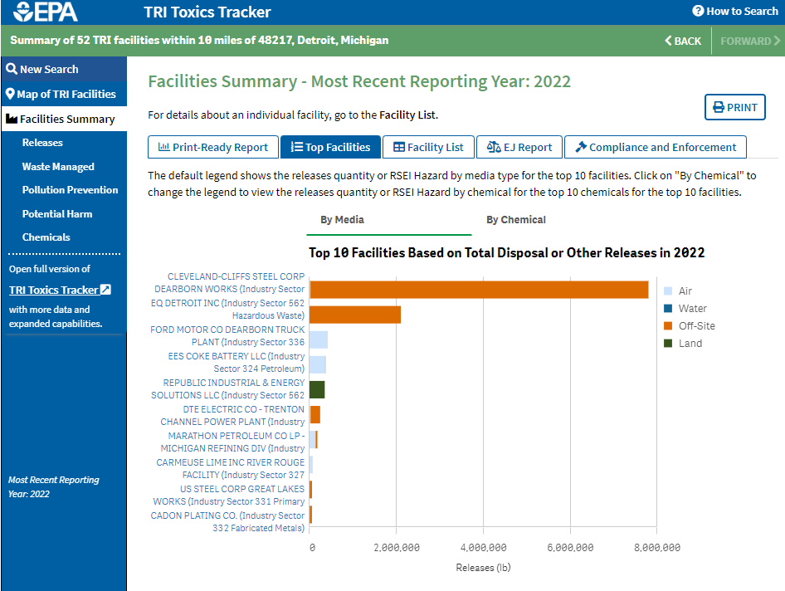
Facilities Summary
Select Compliance next
Select Top Facilities
Look through the Top Facilities list. What types of release do you see? Air? Water? Land? Off-site means the facility moves chemical waste to another location.

Slide 8
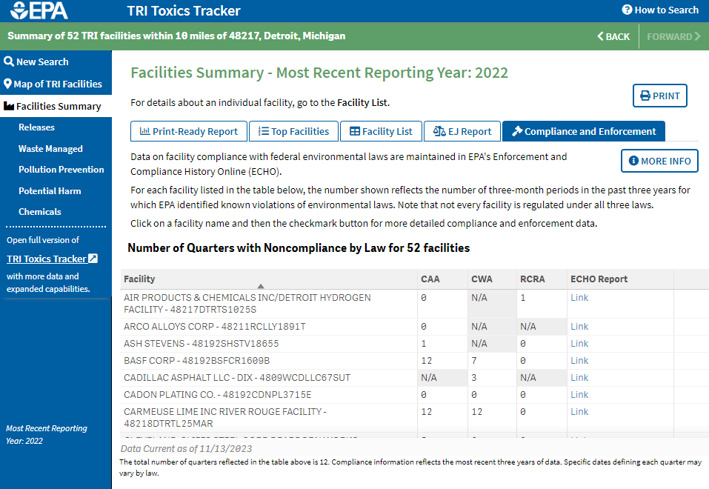
Compliance
CAA=Clean Air Act
CWA=Clean Water Act
RCRA=Resource Conservation and Recovery Act
Sort by column or scroll down to find facilities that have violated environmental laws
Select Releases next
Find a facility with violations and click on the ECHO Report to see details

Slide 9
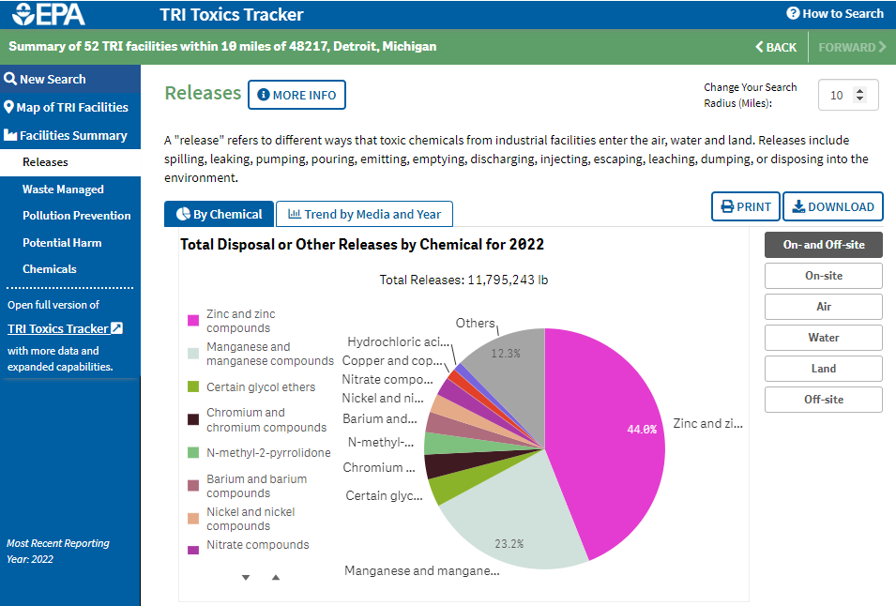
Releases
Next, click on Trend by Media and Year
You can get data for specific types of releases by selecting here.
What chemicals are most released?

Slide 10
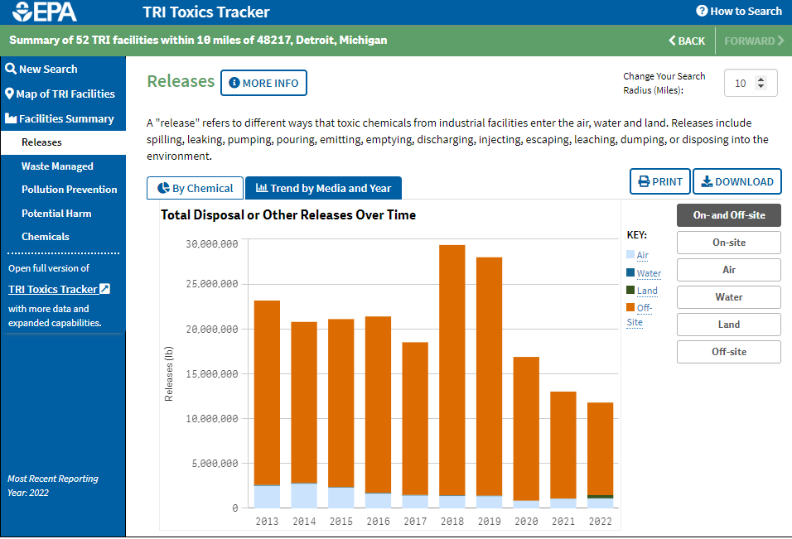
Release Trends
Are releases increasing or decreasing?
Select Chemicals next
Click here to get data for specific types of releases.

Slide 11
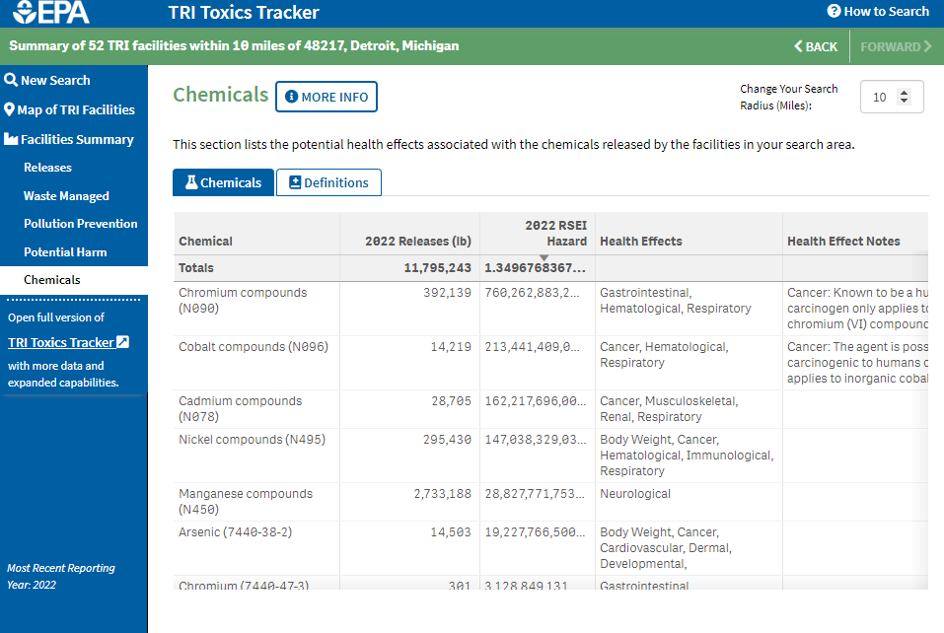
Potential Health Effects
Click on RSEI Hazard to sort in order of potential risk. You can scroll down the list.
What chemicals pose the greatest risk? What are the potential health effects?

Slide 12
Additional Exploration
EJSCREEN is the EPA’s EJ screening tool. Open a report here
Options to explore further:
Look at Pollution Prevention and Potential Harm here
Open the full version of TRI Toxics Tracker here

Slide 13
Additional Information
To better understand and use TRI, go to https://www.epa.gov/toxics-release-inventory-tri-program/find-understand-and-use-tri
Webinar recordings about TRI
How to better find TRI data
What’s happening at a TRI facility?
Learn how people are using TRI data
Understand the basics of risk
Read analyses of TRI data
Connect to other resources

Slide 14
Discussion - What You Can Do
Go to https://www.epa.gov/toxics-release-inventory-tri-program/tri-and-toxic-releases-what-you-can-do
Discuss the questions on the website:
What can I do with the TRI data I find?
What can I do if I think there's a problem at a facility?
What can I do if there's a facility-related emergency?
How can I find more information?

Slide 15
Disclaimer
The Midwest Consortium has copyrighted this material. A recipient of the material, other than the Federal Government, may not reproduce it without permission of the copyright owner.
The material was prepared for use by experienced instructors for the training of residents to identify sources and risks of exposures. Authors of this material have prepared it for the training of this target audience as of the date specified on the title page. Users are cautioned that the subject is constantly evolving. Therefore, the material may require additions, deletions, or modifications to incorporate the effects of that evolution occurring after the date of this material preparation.

