Slide 1
What is happening in my zip code?

Slide 2
Acknowledgements
This program was developed by the Midwest Consortium for Hazardous Waste Worker Training under cooperative agreement U45 ES06184 from the National Institute of Environmental Health Sciences.
Copyright © 2024 Midwest Consortium for Hazardous Waste Worker Training

Slide 3
Objectives
Tools are available to access data about emissions to air, water and land in your community.
Objectives
Access electronic resources to find local information
Demonstrate the use of these resources to identify emission sources and types of emissions in your zip code

Slide 4
MyEnvironment
The US Environmental Protection Agency (EPA) has websites available to gather environmental information about communities in our country.
You will use MyEnvironment to find information about your zip code. Information on how to access other helpful websites (TRI and ECHO) are in the Tools section at the end of this exercise.

Slide 5
MyEnvironment
At MyEnvironment you can access environmental data for a local community.
Access: type https://enviro.epa.gov/myenvironment/ into your browser.
Enter: zip code (Note: You can also enter a city, county, etc.)
You will be taken to the Home Page.

Slide 6
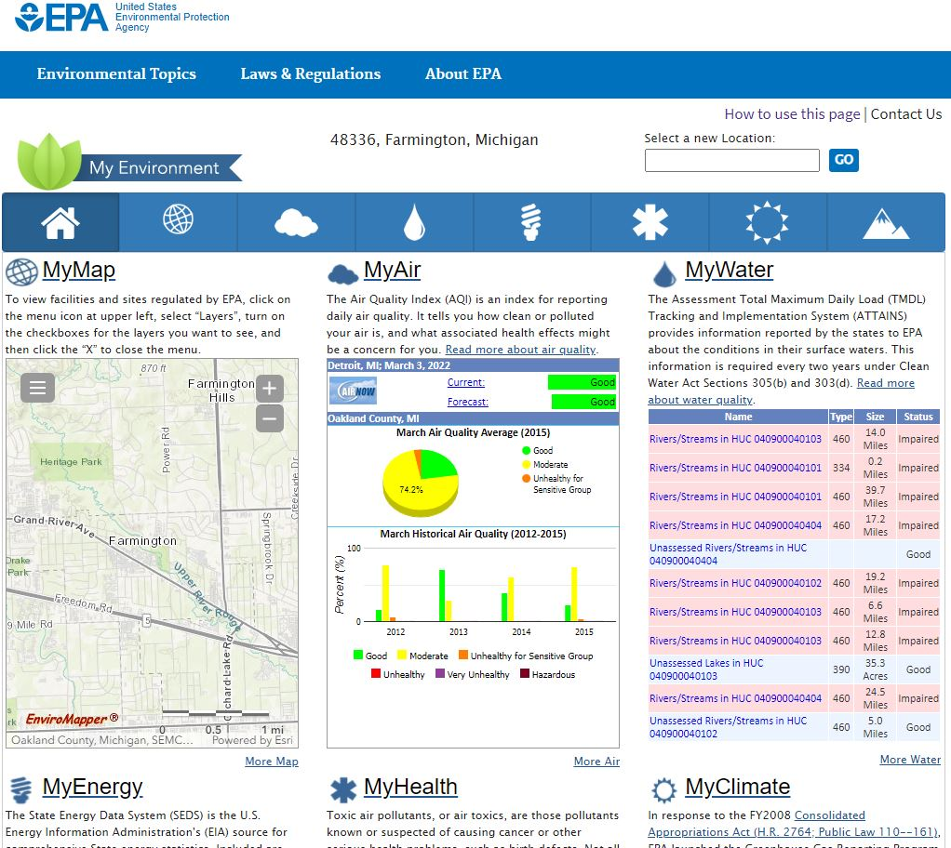
Home Page
At the top of the Home Page, and each page in MyEnvironment, is a blue tool bar of icons. Each icon is a shortcut to a specific topic. Hover over each to display the name of the topic, such as MyAir.

Slide 7
Home Page
How to use this page provides instructions on how to navigate this website.
The Home Page contains a summary of each topic.

Slide 8
Icons
The website has 7 screens (each represented by an icon in the tool bar):
MyMap - display or download a map of the EPA-regulated facilities for the selected area; customize your mapping using Select Map Contents.
MyAir - air quality index (AQI), radon and UV radiation information
MyWater - water quality and source information

Slide 9
Icons
MyEnergy - energy production and consumption; how to conserve
MyHealth - cancer and infant mortality and low birth weigh
MyClimate – greenhouse gas emissions, climate change indicators, your carbon footprint
MyLand - locate emergency incidents, Brownfields, NPL and hazardous waste links; Cleanups in my Community mapping

Slide 10
MyMap
MyMap: display or download a map of the EPA-regulated facilities for the selected area; customize your mapping using Select Map Contents.
Click on MyMaps from the top menu. A map of your zip code will appear.

Slide 11
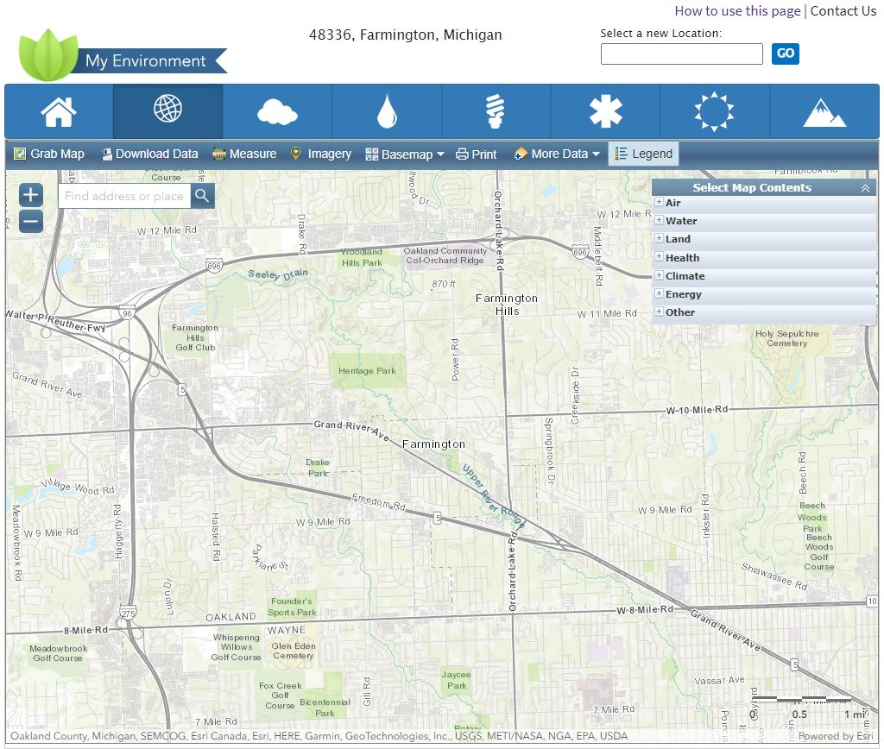
Map
The menu allows you to change the map to reveal different aspects of your area. Click on Legend.

Slide 12
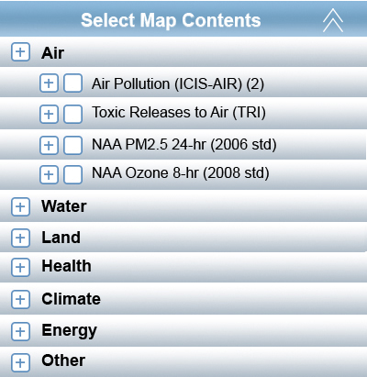
Map Contents
A pop-up menu will appear, Select Map Contents, listing the topics such as water, air, land, etc. Clicking any of these brings down another drop-down menu. Select the specific items you want to display on your map and icons will appear on the map corresponding to your selections.
The map contents relate directly to the site topics. You can explore the site topics and return to the map page to add areas of interest to your map.

Slide 13
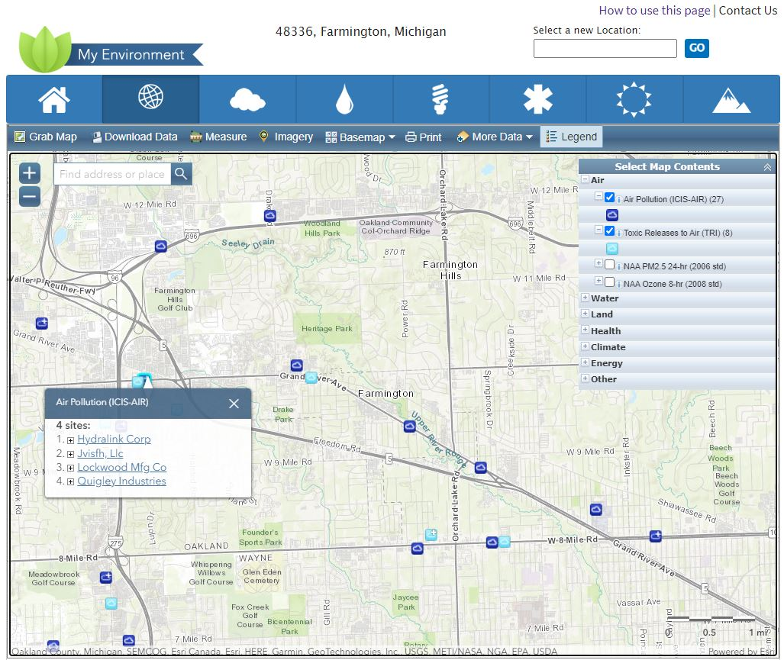
Map Symbols
Each cloud or other symbol on the map identifies an emission site or sites.
Click on a symbol and the name of the site(s) will appear.
Click on the name of a site and a new screen will open with details about that site

Slide 14
Exercise
Work in small groups to complete the worksheet using MyEnvironment.
One member of the group should be prepared to provide feedback to other participants.

Slide 15
Worksheet
Zip Code ________ Sources & Types of emissions identified:
Topics accessed (mark all that apply) MyMap Most useful part(s) of the website: MyAir MyWater MyEnergy MyHealth How I may use this in the community: MyClimate MyLand

Slide 16
Discussion
Discuss information reported by each group.
Identify needs for more information, and what resources are available.

Slide 17
More Information
Help to use MyEnvironment
Click on How to use this page (upper right-hand corner of Home Page.
More useful background for MyAir:
More definitions and links at:
https://www.airnow.gov/aqi/aqi-basics/

Slide 18
More Information
More useful background for MyWater:
States and Tribal Nations set standards, and then monitor the water to determine if the standard is met.
If the quality criteria is/are not met after implementing minimal levels of pollution technology then the source is categorized as ‘water quality limited’ or ‘impaired water’. These sources go onto the 303(d) list and a TMDL (Total Maximum Daily Load) for pollutants is calculated and monitored.
Water sources can also be listed if the quality data shows that the water is approaching non-compliance and might be expected in the next two year reporting cycle. See http://water.epa.gov/lawsregs/lawsguidance/cwa/tmdl/index.cfm.

Slide 19
More Information
More useful background for MyEnergy:
BTU=British Thermal Unit. The amount of energy needed to heat or cool a pound of water 1 degree Fahrenheit. A ton of coal is about 20 million BTUs (varies by type of coal); a gallon of #2 heating oil is about 140,000 BTUs; a thousand cubic feet of natural gas is about 1 million BTUs.
More useful background for MyHealth:
Click on more information or click to get the entire list for useful definitions and data.

Slide 20
More Information
More useful background for MyClimate:
Click on More links for more information.
More useful background for MyLand:
Click on EPA Brownfields Program, Waste Program Homepage or Superfund Hazardous Waste Sites and other links shown in blue type for details and definitions.

Slide 21
Tools - TRI
TRI - Toxic Release Inventory information for facilities in a selected area. This tool answers your questions about toxic chemicals released to the air, water and land at a specific facility, what health effects may result from exposure and the history of regulatory compliance at a facility.
This tool links to the Toxic Release Inventory data for a specific facility, where you can find the quantities of chemicals that are released, how the facility ranks compared with others and additional compliance data.
English and Spanish versions are available.

Slide 22
Tools - TRI
For use with any device:
Access: https://www.epa.gov/toxics-release-inventory-tri-program and then click on TRI Data and Tools
OR https://www.epa.gov/toxics-release-inventory-tri-program/tri-data-and-tools

Slide 23
Tools - ECHO
ECHO - Enforcement and Compliance History Online
This resource shows enforcement and compliance data for air, surface water, hazardous waste and drinking water systems. Approximately 800,000 regulated facilities nationwide are included. You can create maps and show trends, including pollutions sources, greenhouse gases, toxic chemicals and waste water discharges.
Access: http://echo.epa.gov/
Enter: city/state or zip code for all facilities
Enter: facility for specific information

Slide 24
Website Resources
TRI for Communities
https://www.epa.gov/toxics-release-inventory-tri-program/tri-for-communities
EnviroFacts one-stop data access, links to other resources http://www.epa.gov/enviro/

Slide 25
Disclaimer
Content was updated January 30, 2024 and all web links are active as of that date; if you find an error, please inform the facilitator so that it can be updated.
The Midwest Consortium has copyrighted this material. A recipient of the material, other than the Federal Government, may not reproduce it without permission of the copyright owner.
The material was prepared for use by experienced instructors for the training of residents to identify sources and risks of exposures. Authors of this material have prepared it for the training of this target audience as of the date specified on the title page. Users are cautioned that the subject is constantly evolving. Therefore, the material may require additions, deletions, or modifications to incorporate the effects of that evolution occurring after the date of this material preparation.

