Slide 1
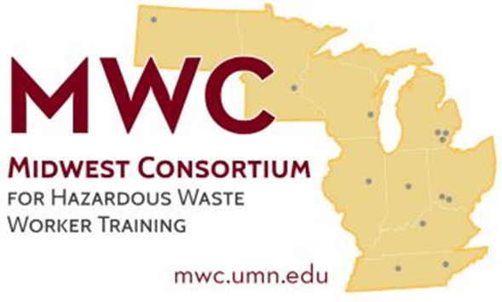
Mold Safety and Cleanup
Copyright © 2024 Midwest Consortium for Hazardous Waste Worker Training
Notes:
Developed April 16, 2024

Slide 2
Acknowledgements
This program was developed by the Midwest Consortium for Hazardous Waste Worker Training under cooperative agreement U45 ES06184 from the National Institute of Environmental Health Sciences. Neil Carlson at the University of Minnesota contributed content and images towards this program.
Content was created April 16, 2024 and all web links are active as of that date; if you find an error, please inform the facilitator so that it can be updated.

Slide 3
Objectives
When you complete this program, you will better be able to:
Recognize hazards related to mold and mold cleanup
Describe the investigation of mold and moisture problems
Identify how to protect yourself during cleanup
Describe steps for mold cleanup
Identify effective mold cleanup methods

Slide 4
Agenda
Module 1: Mold and Health Effects
Module 2: Inspection
Module 3: Cleanup

Slide 5
Module 1 - Mold and Health Effects
Objective:
Recognize hazards related to mold and mold cleanup

Slide 6
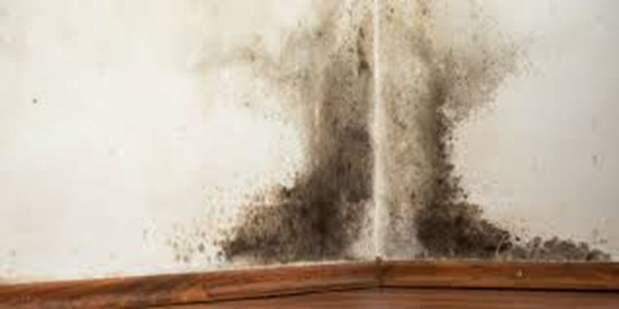
What is Mold?
Molds are part of the fungi kingdom, which includes yeasts, molds, and mushrooms
There are thousands of different species of mold
Mildew is a type of mold
Molds come in many colors
Mold growth on drywall above wood baseboard

Slide 7
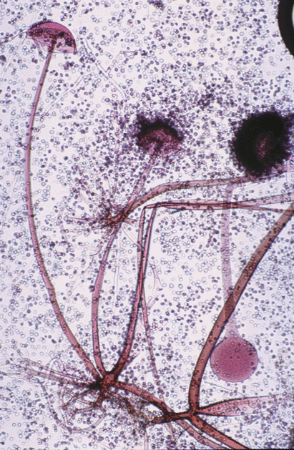
Mold as seen under a microscope
Rhizopus spp.

Slide 8
How does mold grow?
Mold needs 2 things to grow
Moisture
Food
Mold does not need light
Most mold grows best between 60 and 90 degrees
Mold thrives in warm, humid places like basements and bathrooms

Slide 9
Mold growth is usually a direct result of moisture
Moisture can come from many different sources
A leaky roof, pipe, sprinkler system, or HVAC system
Condensation on windows or due to cold spots in the building
Gutters and landscaping which do not sufficiently direct water away from the building’s foundation
Flooding
High humidity areas like bathrooms and basements/crawl spaces
Take away the moisture, and you’ll likely stop the mold growth

Slide 10
How does mold live?
Any organic material is a food source for mold
Mold slowly destroys the surface that it is growing on
Mold can grow on wood, insulation, drywall, carpet, wallpaper, and ceiling tiles
Mold grows on paper, cardboard, fabric, upholstery, and food
It can also grow in paint and dust/dirt (such as in HVAC systems)
Buildings are full of organic materials so when a building experiences a moisture problem, mold can grow

Slide 11
Moldy drywall
Aspergillus fumigatus growth on the back of sheetrock; Photo - Andy Streifel, University of Minnesota

Slide 12
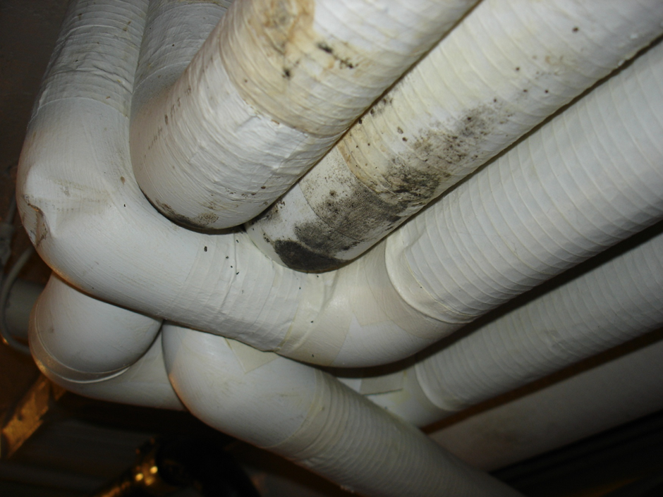
Moldy pipes
Mold growth on cold water pipes insulated with paper covered fiberglass
Notes:
Cold water pipes facilitate condensation from water vapor in the air. This can happen even when the pipes are insulated.

Slide 13
Moldy wood
Mold growth on the back of seats in a humid auditorium

Slide 14
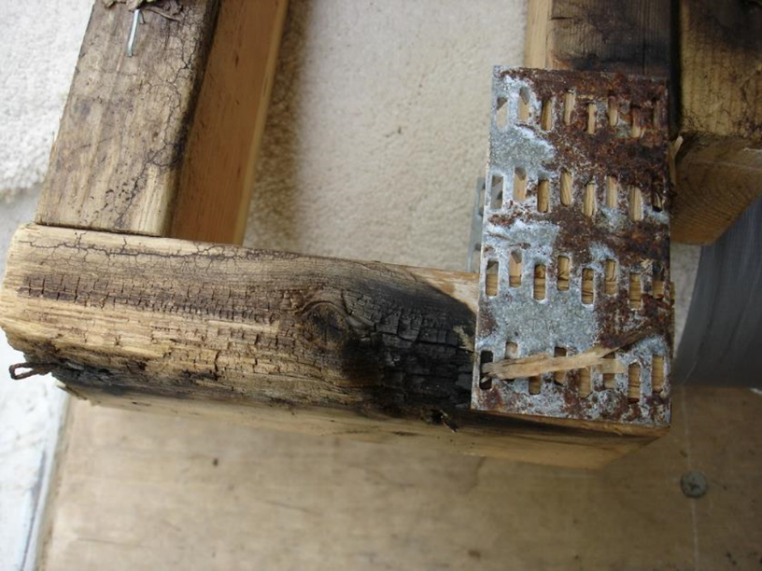
Wood rot caused by a basidiomycete on the wood frame of a house
Wood rot

Slide 15
Moldy books
Mold growth on books in a library with poor humidity control

Slide 16
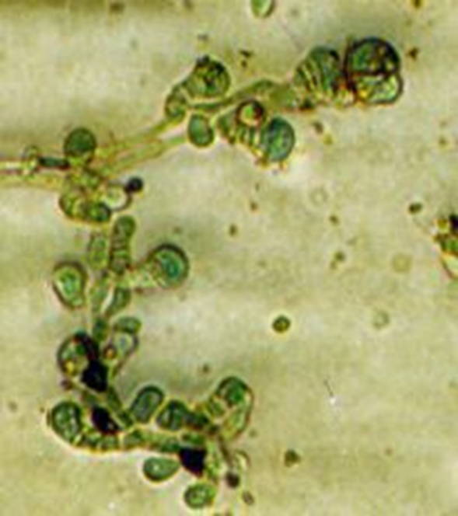
Molds reproduce through spores
Spores are released from mold and float through the air until they come to rest on a surface. If the surface is organic and damp, then mold may begin to grow.
Some species of mold start growing immediately while others can take about a week to form a visible colony.
Epicoccum spp. as seen under a microscope

Slide 17
Mold spores
Mold spores are so small that you generally cannot see them without a microscope.
They can enter buildings through open doors, windows, vents, and heating and air conditioning systems. They can also be brought indoors on clothing, shoes, bags, and even pets.
There are so many spores in the air that it is virtually impossible to get rid of them all. However, the level of mold spores can be controlled by controlling moisture.

Slide 18
Mold can cause health problems
Potential health effects from mold exposure vary from person to person
Most people who do not have mold-related allergies are not affected by typical airborne spores
Reactions to mold can be immediate or delayed
Dead mold may still cause health effects. It is not enough to simply kill the mold, it must also be removed.

Slide 19
Potential health concerns
Allergic Rhinitis – watery eyes, runny nose, sneezing, skin rash, headache
Allergic Asthma – shortness of breath, cough, wheezing
Hypersensitivity Pneumonitis – an allergic reaction affecting lungs
Diseases such as aspergillosis
Mycotoxins – poisonous substance produced by some molds

Slide 20
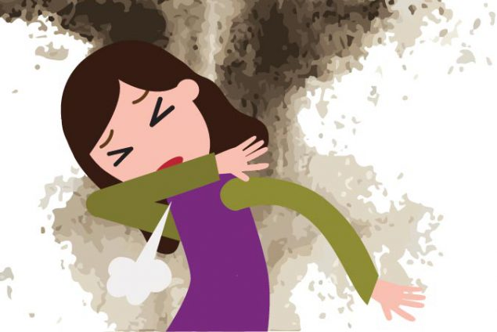
People at greatest risk
People with mold allergies
Asthmatics
Immunocompromised
People taking immunosuppressive drugs

Slide 21
What can make the health effect worse?
Amount of mold
Type of mold
Duration of exposure
Susceptibility of the person

Slide 22
Seasonal allergies vs. Mold
Seasonal Allergies Mold
Sneezing, runny nose, itchy eyes Sneezing, runny nose, itchy eyes
During pollen season After pollen season
Late-February to early Fall Year-round
Symptoms when outdoors Symptoms when indoors
Notes:
These comparisons apply generally.

Slide 23
Mold and Health Effects - Summary
Mold…
requires moisture to grow
can be found anywhere
reproduces through spores
can cause health problems and property damage

Slide 24
Module 2 - Inspection
Objective:
Describe the investigation of mold and moisture problems

Slide 25
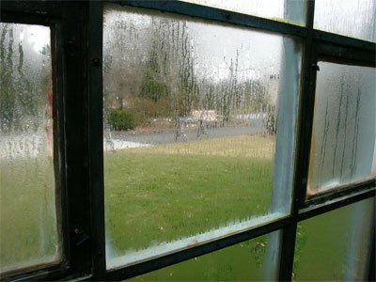
How is a mold problem detected?
Mold is suspected if… visible, there is water damage, or there is an unusual odor
Visible signs of mold include:
Growth on surfaces
Signs of water and potential damage include:
Discoloration on walls, floors, or ceilings
Standing water
Condensation on pipes or windows
Rotten wood
Mold often smells like:
Dirty socks
Stale, damp spaces
Window with condensation on inside

Slide 26
How to inspect
Visually inspect exterior and interior
Use camera to record inspection
Be sure to check hidden areas such as under carpet, behind drywall/wallpaper/baseboards, and crawl spaces

Slide 27
Inspection safety
Wear an N-95 mask and gloves
Do not touch mold or moldy surfaces with your bare hands
Do not get mold, spores, or fragments in your eyes
Do not breathe in mold, spores, or fragments
Do not eat or drink in areas where you suspect mold is present
Do not carry makeup, chewing gum, cigarettes, etc. into contaminated areas
Wash hands after inspection

Slide 28
Exterior issues
Gutter missing downspout
Downspout close to foundation
28
Notes:
28

Slide 29
Lawn sprinkler spraying brick dormitory wall; Photo - Mike Buck, University of Minnesota

Slide 30
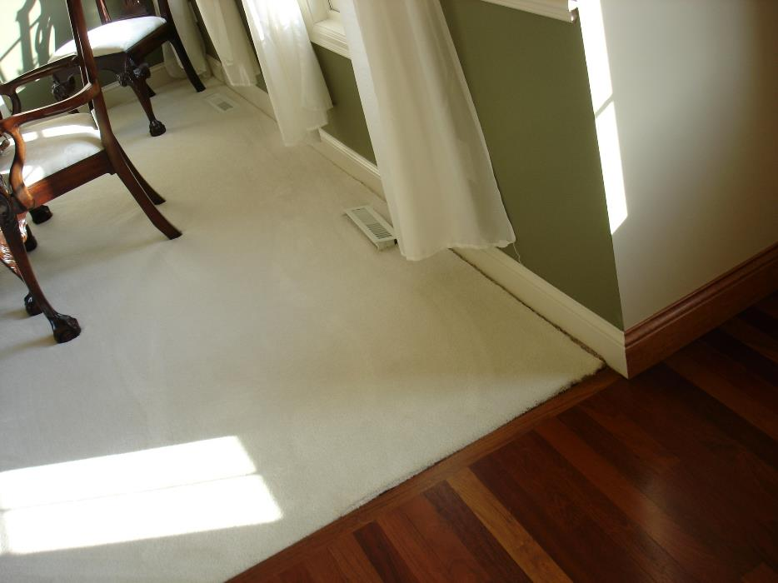
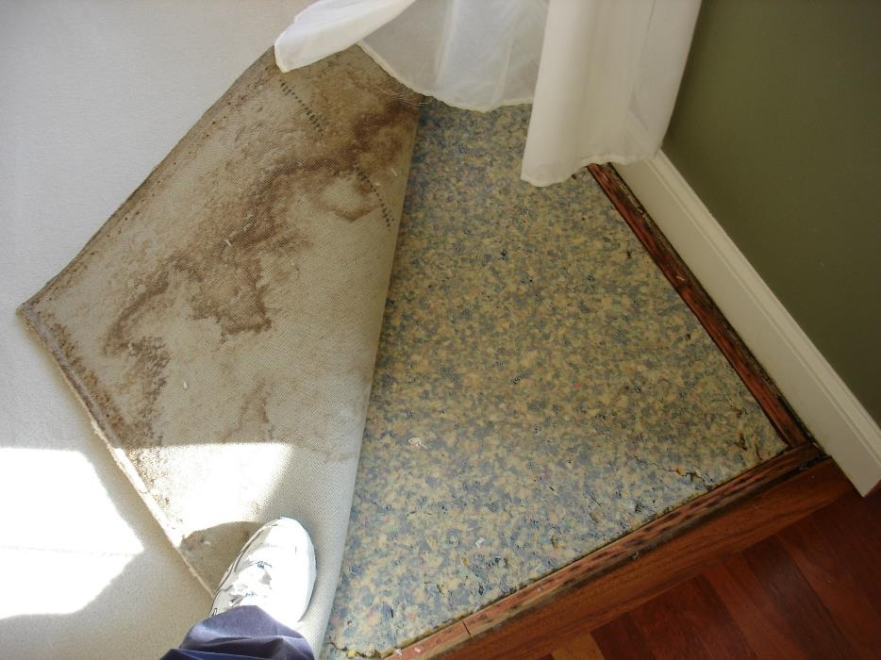
Carpet pulled back
Water stains on the back of a living room carpet showing evidence of multiple water events

Slide 31
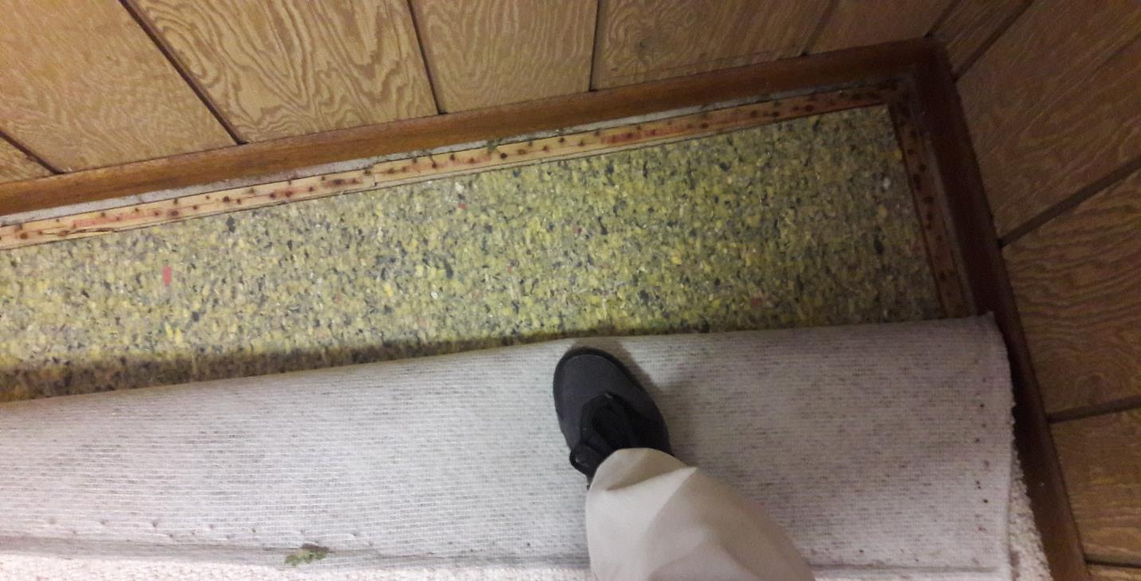
Rust stains on the back side of the carpet and on the carpet tack strip in a basement

Slide 32
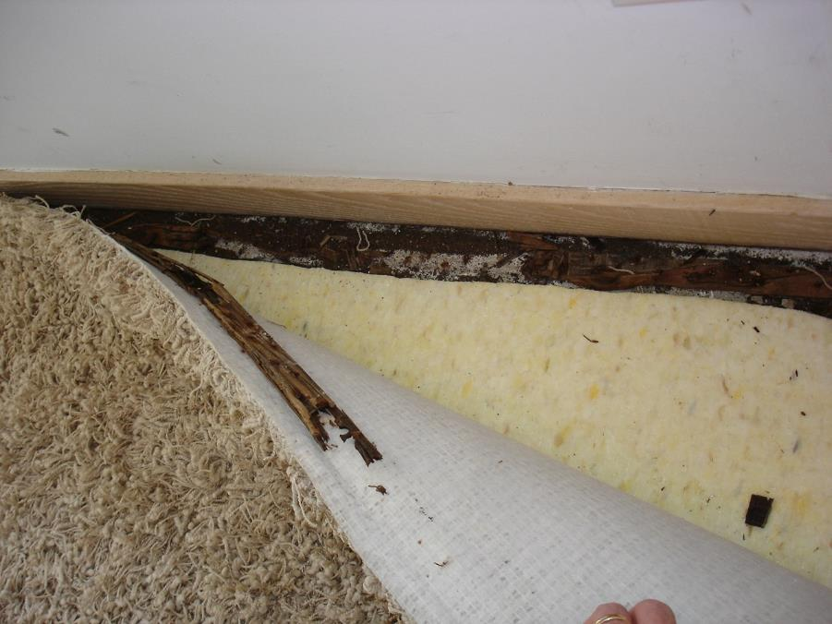
Poor exterior wall construction
Ice under lower level window
Wood rot on carpet tack strip with heavy water damage

Slide 33
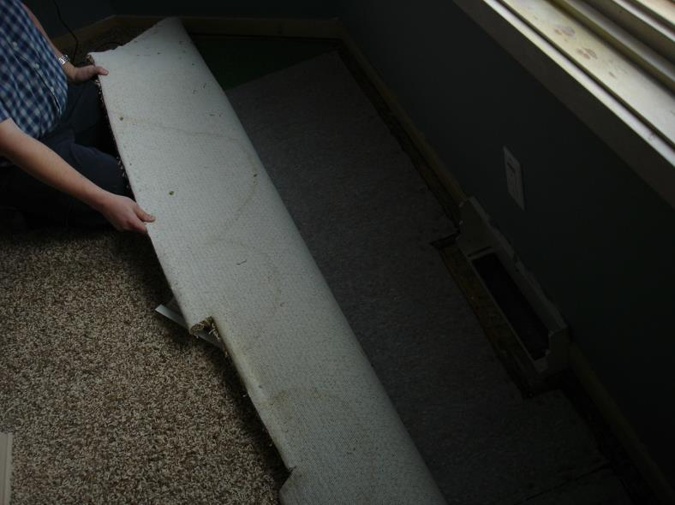
Condensation and moisture intrusion
Carpet water stains
Condensation and ice on lower level window

Slide 34
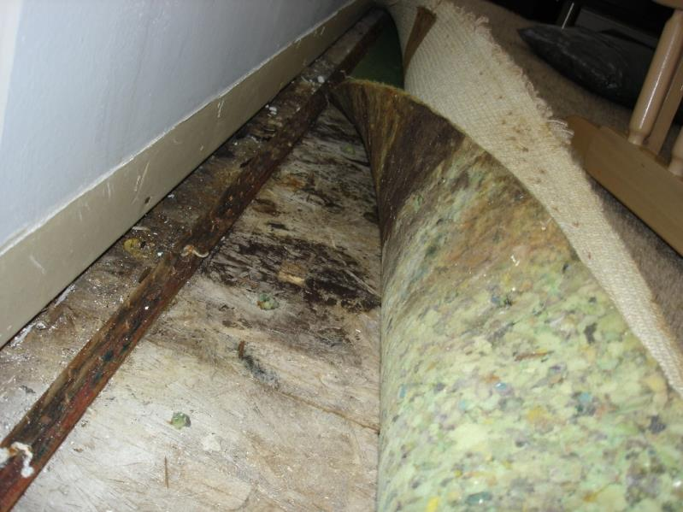
Exterior water infiltration
Mold growth on subfloor caused by water infiltration from adjacent deck

Slide 35
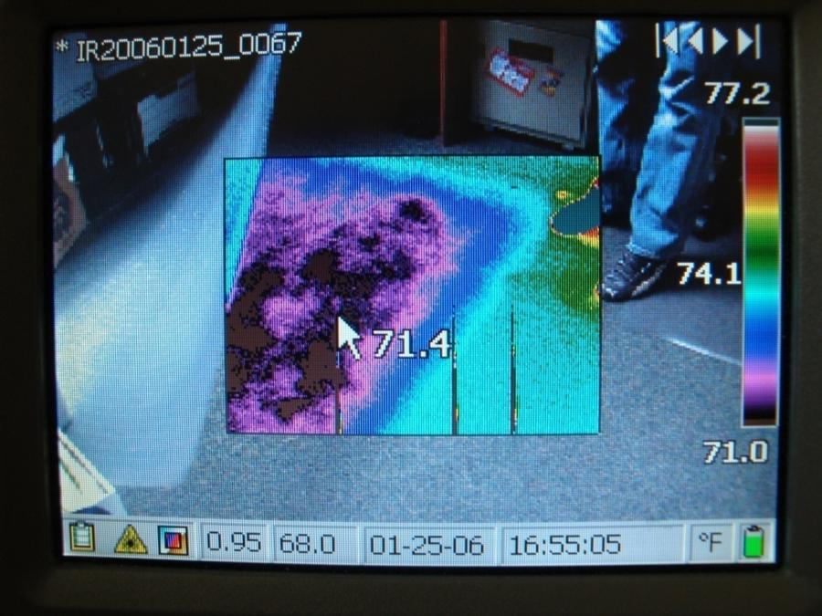
Visual and infrared image of sub slab moisture trapped under a chair mat
Moisture and mold can be hidden. See what happens when an Infrared Camera is used.

Slide 36
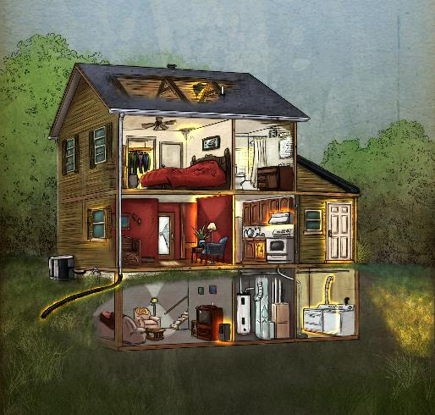
Interactive Mold House Tour
Tour the EPA Mold House room-by-room to learn about common mold issues and how to address them.
https://www.epa.gov/mold/interactive-mold-house-tour#top

Slide 37
Sampling
Sampling is not necessary before cleaning up mold.
If a visual inspection reveals mold growth or damage, that is sufficient reason to clean up.
It is not necessary to identify specific mold species.

Slide 38
Module 2 Summary
Mold is suspected if it is visible, there is water damage, or there is an unusual odor
Mold is often hidden
Inspect thoroughly to find all mold and the moisture problem
Protect yourself while investigating

Slide 39
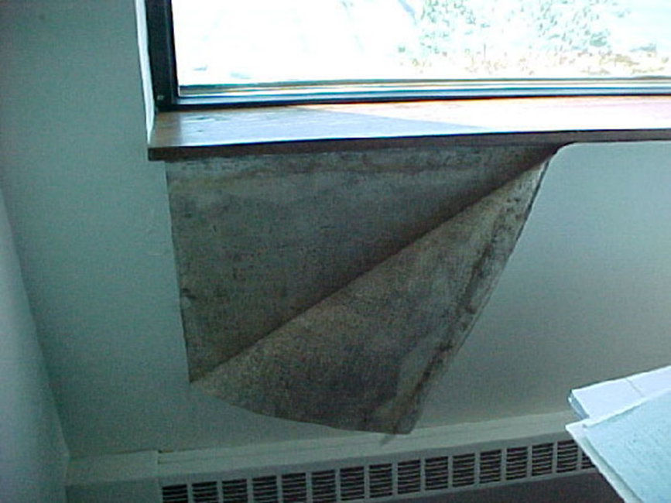
Exercise: Inspection Scenario 1
Your kids peel back some wallpaper in your home and find mold. See picture.
What should you do? Where else should you look?
Vinyl wall cover with mold growth under a window

Slide 40
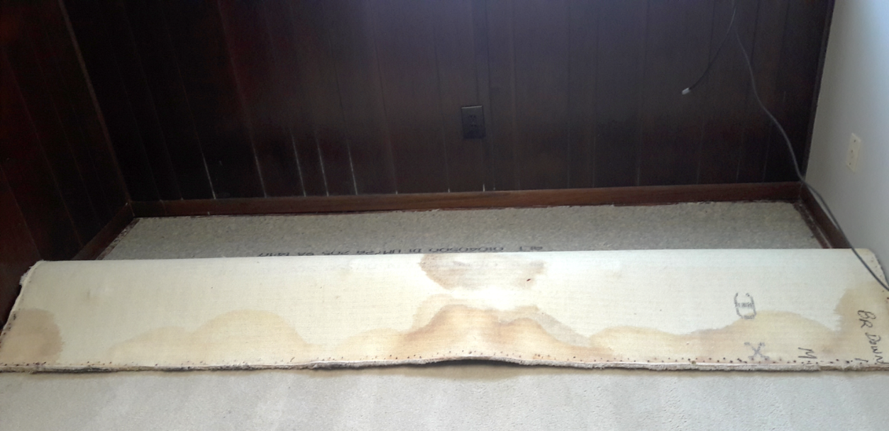
Inspection Scenario 2
You notice a musty smell in a spare bedroom and find this when pulling back the carpet. What should you do? Where else should you look?
Water stains on a basement carpet showing evidence of multiple past water events

Slide 41
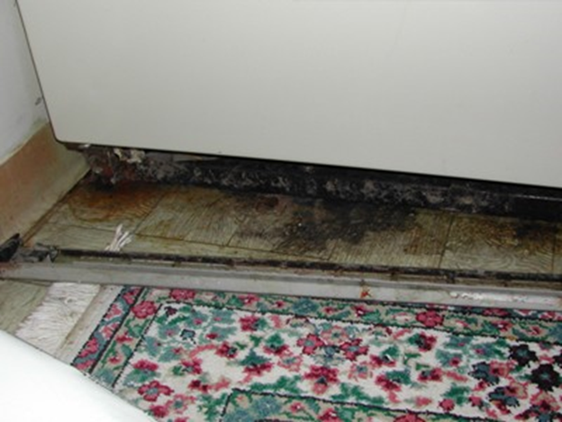
Inspection Scenario 3
Your spouse discovered mold under the refrigerator.
What should you do? Where else should you look?
Mold growth under a refrigerator

Slide 42
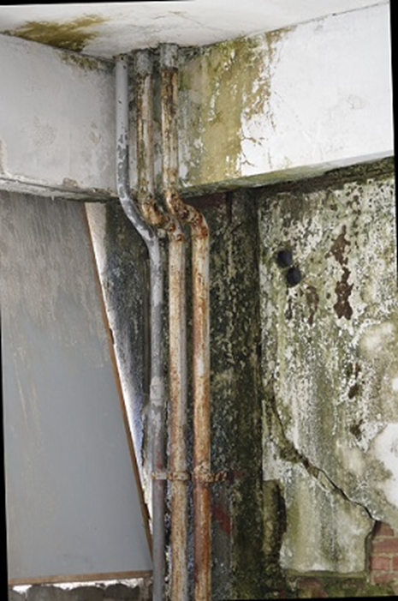
Inspection Scenario 4
In a dark corner of your basement you notice this.
What should you do? Where else should you look?
Green mold growth from ceiling to floor

Slide 43
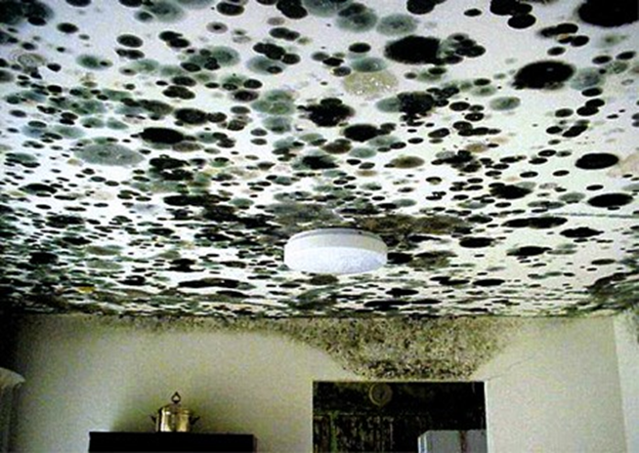
Inspection Scenario 5
You return home from a long vacation and your apartment looks like this picture.
What should you do? Where else should you look?
Mold growth on a ceiling

Slide 44
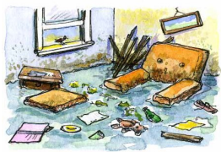
Module 3 - Cleanup
Objectives:
Identify how to protect yourself during cleanup
Describe steps for mold cleanup
Identify appropriate mold cleanup methods

Slide 45
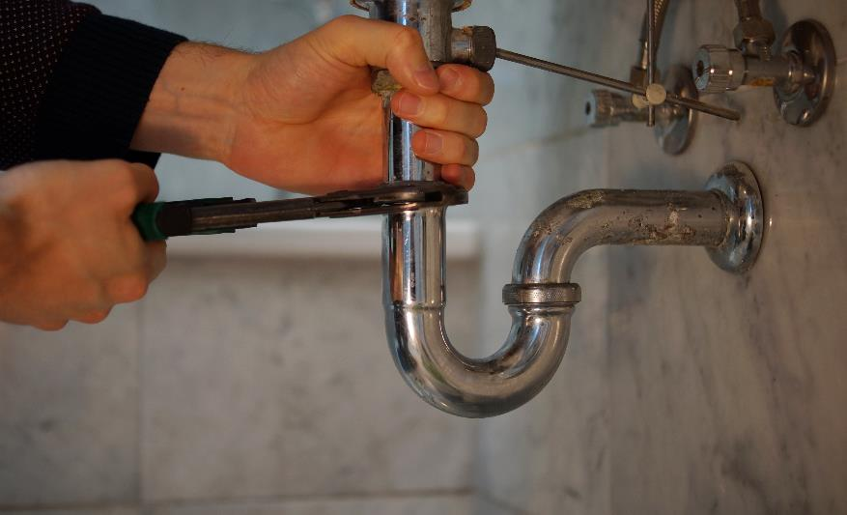
Identify the source of water or moisture
To fix a mold problem, you must remove the damaged and contaminated materials AND you must fix the source of the moisture.
Landscaping or fixing gutters can solve some moisture problems.
If the problem is leaky plumbing, roof, or HVAC system, you may need the help of other professionals.

Slide 46
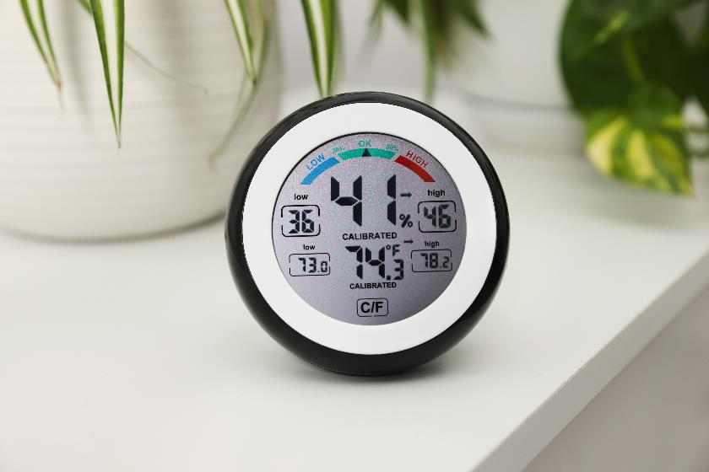
Identify the source of water or moisture (cont.)
Humidity-related problems can be aided by installing ventilation fans or dehumidifiers.
When the relative humidity of a room or building is between 30% and 60%, mold growth will likely be held in control during spring through fall. Wintertime humidity may need to be below 30% to prevent condensation on cold surfaces.
Humidity can be measured with a hygrometer, which can be purchased inexpensively

Slide 47
How to enter after a flood?
Make sure electricity and gas are turned off. Check for loose power lines, gas leaks, structural problems like sagging ceilings or floors.
Wear N-95 respirator, goggles, gloves. Shower and wash clothing afterward.
Don’t wade through water.
Use battery-powered flashlights.
Determine if water was clean, gray, or black.
Take pictures of damage and damaged items.
Open all windows and doors unless humidity is higher outside.
Notes:
Black water is the wastewater from bathrooms and toilets that contains fecal matter and urine. Water from kitchens and dishwashers is also considered blackwater due to the contamination by pathogens and grease. Gray water is the wastewater that comes from sinks, washing machines, bathtubs, and showers. It contains lower levels of contamination.

Slide 48
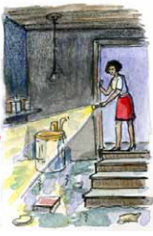
Contaminated water
The following guidelines are for damage caused by clean water.
If you know or suspect that the water is contaminated with sewage, or with chemical or biological pollutants, then an experienced professional should be consulted.
Do not use fans until you have determined that the water is clean or sanitary.

Slide 49
Should you clean it yourself?
Consider professional help if:
The mold is more than 10 square feet (3 feet by 3 feet)
You think the heating/air conditioning/ventilation system is moldy
You think the damage was caused by sewage or contaminated water
You have health concerns
There is a lot of water damage
If you hire someone, make sure they have experience in mold remediation and follow appropriate guidelines

Slide 50
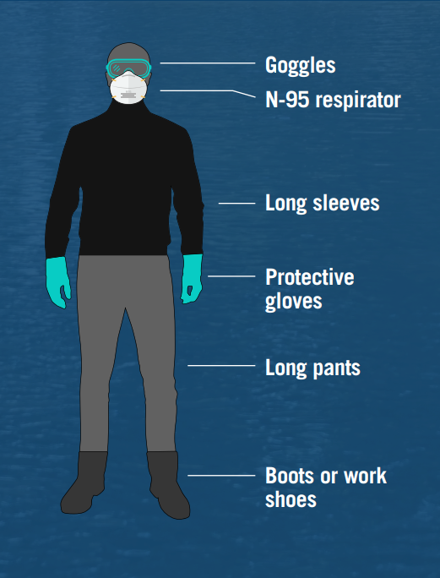
What to wear?

Slide 51
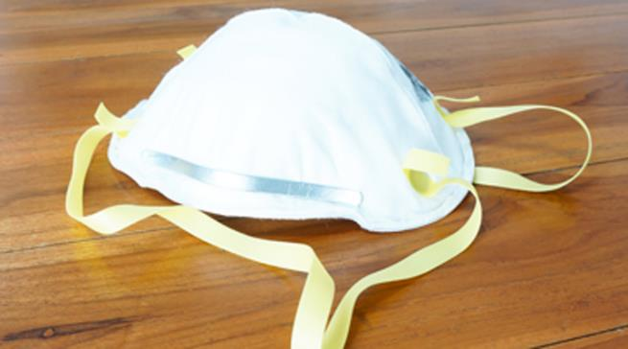
N-95
For mold cleanup, an N-95 respirator is generally used.
An N-95 single-use respirator is:
• N - not resistant to oil
• 95 - removes 95% or more of airborne particulate
The percent of particulate removed assumes a very good seal between the face and the mask. Facial hair impacts the fit of a respirator.

Slide 52
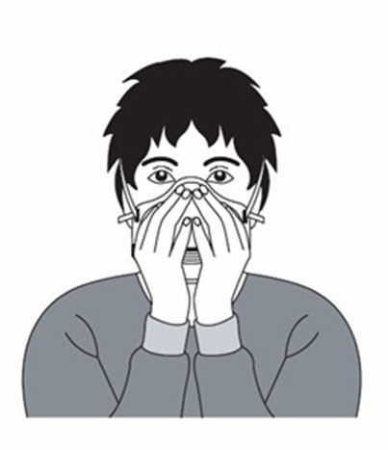
Wearing an N-95
Select an approved respirator
Place over nose, mouth, and chin
Fit flexible nose piece over nose bridge
Secure on head with elastic straps
Adjust to fit
Perform a fit check
Inhale: respirator should collapse
Exhale: check for leakage around face
Video – OSHA https://www.youtube.com/watch?v=oiNwfhvhVfI

Slide 53
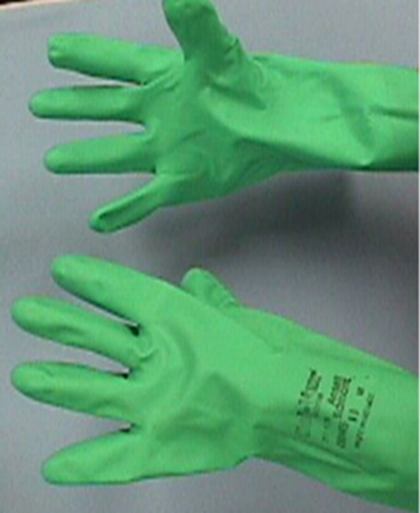
Gloves
Protect the skin from contact with mold and potentially irritating cleaning solutions. Long gloves that extend to the middle of the forearm are recommended.
If a mild soap detergent is being used, ordinary household rubber gloves are suitable..
The routine use of chlorine bleach or strong cleaning solutions is not recommended. If you choose to use bleach or a strong cleaning solution, gloves should be made from natural rubber, neoprene, nitrile, polyurethane, or polyvinylchloride (PVC).

Slide 54
Goggles
Properly fitted goggles provide eye protection
Goggles must be designed to keep out dust and small particles
Safety glasses or goggles that have open vent holes are not acceptable

Slide 55
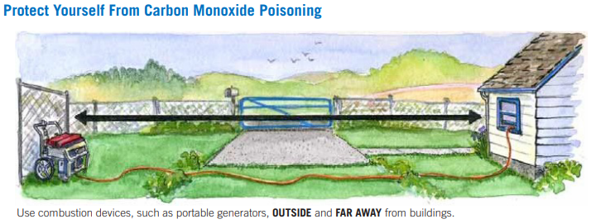
Generator safety

Slide 56
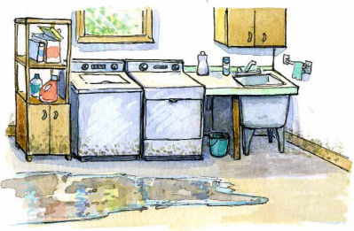
Remove standing water
Your first step will be to remove all standing water as soon as possible
A wet vacuum can be used

Slide 57
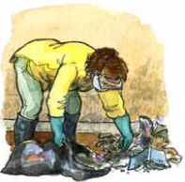
What should be thrown away?
Throw away all porous items that have been wet for more than 48 hours and that cannot be thoroughly cleaned and dried
This includes carpeting and carpet padding, upholstery, wallpaper, drywall, ceiling tiles, insulation, bedding, mattresses, curtains, some clothing, leather, paper, some wood and wood products, some toys
Throw away unsafe food
When in doubt, throw it out

Slide 58
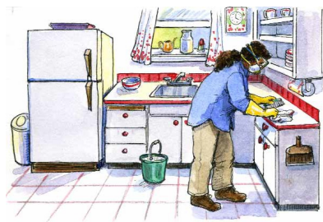
What can be cleaned?
Hard, nonporous surfaces such as stainless steel, metal, glass, hard plastic
Ducts
Wood and concrete if structurally sound
Maybe carpet and drywall
EPA video Things to Keep, Clean, or Remove

Slide 59
How to clean?
Clean and dry out as quickly as possible. If not able to dry everything within 24-48 hours, assume you will have mold growth.
Open cabinet doors, drawers.
Use fans and dehumidifiers. If mold is already growing, fans should only blow air out windows and doors to prevent spreading spores indoors.
Use wet vacuum to remove water and clean items such as studs or exposed wood framing.
Any part of HVAC system that was submerged should be thoroughly cleaned so as to not spread mold. Moisture can also collect in parts of system that were not submerged.
There may be hidden mold.

Slide 60
Use what to clean?
Wash surfaces with soap and warm clean water
Scrub hard surfaces like tile, concrete, stone, and wood with a stiff brush and soapy water
Disinfect all cleaned surfaces with a 10% bleach solution (approximately 1 cup of bleach per 1 gallon of water). Let the solution stay on the surface for at least 10 minutes before rinsing with clear water or allowing to dry
Never mix bleach with ammonia as this can create a toxic gas that can injure your lungs or even kill you
Notes:
Mixing bleach and ammonia can create chloramine gas. Chloramine gas is toxic and can injure your lungs or even kill you.

Slide 61
Damp wipe
A worker with a gloved hand uses a damp sponge to clean a surface

Slide 62
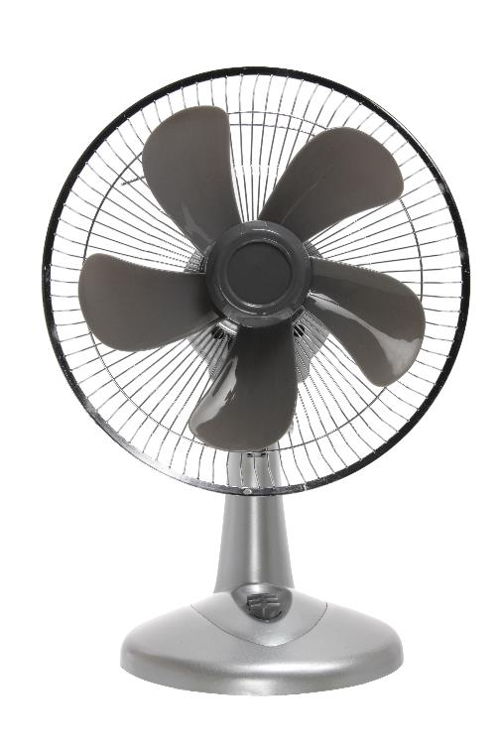
How to reduce mold exposure
Minimize disturbance of mold (breaking moldy wallboard, peeling wallpaper)
Ventilation
Air filtration
Clean environment
Humidity control

Slide 63
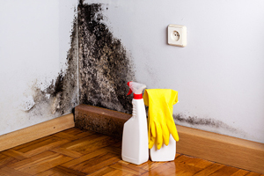
Exposures besides mold
Biocides are toxic. Use of a biocide such as chlorine bleach is not recommended as a routine practice in mold remediation.
Do not use fungicides developed for outdoor use in any indoor application.
Corner mold growth on dry wall with gloves and spray bottle

Slide 64
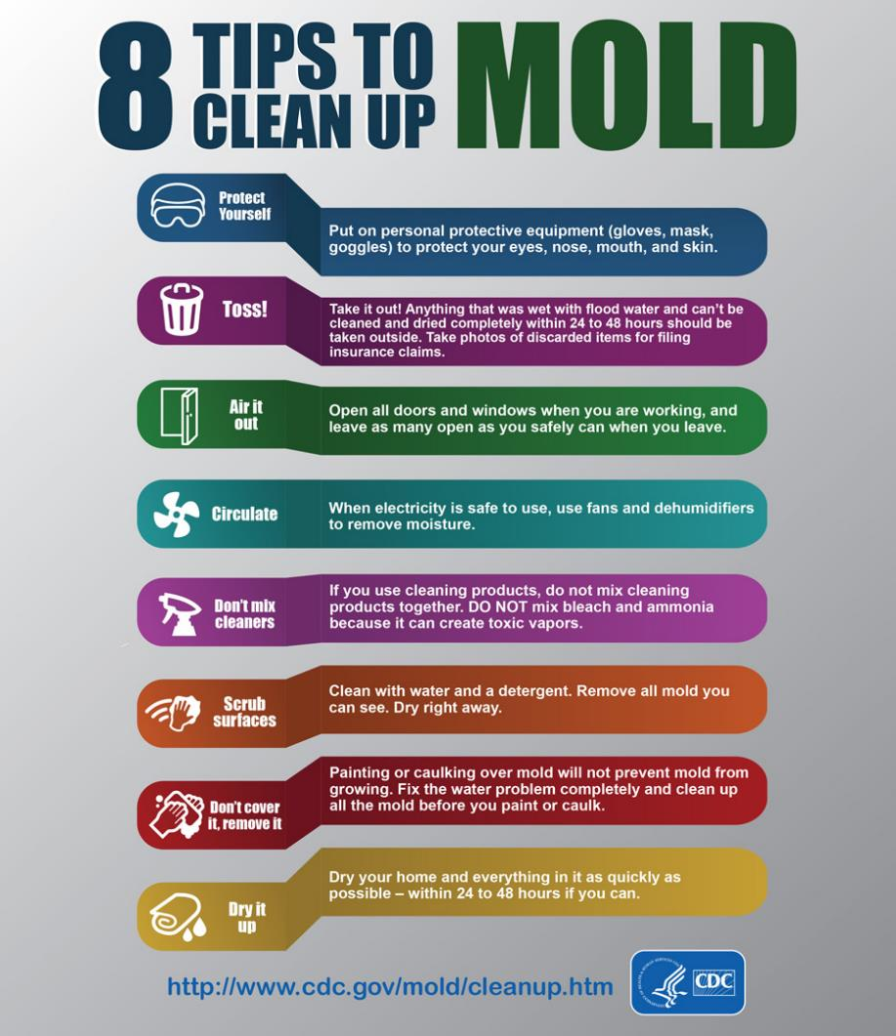
Mold cleanup tips

Slide 65
EPA flood cleanup videos
The EPA has many short videos on flood cleanup topics such as entering your home, what to wear, removing standing water, drying everything out, and trash disposal.
https://www.epa.gov/flooded-homes

Slide 66
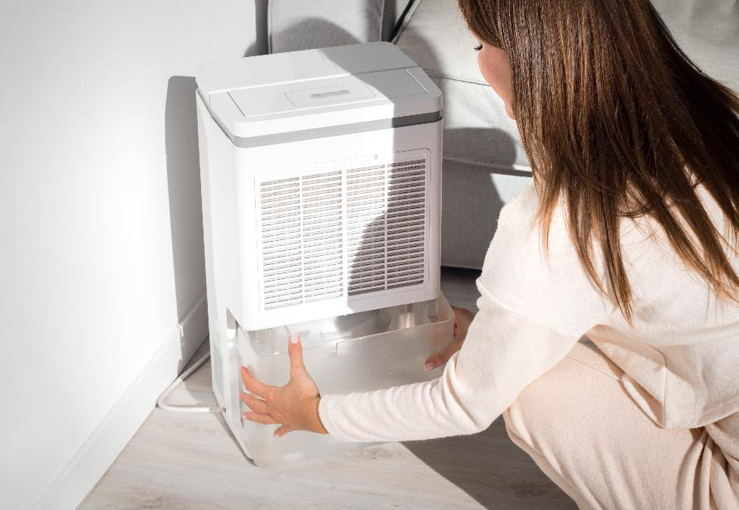
Mold Prevention
Keep home dry, clean, and well ventilated
Keep humidity low, 30-50% if possible
Perform routine maintenance/repairs of HVAC, bathrooms, furnace humidifiers, landscaping/foundations
When things get wet, dry them quickly (24-48 hours)
Consider anti-microbial paint

Slide 67
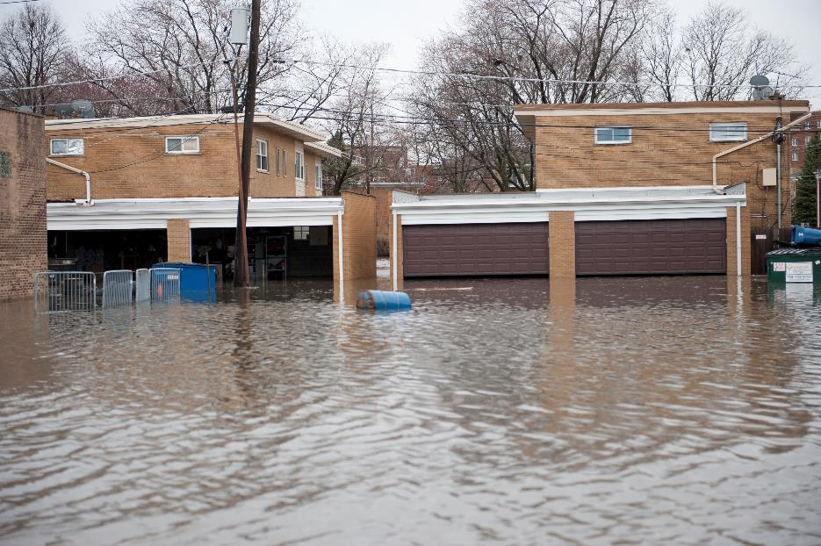
Module 3 Summary
Wear appropriate clothing and equipment during mold cleanup
Some items can be cleaned and others should be tossed
Use best practices to clean moldy areas

Slide 68
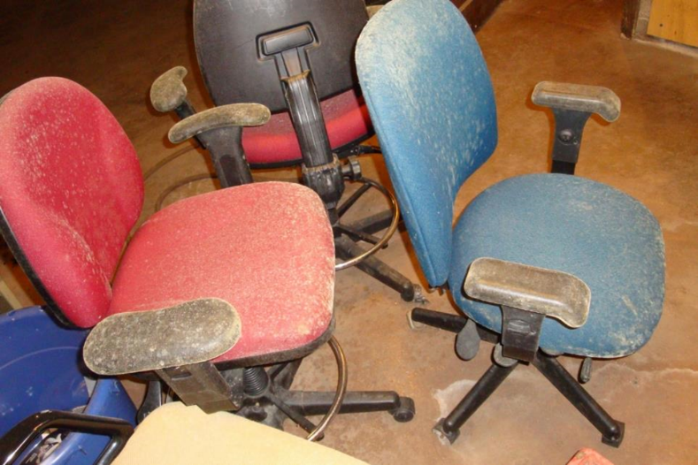
Exercise: Cleanup Scenario 1
You discover mold on chairs in your basement. See picture.
Should you clean these? If so, how? What else should you do?
Mold growth on chairs stored in a humid environment

Slide 69
Scenario 2
You return home after several days of mandatory evacuation due to flooding. Your home looks like this. What are your next steps related to mold cleanup?
Single family homes with the flood waters just above the door entrances

Slide 70
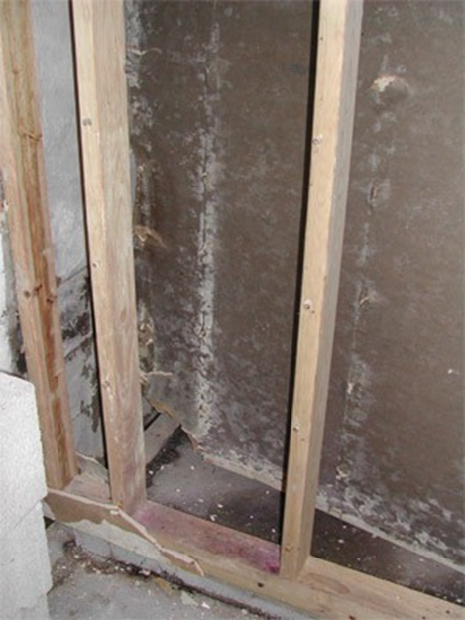
Scenario 3
You discover mold on the drywall and wood in your parent’s basement.
What should you do? What other information would be helpful?
Mold growth on sheetrock in corner by wall studs

Slide 71
Additional Information
EPA http://www.epa.gov/mold/
EPA https://www.epa.gov/indoor-air-quality-iaq/resources-flood-cleanup-and-indoor-air-quality
CDC https://www.cdc.gov/mold/default.htm
Local Health Department
In Spanish - https://espanol.epa.gov/cai/limpieza-del-moho-en-su-casa
In Spanish - https://espanol.epa.gov/cai/limpieza-posterior-una-inundacion-para-proteger-la-calidad-del-aire-de-los-interiores

Slide 72
Closing and Evaluation
Please ask any remaining questions.
Please take 10 minutes to complete the evaluation form. This is important for improving the program. We take your comments seriously and make changes in content based on participant feedback. Your comments are anonymous.

Slide 73
Disclaimer
The Midwest Consortium has copyrighted this material. A recipient of the material, other than the Federal Government, may not reproduce it without permission of the copyright owner.
The material was prepared for use by experienced instructors for the training of those involved with mold remediation. Authors of this material have prepared it for the training of this target audience as of the date specified on the title page. Users are cautioned that the subject is constantly evolving. Therefore, the material may require additions, deletions, or modifications to incorporate the effects of that evolution occurring after the date of this material preparation.

